Slide 1
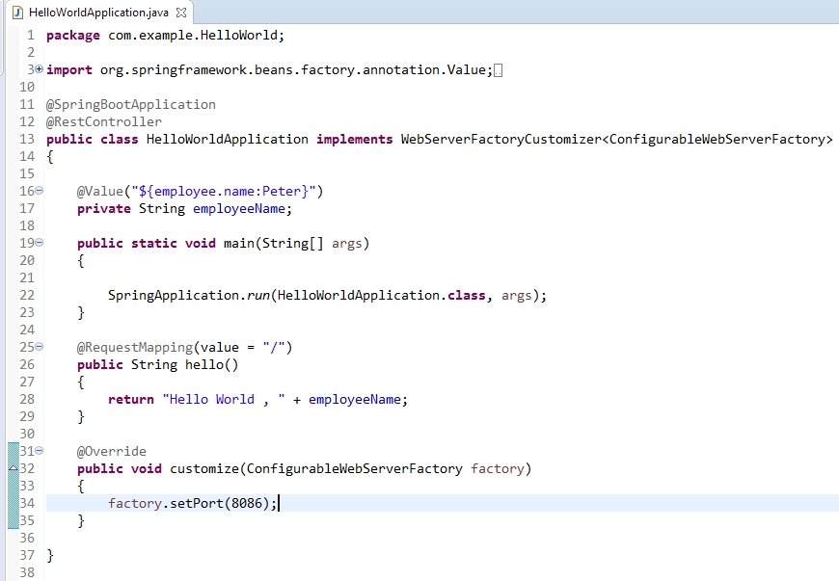
How to configure the port programmatically
We can configure the port programmatically by customizing the embedded server configuration.
To customize the server configuration, we have to implement the WebServerFactoryCustomizerinterface:

