Slide 1
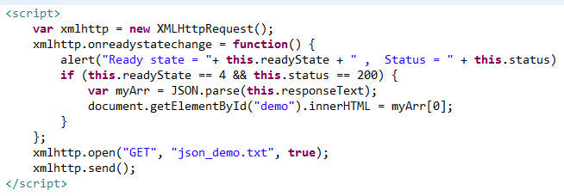
Array as JSON
When using the JSON.parse() on a JSON derived from an array, the method will return a JavaScript array, instead of a JavaScript object.

