Slide 1

JSON - Introduction
JSON: JavaScript Object Notation.
JSON is a syntax for storing and exchanging data.
JSON is text, written with JavaScript object notation.
JSON is a lightweight data-interchange format
JSON is "self-describing" and easy to understand
JSON is language independent *
JSON uses JavaScript syntax, but the JSON format is text only. Text can be read and used as a data format by any programming language.
Why use JSON?
Since the JSON format is text only, it can easily be sent to and from a server, and used as a data format by any programming language.

Slide 2

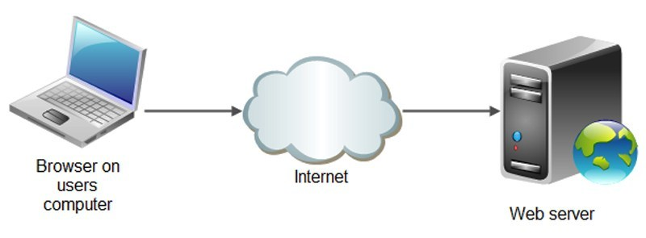
JSON - Introduction
When exchanging data between a browser and a server, the data can only be text.
JSON is text, and we can convert any JavaScript object into JSON, and send JSON to the server.
We can also convert any JSON received from the server into JavaScript objects.
This way we can work with the data as JavaScript objects, with no complicated parsing and translations.
Java script object
Java script object

Slide 3
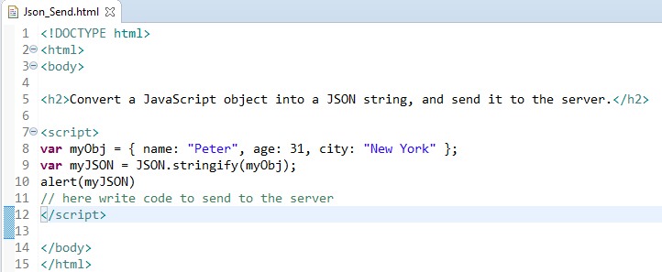
JSON - Introduction
Sending Data - If you have data stored in a JavaScript object, you can convert the object into JSON, and send it to a server

Slide 4
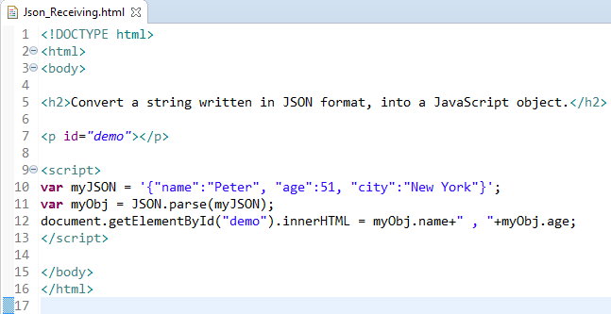
JSON - Introduction
Receiving Data - If you receive data in JSON format, you can convert it into a JavaScript object

