Slide 1
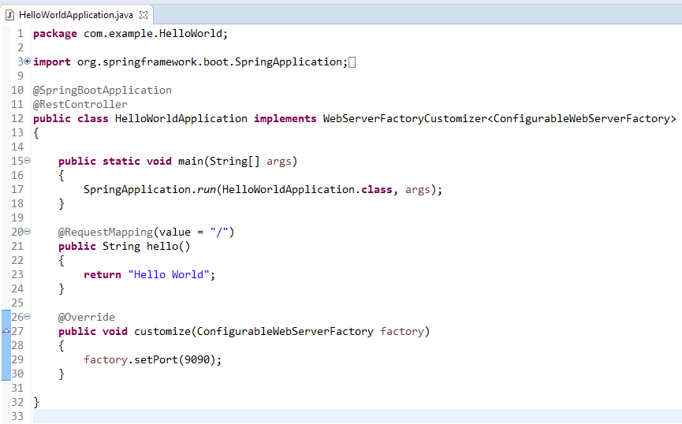
How to Change the Default Port in Spring Boot programmatically?
We can configure the port programmatically by customizing the embedded server configuration.
To customize the server configuration, we have to implement the WebServerFactoryCustomizer interface:

