Slide 1
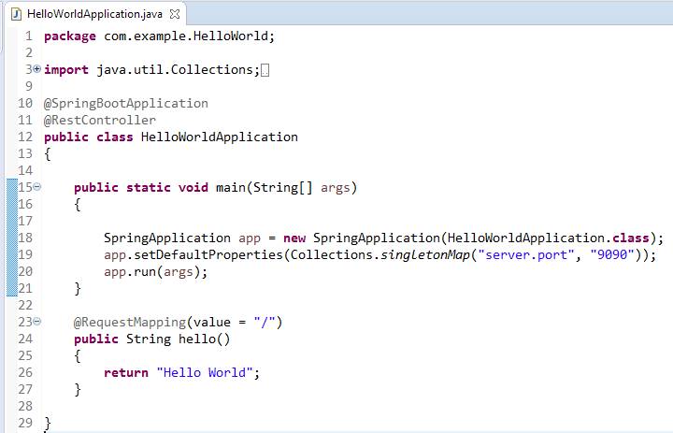
How to Change the Default Port in Spring Boot programmatically?
We can configure the port programmatically by either setting the specific property when starting the application.

