Slide 1
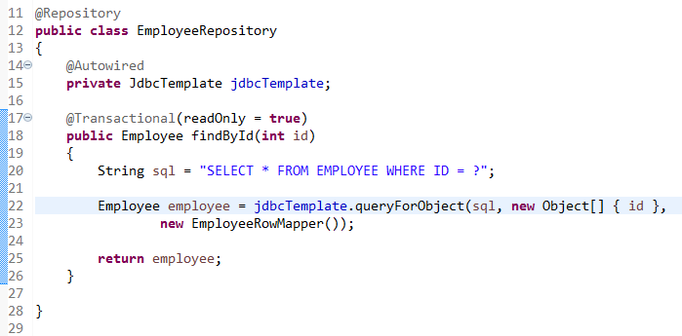
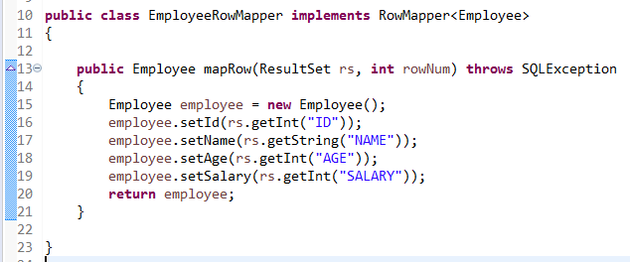
How to get the record using JdbcTemplate with SpringBoot?
In general, It’s always recommended to implement the RowMapper interface to create a custom RowMapper to suit your needs.
queryForObject() method, the returned result will call your custom mapRow() method to match the value into the properly.

