Slide 1

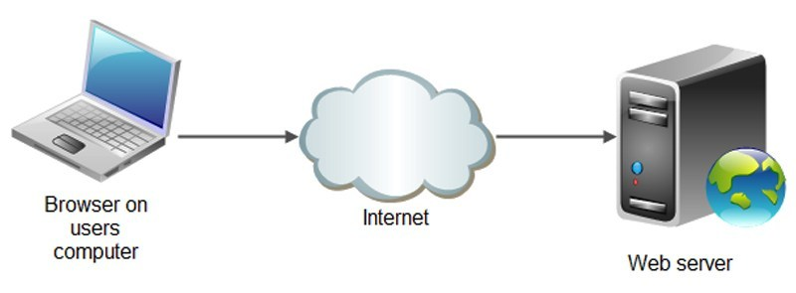
JSON.parse()
A common use of JSON is to exchange data to/from a web server.
When receiving data from a web server, the data is always a string.
Parse the data with JSON.parse(), and the data becomes a JavaScript object.
Java script object
Java script object

Slide 2
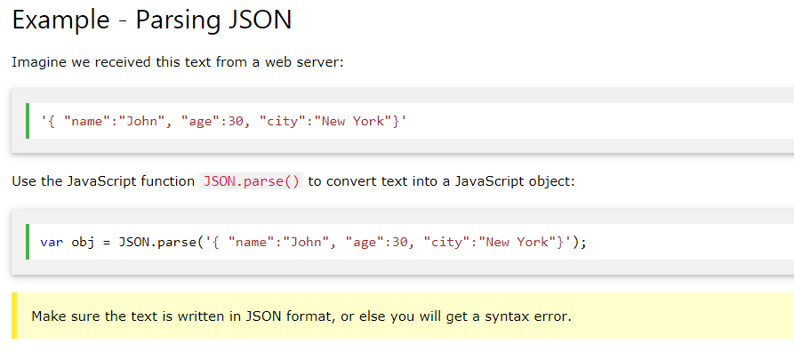
JSON.parse()

