Slide 1

Java Architecture for XML Binding (JAXB)
JAXB stands for Java Architecture for XML Binding.
JAXB provides mechanism to marshal (write) java object into XML and unmarshal (read) XML into object. Simply, you can say it is used to convert java object into xml and vice-versa.
Marshalling – Convert a Java object into a XML file. Unmarshalling – Convert XML content into a Java Object.
Java Object
JAXB
Marshalling
JAXB
Java Object
UnMarshalling

Slide 2
Java Architecture for XML Binding (JAXB)
BookStore
Book1
Book2
JAXB

Slide 3
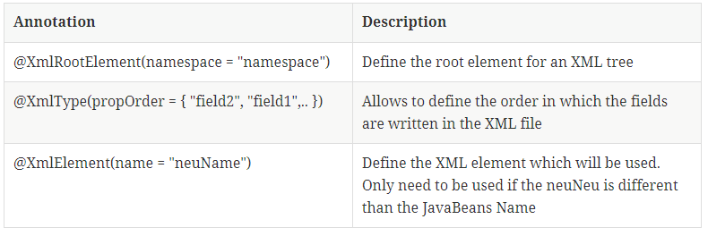
Java Architecture for XML Binding (JAXB)

