Slide 1
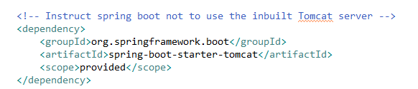
How to Deploy Spring Boot Applications on External Tomcat Server?
So far, in previous examples we used to deploy and run the applications using embedded tomcat server provided by the spring boot. Generally in the real-time projects we wont use inbuilt servers provided by the frameworks because of many reasons like security, maintenance and control. So we will see how can we deploy the spring boot applications on external servers(e.g Tomcat).

Slide 2
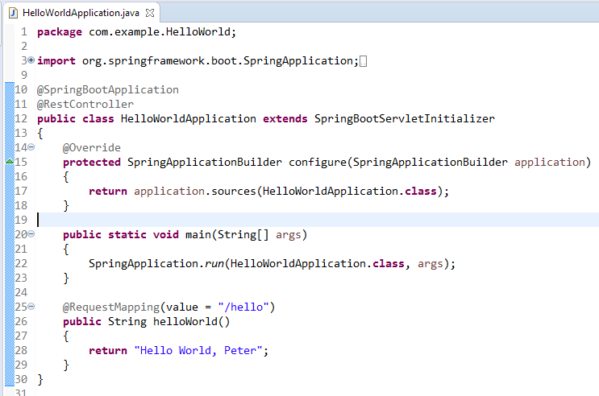

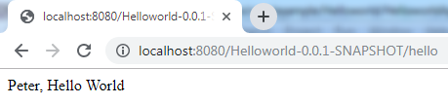
How to Deploy Spring Boot Applications on External Tomcat Server?
Extend your main class with SpringBootServletInitializer and override its configure method
mvn clean install
catalina.bat run
context path as Artifact Id + Version from pom.xml

