Slide 1
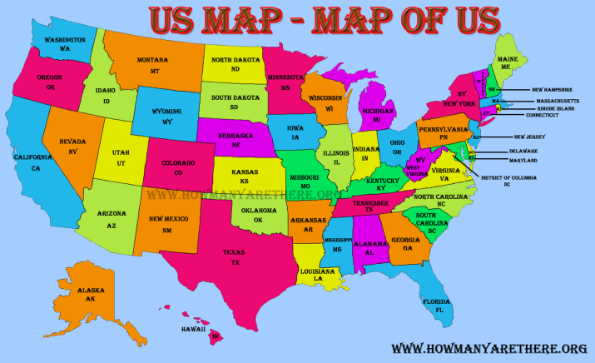

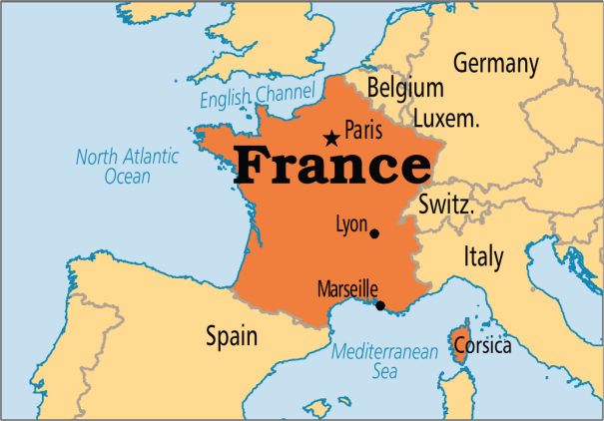
Internationalization and Localization in Java
Internationalization is a mechanism to create such an application that can be adapted to different languages and regions.
Internationalization is one of the powerful concept of java if you are developing an application and want to display messages, currencies, date, time etc. according to the specific region or language.
Localization is the mechanism to create such an application that can be adapted to a specific language and region by adding locale-specific text and component.
Language = English
$2,000.91
Language = English
£2,000.91
Language = French
2 000,91 €

Slide 2
Internationalization and Localization in Java
The informations that differ
from one region to another
Messages
Dates
Times
Numbers
Currencies
Measurements
Phone Numbers
Postal Addresses
Labels on GUI components etc.
Internationalization is also abbreviated as I18N because there are total 18 characters between the first letter 'I' and the last letter 'N'.

