Slide 1


Spring Boot – RESTful Web Service with POST Request in XML Example
As Spring Boot by default supports JSON request and responses, we no need to add any dependencies. A simple annotation called @RequestBody will do the trick for us. But if we want to send a XML then we need to add below dependency in pom.xml.
Postman client
SpringBootDemo
Send/Consuming a RESTful Web Services by using Postman client
Save Employee details

Slide 2
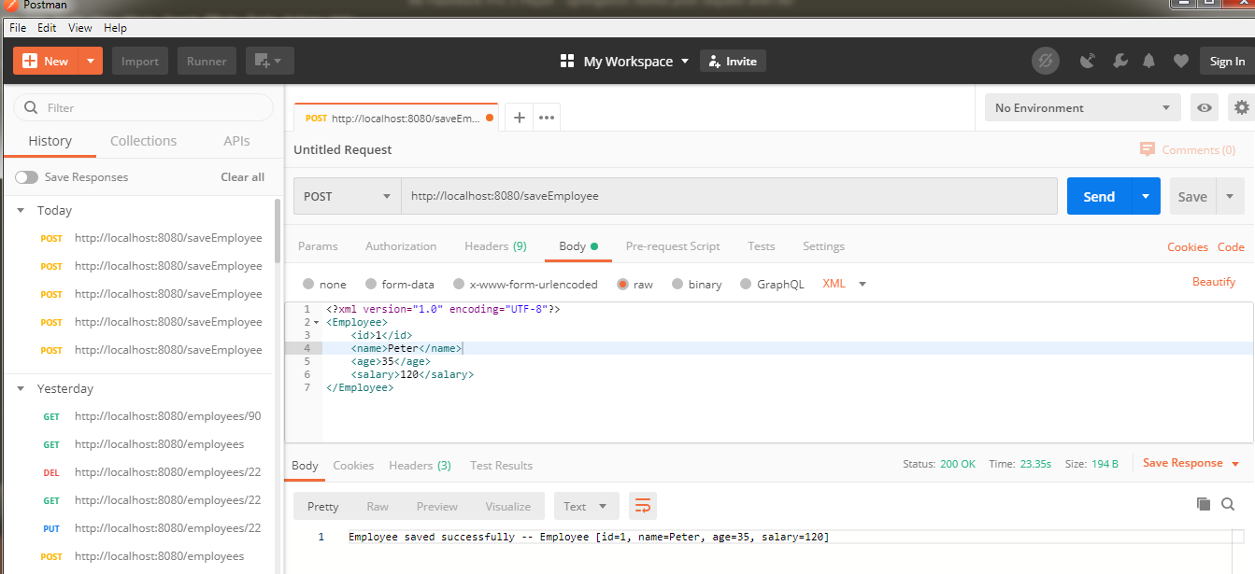
Spring Boot – RESTful Web Service with POST Request in XML Example

