Slide 1
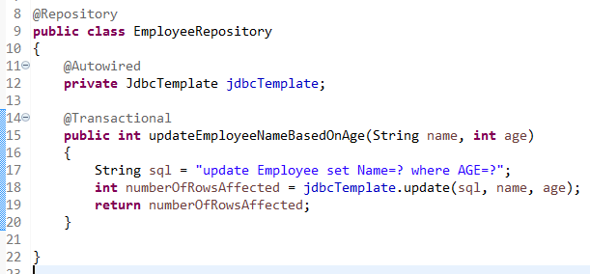
How to update the record using JdbcTemplate with SpringBoot?

