Slide 1

Spring Boot + Spring Security – RESTful Web Service with basic Authentication

Slide 2
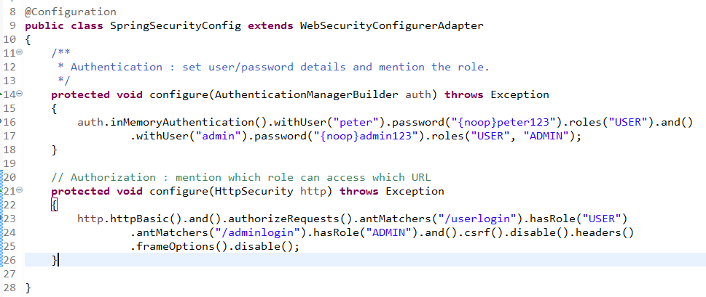
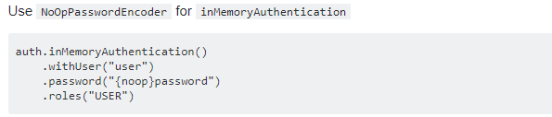
Spring Boot + Spring Security – RESTful Web Service with basic Authentication
We can also simply prefix {noop} to your passwords in order for the DelegatingPasswordEncoder use the NoOpPasswordEncoder to validate these passwords.
It works but Using NoOpPasswordEncoder password is not secure.
User Name | Password | Roles | Can access URL
peter | peter123 | USER | /userlogin
admin | admin123 | USER, ADMIN | /userlogin, /adminlogin

Slide 3
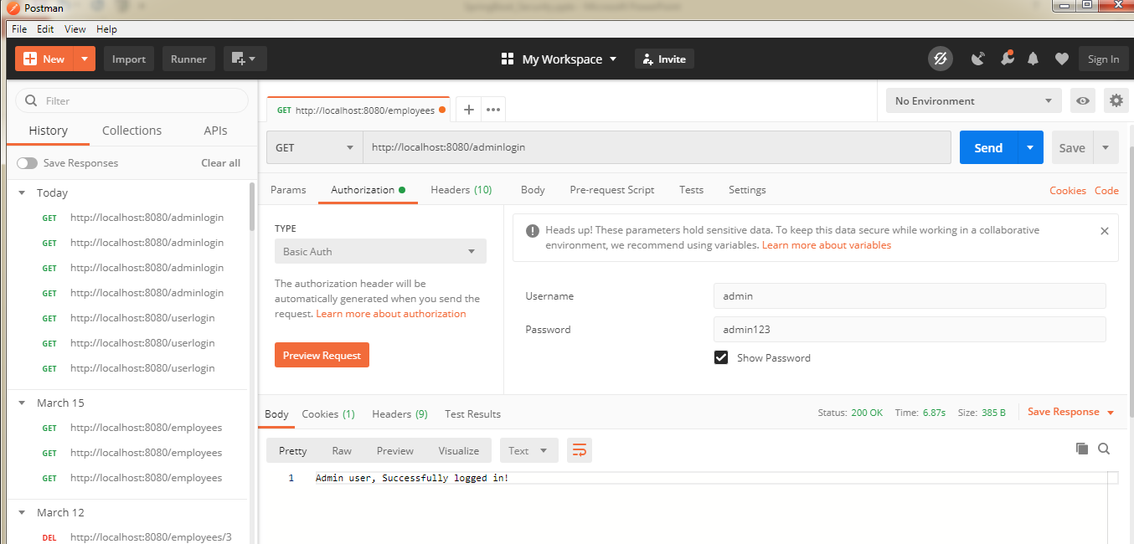
Spring Boot + Spring Security – RESTful Web Service with basic Authentication

