Slide 1
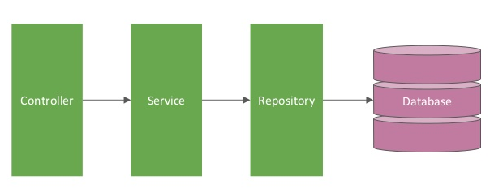
Spring boot [Controller → Service → Repository] – Create Employee
EmployeeServiceController.java
EmployeeServiceImpl.java
EmployeeRepository.java
@RestController
@Service
@Repository

Slide 2
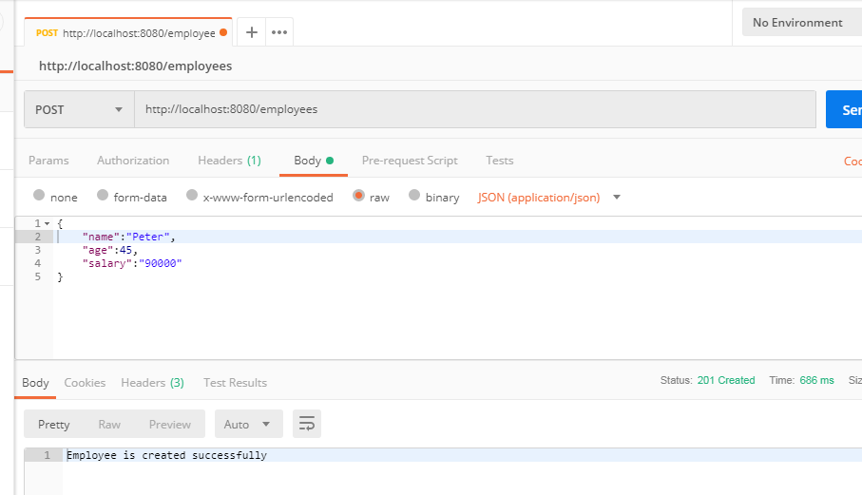
Spring boot [Controller → Service → Repository] – Create Employee

