Slide 1
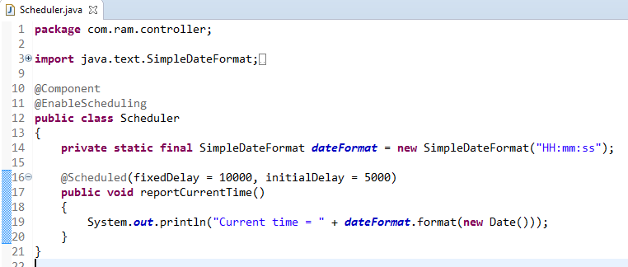
Schedule a Task with Initial Delay
@EnableScheduling ensures that a background task executor is created. Without it, nothing gets scheduled.
We’re using both fixedDelay as well as initialDelay in this example.
The task will be executed a first time after the initialDelay value – and it will continue to be executed according to the fixedDelay.
This option comes handy when the task has a set-up that needs to be completed.
The simple rules that need to be followed to annotate a method with @Scheduled are:
a method should have void return type
a method should not accept any parameters

Slide 2
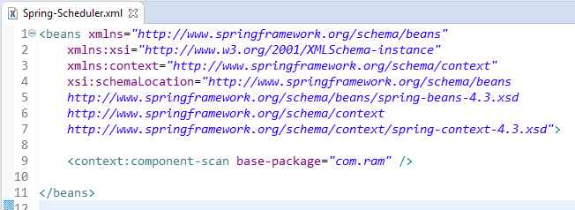
Schedule a Task with Initial Delay

Slide 3
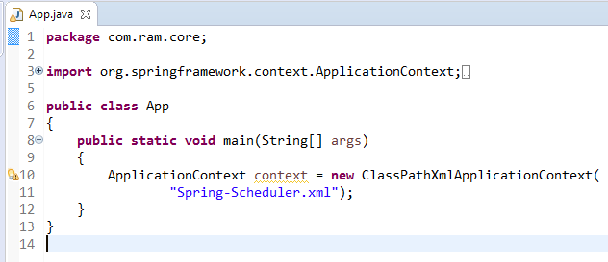
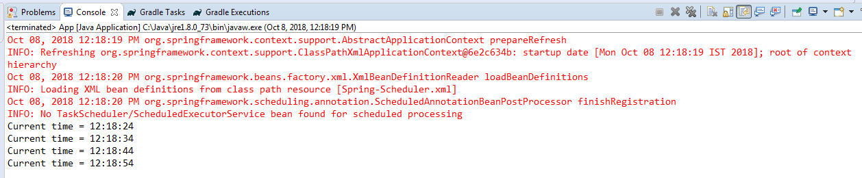
Schedule a Task with Initial Delay

