Slide 1
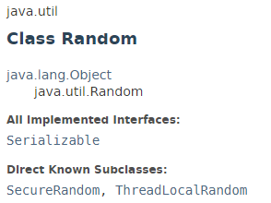
Random
The java.util.Random class instance is used to generate a stream of pseudorandom numbers.
The class uses a 48-bit seed, which is modified using a linear congruential formula.

Slide 2
Observable
https://docs.oracle.com/javase/8/docs/api/index.html?java/util/Random.html

