Slide 1
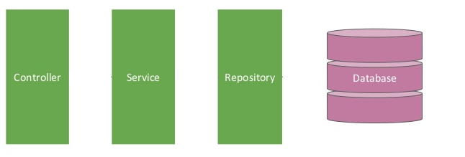

Spring boot [Controller -- Service -- Repository] – Get Employee
Postman client
Get Employee Request
Get Employee Response
EmployeeServiceController.java
EmployeeServiceImpl.java
EmployeeRepository.java
@RestController
@Service
@Repository

Slide 2
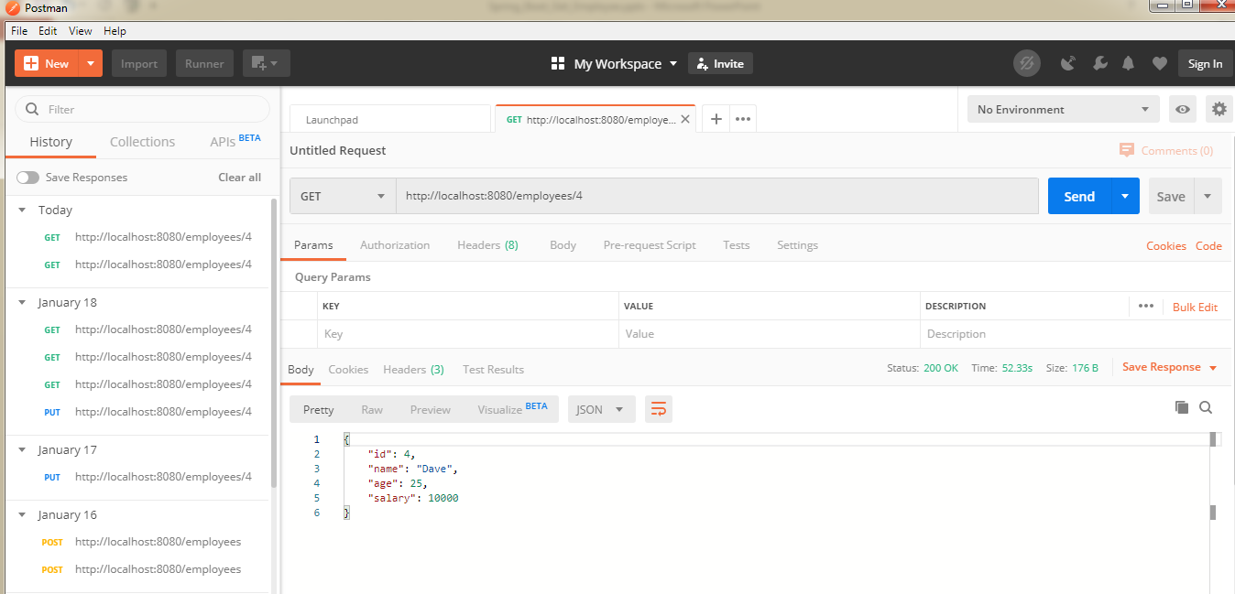
Spring boot [Controller -- Service -- Repository] – Get Employee

