Slide 1
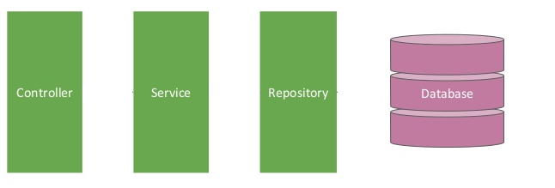

Spring boot [Controller -- Service -- Repository] – Update Employee
Postman client
Update Employee Request
Update Employee Response
EmployeeServiceController.java
EmployeeServiceImpl.java
EmployeeRepository.java
@RestController
@Service
@Repository

Slide 2
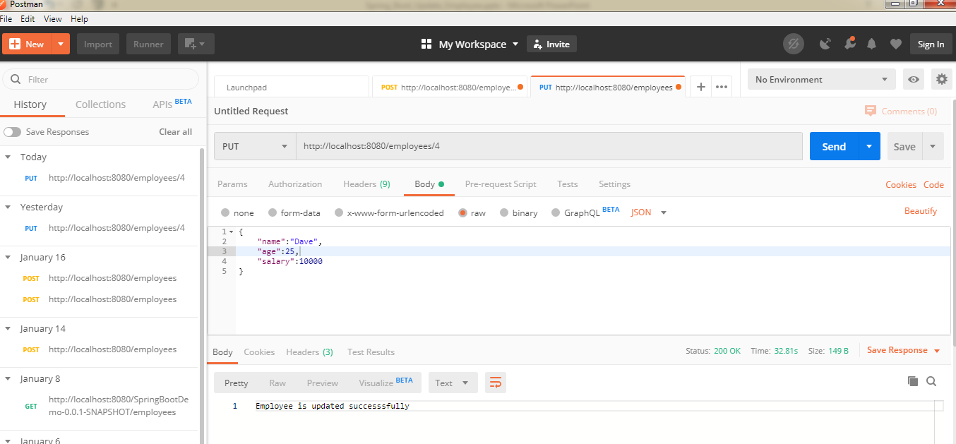
Spring boot [Controller -- Service -- Repository] – Update Employee

Slide 3
Spring boot [Controller -- Service -- Repository] – Update Employee
{
"name":"Dave",
"age":25,
"salary":10000
}

