Slide 1
Spring Boot - Enabling HTTPS
By default, Spring Boot application uses HTTP 8080 port when the application starts up.
We need to follow the steps given below to configure the HTTPS and the port 443 in Spring Boot application
Obtain the SSL certificate – Create a self-signed certificate or get one from a Certificate Authority
Enable HTTPS and 443 port

Slide 2
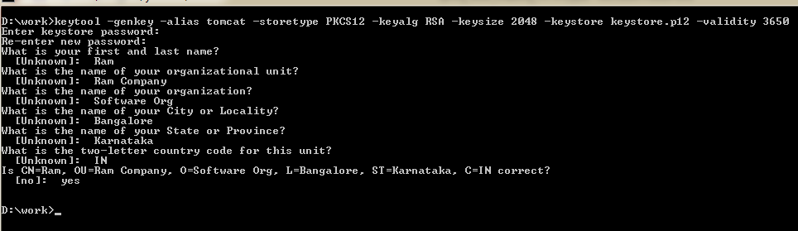
Spring Boot - Enabling HTTPS
Self-Signed Certificate
To create a self-signed certificate, Java Run Time environment comes bundled with certificate management utility key tool. This utility tool is used to create a Self-Signed certificate.
keytool -genkey -alias tomcat -storetype PKCS12 -keyalg RSA -keysize 2048 -keystore keystore.p12 -validity 3650

Slide 3
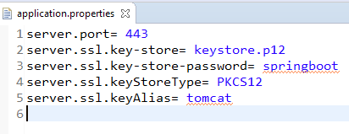
Spring Boot - Enabling HTTPS
Configure HTTPS

