Slide 1
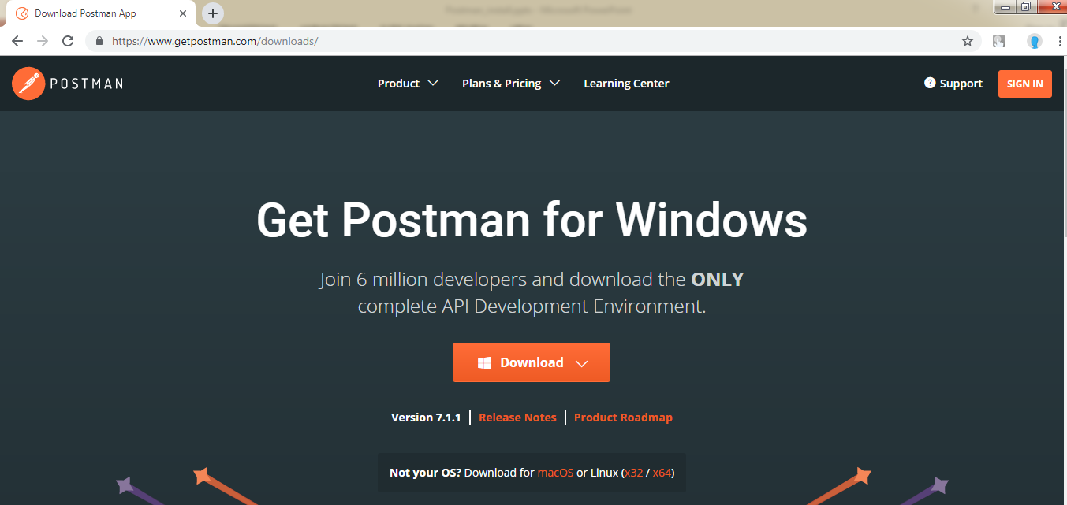
Postman Installation
https://www.getpostman.com/downloads/

