Slide 1
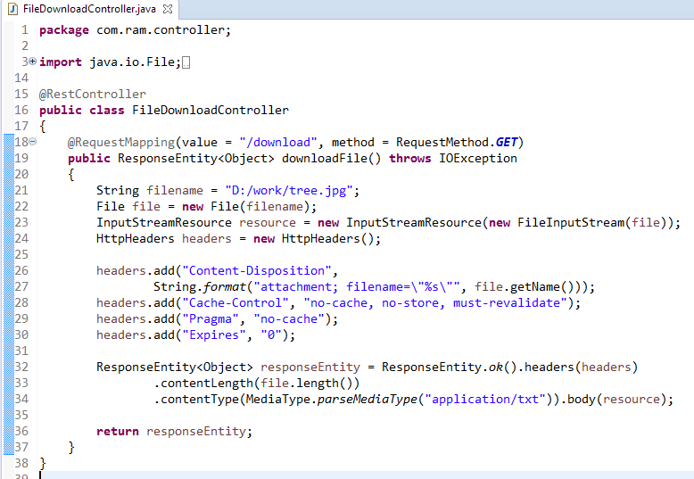
Spring Boot - File Download
We need to set the HttpHeader
Content-Disposition in Response and need to specify the response Media Type of the application.

Slide 2
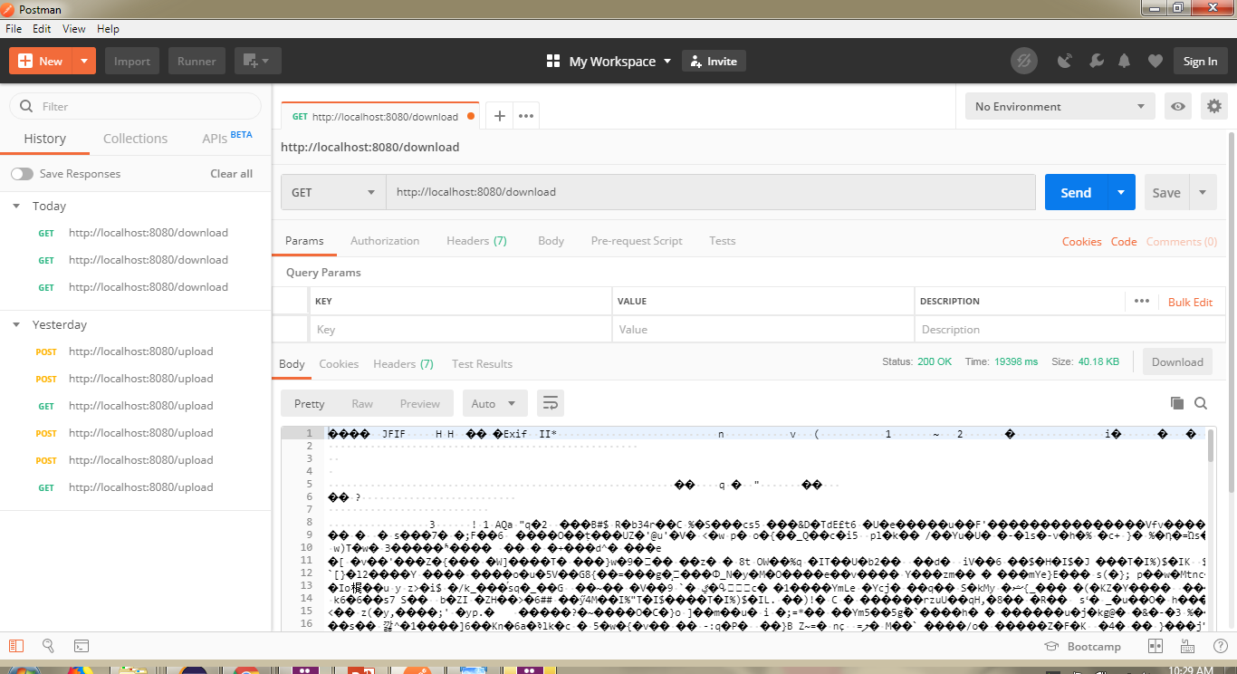
Spring Boot - File Download
http://localhost:8080/download

