Slide 1
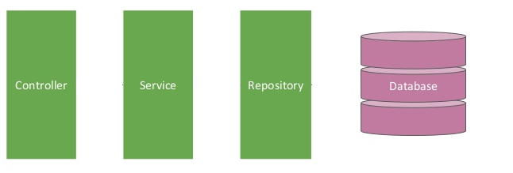

Spring boot [Controller -- Service -- Repository] – Delete Employee
Postman client
Delete Employee Request
Delete Employee Response
EmployeeServiceController.java
EmployeeServiceImpl.java
EmployeeRepository.java
@RestController
@Service
@Repository

Slide 2
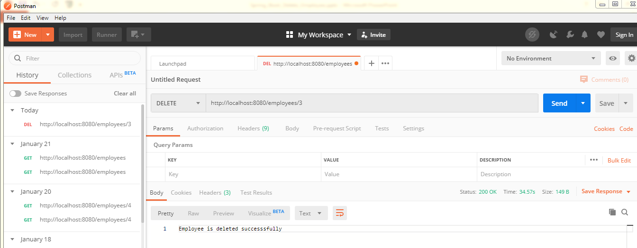
Spring boot [Controller -- Service -- Repository] – Delete Employee

