Slide 1
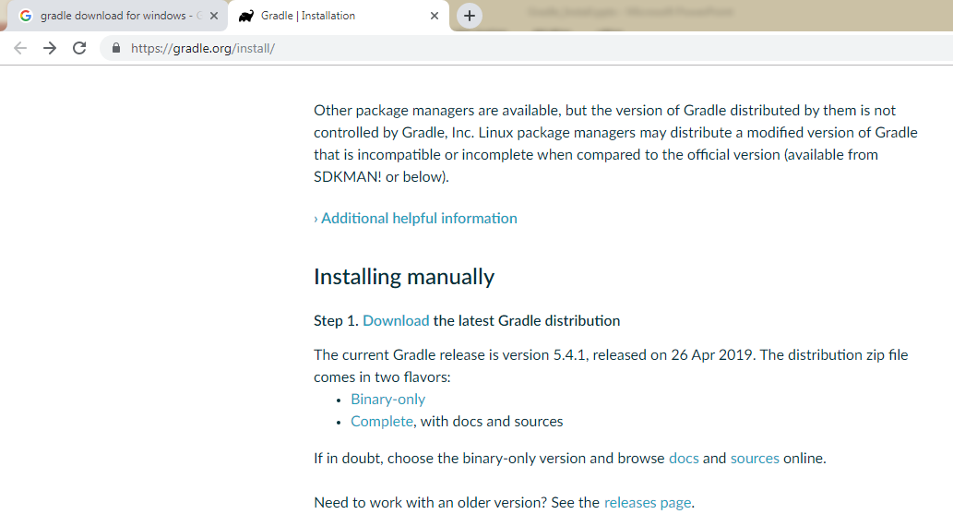
Gradle - Install
https://gradle.org/install/

