Slide 1
1. Assume you are training a logistic regression classifier. Recall that logistic regression learns a score similar to perceptron, w^{T}x, which then gets plugged into the logistic function to convert the score to a probability.
If w^{T}x = 0, what is the probability that Y=1?
If w^{T}x = -5.0, which is more probable, Y=1 or Y=0?
Suppose w^{T}x = 10.0, where x is a training instance and the training data are linearly separable. Suppose you train the classifier again, this time using a larger L2 penalty (heavier regularization). Would the score increase, decrease, or stay the same?

Slide 2


2. For each hyperparameter below, answer the question: If you increase the hyperparameter, does this increase or decrease variance?
k in k-nearest-neighbors classification
λ in the logistic regression objective:
C in the SVM objective function:

Slide 3
3. You try to build a classifier on a dataset. You experiment with perceptron, linear regression, and a linear SVM, but the training accuracy is always near 50%. Assume you tuned the algorithms as best you could. Provide a suggestion for something that could potentially improve the training accuracy, and explain why this might help. Try to limit your response to concepts that have been learned in class so far.

Slide 4
4. We learned two methods for using binary classifiers for multiclass classification: one-vs-rest and all-pairs. Suppose you develop a method that combines these two techniques for a particular problem. Suppose you have 10 classes, and you split them into two groups of 5 classes. The way an instance gets classified in your new technique is that first a classifier predicts which of the two groups the instance belongs to, then you use an all-pairs approach to classify the instance as one of the 5 classes in the group.
a) Compared to one-vs-rest, does this new technique require more or fewer classifiers?
b) Compared to all-pairs, does this new technique require more or fewer classifiers?
c) In the traditional all-pairs approach, there are “10 choose 2” different classifiers. Write an expression for the number of classifiers in this new technique.

Slide 5
5. Suppose you have a feature describing eye color, and it can have one of four categorical values: “brown”, “green”, “blue”, “other”. To convert this feature to a numerical feature, you replace the four values with 1, 2, 3, 4. Explain why this is not a good way to convert this feature to numerical.

Slide 6
6. Suppose you have a training dataset with 1000 instances (describing medical records of patients) and 3 features (blood pressure, temperature, and heart rate). Temperature has low variance, while blood pressure and heart rate both have high variance across patient records. During preprocessing, you discover that one record has an invalid heart rate value (a value of “00”, which appears to be a typo).
Describe two methods for handling this incorrect value. Then say which method would be better in this situation, and why.

Slide 7
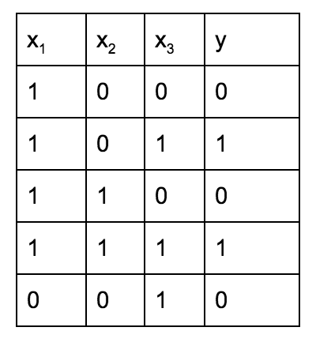
7. The following instances are not linearly separable. In this problem, create a new feature called x₄ that is a function of the first three features and makes the data linearly separable, meaning you could create a linear classifier that can perfectly classify the training data.

Slide 8
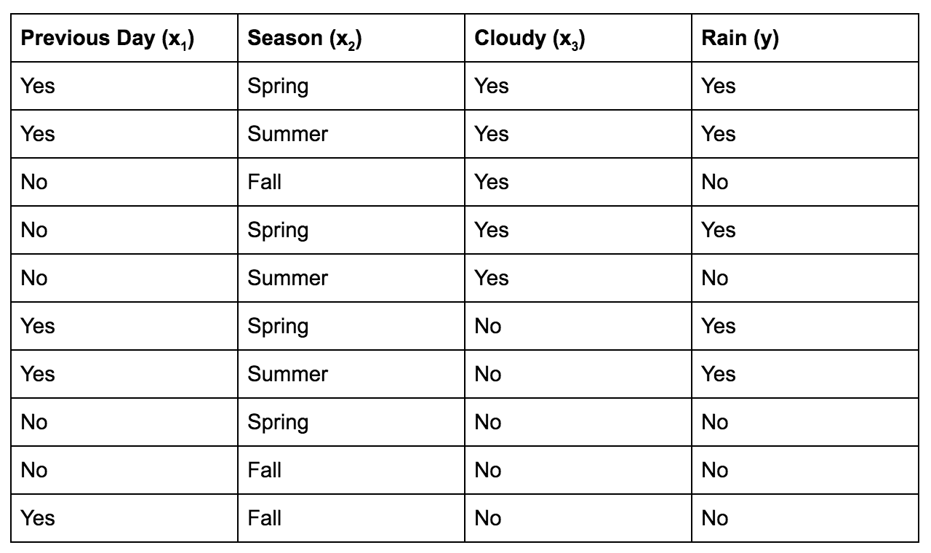
8. Draw a decision tree for the data below.

