Slide 1
Support Vector Machines
INFO-4604, Applied Machine Learning
University of Colorado Boulder
September 27, 2018
Prof. Michael Paul

Slide 2
Today
Two important concepts:
Margins
Kernels

Slide 3
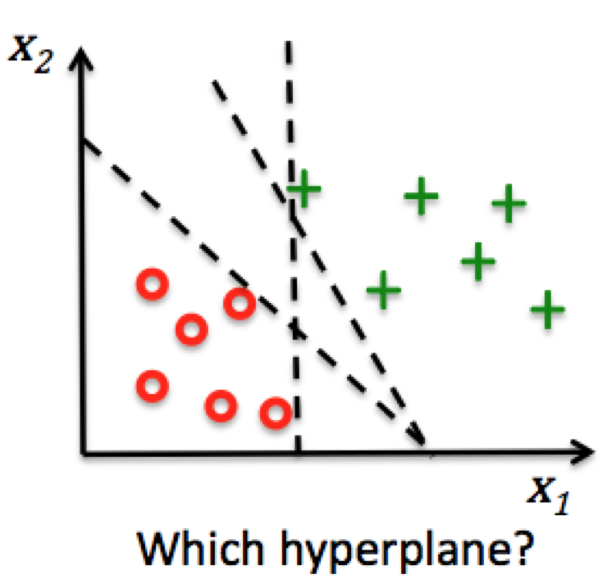
Large Margin Classification

Slide 4
Linear Predictions
Perceptron:
f(x) = 1, w^{T}x ≥ 0
-1, w^{T}x < 0
SVM:
f(x) = 1, w^{T}x ≥ 1
-1, w^{T}x ≤ -1
Two different boundaries for positive vs negative

Slide 5
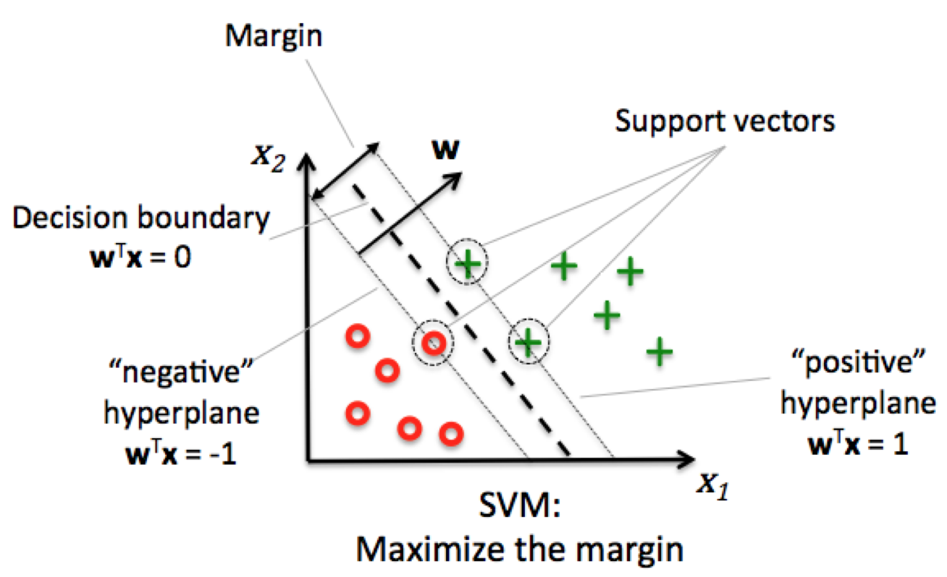
Large Margin Classification

Slide 6
Large Margin Classification
The margin is the distance between the two boundaries.
The support vectors are the instances at the boundaries (when w^{T}x = 1 or -1)
Or within the boundaries, if not linearly separable
The goal of SVMs is to learn the boundaries to make the margin as large as possible (while still correctly classifying the instances)
maximum margin classification

Slide 7
Large Margin Classification
The size of the margin is: 2 / ||w||
Recall: ||w|| is the L2 norm of the weight vector
Smaller weights → larger margin
Learning goal:
Maximize 2 / ||w||, subject to the constraints that all instances are correctly classified
Turn it into minimization problem by taking the inverse: ½ ||w||
Can also square the L2 norm (makes the calculus easier), just like with L2 regularization: ½ ||w||²

Slide 8
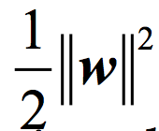
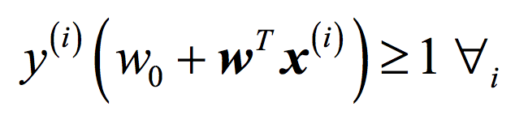
Large Margin Classification
The size of the margin is: 2 / ||w||
Recall: ||w|| is the L2 norm of the weight vector
Smaller weights → larger margin
Learning goal:
Minimize:
Subject to the constraints:
Only possible to satisfy these constraints if the instances are linearly separable!

Slide 9
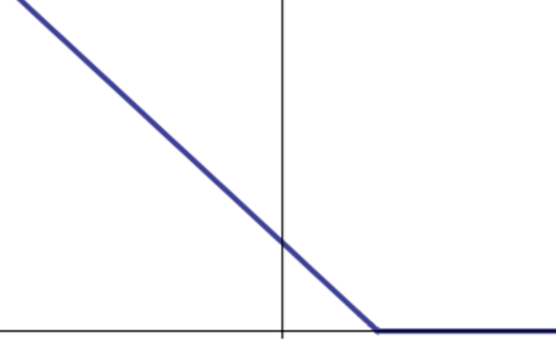
Large Margin Classification
In the general case, SVM uses this loss function:
L_{i}(w; x_{i}) = 0, y_{i} (w^{T}x_{i}) ≥ 1
- y_{i} (w^{T}x_{i}), otherwise
Same as perceptron, but y_{i} (w^{T}x_{i}) ≥ 1 instead of y_{i} (w^{T}x_{i}) ≥ 0

Slide 10
Large Margin Classification
In the general case, SVM uses this loss function:
L_{i}(w; x_{i}) = 0, y_{i} (w^{T}x_{i}) ≥ 1
- y_{i} (w^{T}x_{i}), otherwise
The learning goal of SVMs when the data are not linearly separable is to minimize:
½ ||w||² + C L(w)
inverse training margin loss
SVMs also use L2 regularization
C is like λ from before, but larger C → lower loss

Slide 11
Large Margin Classification
Like perceptron, the SVM function can be minimized using stochastic (sub)gradient descent
With sklearn’s SGDClassifier class, SVM can be implemented by setting loss='hinge’
Other implementations (usually using different optimization algorithms than SGD)
Liblinear and LIBSVM (both used by sklearn)
SVM-light

Slide 12
Large Margins: Summary

Slide 13
Large Margins: Summary
Classifiers with large margins are more likely to have better generalization, less overfitting
Hyperparameter C controls the tradeoff between margin size and classification error
The large margin principle is another justification for L2 regularization that you saw earlier
Since the size of the margin is inversely proportional to the L2 norm of the weight vector

Slide 14
Kernel Trick
It turns out that the optimal solution for w is equivalent to:
Σ_{i} α_{i} x_{i}
So in the loss function and prediction functions, we can replace w^{T}x with Σ_{i} α_{i} x_{i}^{T}x
α_{i} is only nonzero for support vectors
This summation can therefore skip over all other instances, making this calculation more efficient.
Combination of each training instance’s feature vector, weighted by α

Slide 15
Kernel Trick
In the loss function and prediction functions, we can replace w^{T}x with Σ_{i} α_{i} x_{i}^{T}x
Now this looks similar to weighted nearest neighbor classification, where the “similarity” between an instance x and another instance x_{i} is x_{i}^{T}x and this is additionally weighted by α_{i}
Learning goal is now to learn α instead of w
How? More complex than before…

Slide 16
Kernel Functions
Loosely, a kernel function is a similarity function between two instances
General kernel trick: Replace w^{T}x with Σ_{i} α_{i} k(x_{i}, x)
The linear kernel function for an SVM is:
k(x_{i}, x_{j}) = x_{i}^{T}x_{j}

Slide 17
Kernel Functions
What happens if we define the kernel function in some other way?
Then it won’t be true that Σ_{i} α_{i} k(x_{i}, x) = w^{T}x
But: kernels can be defined so that,
Σ_{i} α_{i} k(x_{i}, x) = w^{T}φ(x),
where φ(x) is some other feature representation.

Slide 18
Kernel Functions: Polynomial
A polynomial kernel function is defined as:
k(x_{i}, x_{j}) = (x_{i}^{T}x_{j} + c)^{d}
If d=2 (quadratic kernel), then it turns out that
Σ_{i} α_{i} k(x_{i}, x) = w^{T}φ(x)
where

Slide 19
Kernel Functions: Polynomial
In other words, using a quadratic kernel is equivalent to using a standard SVM where you’ve expanded the feature vectors to include:
Each original feature value (times a constant)
Each feature value squared
The product of each pair of feature values (times a constant)
This can be especially useful, since it can capture interactions between features
Without the kernel trick, this large feature set would be computationally expensive to work with.

Slide 20
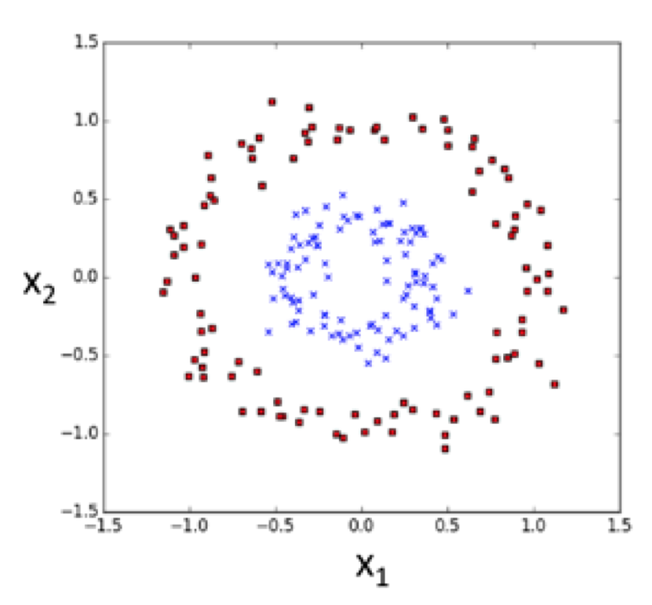
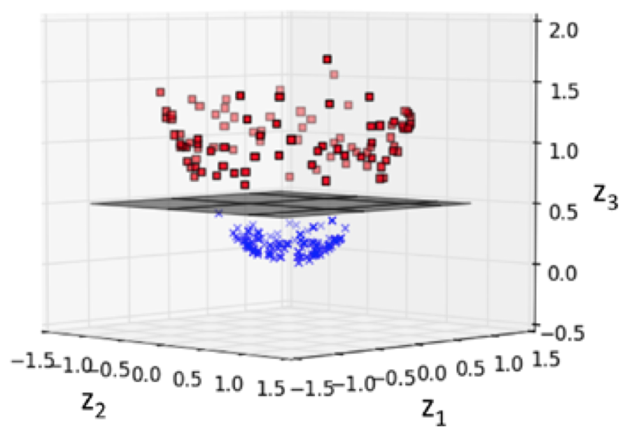
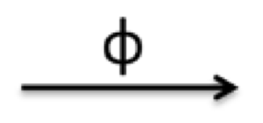
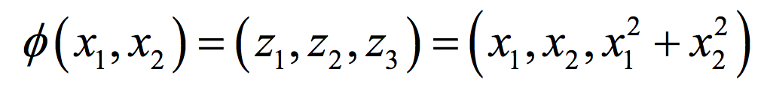
Kernel Functions
In general, the kernel trick can create new features as nonlinear combinations of the old features
Data that are not linearly separable in the original feature space might be separable in the new space

Slide 21
Kernel Functions: RBF
The radial basis function (RBF kernel) is:
k(x_{i}, x_{j}) = exp(-γ ||x_{i} – x_{j}||² )
One of the most popular SVM kernels
Related to the Gaussian/normal distribution
Interpretation as expanded feature vector?
It actually maps to a feature vector with infinitely many features… so technically equivalent, but impossible to implement without using the kernel trick.
squared Euclidean distance
Notes:
https://arxiv.org/pdf/0904.3664v1.pdf

Slide 22
Kernel Functions: RBF
From: http://qingkaikong.blogspot.com/2016/12/machine-learning-8-support-vector.html

Slide 23
Kernel Functions: RBF
The radial basis function (RBF kernel) is:
k(x_{i}, x_{j}) = exp(-γ ||x_{i} – x_{j}||² )
In addition to C, γ also affects overfitting
Large γ → small differences in distance between x_{i} and x_{j} are magnified
This will cause the classifier to fit the training data better, but may do worse on future data
Notes:
https://www.info.ucl.ac.be/~pdupont/pdupont/pdf/Capacity_n4.pdf

Slide 24
Kernel Functions: RBF
From: http://qingkaikong.blogspot.com/2016/12/machine-learning-8-support-vector.html

Slide 25
Kernel Methods: Summary (1)
Kernel SVM is a reformulation of SVM that uses similarity between instances
To make a prediction for a new instance, need to calculate kernel function for the new instance and all training instances that are the support vectors
Kernel SVM is equivalent to an SVM with a expanded feature set
Sometimes there is an intuitive interpretation of what the “new” features mean; sometimes not
Kernel SVM with a linear kernel is equivalent to a standard SVM

Slide 26
Kernel Methods: Summary (2)
Kernels can be useful when your data has a small number of features and/or when the dataset is not linearly separable
Some kernels are prone to overfitting
High degree polynomial; RBF with high scaling parameter
Kernel SVM has additional hyperparameters you have to choose
Type of kernel
Parameters of kernel (e.g., d in polynomial, γ in RBF)

Slide 27
Kernel Methods: Summary (3)
Also be aware that:
Kernel methods not unique to SVM (invented long before, for perceptron), but popularized by it.
Lots of other kernel functions not shown here, but these are the most common.
Specialized kernels exist for certain types of data (e.g., biological sequences, syntax trees)

