Slide 1


What Makes a Restaurant Successful?
Brian Knox
Abe Melloh
Bethany Lesser
Vivian Li

Slide 2
Problem
What factors make a restaurant successful?
Restaurants can use this information to direct investment opportunities to drive sales
If a restaurant is not doing well, this analysis can help them identify areas they need to improve

Slide 3
Data
The data came from Yelp as part of an analytics contest
86,000 rows of information on restaurants around the world (US, Mexico, Canada, Germany, UK)
We used 12 attributes
Operational Definition of Success – Higher stars rating (Y variable)

Slide 4
Process of Obtaining the Data
Process of Converting and Cleaning data to input into R:
Downloaded yelp data from their website
Changed .tar file to .json file
Used Python to convert .json file to .csv file
Processed the csv file in Excel - reduced data down from 56 to 38 attributes by removing hours, Latitude, Longitude & nested attributes that would not convert well into an R data frame

Slide 5
Analysis Process
Conducted a single regression for Wi-Fi which we considered likely to be significant
As every observation included at least one blank or NA value, we used our judgement to choose variables to input as predictors, creating two multiple regressions, changing factor variables to resemble categorical ranking
We then added the variables from those two regressions together to test confounds and interactions
Identified areas of interest such as Outdoor Seating and price range and how they are related to coat checks
Found significant correlation between coat checks and price range

Slide 6
Analysis Process (cont.)
Created a binary North/South variable (Region) to test possible third variable (weather) in loss of predictor significance – then added it to the combined Multiple regression
found Region to be a significant predictor
Performed a Best Subset Selection test to see how many predictors, and which ones, created the best Fit prediction model
Split the ratings (Y Variable) into an 80th Percentile Binary and tested the model with confusion matrices in multiple models

Slide 7
Wi-Fi
Single Regression Analysis
Predictors ranked: No Wi-Fi (1), Paid (2), Free (3)
23,500 Observations
For every 1 increment increase in ranking of Wi-Fi there was a 0.0332 increase in the restaurant ranking (out of 5 stars)
P-value = 0.00000000000987

Slide 8
Multiple Regression
Significant
Predictors:
Primary Judgement | Secondary Judgement | Combination | After Adding Region
Credit Cards | Credit Cards
 | Alcohol | Alcohol | Alcohol
TV |  | TV | TV
 | Noise Level | Noise Level | Noise Level
 | Outdoor Seating
Price Range | Price Range
 | Waiter Service
 | Wi-Fi | Wi-Fi | Wi-Fi
 |  | Coat Check (less sig.) | Coat Check (less sig.)
 |  |  | Region (North/South)

Slide 9
Measures Of Model Fit
 | R squared | Adjusted R squared | Mean Squared Error
Primary Judgement | 0.039031320 | 0.037808714 | 0.3776450
Wi-Fi | 0.001977196 | 0.001934585 | 0.5446356
Secondary Judgement | 0.051149646 | 0.050641356 | 0.4291788
Add Coat Check (CC) | 0.092900827 | 0.089071609 | 0.2919672
Add State | 0.093569516 | 0.089315971 | 0.2917519
Remove CC | 0.091223954 | 0.087387657 | 0.2925069
Region (Reg.) & CC | 0.001900472 | 0.001484424 | 0.4109954
Interaction (Reg./CC) | 0.001900472 | 0.001484424 | 0.4109954
Region & All | 0.097567052 | 0.093332266 | 0.2904652

Slide 10
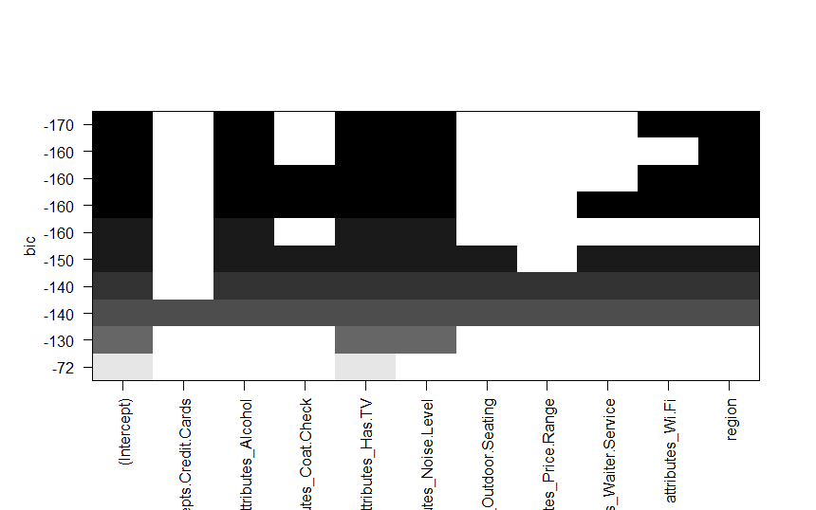
Best Subset Selection
The model with the lowest BIC score (5) showed that the best subset included the predictors:
Alcohol
TV
Noise Level
Wi-Fi
Region
The red predictors previously identified as important in previous models

Slide 11
Confusion Matrices
starBin – New Y variable, Binary where is 1 if stars is in the top 80th percentile, 0 otherwise
Tested the Predictors against starBin with logarithmic, LDA, QDA and KNN models
Created confusion matrices for each model and error rates
The Power Rate was particularly important as it identified the businesses that were correctly predicted as belonging in the top 80th percentile
The model with the highest Power Rate was the QDA analysis, indicating a non-linear relationship between predictors and percentile rating

Slide 12
Recommendations
For franchises – choosing to expand in the North could be profitable
If a restaurant would like to boost their ratings and draw more customers, they could provide free Wi-Fi, a full bar, a TV, or try to lower the ambient noise levels

