Slide 1
Gemfire/Geode Cache Evaluation

Slide 2
Gemfire Design
Gemfire works using a client-server model built on providing fast, reliable data to applications. Servers in the cluster are partitioned together and are exact copies of each other to provide the redundancy and load balancing needed to meet the higher performance requirements of the industry.
GEM Client
GEM Client
GEM Client
GEM Server
GEM Server
GEM Server

Slide 3
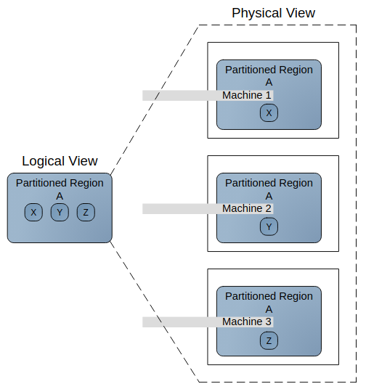
Gemfire Partitioning
Servers are grouped together into logical partitions used to store data. GemFire automatically determines the physical location of data in the members that host a partitioned region’s data. GemFire breaks partitioned region data into units of storage known as buckets and stores each bucket in a region host member. Buckets are distributed in accordance to the member’s region attribute settings.

Slide 4
Data Design
GemFire will automatically optimize how data is distributed across nodes to optimize latency and usage of system resources. Administrators and developers can also configure partitioning and replication of data to further optimize application response time. GemFire will appropriately direct processing operations on data to the specific nodes where data resides in order to reduce latency and network traffic.

Slide 5
Performance
Tests were conducted using small, consistent workloads to gather performance data in order to make estimations on the required infrastructure. The following data was extracted from a benchmark on a AWS r4.xlarge:
Throughput(ops/sec): 363.10820624546113
Average Latency(us): 1204.801

Slide 6
Costing High Level Summary
Software: Gemfire is not free of charge, but the open source version, Apache Geode, comes with the same set of features and performance as the paid version (business model based off of support).
Infrastructure: AWS r4.xlarge instances offer memory optimized solutions for a fraction of the cost of t2.
Development: Due to the Redis adapter, development time is minimized.
Support: Two teams should be able to handle BAU support for the app. One team focused on new feature development and the other on production deployments and Production Support.

Slide 7
