Slide 1

Mockup Website Presentation

Slide 2
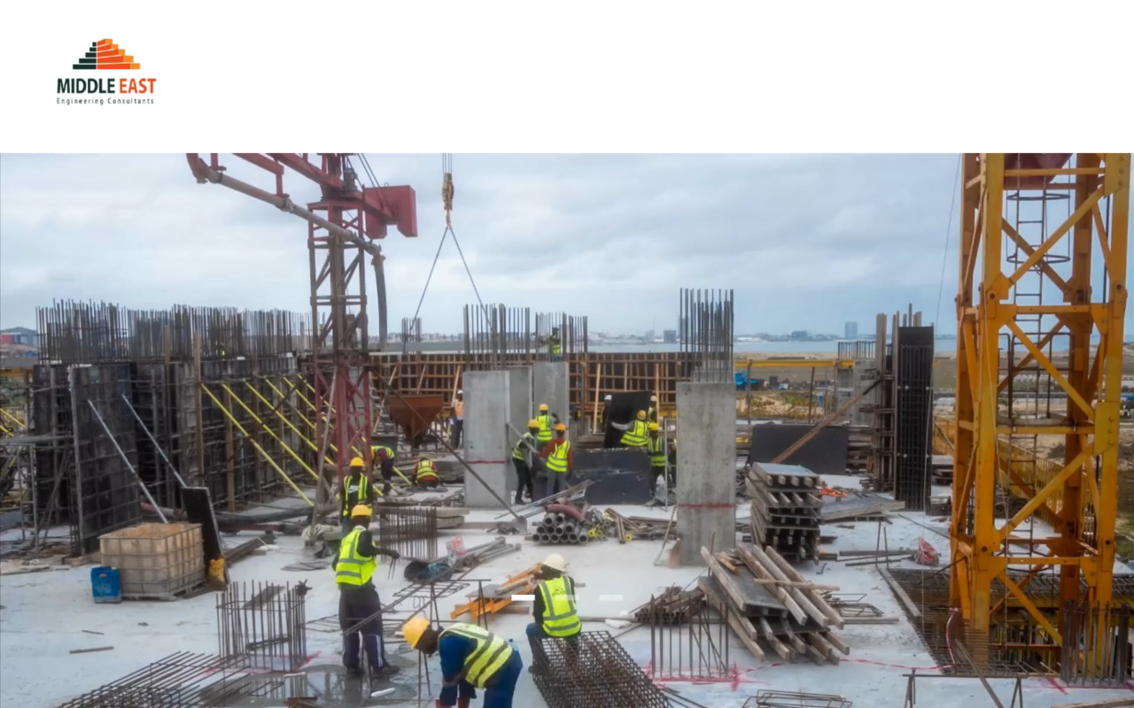

Slide 3
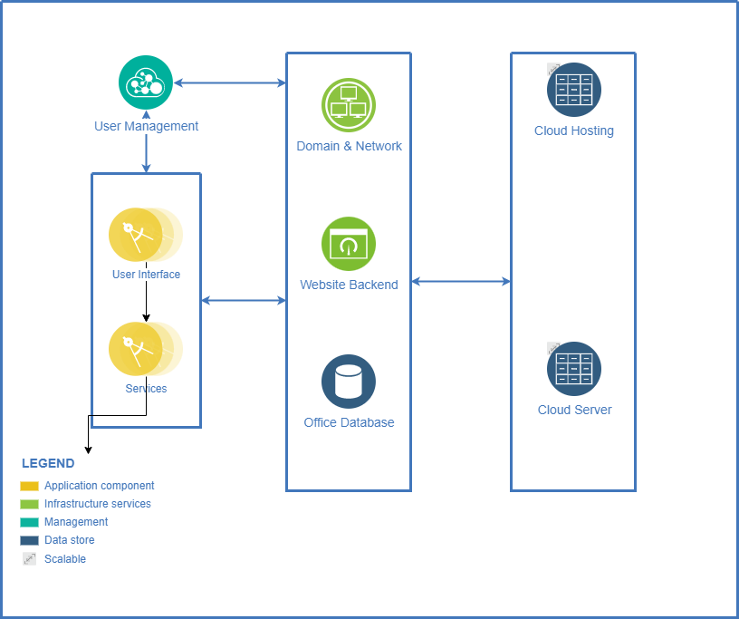

Slide 4
For the Realtime Mockup Please Visit:
HTTP://MEC.ENGINEER

