Slide 1

Chapter 3
Data and Signals
3.<number>
Copyright © The McGraw-Hill Companies, Inc. Permission required for reproduction or display.

Slide 2

Note
To be transmitted, data must be transformed to electromagnetic signals.
3.<number>

Slide 3
3-1 ANALOG AND DIGITAL
Data can be analog or digital.
Analog data refers to information that is continuous.
Digital data refers to information that has discrete states.
Analog data take on continuous values.
Digital data take on discrete values.
Topics discussed in this section:
Analog and Digital Data
Analog and Digital Signals
Periodic and Nonperiodic Signals
3.<number>

Slide 4
Note
Signals can be analog or digital.
Analog signals can have an infinite number of values in a range; digital signals can have only a limited
number of values.
3.<number>

Slide 5

Figure 3.1 Comparison of analog and digital signals
3.<number>

Slide 6
Note
In data communications, we commonly use periodic analog signals and nonperiodic digital signals.
3.<number>

Slide 7
3-2 PERIODIC ANALOG SIGNALS
Periodic analog signals can be classified as simple or composite.
A simple periodic analog signal, a sine wave, cannot be decomposed into simpler signals.
A composite periodic analog signal is composed of multiple sine waves.
Topics discussed in this section:
Sine Wave
Wavelength
Time and Frequency Domain
Composite Signals
Bandwidth
3.<number>

Slide 8
RMS – Root Mean Square
The RMS value is the effective value of a varying voltage or current. It is the equivalent steady DC (constant) value which gives the same effect. For example, a lamp connected to a 6V RMS AC supply will shine with the same brightness when connected to a steady 6V DC supply.
Calculation of RMS: the RMS voltage (V_{RMS}) of a sinusoidal waveform is determined by multiplying the peak voltage value by 0.7071, which is the same as one divided by the square root of two ( 1/√2 ).
3.<number>

Slide 9
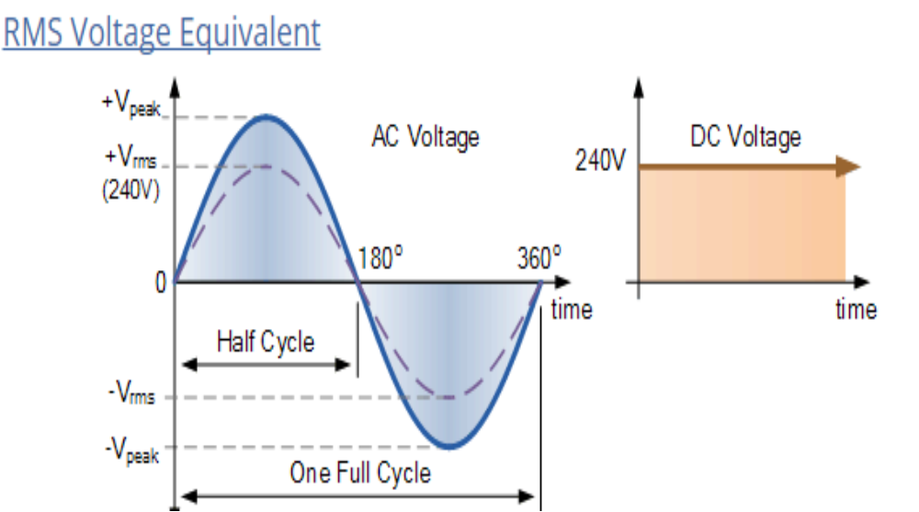
3.<number>

Slide 10

Figure 3.2 A sine wave
3.<number>

Slide 11
Note
We discuss a mathematical approach to sine waves in Appendix C.
3.<number>

Slide 12

Figure 3.3 Two signals with the same phase and frequency,
but different amplitudes
3.<number>

Slide 13
Example 3.2
The voltage of a battery is a constant; this constant value can be considered a sine wave, as we will see later. For example, the peak value of an AA battery is normally
1.5 V.
3.<number>

Slide 14

Note
Frequency and period are the inverse of each other.
3.<number>

Slide 15

Figure 3.4 Two signals with the same amplitude and phase,
but different frequencies
3.<number>

Slide 16

Table 3.1 Units of period and frequency
3.<number>

Slide 17

Example 3.3
The power we use at home has a frequency of 60 Hz. The period of this sine wave can be determined as follows:
3.<number>

Slide 18
Example 3.4
Express a period of 100 ms in microseconds.
Solution
From Table 3.1 we find the equivalents of 1 ms (1 ms is 10⁻³ s) and 1 s (1 s is 10⁶ μs). We make the following substitutions:.
3.<number>

Slide 19

Example 3.5
The period of a signal is 100 ms. What is its frequency in kilohertz?
Solution
First we change 100 ms to seconds, and then we calculate the frequency from the period (1 Hz = 10⁻³ kHz).
3.<number>

Slide 20
Note
Frequency is the rate of change with respect to time.
Change in a short span of time
means high frequency.
Change over a long span of
time means low frequency.
3.<number>

Slide 21
Note
If a signal does not change at all, its frequency is zero.
If a signal changes instantaneously, its frequency is infinite.
3.<number>

Slide 22
Note
Phase describes the position of the waveform relative to time 0.
3.<number>

Slide 23

Figure 3.5 Three sine waves with the same amplitude and frequency,
but different phases
3.<number>

Slide 24

Example 3.6
A sine wave is offset 1/6 cycle with respect to time 0. What is its phase in degrees and radians?
Solution
We know that 1 complete cycle is 360°. Therefore, 1/6 cycle is
3.<number>

Slide 25

Figure 3.6 Wavelength and period
A wave moves a distance of one wavelength in a time of one period
3.<number>

Slide 26

Figure 3.7 The time-domain and frequency-domain plots of a sine wave
3.<number>

Slide 27
Note
A complete sine wave in the time domain can be represented by one single spike in the frequency domain.
3.<number>

Slide 28
Example 3.7
The frequency domain is more compact and useful when we are dealing with more than one sine wave. For example, Figure 3.8 shows three sine waves, each with different amplitude and frequency. All can be represented by three spikes in the frequency domain.
3.<number>

Slide 29

Figure 3.8 The time domain and frequency domain of three sine waves
3.<number>

Slide 30
Note
A single-frequency sine wave is not useful in data communications;
we need to send a composite signal, a signal made of many simple sine waves.
3.<number>

Slide 31
Note
According to Fourier analysis, any composite signal is a combination of
simple sine waves with different frequencies, amplitudes, and phases.
Fourier analysis is discussed in Appendix C.
3.<number>

Slide 32
Note
If the composite signal is periodic, the decomposition gives a series of signals with discrete frequencies;
if the composite signal is nonperiodic, the decomposition gives a combination of sine waves with continuous frequencies.
3.<number>

Slide 33
Example 3.8
Figure 3.9 shows a periodic composite signal with frequency f. This type of signal is not typical of those found in data communications. We can consider it to be three alarm systems, each with a different frequency. The analysis of this signal can give us a good understanding of how to decompose signals.
3.<number>

Slide 34

Figure 3.9 A composite periodic signal
3.<number>

Slide 35

Figure 3.10 Decomposition of a composite periodic signal in the time and
frequency domains
3.<number>

Slide 36
Example 3.9
Figure 3.11 shows a nonperiodic composite signal. It can be the signal created by a microphone or a telephone set when a word or two is pronounced. In this case, the composite signal cannot be periodic, because that implies that we are repeating the same word or words with exactly the same tone.
3.<number>

Slide 37

Figure 3.11 The time and frequency domains of a nonperiodic signal
3.<number>

Slide 38
Note
The bandwidth of a composite signal is the difference between the
highest and the lowest frequencies contained in that signal.
3.<number>

Slide 39

Figure 3.12 The bandwidth of periodic and nonperiodic composite signals
3.<number>

Slide 40

Example 3.10
If a periodic signal is decomposed into five sine waves with frequencies of 100, 300, 500, 700, and 900 Hz, what is its bandwidth? Draw the spectrum, assuming all components have a maximum amplitude of 10 V.
Solution
Let f_{h} be the highest frequency, f_{l} the lowest frequency, and B the bandwidth. Then
The spectrum has only five spikes, at 100, 300, 500, 700, and 900 Hz (see Figure 3.13).
3.<number>

Slide 41

Figure 3.13 The bandwidth for Example 3.10
3.<number>

Slide 42
Example 3.11
A periodic signal has a bandwidth of 20 Hz. The highest frequency is 60 Hz. What is the lowest frequency? Draw the spectrum if the signal contains all frequencies of the same amplitude.
Solution
Let f_{h} be the highest frequency, f_{l} the lowest frequency, and B the bandwidth. Then
The spectrum contains all integer frequencies. We show this by a series of spikes (see Figure 3.14).
3.<number>

Slide 43

Figure 3.14 The bandwidth for Example 3.11
3.<number>

Slide 44
Example 3.12
A nonperiodic composite signal has a bandwidth of 200 kHz, with a middle frequency of 140 kHz and peak amplitude of 20 V. The two extreme frequencies have an amplitude of 0. Draw the frequency domain of the signal.
Solution
The lowest frequency must be at 40 kHz and the highest at 240 kHz. Figure 3.15 shows the frequency domain and the bandwidth.
3.<number>

Slide 45

Figure 3.15 The bandwidth for Example 3.12
3.<number>

Slide 46
Example 3.13
An example of a nonperiodic composite signal is the signal propagated by an AM radio station. In the United States, each AM radio station is assigned a 10-kHz bandwidth. The total bandwidth dedicated to AM radio ranges from 530 to 1700 kHz. We will show the rationale behind this 10-kHz bandwidth in Chapter 5.
3.<number>

Slide 47
Example 3.14
Another example of a nonperiodic composite signal is the signal propagated by an FM radio station. In the United States, each FM radio station is assigned a 200-kHz bandwidth. The total bandwidth dedicated to FM radio ranges from 88 to 108 MHz. We will show the rationale behind this 200-kHz bandwidth in Chapter 5.
3.<number>

Slide 48
Example 3.15
Another example of a nonperiodic composite signal is the signal received by an old-fashioned analog black-and-white TV. A TV screen is made up of pixels. If we assume a resolution of 525 × 700, we have 367,500 pixels per screen. If we scan the screen 30 times per second, this is 367,500 × 30 = 11,025,000 pixels per second. The worst-case scenario is alternating black and white pixels. We can send 2 pixels per cycle. Therefore, we need 11,025,000 / 2 = 5,512,500 cycles per second, or Hz. The bandwidth needed is 5.5125 MHz.
3.<number>

Slide 49
3-3 DIGITAL SIGNALS
In addition to being represented by an analog signal, information can also be represented by a digital signal. For example, a 1 can be encoded as a positive voltage and a 0 as zero voltage. A digital signal can have more than two levels. In this case, we can send more than 1 bit for each level.
Topics discussed in this section:
Bit Rate
Bit Length
Digital Signal as a Composite Analog Signal
Application Layer
3.<number>

Slide 50

Figure 3.16 Two digital signals: one with two signal levels and the other
with four signal levels
3.<number>

Slide 51
Note
Appendix C reviews information about exponential and logarithmic functions.
Appendix C reviews information about exponential and logarithmic functions.
3.<number>

Slide 52
Example 3.16
A digital signal has eight levels. How many bits are needed per level? We calculate the number of bits from the formula
3.<number>

Slide 53

Each signal level is represented by 3 bits.
3.<number>

Slide 54
Example 3.17
A digital signal has nine levels. How many bits are needed per level?
3.<number>

Slide 55
We calculate the number of bits by using the formula. Each signal level is represented by 3.17 bits. However, this answer is not realistic. The number of bits sent per level needs to be an integer as well as a power of 2. For this example, 4 bits can represent one level.
3.<number>

Slide 56
Example 3.18
Assume we need to download text documents at the rate of 100 pages per second. What is the required bit rate of the channel?
If we assume that a page is an average of 24 lines with 80 characters in each line. And one character requires 8 bits.
3.<number>

Slide 57
Solution
The bit rate is
3.<number>

Slide 58
Example 3.19
A digitized voice channel, as we will see in Chapter 4, is made by digitizing a 4-kHz bandwidth analog voice signal. We need to sample the signal at twice the highest frequency (two samples per hertz). We assume that each sample requires 8 bits. What is the required bit rate?
3.<number>

Slide 59

Solution
The bit rate can be calculated as
3.<number>

Slide 60
Example 3.20
What is the bit rate for high-definition TV (HDTV)?
Solution
HDTV uses digital signals to broadcast high quality video signals. The HDTV screen is normally a ratio of 16 : 9. There are 1920 by 1080 pixels per screen, and the screen is renewed 30 times per second. Twenty-four bits represents one color pixel.
The TV stations reduce this rate to 20 to 40 Mbps through compression.
3.<number>

Slide 61
Fourier analysis
Fourier analysis can be used to decompose a digital signal. If the digital signal is periodic, which is rare in data communications, the decomposed signal has a frequency domain
representation with an infinite bandwidth and discrete frequencies.
If the digital signal is nonperiodic, the decomposed signal still has an infinite bandwidth, but the frequencies are continuous. Figure 3.17 shows a periodic and a nonperiodic digital signal and their bandwidths.
3.<number>

Slide 62

Figure 3.17 The time and frequency domains of periodic and nonperiodic
digital signals
3.<number>

Slide 63
Digital signal
We will study the case of a nonperiodic digital signal, similar to the ones we encounter in data communications.
The fundamental question is:
How can we send a digital signal from point A to point B?
We can transmit a digital signal by using
one of two different approaches:
baseband transmission or
broadband transmission (using modulation).
3.<number>

Slide 64
Baseband transmission means sending a digital signal over a channel without changing the digital signal to an analog signal. Figure 3.18 shows baseband transmission.
3.<number>

Slide 65

Figure 3.18 Baseband transmission
3.<number>

Slide 66
Note
A digital signal is a composite analog signal with an infinite bandwidth.
3.<number>

Slide 67
Baseband transmission
Baseband transmission requires that we have a low-pass channel, a channel with a bandwidth that starts from zero. This is the case if we have a dedicated medium with a bandwidth constituting only one channel. For example, the entire bandwidth of a cable connecting two computers is one single channel. As another example, we may connect several computers to a bus, but not allow more than two stations to communicate at a time. Again we have a low-pass channel, and we can use it for baseband communication.
3.<number>

Slide 68

Figure 3.19 Bandwidths of two low-pass channels
3.<number>

Slide 69
Low-Pass Channel with Wide Bandwidth
If we want to preserve the exact form of a nonperiodic digital signal with vertical segments
vertical and horizontal segments horizontal, we need to send the entire spectrum, the continuous range of frequencies between zero and infinity. This is possible if we have a dedicated medium with an infinite bandwidth between the sender and receiver that preserves the exact amplitude of each component of the composite signal.
3.<number>

Slide 70
Low-Pass Channel with Wide Bandwidth
Although this may be possible inside a computer (e.g., between CPU and memory), it is not possible between two devices. Fortunately, the amplitudes of the frequencies at the border of the bandwidth are so small that they can be ignored. This means that if we have a medium, such as a coaxial or fiber optic cable, with a very wide bandwidth, two stations can communicate by using digital signals with very good accuracy, as shown in Figure 3.20. Note that f1 is close to zero, and f2 is very high.
3.<number>

Slide 71

Fig 3.20 Baseband transmission using a dedicated medium, Fiber or Coaxial
3.<number>

Slide 72
Note
Baseband transmission of a digital signal that preserves the shape of the digital signal is possible only if we have a low-pass channel with an infinite or very wide bandwidth.
3.<number>

Slide 73
Low-Pass Channel with Limited Bandwidth (Rough Approximation)
: Let us assume that we have a digital signal of bit rate N. If we want to send analog signals to roughly simulate this signal, we need to consider the worst case, a maximum number of changes in the digital signal. This happens when the signal carries the sequence 01010101 ... or the sequence 10101010 .... To simulate these two cases, we need an analog signal of frequency f = N/2. Let 1 be the positive peak value and 0 be the negative peak value. We send 2 bits in each cycle;
3.<number>

Slide 74
Low-Pass Channel with Limited Bandwidth (Rough Approximation)
Figure 3.21 shows the idea. The two similar cases (000 and 111) are simulated with a signal with frequency f = 0 and a phase of 180° for 000 and a phase of 0° for 111.
The two worst cases (010 and 101) are simulated with an analog signal with frequency f = N/2 and phases of 180° and 0°. The other four cases can only be simulated with an analog signal with f = N/4 and phases of 180°, 270°, 90°, and 0°. In other words, we need a channel that can handle frequencies 0, N/4, and N/2. This rough pproximation is referred to as using the first harmonic (N/2) frequency.
3.<number>

Slide 75

Figure 3.21 Rough approximation of a digital signal using the first harmonic
for worst case
3.<number>

Slide 76
Better Approximation
To make the shape of the analog signal look more like that of a digital signal, we need
to add more harmonics of the frequencies. We need to increase the bandwidth. We can
increase the bandwidth to 3N/2, 5N/2, 7N/2, and so on.
3.<number>

Slide 77
Better Approximation
Figure 3.22 shows the effect ofthis increase for one of the worst cases, the pattern 010. Note that we have shown only the highest frequency for each harmonic. We use the first, third, and fifth harmonics. The required bandwidth is now 5N/2, the difference between the lowest frequency 0 and the highest frequency 5N/2. As we emphasized before, we need to remember that the required bandwidth is proportional to the bit rate.
3.<number>

Slide 78
Example 3.21
An example of a dedicated channel where the entire bandwidth of the medium is used as one single channel is a LAN. Almost every wired LAN today uses a dedicated channel for two stations communicating with each other. In a bus topology LAN with multipoint connections, only two stations can communicate with each other at each moment in time (timesharing); the other stations need to refrain from sending data. In a star topology LAN, the entire channel between each station and the hub is used for communication between these two entities. We study LANs in Chapter 14.
3.<number>

Slide 79

Figure 3.22 Simulating a digital signal with first three harmonics
3.<number>

Slide 80
Note
In baseband transmission, the required bandwidth is proportional to the bit rate;
if we need to send bits faster, we need more bandwidth.
In baseband transmission, the required bandwidth is proportional to the bit rate;
if we need to send bits faster, we need more bandwidth.
3.<number>

Slide 81

Table 3.2 Bandwidth requirements
3.<number>

Slide 82
Example 3.22
What is the required bandwidth of a low-pass channel if we need to send 1 Mbps by using baseband transmission?
Solution
The answer depends on the accuracy desired.
a. The minimum bandwidth, is B = bit rate /2, or 500 kHz.
b. A better solution is to use the first and the third
harmonics with B = 3 × 500 kHz = 1.5 MHz.
c. Still a better solution is to use the first, third, and fifth
harmonics with B = 5 × 500 kHz = 2.5 MHz.
3.<number>

Slide 83
Example 3.22
We have a low-pass channel with bandwidth 100 kHz. What is the maximum bit rate of this
channel?
3.<number>

Slide 84
Solution
The maximum bit rate can be achieved if we use the first harmonic. The bit rate is 2 times the available bandwidth, or 200 kbps.
3.<number>

Slide 85

Figure 3.23 Bandwidth of a bandpass channel
3.<number>

Slide 86
Note
If the available channel is a bandpass channel, we cannot send the digital signal directly to the channel;
we need to convert the digital signal to an analog signal before transmission.
3.<number>

Slide 87

Figure 3.24 Modulation of a digital signal for transmission on a bandpass
channel
3.<number>

Slide 88
Example 3.24
An example of broadband transmission using modulation is the sending of computer data through a telephone subscriber line, the line connecting a resident to the central telephone office. These lines are designed to carry voice with a limited bandwidth. The channel is considered a bandpass channel. We convert the digital signal from the computer to an analog signal, and send the analog signal. We can install two converters to change the digital signal to analog and vice versa at the receiving end. The converter, in this case, is called a modem which we discuss in detail in Chapter 5.
3.<number>

Slide 89
Example 3.25
A second example is the digital cellular telephone. For better reception, digital cellular phones convert the analog voice signal to a digital signal (see Chapter 16). Although the bandwidth allocated to a company providing digital cellular phone service is very wide, we still cannot send the digital signal without conversion. The reason is that we only have a bandpass channel available between caller and callee. We need to convert the digitized voice to a composite analog signal before sending.
3.<number>

Slide 90
3-4 TRANSMISSION IMPAIRMENT
Signals travel through transmission media, which are not perfect. The imperfection causes signal impairment. This means that the signal at the beginning of the medium is not the same as the signal at the end of the medium. What is sent is not what is received. Three causes of impairment are attenuation, distortion, and noise.
Topics discussed in this section:
Attenuation
Distortion
Noise
3.<number>

Slide 91

Figure 3.25 Causes of impairment
3.<number>

Slide 92

Figure 3.26 Attenuation
3.<number>

Slide 93
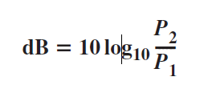
Decibel
To show that a signal has lost or gained strength, engineers use the unit of the decibel.
The decibel (dB) measures the relative strengths of two signals or one signal at two different points. Note that the decibel is negative if a signal is attenuated and positive if a signal is amplified.
3.<number>

Slide 94
Decibel
Variables P1 and P2 are the powers of a signal at points 1 and 2, respectively. Note that some engineering books define the decibel in terms of voltage instead of power. In this case, because power is proportional to the square of the voltage, the formula is dB = 20 log10 (V2/V1). In this text, we express dB in terms of power.
3.<number>

Slide 95

Example 3.26
Suppose a signal travels through a transmission medium and its power is reduced to one-half. This means that P2 is (1/2)P1. In this case, the attenuation (loss of power) can be calculated as
A loss of 3 dB (–3 dB) is equivalent to losing one-half the power.
3.<number>

Slide 96
Example 3.27
A signal travels through an amplifier, and its power is increased 10 times. This means that P₂ = 10P₁ . In this case, the amplification (gain of power) can be calculated as
Remember: 10^{log a} = a
3.<number>

Slide 97
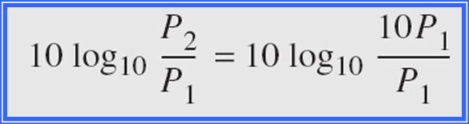
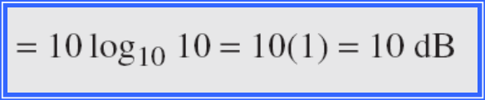
3.<number>

Slide 98

Example 3.28
One reason that engineers use the decibel to measure the changes in the strength of a signal is that decibel numbers can be added (or subtracted) when we are measuring several points (cascading) instead of just two. In Figure 3.27 a signal travels from point 1 to point 4. In this case, the decibel value can be calculated as
3.<number>

Slide 99

Figure 3.27 Decibels for Example 3.28
3.<number>

Slide 100
Example 3.29
Sometimes the decibel is used to measure signal power in milliwatts. In this case, it is referred to as dB_{m} and is calculated as dB_{m} = 10 log10 P_{m} , where P_{m} is the power in milliwatts. Calculate the power of a signal with dB_{m} = −30.
Solution
We can calculate the power in the signal as
3.<number>

Slide 101
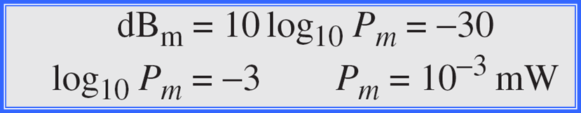

3.<number>

Slide 102

Example 3.30
The loss in a cable is usually defined in decibels per kilometer (dB/km). If the signal at the beginning of a cable with −0.3 dB/km has a power of 2 mW, what is the power of the signal at 5 km?
Solution
The loss in the cable in decibels is 5 × (−0.3) = −1.5 dB. We can calculate the power as
3.<number>

Slide 103
Distortion
Means that the signal changes its shape. It occur in a composite signal made of different frequencies. Each signal component has its own propagation speed through a medium and, therefore, its own delay in arriving at the final destination. Differences in delay may create a difference in phase if the delay is not exactly the same as the period duration. In other words, signal components at the receiver have phases different from what they had at the sender. Figure 3.28 shows the effect of distortion on a composite signal.
3.<number>

Slide 104

Figure 3.28 Distortion
3.<number>

Slide 105
Noise
Several types of noise, such as thermal noise, induced noise, crosstalk, and impulse noise, may corrupt the signal. Thermal noise is the random motion of electrons in a wire, which creates an extra signal not originally sent by the transmitter. Induced noise comes from sources such as motors and appliances.
3.<number>

Slide 106
Noise
These devices act as a sending antenna, and the transmission medium acts as the
receiving antenna. Crosstalk is the effect of one wire on the other. One wire acts as a sending antenna and the other as the receiving antenna. Impulse noise is a spike (a signal with high energy in a very short time) that comes from power lines, lightning, and so on. Figure 3.29 shows the effect of noise on a signal
3.<number>

Slide 107

Figure 3.29 Noise
3.<number>

Slide 108
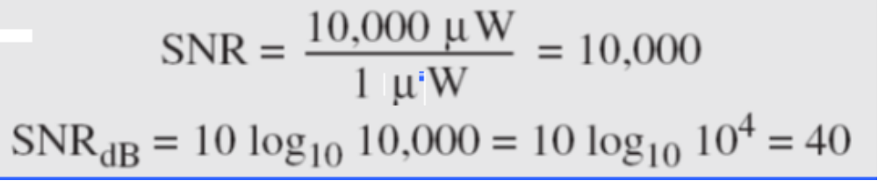
Example 3.31
The power of a signal is 10 mW and the power of the noise is 1 μW; what are the values of SNR and SNR_{dB} ?
Solution
The values of SNR and SNRdB can be calculated as follows:
3.<number>

Slide 109

Example 3.32
The values of SNR and SNRdB for a noiseless channel are
We can never achieve this ratio in real life; it is an ideal.
3.<number>

Slide 110

Figure 3.30 Two cases of SNR: a high SNR and a low SNR
3.<number>

Slide 111
3-5 DATA RATE LIMITS
A very important consideration in data communications is how fast we can send data, in bits per second, over a channel. Data rate depends on three factors:
1. The bandwidth available
2. The level of the signals we use
3. The quality of the channel (the level of noise)
3.<number>

Slide 112
Note
Two theoretical formulas were developed to calculate the data rate:
1- Nyquist for a noiseless channel,
2- Shannon for a noisy channel.
3.<number>

Slide 113

1- Noiseless Channel: Nyquist Bit Rate
For a noiseless channel, the Nyquist bit rate formula defines the theoretical maximum
bit rate
BitRate = 2 x B x L
Where , B is the bandwidth of the channel, L is the number of signal levels used to represent data, and BitRate is the bit rate in bits per second.
3.<number>

Slide 114
1- Noiseless Channel: Nyquist Bit Rate (cont.)
According to the Nyquist Bit Rate, we might think that, given a specific bandwidth, we can have any bit rate we want by increasing the number of signal levels.
3.<number>

Slide 115
Example 3.34
Consider a noiseless channel with a bandwidth of 3000 Hz transmitting a signal with two signal levels. The maximum bit rate can be calculated as
3.<number>

Slide 116
Example 3.35
Consider the same noiseless channel transmitting a signal with four signal levels (for each level, we send 2 bits). The maximum bit rate can be calculated as
3.<number>

Slide 117

Example 3.36
We need to send 265 kbps over a noiseless channel with a bandwidth of 20 kHz. How many signal levels do we need?
Solution
We can use the Nyquist formula as shown:
Since this result is not a power of 2, we need to either increase the number of levels or reduce the bit rate. If we have 128 levels, the bit rate is 280 kbps. If we have 64 levels, the bit rate is 240 kbps.
3.<number>

Slide 118

2- Noisy Channel: Shannon Capacity
In reality, we cannot have a noiseless channel; the channel is always noisy. In 1944, Claude Shannon introduced a formula, called the Shannon capacity, to determine the theoretical highest data rate for a noisy channel:
C = B x (1 + SNR)
In this formula, B is the bandwidth of the channel, SNR is the signal-to noise ratio, and C is the capacity of the channel in bits per second.
3.<number>

Slide 119
2- Noisy Channel: Shannon Capacity (cont.)
Note that in the Shannon formula there is no indication of the signal level, which means that no matter how many levels we have, we cannot achieve a data rate higher than the capacity of the channel. In other words, the formula defines a characteristic of the channel, not the method of transmission.
3.<number>

Slide 120
Example 3.37
Consider an extremely noisy channel in which the value of the signal-to-noise ratio is almost zero. In other words, the noise is so strong that the signal is faint. For this channel the capacity C is calculated as
This means that the capacity of this channel is zero regardless of the bandwidth. In other words, we cannot receive any data through this channel.
3.<number>

Slide 121
Example 3.38
We can calculate the theoretical highest bit rate of a regular telephone line. A telephone line normally has a bandwidth of 3000. The signal-to-noise ratio is usually 3162. For this channel the capacity is calculated as
This means that the highest bit rate for a telephone line is 34.860 kbps. If we want to send data faster than this, we can either increase the bandwidth of the line or improve the signal-to-noise ratio.
3.<number>

Slide 122
Example 3.39
The signal-to-noise ratio is often given in decibels. Assume that SNR_{dB} = 36 and the channel bandwidth is 2 MHz. The theoretical channel capacity can be calculated as
3.<number>

Slide 123


Example 3.40
For practical purposes, when, and only when, the SNR is very high, we can assume that SNR + 1 is almost the same as SNR. In these cases, the theoretical channel capacity can be simplified to
For example, we can calculate the theoretical capacity of the previous example as
3.<number>

Slide 124
How? غير مطلوب
C = B log (base2 ) [1 + SNR]
C/B = log (base2) [1 + SNR]
C/B = log(base10)(1+S/N) / log(base10)(2) (property of logaritms. Change base)
log(base10)(2)=0.30102...
Then we have:
(C/B)*0.3 = log(base10)(1+S/N)
Now we multiplicate both sides by 10:
10*(C/B)*0.3 = 10*[log(base10)(1+S/N)]
Now if S/N is very large the one in the formula can be discarded so we have:
10*(C/B)*0.3 = 10*[log(base10)(S/N)]
and 10*[log(base10)(S/N)]= SNR in Db, by definition of a decibel, so:
10*(C/B)*0.3 = SNR in Db
3.<number>

Slide 125
Example 3.41
We have a channel with a 1-MHz bandwidth. The SNR for this channel is 63. What are the appropriate bit rate and signal level?
Solution
First, we use the Shannon formula to find the upper limit.
3.<number>

Slide 126
Example 3.41 (continued)
The Shannon formula, which is used for noisy channel gives us 6 Mbps, the upper limit. So for better performance and to use Nyquist formula, which is used for noisless channel, we choose something lower, 4 Mbps, for example. Then we use the Nyquist formula to find the number of signal levels.
3.<number>

Slide 127
Note
The Shannon capacity gives us the upper limit; the Nyquist formula tells us how many signal levels we need.
3.<number>

Slide 128
3-6 PERFORMANCE
One important issue in networking is the performance of the network—how good is it? We discuss quality of service, QoS an overall measurement of network performance, in greater detail “Computers NWs” course. In this section, we introduce terms that we need for “Data Communication course”.
Topics discussed in this section:
Bandwidth
Throughput
Latency (Delay)
Bandwidth-Delay Product
3.<number>

Slide 129
Note
In networking, we use the term bandwidth in two contexts.
❏ The first, bandwidth in hertz, refers to
the range of frequencies in a
composite signal or the range of
frequencies that a channel can pass.
❏ The second, bandwidth in bits per
second, refers to the speed of bit
transmission in a channel or link.
3.<number>

Slide 130
Example 3.42
The bandwidth of a subscriber line is 4 kHz for voice or data. But the bandwidth of this subscriber line for data transmission can be up to 56,000 bps using a sophisticated modem to change the digital signal to analog.
3.<number>

Slide 131
Example 3.43
If the telephone company improves the quality of the same subscriber lsine and increases the bandwidth to 8 kHz, we can send 112,000 bps by using the same technology as mentioned in Example 3.42.
3.<number>

Slide 132

Example 3.44
A network with bandwidth of 10 Mbps can pass only an average of 12,000 frames per minute with each frame carrying an average of 10,000 bits. What is the throughput of this network?
Solution
We can calculate the throughput as
The throughput is almost one-fifth of the bandwidth in this case.
3.<number>

Slide 133

Example 3.45
What is the propagation time if the distance between two points is 12,000 km? Assume the propagation speed to be 2.4 × 108 m/s in cable.
Solution
We can calculate the propagation time as
The example shows that a bit can go over the Atlantic Ocean in only 50 ms if there is a direct cable between the source and the destination.
3.<number>

Slide 134
Example 3.46
What are the propagation time and the transmission time for a 2.5-kbyte message (an e-mail) if the bandwidth of the network is 1 Gbps? Assume that the distance between the sender and the receiver is 12,000 km and that light travels at 2.4 × 108 m/s.
Solution
We can calculate the propagation and transmission time as shown on the next slide:
3.<number>

Slide 135

Example 3.46 (continued)
Note that in this case, because the message is short and the bandwidth is high, the dominant factor is the propagation time, not the transmission time. The transmission time can be ignored.
3.<number>

Slide 136
Example 3.47
What are the propagation time and the transmission time for a 5-Mbyte message (an image) if the bandwidth of the network is 1 Mbps? Assume that the distance between the sender and the receiver is 12,000 km and that light travels at 2.4 × 10⁸ m/s.
Solution
We can calculate the propagation and transmission times as shown on the next slide.
3.<number>

Slide 137

Example 3.47 (continued)
Note that in this case, because the message is very long and the bandwidth is not very high, the dominant factor is the transmission time, not the propagation time. The propagation time can be ignored.
3.<number>

Slide 138

Figure 3.31 Filling the link with bits for case 1
3.<number>

Slide 139
Example 3.48
We can think about the link between two points as a pipe. The cross section of the pipe represents the bandwidth, and the length of the pipe represents the delay. We can say the volume of the pipe defines the bandwidth-delay product, as shown in Figure 3.33.
3.<number>

Slide 140

Figure 3.32 Filling the link with bits in case 2
3.<number>

Slide 141
Note
The bandwidth-delay product defines the number of bits that can fill the link.
3.<number>

Slide 142

Figure 3.33 Concept of bandwidth-delay product
3.<number>

