Slide 1
ECOM4411 – Data Communications
Syllabus – Fall 2020
Instructor: Dr. Aiman Abu Samra, Office: B341, ext.2883
Teaching Assistant:
Email: aasamra@iugaza.edu.ps
Website: http://site.iugaza.edu.ps/aasamra/
Textbook: Data Communications and Networking, 5th Edition, Behrouz A. Forouzan, McGraw-Hill, 2013
Grading Scheme:
• Discussion 10 %
• Quizzes and Ass. 10%
• Midterm 20 %
• Final 60 %
1.<number>

Slide 2
Course Contents:
• Chapter 1 Introduction
• Chapter 2 Network Models
• Chapter 3 Data and Signals
• Chapter 4 Digital Transmission
• Chapter 5 Analog Transmission
• Chapter 6 Bandwidth Utilization: Multiplexing and Spreading
• Chapter 7 Transmission Media
• Chapter 8 Switching
• Chapter 9 Using Telephone and Cable Networks for Data Transmission
• Chapter 10 Error Detection and Correction
• Chapter 11 Data Link Control
• Chapter 12 Multiple Access
• Chapter 13 Wired LANs: Ethernet
• Chapter 14 Wireless LANs
• Chapter 15 Connecting LANs, Backbone Networks, and Virtual LANs
1.<number>

Slide 3

Chapter 1
Introduction
1.<number>
Copyright © The McGraw-Hill Companies, Inc. Permission required for reproduction or display.
Notes:
1.#

Slide 4
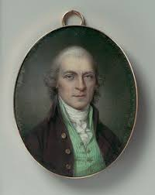
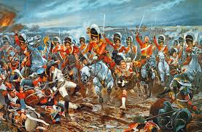
Nathan Rothschild
the Battle of Waterloo 1815
1.<number>

Slide 5
Brief
History of telecommunication
1.<number>

Slide 6
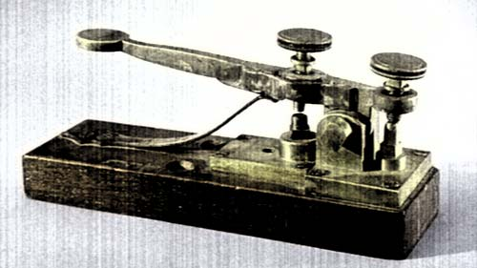
1.<number>

Slide 7
In 1837 Telegraph by ,morse
In 1876 Telephone by Graham Bell
In 1885, Marconi invented the 'wireless telegraph' (radio);
In 1923, the television was invented;
In 1947, the invention of transistors gave birth to the field of electronics;
In 1958, the first integrated circuit was built;
In 1969, the first microprocessor was invented.
1.<number>

Slide 8
1-1 DATA COMMUNICATIONS
The term telecommunication means communication at a distance. The word data refers to information presented in whatever form is agreed upon by the parties creating and using the data. Data communications are the exchange of data between two devices via some form of transmission medium such as a wire cable.
Topics discussed in this section:
Fundamental characteristics of Data Communication
Components
Data Représentation
Data Flow
1.<number>
Notes:
1.#

Slide 9
Fundamental characteristics of Data Communication
Delivery
Accuracy
Timeliness
1.<number>

Slide 10
1-1 DATA COMMUNICATIONS
Data Représentation
Text- ASCII 7 bits, Unicode 32 bits> Basic Latine
Numbers- Binary
Images- B/W 2 bits, RGB, YCM- Yellow, Cyan, Magenta
Audio- mp3, .wav, .wma
Video- mp4, .mov, avi
1.<number>
Notes:
1.#

Slide 11

1-1 DATA COMMUNICATIONS
1.<number>

Slide 12

Data Flow
Figure 1.1 Five components of data communication
1.<number>
Notes:
1.#

Slide 13

Figure 1.2 Data flow (simplex, half-duplex, and full-duplex)
1.<number>
Notes:
1.#

Slide 14
1-2 NETWORKS
A network is a set of devices (often referred to as nodes) connected by communication links. A node can be a computer, printer, or any other device capable of sending and/or receiving data generated by other nodes on the network.
Topics discussed in this section:
Distributed Processing
Network Criteria
Physical Structures
Network Models
Categories of Networks
Interconnection of Networks: Internetwork
1.<number>
Notes:
1.#

Slide 15

Figure 1.3 Types of connections: point-to-point and multipoint
1.<number>
Notes:
1.#

Slide 16

Figure 1.4 Categories of topology
1.<number>
Notes:
1.#

Slide 17

Figure 1.5 A fully connected mesh topology (five devices)
1.<number>
Notes:
1.#

Slide 18

Figure 1.6 A star topology connecting four stations
1.<number>
Notes:
1.#

Slide 19

Figure 1.7 A bus topology connecting three stations
1.<number>
Notes:
1.#

Slide 20

Figure 1.8 A ring topology connecting six stations
1.<number>
Notes:
1.#

Slide 21

Figure 1.9 A hybrid topology: a star backbone with three bus networks
1.<number>
Notes:
1.#

Slide 22

Figure 1.10 An isolated LAN connecting 12 computers to a hub in a closet
1.<number>
Notes:
1.#

Slide 23

Figure 1.11 WANs: a switched WAN and a point-to-point WAN
1.<number>
Notes:
1.#

Slide 24

Figure 1.12 A heterogeneous network made of four WANs and two LANs
1.<number>
Notes:
1.#

Slide 25
Networking Criteria
Performance
reliability
Security
1.<number>

Slide 26
Performance
Can be measured in many ways, including transit time and response time.
Transit time is the amount of time required for a message to travel from one device to another.
Response time is the elapsed time between an inquiry and a response.
1.<number>

Slide 27
Performance
is often evaluated by two networking metrics: throughput and delay.
We often need:
more throughput and
less delay.
However, these two criteria are often contradictory.
1.<number>

Slide 28
Reliability
In addition to accuracy of delivery, network reliability is measured by the frequency of failure, the time it takes a link to recover from a failure, and the network's robustness in a catastrophe.
1.<number>

Slide 29
Security
Network security issues include protecting data from unauthorized access, protecting
data from damage and development, and implementing policies and procedures for
recovery from faults and data losses.
1.<number>

Slide 30
Network types
LAN
WAN
MAN
SAN
1.<number>

Slide 31
Internetworking
It is very rare to see a LAN or a WAN in isolation; they are connected to one another.
When two or more networks are connected, they make an internetwork, or
internet.
1.<number>

Slide 32
Switching
Circuit-switched network
Packet-switching network
1.<number>

Slide 33
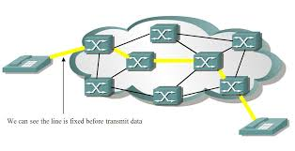
Circuit-switched network
1.<number>

Slide 34
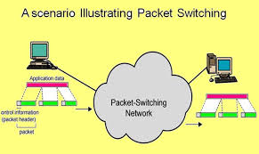
Packet-switching network
1.<number>

Slide 35
1-3 THE INTERNET
The Internet has revolutionized many aspects of our daily lives. It has affected the way we do business as well as the way we spend our leisure time. The Internet is a communication system that has brought a wealth of information to our fingertips and organized it for our use.
Topics discussed in this section:
A Brief History
The Internet Today (ISPs)
1.<number>
Notes:
1.#

Slide 36

Figure 1.13 Hierarchical organization of the Internet
1.<number>
Notes:
1.#

Slide 37
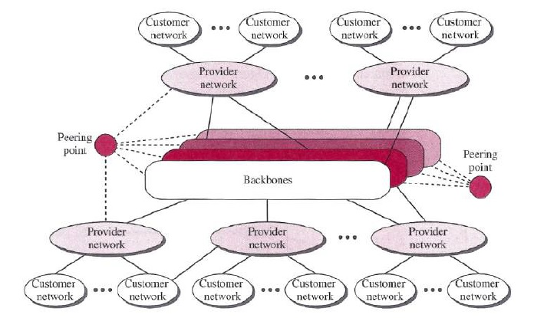
Internet today
1.<number>

Slide 38
Top tier 1 ISPs
• AT&T Services, Inc.
• Global Crossing, Ltd.
• Verizon
• NTT Communications Corp.
• China Telecom
• Savvis, Inc.
1.<number>

Slide 39
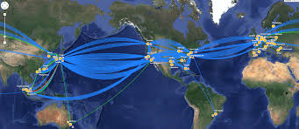
1.<number>

Slide 40
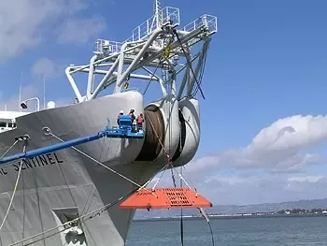
1.<number>

Slide 41
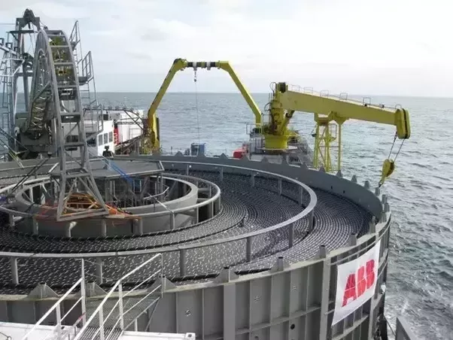
1.<number>

Slide 42
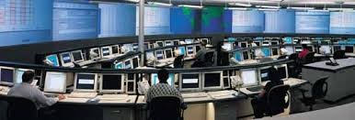
1.<number>

Slide 43
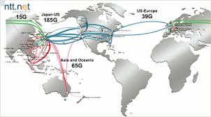
1.<number>

Slide 44
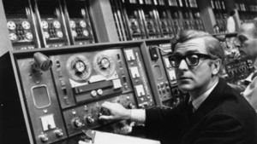
ARPANET
1.<number>

Slide 45
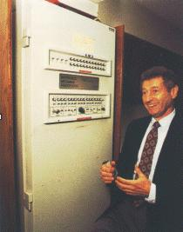
Leonard Kleinrock is an American engineer and computer scientist.
The first permanent ARPANET link was established on November 21, 1969, between the Interface Message Processor (IMP) at UCLA and the IMP at the Stanford Research Institute.
1.<number>

Slide 46
Accessing the Internet
By Telephone networks
  Dial-up Service -modem
  DSL Service -ADSL
By wireless networks -Tajawal
By TV Cable networks
Leased-line like IUG
1.<number>

Slide 47
1-4 PROTOCOLS AND STANDARDS
In this section, we define two widely used terms: protocols and standards. First, we define protocol, which is synonymous with rule. Then we discuss standards, which are agreed-upon rules.
Topics discussed in this section:
Protocols
Standards
Standards Organizations
Internet Standards
1.<number>
Notes:
1.#

Slide 48
Protocols
Communications between computers
require very specific unambiguous rules
A protocol is a set of rules that governs
how two or more communicating parties are to interact
Examples
Transmission Control Protocol (TCP)
HyperText Transfer Protocol (HTTP)
Simple Mail Transfer Protocol (SMTP)
1.<number>

Slide 49
Standards
A “ standard is set of guidelines” to users and manufactures to ensure interconnectivity.
1) “Defacto” not approved but widely used (TCP/IP)
2) “Dejure”: approved by recognized body (IEEE 802.X).
1.<number>

Slide 50
Ethernet
MAC sublayer
CSMA/CD PROTOCOL
IEEE 802.3
1.<number>

Slide 51
Internet standards
IETF-Internet Research Task force
RFC-Request for Comments
IAB Internet Architecture Board
1.<number>

Slide 52
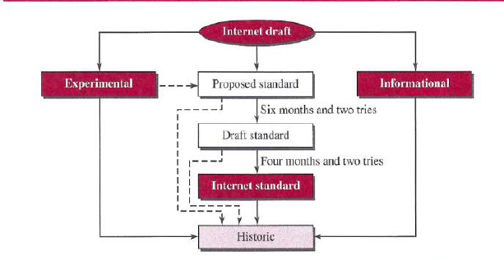
Maturity levels of an RFC
1.<number>

Slide 53
Maturity levels of an RFC
Proposed standard: At this level, the
specification is usually tested and implemented by several different groups.
Draft standard: A proposed standard is elevated to draft standard status after at
least two successful independent and interoperable implementations.
1.<number>

Slide 54
Internet Standard
A draft standard reaches Internet standard status after demonstrations
of successful implementation.
Historic: superseded by later specifications or have never passed the necessary maturity levels to become an Internet standard.
1.<number>

Slide 55
Requirement Levels
RFCs are classified into five requirement levels:
required,
recommended,
elective, limited use,
not recommended.
1.<number>

Slide 56
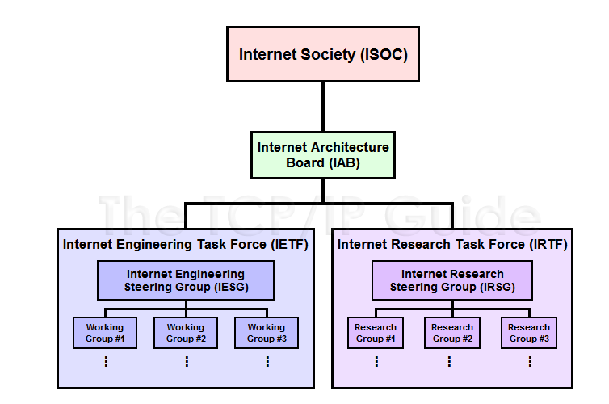
Internet Standards Organization
1.<number>

Slide 57
Quiz
Quiz 5 Grades
1.<number>

Slide 58
Five components of data communication:
Explain the data flow types:
simplex
half-duplex
full-duplex
Two metrics for Performance
Two metrics for Reliability
The following stands for
NAP ISP IETF IRTF IAB RFC CSMA/CD
1.<number>

