Slide 1

Chapter 2
Network Models
2.<number>
Copyright © The McGraw-Hill Companies, Inc. Permission required for reproduction or display.

Slide 2
2-1 LAYERED TASKS
We use the concept of layers in our daily life. As an example, let us consider two friends who communicate through postal mail. The process of sending a letter to a friend would be complex if there were no services available from the post office.
Topics discussed in this section:
Sender, Receiver, and Carrier
Hierarchy
2.<number>

Slide 3

Figure 2.1 Tasks involved in sending a letter
2.<number>

Slide 4
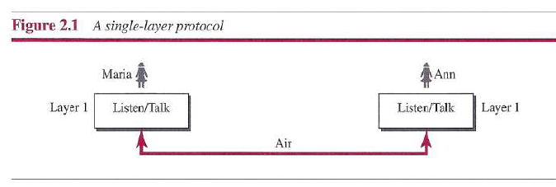
Concept of Layers
2.<number>

Slide 5
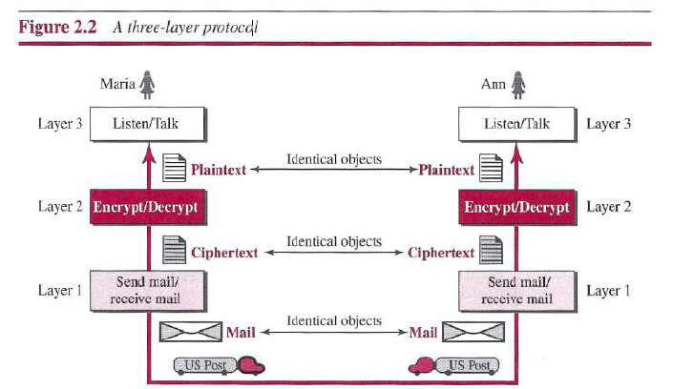
Concept of Layers
2.<number>

Slide 6
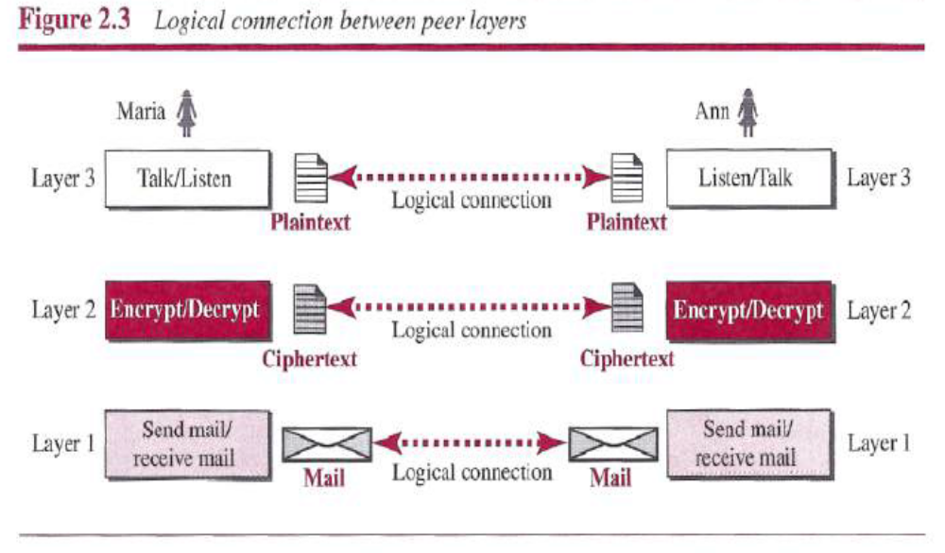
Logical connections
2.<number>

Slide 7
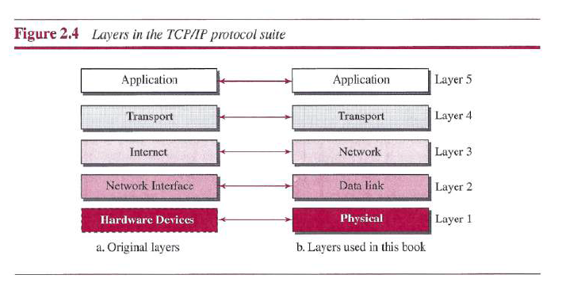
TCP/IP protocol suit
2.<number>

Slide 8
2-2 THE OSI MODEL
Established in 1947, the International Standards Organization (ISO) is a multinational body dedicated to worldwide agreement on international standards. An ISO standard that covers all aspects of network communications is the Open Systems Interconnection (OSI) model. It was first introduced in the late 1970s.
Topics discussed in this section:
Layered Architecture
Peer-to-Peer Processes
Encapsulation
2.<number>

Slide 9

Note
ISO is the organization.
OSI is the model.
2.<number>

Slide 10

Figure 2.2 Seven layers of the OSI model
2.<number>

Slide 11

Figure 2.3 The interaction between layers in the OSI model
2.<number>

Slide 12

Figure 2.4 An exchange using the OSI model
2.<number>

Slide 13
2-3 LAYERS IN THE OSI MODEL
In this section we briefly describe the functions of each layer in the OSI model.
Topics discussed in this section:
Physical Layer
Data Link Layer
Network Layer
Transport Layer
Session Layer
Presentation Layer
Application Layer
2.<number>

Slide 14

Figure 2.5 Physical layer
2.<number>

Slide 15
Note
The physical layer is responsible for movements of
individual bits from one hop (node) to the next.
2.<number>

Slide 16

Figure 2.6 Data link layer
2.<number>

Slide 17
Note
The data link layer is responsible for moving
frames from one hop (node) to the next.
2.<number>

Slide 18

Figure 2.7 Hop-to-hop delivery
2.<number>

Slide 19

Figure 2.8 Network layer
2.<number>

Slide 20
Note
The network layer is responsible for the
delivery of individual packets from
the source host to the destination host.
2.<number>

Slide 21

Figure 2.9 Source-to-destination delivery
2.<number>

Slide 22

Figure 2.10 Transport layer
2.<number>

Slide 23
Note
The transport layer is responsible for the delivery
of a message from one process to another.
2.<number>

Slide 24

Figure 2.11 Reliable process-to-process delivery of a message
2.<number>

Slide 25

Figure 2.12 Session layer
2.<number>

Slide 26
Note
The session layer is responsible for dialog
control and synchronization.
2.<number>

Slide 27

Figure 2.13 Presentation layer
2.<number>

Slide 28
Note
The presentation layer is responsible for translation, compression, and encryption.
2.<number>

Slide 29

Figure 2.14 Application layer
X.500 from CCITT–Directory service protocols like Directory Access Protocol
FTAM-From ISO -File Transfer Access and Management
2.<number>
Notes:
x.500 - the OSI Directory Service

Slide 30
Note
The application layer is responsible for
providing services to the user.
2.<number>

Slide 31

Figure 2.15 Summary of layers
2.<number>

Slide 32
2-4 TCP/IP PROTOCOL SUITE
The layers in the TCP/IP protocol suite do not exactly match those in the OSI model. The original TCP/IP protocol suite was defined as having four layers: host-to-network, internet, transport, and application. However, when TCP/IP is compared to OSI, we can say that the TCP/IP protocol suite is made of five layers: physical, data link, network, transport, and application.
Topics discussed in this section:
Physical and Data Link Layers
Network Layer
Transport Layer
Application Layer
2.<number>

Slide 33

Figure 2.16 TCP/IP and OSI model
2.<number>

Slide 34
2-5 ADDRESSING
Four levels of addresses are used in an internet employing the TCP/IP protocols: physical, logical, port, and specific.
Topics discussed in this section:
Physical Addresses
Logical Addresses
Port Addresses
Specific Addresses
2.<number>

Slide 35

Figure 2.17 Addresses in TCP/IP
2.<number>

Slide 36

Figure 2.18 Relationship of layers and addresses in TCP/IP
2.<number>

Slide 37
Example 2.1
In Figure 2.19 a node with physical address 10 sends a frame to a node with physical address 87. The two nodes are connected by a link (bus topology LAN). As the figure shows, the computer with physical address 10 is the sender, and the computer with physical address 87 is the receiver.
2.<number>

Slide 38

Figure 2.19 Physical addresses
2.<number>

Slide 39
Example 2.2
As we will see in Chapter 13, most local-area networks use a 48-bit (6-byte) physical address written as 12 hexadecimal digits; every byte (2 hexadecimal digits) is separated by a colon, as shown below:
07:01:02:01:2C:4B
A 6-byte (12 hexadecimal digits) physical address.
2.<number>

Slide 40
Example 2.3
Figure 2.20 shows a part of an internet with two routers connecting three LANs. Each device (computer or router) has a pair of addresses (logical and physical) for each connection. In this case, each computer is connected to only one link and therefore has only one pair of addresses. Each router, however, is connected to three networks (only two are shown in the figure). So each router has three pairs of addresses, one for each connection.
2.<number>

Slide 41

Figure 2.20 IP addresses
2.<number>

Slide 42
Example 2.4
Figure 2.21 shows two computers communicating via the Internet. The sending computer is running three processes at this time with port addresses a, b, and c. The receiving computer is running two processes at this time with port addresses j and k. Process a in the sending computer needs to communicate with process j in the receiving computer. Note that although physical addresses change from hop to hop, logical and port addresses remain the same from the source to destination.
2.<number>

Slide 43
Matryoshka
2.<number>

Slide 44


2.<number>

Slide 45

Figure 2.21 Port addresses
2.<number>

Slide 46
Note
The physical addresses will change from hop to hop,
but the logical addresses usually remain the same.
2.<number>

Slide 47
Example 2.5
As we will see in Chapter 23, a port address is a 16-bit address represented by one decimal number as shown.
753
A 16-bit port address represented
as one single number.
2.<number>

Slide 48
Do It
Start
cmd
Ipconfig … what will you receive?
netstat –a (for network statistics)
You receive all TCP connections
Like
192.168.1.107:44512 …. Listening
192.168.1.107:54835 …. Listening
2.<number>

Slide 49
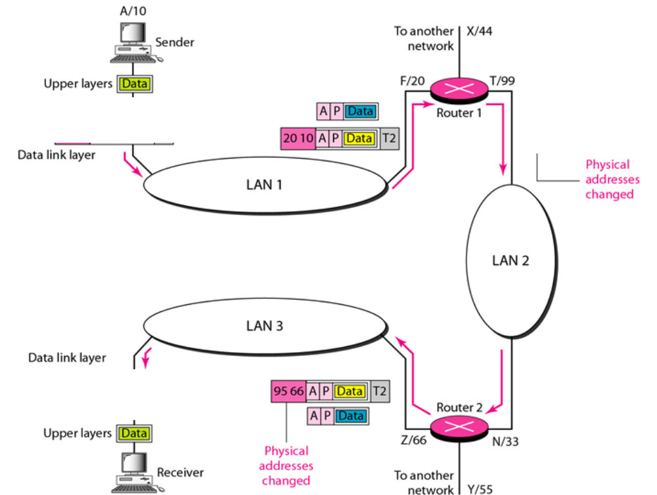
2.<number>

Slide 50
port address is a (16, 32, 48) bit address represented by ……..
physical address is a (16, 32, 48) bit address represented by ………
IP address is a (16, 32, 48) bit address represented by ……..
2.<number>

