Slide 1

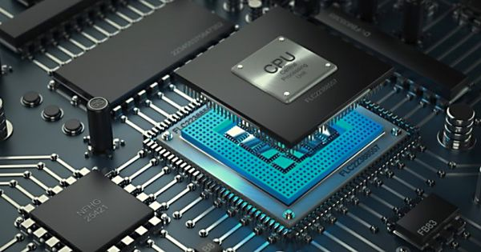
ECOM 4412
Computer Organization &
Assembly Language
Assembly Language for X86 Processors
Instructor: Ruba A. Salamh
Islamic University of Gaza

Slide 2
Basic Concepts
Chapter 1
Readings from the textbook are sections: 1.1 and 1.2

Slide 3
Welcome to Assembly Language
Assembly language is a “low-level” language and provides the basic instructional interface to the computer processor. Programs written in a high-level language are translated into assembly language in order for the processor to execute the program.
Assembly language gives you direct control of the system's resources. This involves setting processor registers, accessing memory locations, and interfacing with other hardware elements. This requires a significantly deeper understanding of exactly how the processor and memory work.
Assembly language is machine specific. For example, code written for an x86-64 processor will not run on a different processor such as a RISC processor (popular in tablets and smart-phones).

Slide 4
Welcome to Assembly Language
Assembly Language for x86-64 Processors focuses on programming microprocessors compatible with Intel and AMD processors running under 32-bit and 64-bit versions of Microsoft Windows
The x86-64 is a Complex Instruction Set Computing (CISC) CPU design. This refers to the internal processor design philosophy. CISC processors typically include a wide variety of instructions (sometimes overlapping), varying instructions sizes, and a wide range of addressing modes. The term was retroactively coined in contrast to Reduced Instruction Set Computer (RISC).

Slide 5
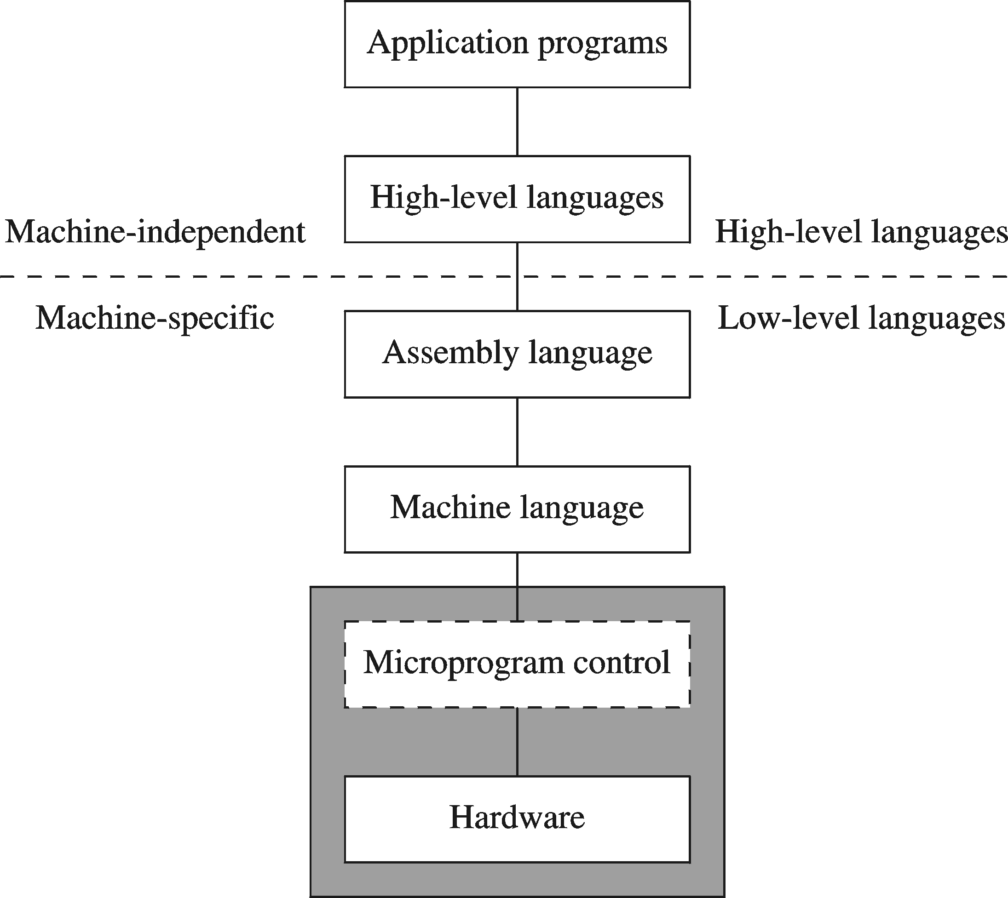
A Hierarchy of Languages

Slide 6
Assembly and Machine Language
Machine language
  Native to a processor: executed directly by hardware
  Instructions consist of binary code: 1s and 0s
Assembly language
  Slightly higher-level language
  Readability of instructions is better than machine language
  One-to-one correspondence with machine language instructions
Assemblers translate assembly to machine code
Compilers translate high-level programs to machine code
  Either directly, or
  Indirectly via an assembler

Slide 7
Translating Languages
English: D is assigned the sum of A times B plus 10.
High-Level Language: D = A * B + 10
A statement in a high-level language is translated typically into several machine-level instructions
Intel Assembly Language:
mov eax, A
mul B
add eax, 10
mov D, eax
Intel Machine Language:
A1 00404000
F7 25 00404004
83 C0 0A
A3 00404008

Slide 8
Advantages of High-Level Languages
Program development is faster
  High-level statements: fewer instructions to code
Program maintenance is easier
  For the same above reasons
Programs are portable
  Contain few machine-dependent details
    Can be used with little or no modifications on different machines
  Compiler translates to the target machine language
  However, Assembly language programs are not portable

Slide 9
Why Learn Assembly Language?
The reasons for learning assembly language are more about understanding how a computer works instead of developing large programs. Since assembly language is machine specific, the lack of portability is very limiting for programming projects.
The process of actually learning assembly language involves writing non-trivial programs to perform specific low-level actions including arithmetic operations, function calls, using stack-dynamic local variables, and operating system interaction for activities such as input/output.
Assembly language helps you to gain an overall understanding of the interaction between computer hardware, operating systems, and application programs. Using assembly language, you can apply and test theoretical information you are given in computer architecture and operating systems courses.

Slide 10
Why Learn Assembly Language?
Gain a Better Understanding of Architecture Issues
  Learning and spending some time working at the assembly language level provides a richer understanding of the underlying computer architecture. This includes the basic instruction set, processor registers, memory addressing, hardware interfacing, and Input/ Output. Since ultimately all programs execute at this level, knowing the capabilities of assembly language provides useful insights into what is possible, what is easy, and what might be more difficult or slower.
Understanding the Tool Chain
  The tool chain is the name for the process of taking code written by a human and converting it into something that the computer can directly execute. This includes the compiler, or assembler in our case, the linker, the loader, and the debugger.

Slide 11
Why Learn Assembly Language?
Improve Algorithm Development Skills
  Working with assembly language and writing low-level programs helps programmers improve algorithm development skills by practicing with a language that requires more thought and more attention to detail.
Improve Understanding of Functions/Procedures
  Working with assembly language provides a greatly improved understanding of how function/procedure calls work. This includes the contents and structure of the function call frame, also referred to as the activation record.

Slide 12
Why Learn Assembly Language?
Some high-level languages abstract their data representation to the point that it becomes awkward to perform low-level tasks such as bit manipulation. In such an environment, programmers will often call subroutines written in assembly language to accomplish their goal.
Hardware manufacturers create device drivers for the equipment they sell. Device drivers are programs that translate general operating system commands into specific references to hardware details. Printer manufacturers, for example, create a different MS-Windows device driver for each model they sell. Often these device drivers contain significant amounts of assembly language code.

Slide 13
Is Assembly Language Portable?
A language whose source programs can be compiled and run on a wide variety of computer systems is said to be portable.
A C++ program, for example, will compile and run on just about any computer, unless it makes specific references to library functions that exist under a single operating system.
A major feature of the Java language is that compiled programs run on nearly any computer system.
Assembly language is not portable, because it is designed for a specific processor family. There are a number of different assembly languages widely used today, each based on a processor family

Slide 14
Assembler
Software tools are needed for editing, assembling, linking, and debugging assembly language programs
An assembler is a program that converts source-code programs written in assembly language into object files in machine language
Popular assemblers have emerged over the years for the Intel family of processors. These include …
  TASM (Turbo Assembler from Borland)
  NASM (Netwide Assembler for both Windows and Linux), and
  GNU assembler distributed by the free software foundation
You will use MASM (Macro Assembler from Microsoft)

Slide 15
Linker and Link Libraries
You need a linker program to produce executable files
It combines your program's object file created by the assembler with other object files and link libraries, and produces a single executable program

Slide 16
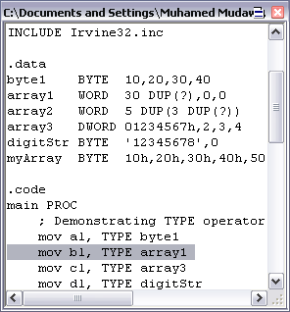
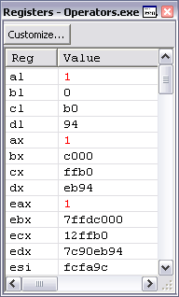
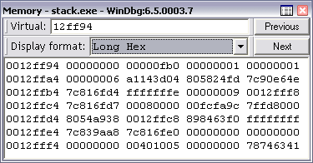
Debugger
Allows you to trace the execution of a program
Allows you to view code, memory, registers, etc.

Slide 17
Data Representation
Binary Numbers
Hexadecimal Numbers
Base Conversions
Integer Storage Sizes
Binary and Hexadecimal Addition
Signed Integers and 2's Complement Notation
Binary and Hexadecimal subtraction
Carry and Overflow
Character Storage

Slide 18
Binary Numbers
Digits are 1 and 0
  1 = true
  0 = false
MSB – most significant bit
LSB – least significant bit
Bit numbering:

Slide 19
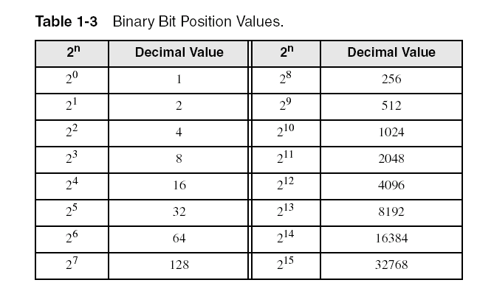
Binary Numbers
Each digit (bit) is either 1 or 0
Each bit represents a power of 2:
Every binary number is a sum of powers of 2
You have to be quick

Slide 20
Converting Binary to Decimal
Weighted positional notation shows how to calculate the decimal value of each binary bit:
Decimal = (d_{n-1} × 2^{n-1}) + (d_{n-2} × 2^{n-2}) + ... + (d₁ × 2¹) + (d₀ × 2⁰)
d = binary digit
binary 00001001 = decimal 9:
(1 × 2³) + (1 × 2⁰) = 9

Slide 21
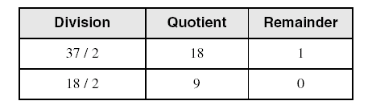
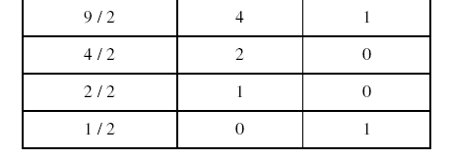
Convert Unsigned Decimal to Binary
Repeatedly divide the decimal integer by 2. Each remainder is a binary digit in the translated value:
least significant bit
most significant bit
37 = 100101
stop when quotient is zero

Slide 22
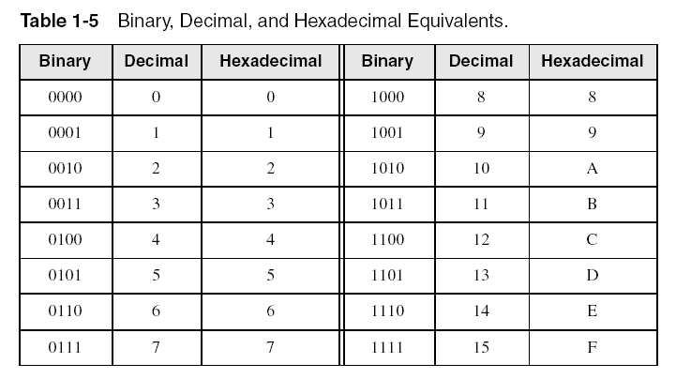
Hexadecimal Integers
Binary values are represented in hexadecimal.

Slide 23

Converting Binary to Hexadecimal
Each hexadecimal digit corresponds to 4 binary bits.
Example: Translate the binary integer 000101101010011110010100 to hexadecimal:

Slide 24
Converting Hexadecimal to Decimal
Multiply each digit by its corresponding power of 16:
Decimal = (d₃ × 16³) + (d₂ × 16²) + (d₁ × 16¹) + (d₀ × 16⁰)
d = hexadecimal digit
Examples:
  Hex 1234 = (1 × 16³) + (2 × 16²) + (3 × 16¹) + (4 × 16⁰) =
  Decimal 4,660
  Hex 3BA4 = (3 × 16³) + (11 * 16²) + (10 × 16¹) + (4 × 16⁰) =
  Decimal 15,268

Slide 25
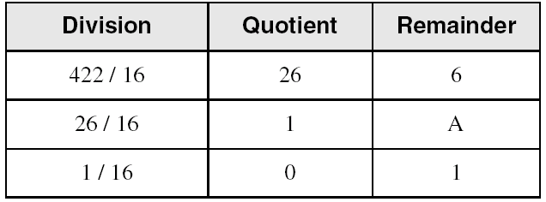
Converting Decimal to Hexadecimal
Repeatedly divide the decimal integer by 16. Each remainder is a hex digit in the translated value:
least significant digit
most significant digit
stop when quotient is zero
Decimal 422 = 1A6 hexadecimal

Slide 26
Integer Storage Sizes
The x86-64 architecture supports a specific set of data storage size elements, all based on powers of two.

Slide 27
Binary Addition
Start with the least significant bit (rightmost bit)
Add each pair of bits
Include the carry in the addition, if present
carry:
1
0
0
0
0
0
1
0
0
(4)
+
0
0
0
0
0
1
1
1
(7)
0
0
0
0
1
0
1
1
(11)
bit position:
7
6
5
4
3
2
1
0

Slide 28
Hexadecimal Addition
Divide the sum of two digits by the number base (16). The quotient becomes the carry value, and the remainder is the sum digit.
1
1
36 28 28 6A
42 45 58 4B
78 6D 80 B5
21 / 16 = 1, remainder 5
Important skill: Programmers frequently add and subtract the addresses of variables and instructions.

Slide 29
Signed Integers
Several ways to represent a signed number
  Sign-Magnitud
  1's complement
  2's complement
Divide the range of values into 2 equal parts
  First part corresponds to the positive numbers (≥ 0)
  Second part correspond to the negative numbers (< 0)
Focus will be on the 2's complement representation
  Has many advantages over other representations
  Used widely in processors to represent signed integers

Slide 30
Two's Complement Representation
Positive numbers
  Signed value = Unsigned value
Negative numbers
  Signed value = 2’s complement
Negative weight for MSB
  Another way to obtain the signed value is to assign a negative weight to most-significant bit
  = -128 + 32 + 16 + 4 = -76
8-bit Binary value | Unsigned value | Signed value
00000000 | 0 | 0
00000001 | 1 | +1
00000010 | 2 | +2
. . . | . . . | . . .
01111110 | 126 | +126
01111111 | 127 | +127
10000000 | 128 | -128
10000001 | 129 | -127
. . . | . . . | . . .
11111110 | 254 | -2
11111111 | 255 | -1
1
0
1
1
0
1
0
0
-128
64
32
16
8
4
2
1

Slide 31
Forming the Two's Complement
starting value | 00100100 = +36
step1: reverse the bits (1's complement) | 11011011
step 2: add 1 to the value from step 1 | + 1
sum = 2's complement representation | 11011100 = -36
Sum of an integer and its 2's complement must be zero:
00100100 + 11011100 = 00000000 (8-bit sum) ⇒ Ignore Carry
The easiest way to obtain the 2's complement of a binary number is by starting at the LSB, leaving all the 0s unchanged, look for the first occurrence of a 1. Leave this 1 unchanged and complement all the bits after it.

Slide 32
Sign Bit
Highest bit indicates the sign. 1 = negative, 0 = positive
If highest digit of a hexadecimal is > 7, the value is negative
Examples: 8A and C5 are negative bytes
A21F and 9D03 are negative words
B1C42A00 is a negative double-word

Slide 33
Maximum and Minimum Values

Slide 34
Sign Extension
Step 1: Move the number into the lower-significant bits
Step 2: Fill all the remaining higher bits with the sign bit
This will ensure that both magnitude and sign are correct
Examples
  Sign-Extend 10110011 to 16 bits
  Sign-Extend 01100010 to 16 bits
Infinite 0s can be added to the left of a positive number
Infinite 1s can be added to the left of a negative number
10110011 = -77
11111111 10110011 = -77
01100010 = +98
00000000 01100010 = +98

Slide 35
Two's Complement of a Hexadecimal
No need to convert hexadecimal to binary
To form the two's complement of a hexadecimal
  Subtract each hexadecimal digit from 15
  Add 1
Examples:
  2's complement of 6A3D = 95C2 + 1 = 95C3
  2's complement of 92F0 = 6D0F + 1 = 6D10
  2's complement of FFFF = 0000 + 1 = 0001

Slide 36
Binary Subtraction
When subtracting A – B, convert B to its 2's complement
Add A to (–B)
0 0 0 0 1 1 0 0 0 0 0 0 1 1 0 0
0 0 0 0 0 0 1 0 1 1 1 1 1 1 1 0 (2's complement)
0 0 0 0 1 0 1 0 0 0 0 0 1 0 1 0 (same result)
Carry is ignored, because
  Negative number is sign-extended with 1's
  You can imagine infinite 1's to the left of a negative number
  Adding the carry to the extended 1's produces extended zeros
–
+
Practice: Subtract 00100101 from 01101001.

Slide 37
Hexadecimal Subtraction
When a borrow is required from the digit to the left, add 16 (decimal) to the current digit's value
Last Carry is ignored
16 + 5 = 21
-1
1
1
C675
A247
242E
C675
5DB9 (2's complement)
242E (same result)
-
+
Practice: The address of var1 is 00400B20. The address of the next variable after var1 is 0040A06C. How many bytes are used by var1?

Slide 38
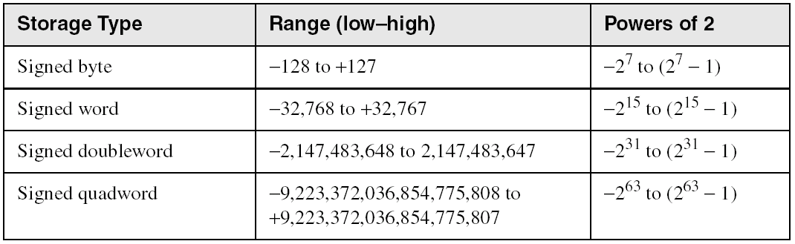
Ranges of Signed Integers
The unsigned range is divided into two signed ranges for positive and negative numbers
Practice: What is the range of signed values that may be stored in 20 bits?

Slide 39
Carry and Overflow
Carry is important when …
  Adding or subtracting unsigned integers
  Indicates that the unsigned sum is out of range
  Either < 0 or >maximum unsigned n-bit value
Overflow is important when …
  Adding or subtracting signed integers
  Indicates that the signed sum is out of range
Overflow occurs when
  Adding two positive numbers and the sum is negative
  Adding two negative numbers and the sum is positive
  Can happen because of the fixed number of sum bits

Slide 40
Carry and Overflow Examples
We can have carry without overflow and vice-versa
Four cases are possible
1
1
1
1
1
1
0
0
0
0
1
1
1
1
15
0
0
0
0
1
1
1
1
15
+
+
0
0
0
0
1
0
0
0
8
1
1
1
1
1
0
0
0
245 (-8)
0
0
0
1
0
1
1
1
23
0
0
0
0
0
1
1
1
7
Carry = 0 Overflow = 0
Carry = 1 Overflow = 0
1
1
1
1
0
1
0
0
1
1
1
1
79
1
1
0
1
1
0
1
0
218 (-38)
+
+
0
1
0
0
0
0
0
0
64
1
0
0
1
1
1
0
1
157 (-99)
1
0
0
0
1
1
1
1
143
(-113)
0
1
1
1
0
1
1
1
119
Carry = 0 Overflow = 1
Carry = 1 Overflow = 1
OverFlow = C_{n} XOR C_{n-1}

Slide 41
Character Storage
Character sets
  Standard ASCII: 7-bit character codes (0 – 127)
  Extended ASCII: 8-bit character codes (0 – 255)
  Unicode: 16-bit character codes (0 – 65,535)
  Unicode standard represents a universal character set
    Defines codes for characters used in all major languages
    Used in Windows-XP: each character is encoded as 16 bits
  UTF-8: variable-length encoding used in HTML
    Encodes all Unicode characters
    Uses 1 byte for ASCII, but multiple bytes for other characters
Null-terminated String
  Array of characters followed by a NULL character

Slide 42
Printable ASCII Codes
 | 0 | 1 | 2 | 3 | 4 | 5 | 6 | 7 | 8 | 9 | A | B | C | D | E | F
2 | space | ! | " | # | $ | % | & | ' | ( | ) | * | + | , | - | . | /
3 | 0 | 1 | 2 | 3 | 4 | 5 | 6 | 7 | 8 | 9 | : | ; | < | = | > | ?
4 | @ | A | B | C | D | E | F | G | H | I | J | K | L | M | N | O
5 | P | Q | R | S | T | U | V | W | X | Y | Z | [ | \ | ] | ^ | _
6 | ` | a | b | c | d | e | f | g | h | i | j | k | l | m | n | o
7 | p | q | r | s | t | u | v | w | x | y | z | { | | | } | ~ | DEL
Examples:
  ASCII code for space character = 20 (hex) = 32 (decimal)
  ASCII code for 'L' = 4C (hex) = 76 (decimal)
  ASCII code for 'a' = 61 (hex) = 97 (decimal)

Slide 43
Control Characters
The first 32 characters of ASCII table are used for control
Control character codes = 00 to 1F (hex)
  Not shown in previous slide
Examples of Control Characters
  Character 0 is the NULL character ⇒ used to terminate a string
  Character 9 is the Horizontal Tab (HT) character
  Character 0A (hex) = 10 (decimal) is the Line Feed (LF)
  Character 0D (hex) = 13 (decimal) is the Carriage Return (CR)
  The LF and CR characters are used together
    They advance the cursor to the beginning of next line
One control character appears at end of ASCII table
  Character 7F (hex) is the Delete (DEL) character

Slide 44
Terminology for Data Representation
Binary Integer
  Integer stored in memory in its binary format
  Ready to be used in binary calculations
ASCII Digit String
  A string of ASCII digits, such as "123"
ASCII binary
  String of binary digits: "01010101"
ASCII decimal
  String of decimal digits: "6517"
ASCII hexadecimal
  String of hexadecimal digits: "9C7B"

Slide 45
Summary
Assembly language helps you learn how software is constructed at the lowest levels
Assembly language has a one-to-one relationship with machine language
An assembler is a program that converts assembly language programs into machine language
A linker combines individual files created by an assembler into a single executable file
A debugger provides a way for a programmer to trace the execution of a program and examine the contents of memory and registers
A computer system can be viewed as consisting of layers. Programs at one layer are translated or interpreted by the next lower-level layer
Binary and Hexadecimal numbers are essential for programmers working at the machine level.

