Slide 1

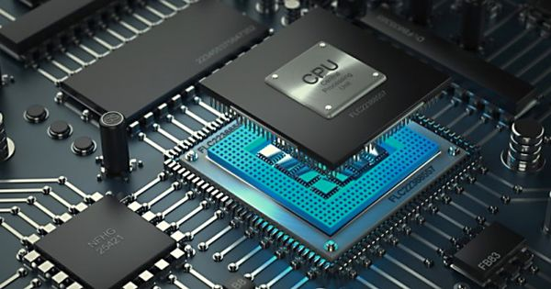
ECOM 4412
Computer Organization & Assembly Language
Assembly Language for X86 Processors
Instructor: Ruba A. Salamah
Islamic University of Gaza

Slide 2
Instructor Information
Teacher Name | Ruba A. Salamah
Office | L506
Phone int. | 2819
Email | Rsalamah@iugaza.edu
Office Hours | Saturday: 11-12 Monday: 11-12 Tuesday 10:11

Slide 3
Course Information
Course Name | Computer Programming 1
Course Code | ECOM 4412
Credits | 4
Pre-requisite | Computer Architecture
LECTURE | Building | Day | Start | End | Room Number
 | L | Sat. Mon. Wed. | 12:00 | 1:00 | L319

Slide 4
Course Description:
This course provides basic computer organization with emphasis on machine representation of data and instructions. Students will study programming in assembly and machine-oriented languages. Students will solve problems and design solutions using assembly language for Intel x86 processor family.

Slide 5
Course Objectives:
Students who successfully complete this course will have demonstrated the ability to:
1. Understand the principles of computer architecture as applied to the Intel x86 processor family,
2. Understand data representation, including signed and unsigned integers, real numbers, and character data,
3. Apply the concepts of basic Boolean logic to computer hardware and programming,
4. Be familiar with the syntax and constructs of assembly language,

Slide 6
Course Objectives (Cont…)
5. Create, compile, link and run assembly language programs using the Microsoft Visual Studio Integrated Development Environment,
6. Construct programs using one or more of the following: sequence, selection, and repetition,
7. Use procedures and arrays,
8. Solve problems and create solutions using assembly language.

Slide 7
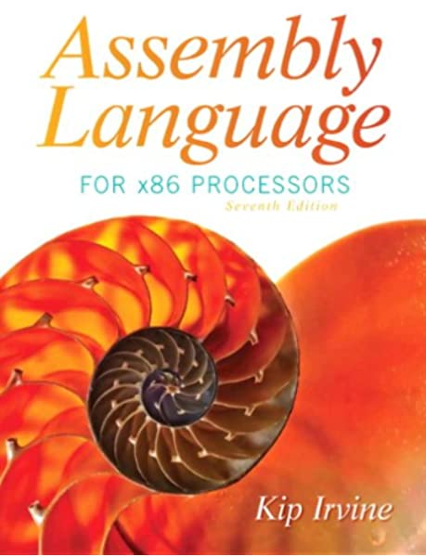
Course Text Book
"Assembly Language for x86 Processors", by Kip R. Irvine (7th Edition), Prentice-Hall, 2015.
Lecture notes will follow
the book.
Please keep up with the reading!
  7

Slide 8
Outline:
These chapters will be covered from the textbook:
Basic Concepts (Ch. 1)
x86 Processor Architecture (Ch. 2)
Assembly Language fundamentals (Ch. 3)
Data Transfers, Addressing and Arithmetic (Ch. 4)
Procedures (Ch. 5)
Conditional Processing (Ch. 6)
Integer Arithmetic (Ch. 7)
Advanced Procedures (Ch. 8)
Structures and Macros (ch. 10)

Slide 9
Software
All the example programs and lab eercises will be tested with Microsoft Macro Assembler (MASM) Version 11.0, running in Microsoft Visual Studio
  9

Slide 10
Grading
Your grade will be determined as follows:
  Labs, Activities and Quizes 30%
  Research 10%
  MidTerm Exam 20%
  Final Exam 50%
  10

Slide 11
Good Luck!!!!!

