Slide 1
Assignment #1 - Decision Trees
[Your Name Goes Here]

Slide 2
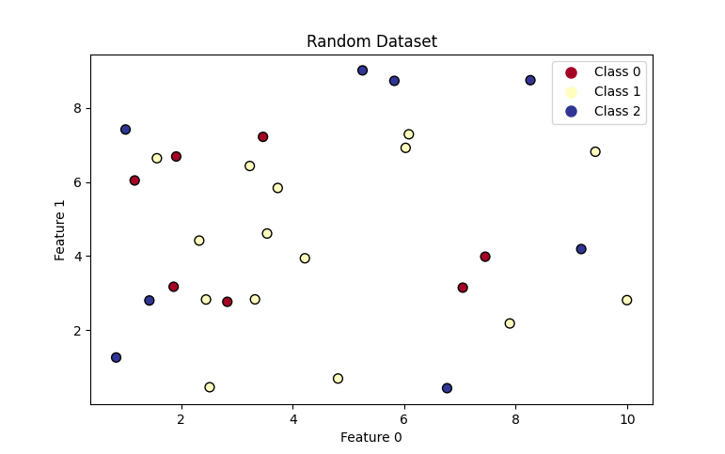
Part 1 - Random Dataset
Your plot goes here
Accuracy: ___________

Slide 3
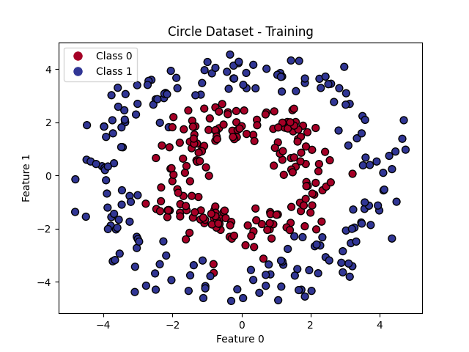
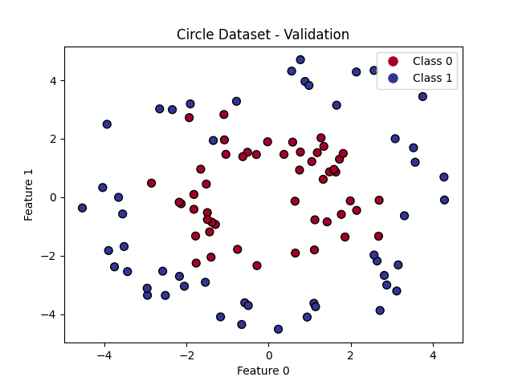
Part 2 - Circle Dataset (unconstrained depth)
Your written analysis goes here….
Decision Boundary overlayed on training dataset
Decision Boundary overlayed on validation dataset
Training Accuracy: __________
Validation Accuracy: _________

Slide 4
Part 3 - Circle Dataset (max_depth=1)
Your written analysis goes here….
Decision Boundary overlayed on training dataset
Decision Boundary overlayed on validation dataset
Training Accuracy: __________
Validation Accuracy: _________

Slide 5
Part 4 - Hyperparemeter Tuning (max_depth)
Hyperparemeter tuning plot goes here
Your written analysis goes here….
Optimal Max Depth: __________

Slide 6
Part 5 - Circle Dataset (optimal max_depth)
Your written analysis goes here….
Decision Boundary overlayed on training dataset
Decision Boundary overlayed on validation dataset
Training Accuracy: __________
Validation Accuracy: _________

