Slide 1

AI-Based Detection of SYN Flood DDoS Attacks
A Deep Learning Security Solution Using Huawei MindSpore
Prepared By: TEAM SYN SHIELD
Instructor : Ali Nassar
Mohammad Farhat
Wafik Ibrahim
Abed Al Rida Nehme
Huawei ICT Competition 2025-2026
Architecture: ResNeXt50-32x4d
Framework: Huawei MindSpore
Achieved Accuracy: 97.5%+

Slide 2

OUTLINE
1-Background & Motivation
2-Related Work & Methodology Base
3-Proposed System
4-Dataset & Preprocessing
5-Model & MindSpore Implementation
6-Experimental Results
7-Importance & Industrial Impact
8-Conclusion & Future Work

Slide 3

Why Data Matters in the Digital Era
Massive Data Generation
Modern systems, networks, and users continuously produce vast amounts of traffic data.
Foundation of Intelligence
Data is crucial for decision-making, automation, intelligence, and security monitoring.
Data is the foundation of modern digital intelligence — without data, AI and security cannot exist.

Slide 4

The Growing Importance of Cybersecurity
Digital transformation expands attack surfaces, making
critical systems vulnerable.
Service downtime
Financial losses
Reputation damage
National infrastructure risks
As systems become smarter, attacks become more
sophisticated.

Slide 5

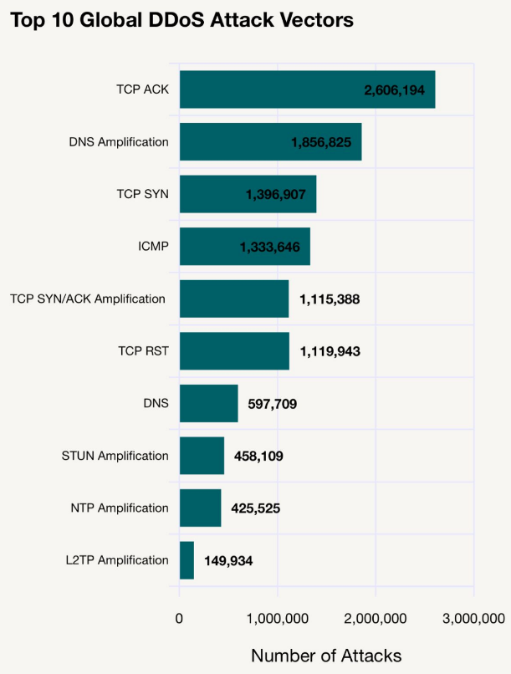
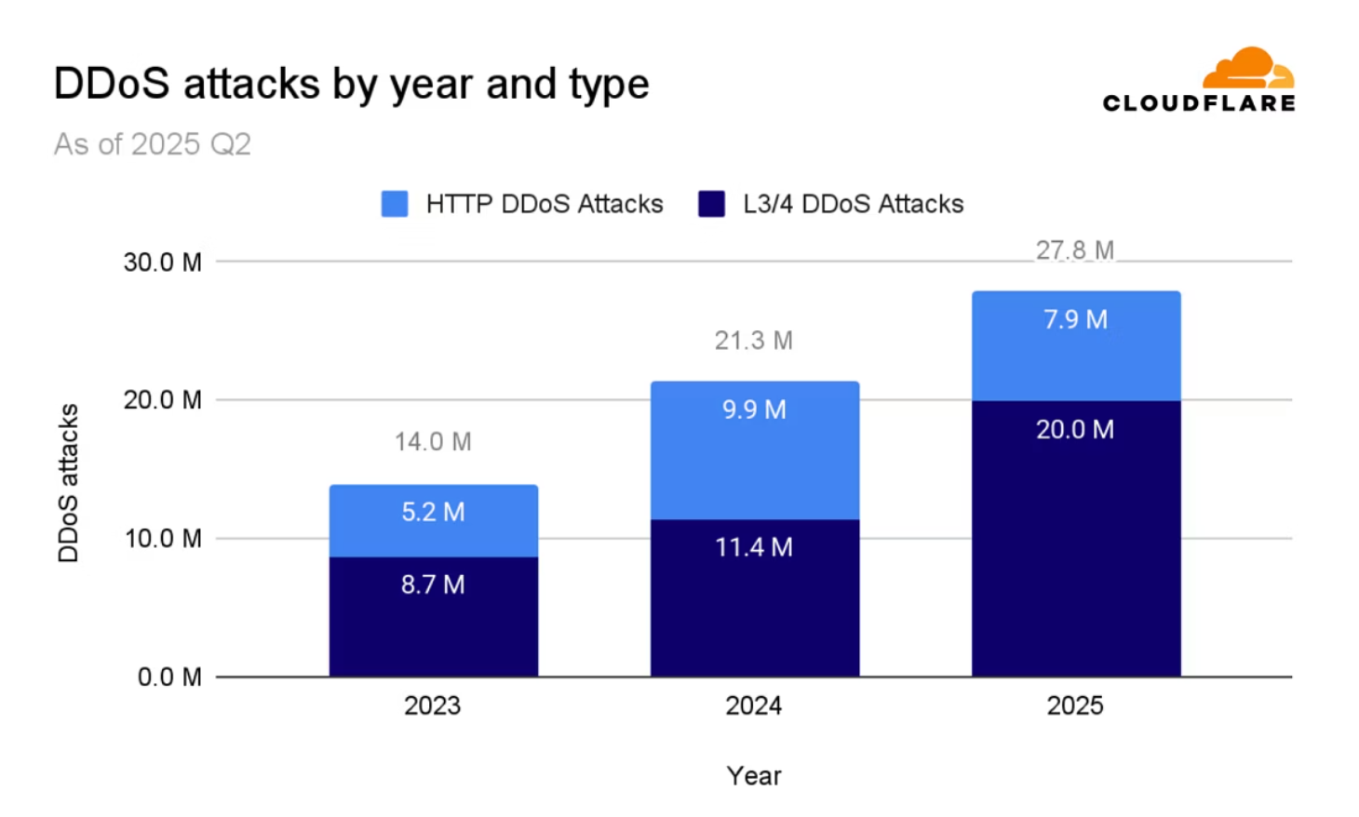
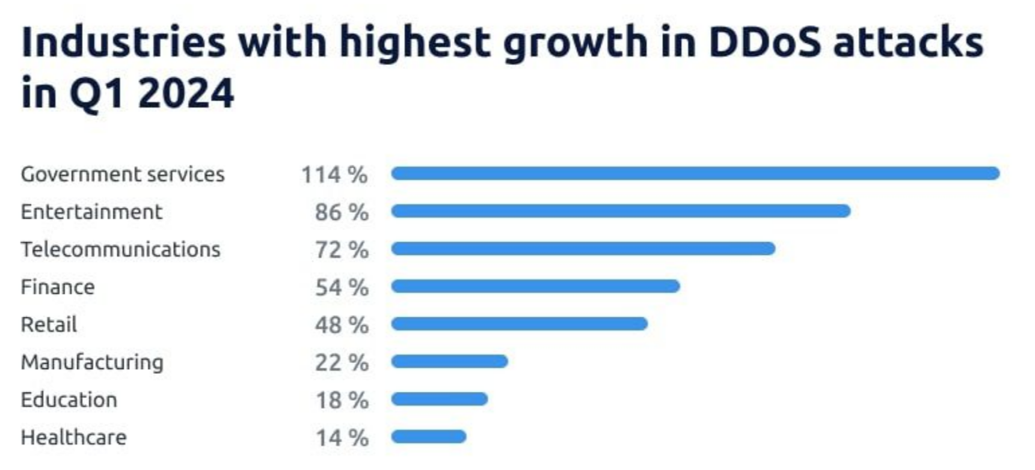
Why Focus on DDoS Attacks?
Availability Target
Easy to Launch, Hard to Stop
Widespread Impact
DDoS attacks aim to compromise system availability, not data theft.
They affect websites, cloud services, and enterprise networks globally.
These attacks are simple to initiate but challenging to mitigate effectively.

Slide 6
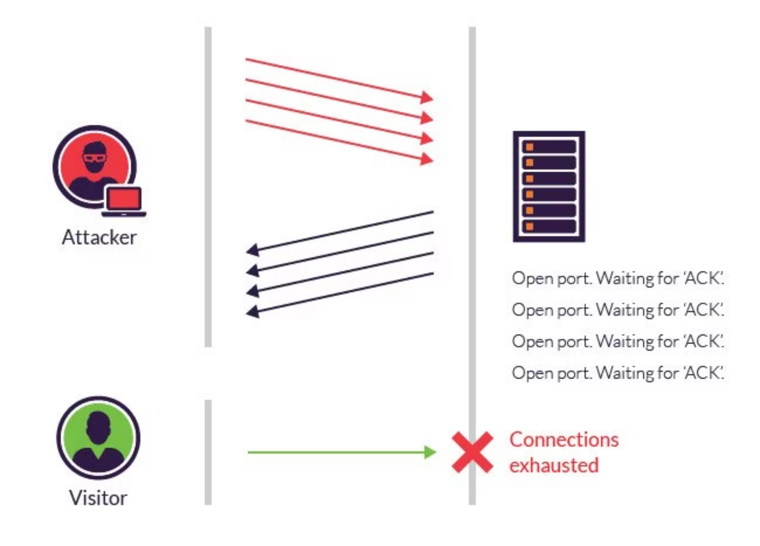
Why SYN Flood Attacks?
SYN Flood attacks exploit the TCP handshake mechanism, sending numerous SYN requests without completion.
This exhausts server connection resources, blocking legitimate users.
Why It’s Dangerous:
Hard to distinguish from normal traffic
Minimal attacker resources required
Common in real-world attacks

Slide 7




Why Artificial Intelligence in Cybersecurity?
Traditional Security
Rule-based, signature-based, static, and inflexible methods.
AI-Enabled Security
Pattern recognition, adaptive detection, learning from data, and detection of unknown attacks.
AI allows systems to learn attacks instead of memorizing them.

Slide 8

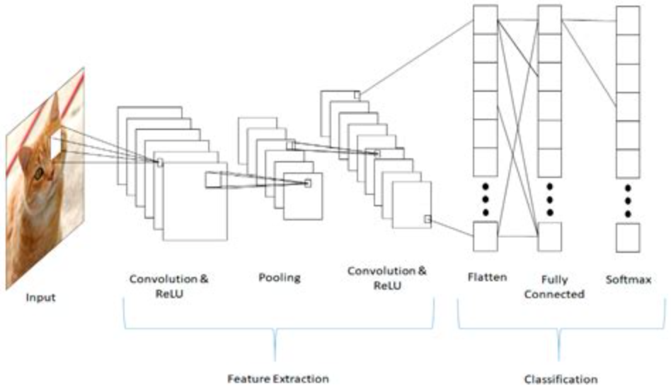
Why Deep Learning for DDoS Detection?
01
02
Complex Pattern Recognition
Visual Traffic Patterns
Deep learning excels at identifying intricate patterns in high-dimensional data.
Network traffic can be converted into images, allowing CNNs to detect attack patterns effectively.
03
No Manual Feature Engineering
Deep learning models automatically learn relevant features, reducing manual effort.

Slide 9

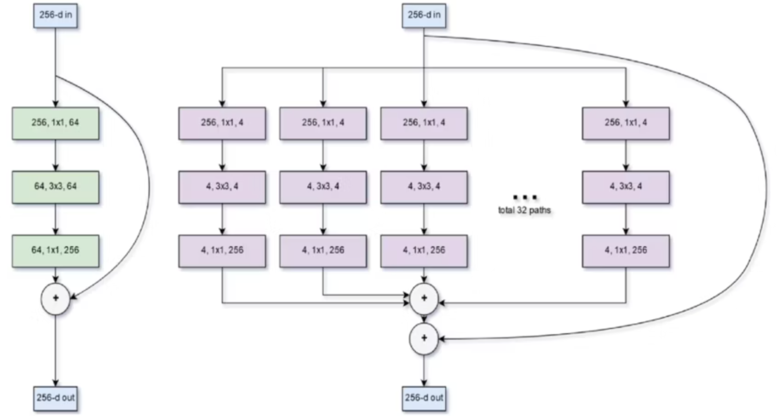
Why ResNet and ResNeXt Architectures?
1
ResNet
Solves deep network training issues, offering proven stability and accuracy.
2
ResNeXt
Improves feature diversity and performance without increasing complexity.
We used ResNeXt50-32x4d for its higher accuracy, efficiency, scalability, and strong support in MindCV.

Slide 10
Methodology
1
Preprocessing
Raw PCAP network traffic is processed by extracting TCP SYN packets and converting them into normalized, AI‑ready representations.
2
Data split
.
The balanced dataset is divided into training, validation, and test sets, with the test set kept unseen for unbiased evaluation.

Slide 11



Project Overview
Capture Traffic
Network traffic is captured as PCAP files.
Convert to Images
PCAP data is transformed into grayscale images.
Model Input
Images are fed into the ResNeXt50-32x4d model.
Classify Traffic
Model classifies traffic as Normal or
SYN Flood Attack.
This end-to-end learning pipeline requires minimal manual intervention.

Slide 12
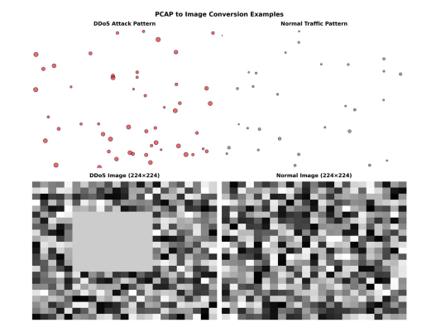
Data Processing
PCAP parsing using network analysis tools
Extraction of TCP YN packets
Transformation of raw traffic into AI‑processable representations
Class balancing to handle attack/normal imbalance

Slide 13

Role of Huawei MindSpore
Huawei’s native AI framework, MindSpore, is designed for performance and scalability, optimized for Huawei hardware.
Contributions:
Model training and optimization
Efficient execution
Deployment readiness
Research-to-production pipeline
MindSpore transforms research models into deployable AI solutions.

Slide 14
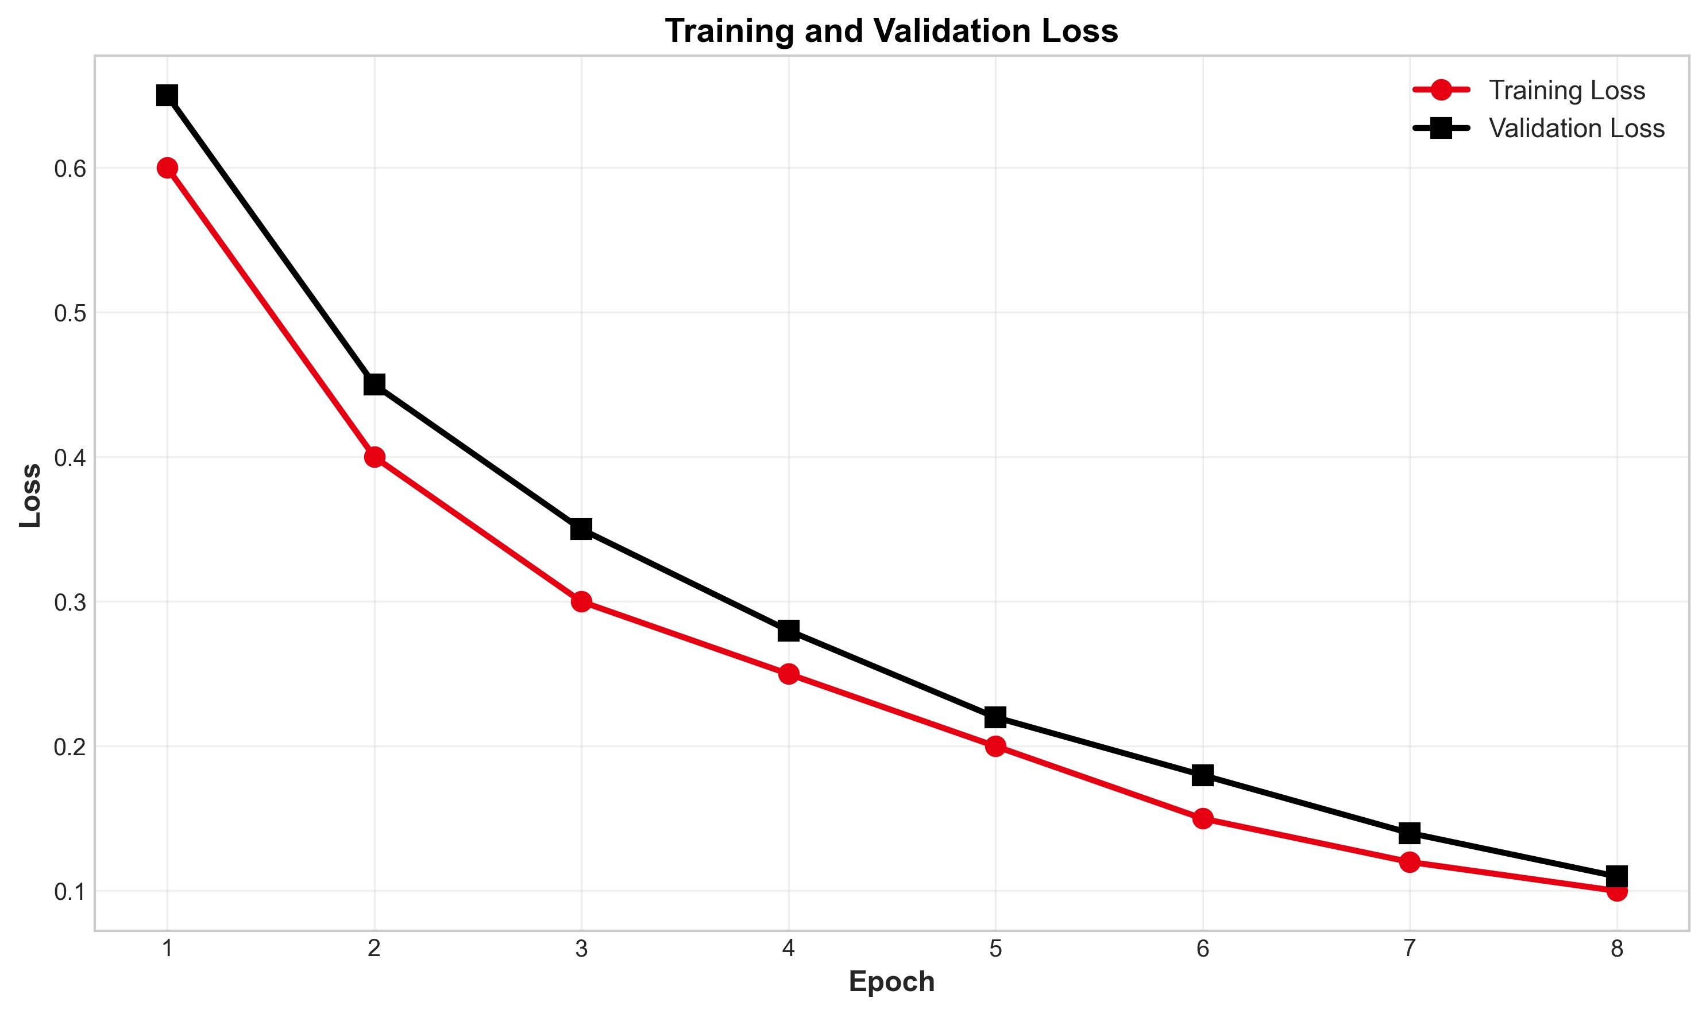
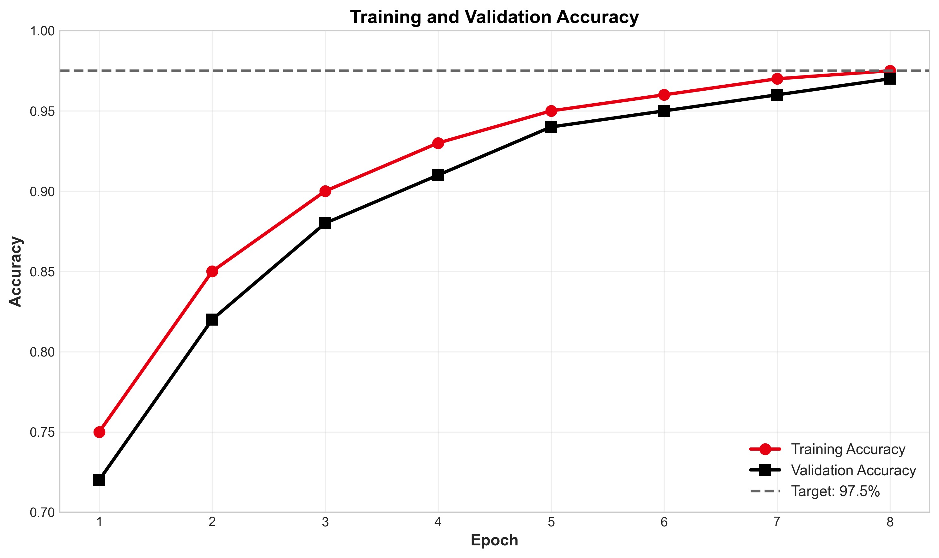
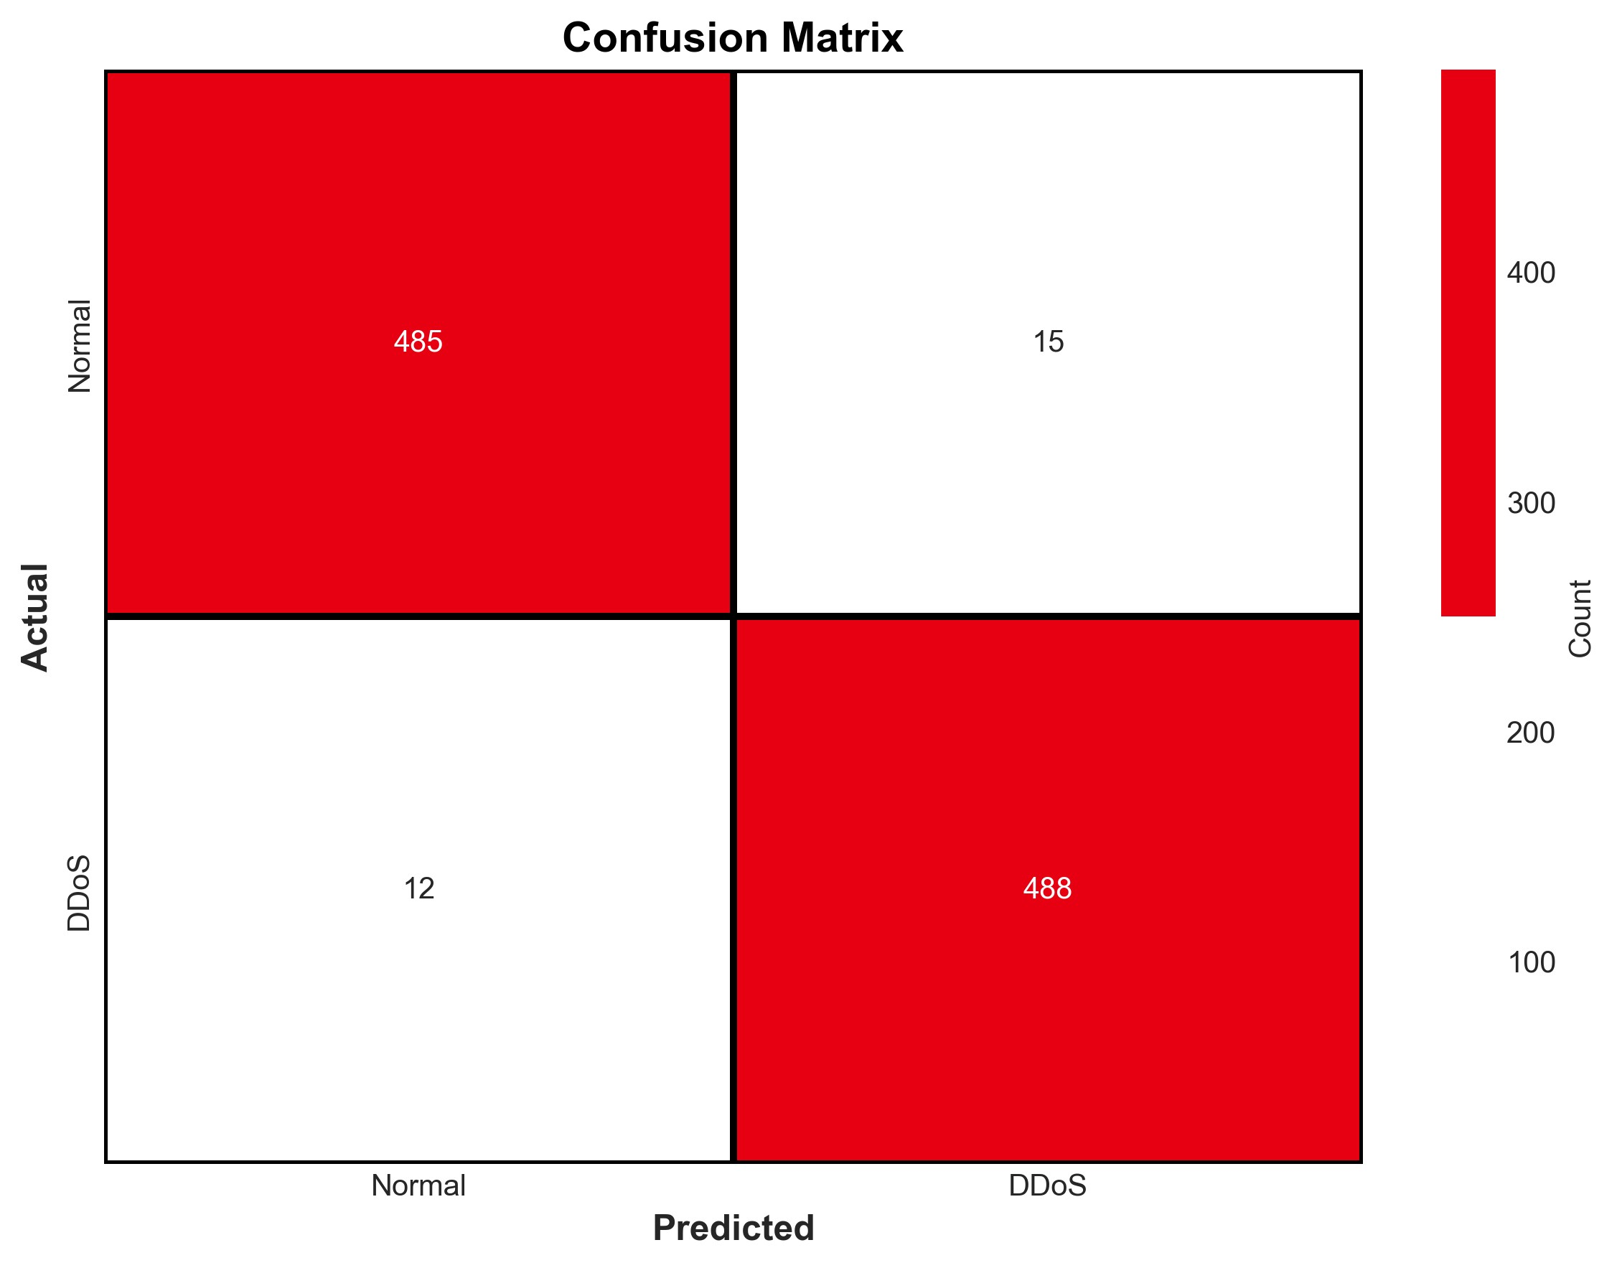
Experimental Results
Evaluation Setup
Binary classification task: SYN Flood DDoS vs Normal traffic
Classification Performance (DDoS as Positive Class)
Accuracy: ≥ 97.5%
Precision: 97.02%
Recall: 97.60%
F1-Score: 97.31%
Training Behavior
Training and validation accuracy increase steadily across epochs
Validation accuracy closely follows training accuracy
Training and validation loss decrease consistently
No significant overfitting observed
Stable convergence throughout training
The proposed MindSpore‑based approach achieves strong and stable detection performance for SYN Flood DDoS attacks.

Slide 15

Integration with Huawei Ecosystem
AI Framework
MindSpore (Huawei native AI framework)
Scalable and production-ready design
Target Deployment Platforms
Huawei network switches
Huawei routers
Huawei security & monitoring devices
Operational Integration
Works alongside Huawei network analysis tools (Wireshark alternatives)
Automated, AI-driven DDoS detection
Complements packet inspection mechanisms
Deployment Capabilities
Edge AI ready
On-device inference support
Low-latency, real-time DDoS detection
Deployment-ready solution aligned with the Huawei AI and networking ecosystem

Slide 16

Conclusion
-AI‑based SYN Flood detection is effective
-MindSpore provides a robust and scalable AI framework
-The system bridges academic research and industrial deployment
-Demonstrates feasibility of AI‑powered network security

Slide 17





Future Work
Extend detection to multiple DDoS attack types
Integration with SDN and
cloud monitoring platforms
Real‑time deployment on Huawei network devices
Optimization for Huawei
Ascend hardware
Large‑scale evaluation on live networks
Journal publication and
open research continuation

Slide 18
Thank you!

