Slide 1
Image Painting Classification
This project aims:
to classify images of paintings, determining whether they belong to the same artist or not.
Building a neural network that can analyze the visual features of paintings and make predictions based on similarities and differences between them.
To make a model that makes representation for images in a lower dimension.

Slide 2

Preprocessing data
Taking all the classes in train and test, and selecting the same number of images for each class.
The Preprocess method on images:
Randomly crop
Converts them to PyTorch tensors.
normalizing these tensors with $\left[0.485, 0.456, 0.406\right] for mean$ and $\left[0.229, 0.224, 0.225\right] for standard deviation$.
converts the transformed images into a NumPy array .

Slide 3
The reason of taking all the classes and selecting the same number of images for all the classes:
helps prevent a biased model.
helps the model generalize well to unseen data and perform accurately.
Stability during Training (Reduce Overfitting).

Slide 4
The reason of using the specific std, mean in normalization:
The ResNet is pretrained on ImageNet dataset and these values accordance to the ImageNet dataset.
The reason of resize the images to 224x224 pixels size:
ResNet pretrained on the ImageNet dataset which contains images of resolution of 224x224 pixels.

Slide 5
The reason of converting the images into NumPy array:
after normalizing the images we get pixel values being scaled to a certain range (-x,x), converting these normalized tensors back to images the values become between 0-256 and all the negative values will convert to 0 so using NumPy array more accurate and saving the same values of the certain range (-x,x).

Slide 6
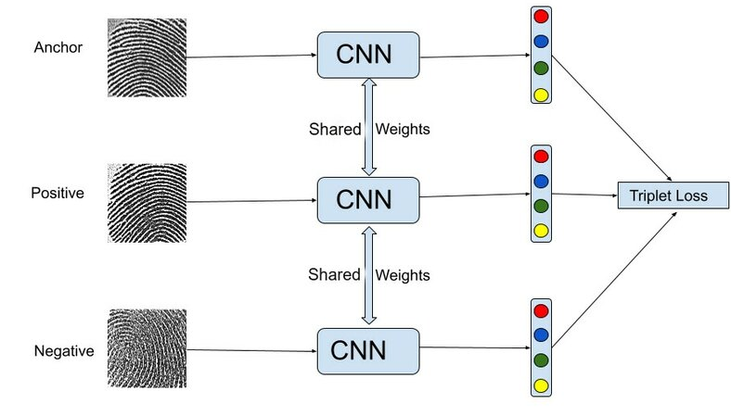
Architecture of the neural network
An input of 3 x 244 x 244 (that's what ResNet are trained on).
ResNet18 with pretrained weights.
The result of the ResNet18 is a vector of length 1000.
A fully connected layer reduces the dimensionality from 1000 to 512.
A fully connected layer reduces the dimensionality from 512 to 256.

Slide 7

The loss function
Triplet loss function
it aims to enhance the separation between the anchor and negative samples while reducing the gap between the anchor and positive samples.
$the implemntation Given (A,P,N):$
A Is an anchor input.
P in a positive input of the same class as A.
N is a negative input of a different class from A.
$α$ is a margin between positive and negative pairs.
f is an embedding of a specific image.
The triplet loss L is calculated as:
$L=max⁡({\left\|f\left(A\right)−f\left(P\right)\right\|}_{2}−{\left\|f\left(A\right)−f\left(N\right)\right\|}_{2}+α,0)$

Slide 8
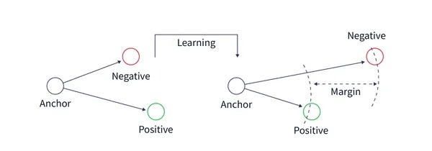
Why using the Triplet loss function
it keeps penalizes the model until the distance between anchor and positive is less than the distance between anchor and negative – margin.
Triplet Loss allows to stretch clusters in such a way as to include outliers while still ensuring a margin between samples from different clusters.
it is already satisfied when different samples are easily distinguishable from similar ones. It does not change the distances in a positive cluster if there is no interference from negative examples, makes it less greedy.
The loss is decreased that indicates that the model is learning.

Slide 9

Model evaluation
after getting the embeddings of each image
computes the pairwise Euclidean distance between anchor-positive and anchor-negative.
compares the two distances calculated above$.$
$(Euclidean distance \left(anchor positive\right)<Euclidean distance (anchor negative))$.
creates a label 1 .
calculates accuracy by comparing the result of row 2 with label ,if the result is true that means we classify the positive and negative images correctly.
The loss using Triplet loss function is decreased that indicates that the model is learning

Slide 10
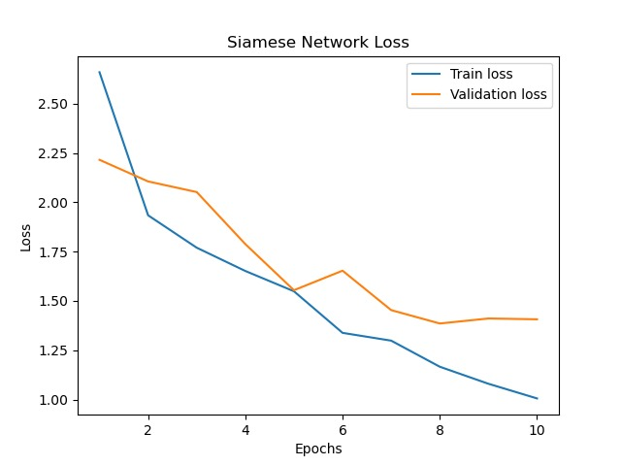
Siamese Network Loss

Slide 11
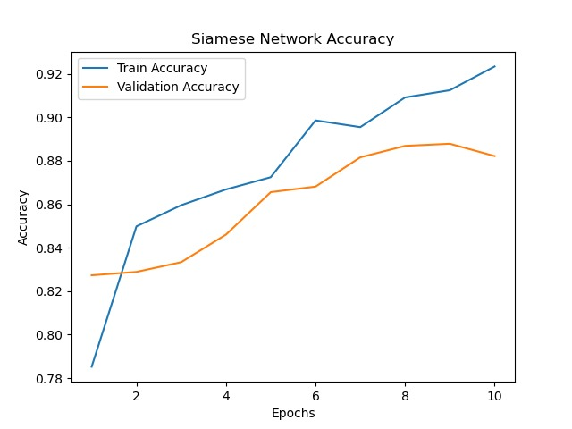
Siamese Network Accuracy
test accuracy is 0.8015625

Slide 12
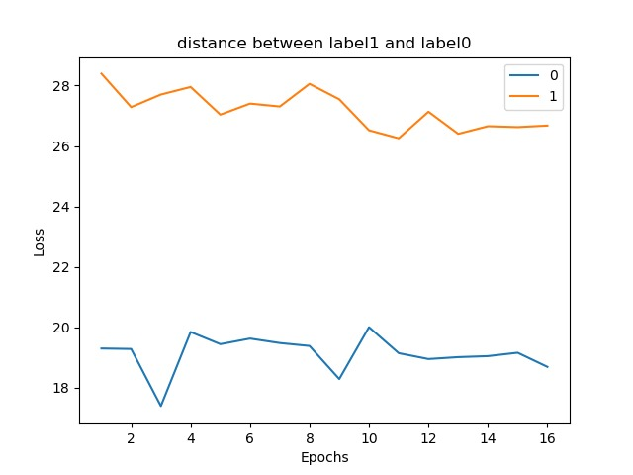
Distance between label1 and label0

