Slide 1
Learning Quantum Phase Estimation by Variational Quantum Circuits
Team LearnQPE

Slide 2
Motivation
Quantum Phase Estimation (QPE) has low performance on NISQ hardware due to accumulated gate errors, yet QPE is crucial in many algorithms. Thus, we aim to mimic QPE result.

Slide 3
01
Quantum Phase Estimation
Purpose, Process & Problem

Slide 4
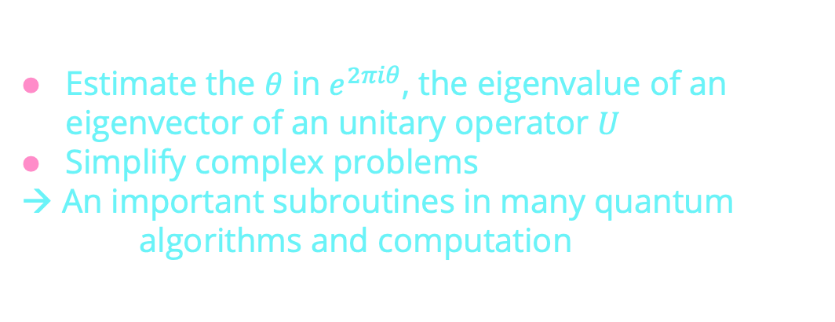
Purpose of QPE
Estimate the $θ$ in $e^{2πiθ}$, the eigenvalue of an eigenvector of an unitary operator $U$
Simplify complex problems
→ An important subroutines in many quantum algorithms and computation

Slide 5
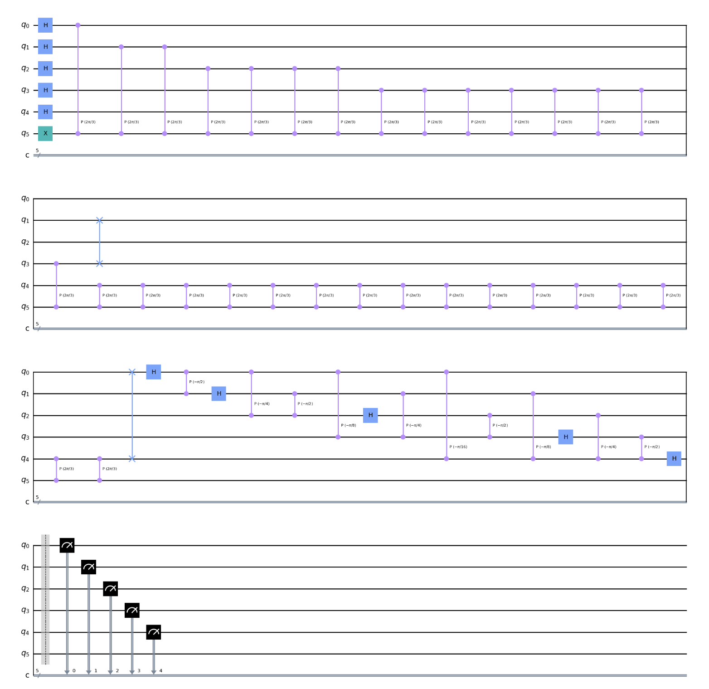
Process of QPE
Superposition, Controlled unitary operations, and Inversed Fourier Transformation.

Slide 6
Problem with QPE
Increasing the accuracy (the number of first register) increases the circuit depth in geometric order
Accumulated gate errors on NISQ hardware cause undesired result

Slide 7
02
Variational Quantum Circuit
Components, Cost function, Entangler

Slide 8
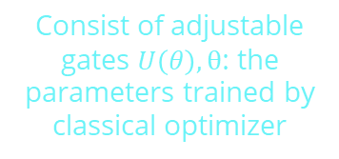
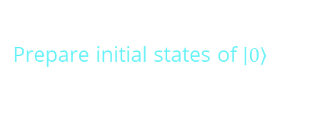

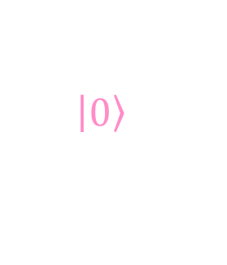

Components of VQC
Initial State
Parameterized Quantum Circuit
$$\left|\left.0\right\rangle \right.$$
$$U\left(θ\right)$$
$$A=πr^{2}$$
Measurement
Despite being red, Mars is actually a cold place. It’s full of iron oxide dust
Prepare initial states of $\left|\left.0\right\rangle \right.$
Consist of adjustable gates $U\left(θ\right), θ$: the parameters trained by classical optimizer
Feed measurements, (a.k.a. expectation values) to classical optimizer

Slide 9
Classical Optimizer & Cost Function
Cost values is defined as the mean square error of the measurement result between QPE circuit and VQC
Classical Optimizer will update the parameters to minimize the cost value
Classical optimizer will make post-measurement calculation of the cost value using the measurement result
Thereby obtain the set of parameters that produce the desired approximation

Slide 10
Full & Linear Entangler
Full
Linear
Create entanglement of all combinations of qubits
→ More Expressive
→ has significant difference when there are more qubits
Create entanglement of only the adjcent qubits
→ Less gates
→ Comparable when there are less qubits
Pierpaolo Pravatto et al 2021 New J. Phys. 23 123045

Slide 11
03
Learning QPE by VQC
Applicability, Method

Slide 12
LearnQPE process
01
02
03
04
Run QPE simulation
Train parameters
Feed back to VQC
Run trained VQC
Obtain the ideal wave function after QPE
Use the trained parameters to set the gates in VQC
Run the VQC; yield the approximated wave function
Use the simulation result & optimizer to train the free parameters

Slide 13
Applicability
QPE Simulation
Simulation of QPE on classical computer must be achievable for this approach to function.
Must run the QPE simulation to obtain a ground truth to train the VQC
In this project, we use the QPE circuit with 5 counting qubits as the example in the Qiskit documentation

Slide 14

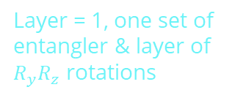
Our Method
5 counting qubits
Full Entangler
Yield more accurate approximation for the phase angle
More epressive
Learn QPE
$R_{y}R_{z}$ Form
COBYLA
Only one function evaluation per iteration
Layer = 1, one set of entangler & layer of $R_{y}R_{z}$ rotations

Slide 15
Testing Condition
01
02
03
Ideal QPE
Noisy QPE
QPE real hardware
04
05
06
Ideal VQC
Noisy VQC
VQC real hardware
QPE simulation without noise
(backend = ibmq_qasm_simulator)
QPE simulation with noise (backend= ibm_oslo_sim)
Run QPE circuit on ibm_oslo
VQC simulation without noise
(backend = ibmq_qasm_simulator)
VQC simulation with noise (backend= ibm_oslo_sim)
Run VQC circuit on ibm_oslo
(Train with noisy simulation)

Slide 16
04
Results
Comparison between VQC & QPE

Slide 17
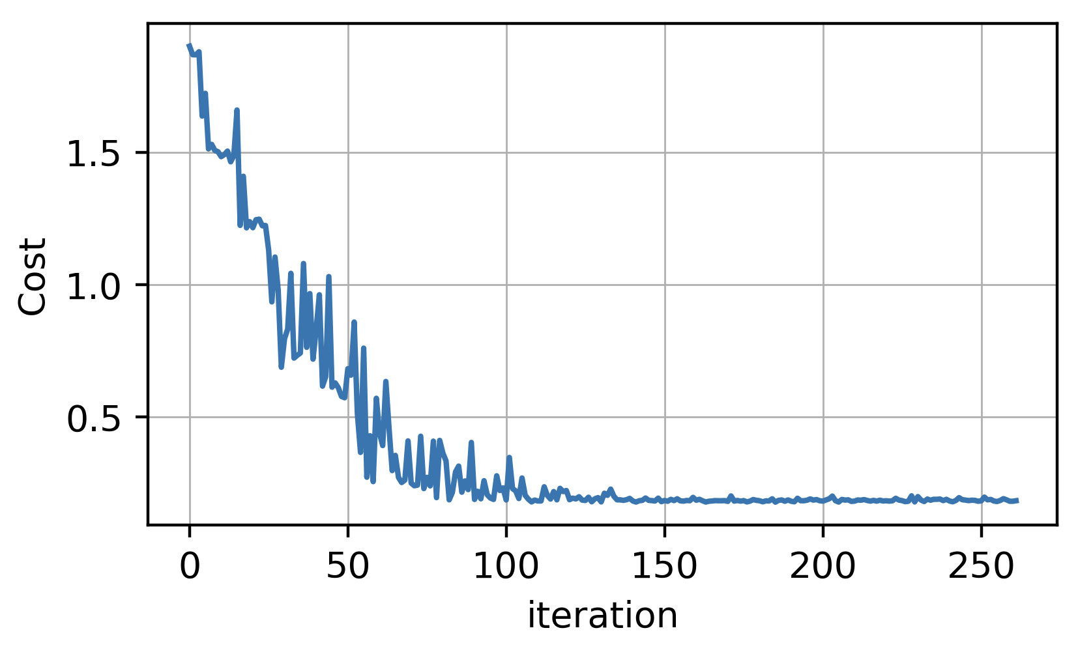
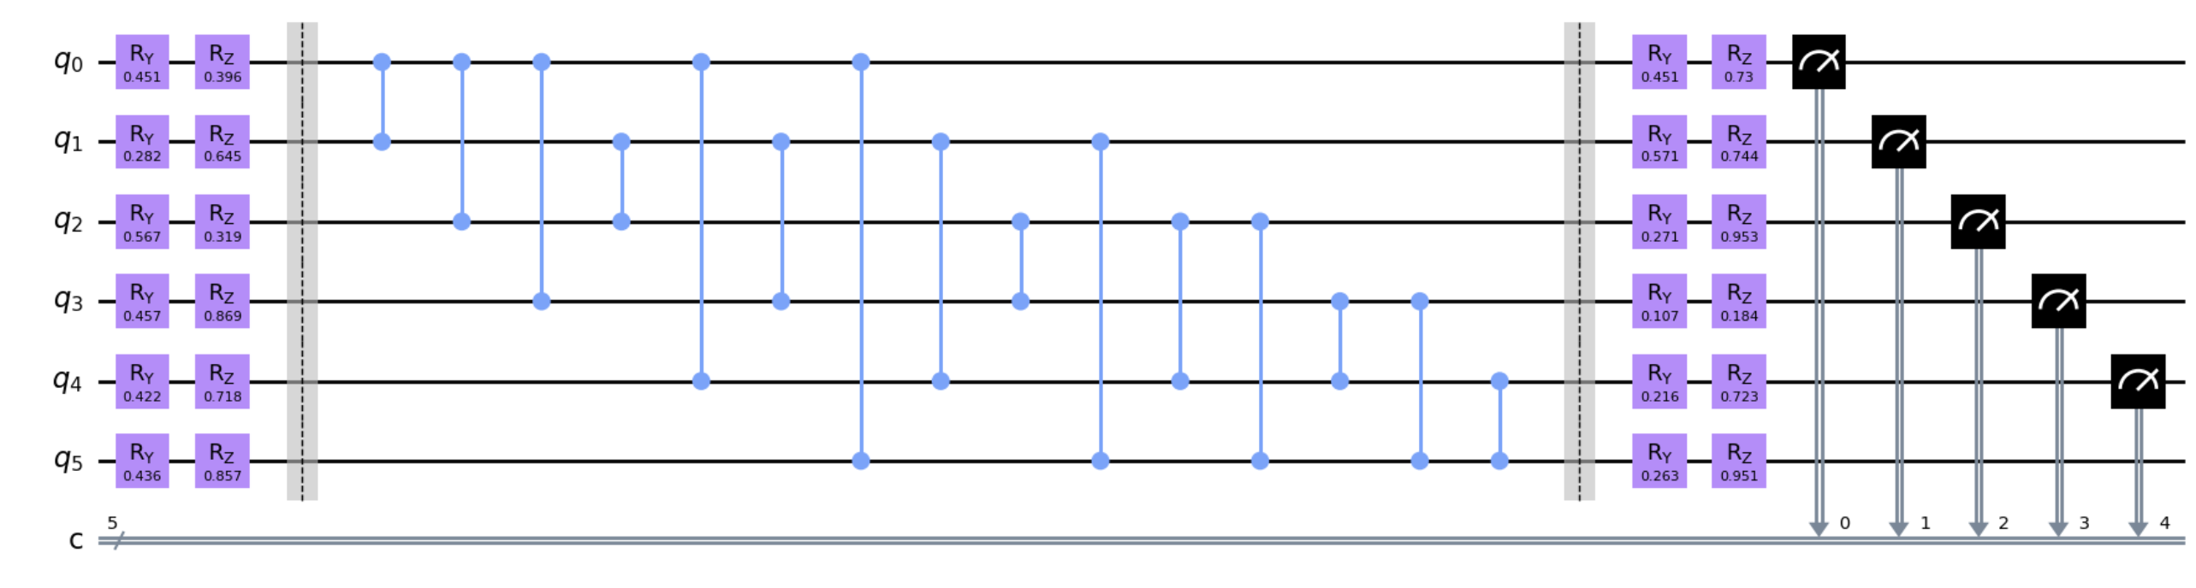
Results
Original QPE circuit (depth : 43)
Learning
Corresponding VQC (depth : 14)

Slide 18
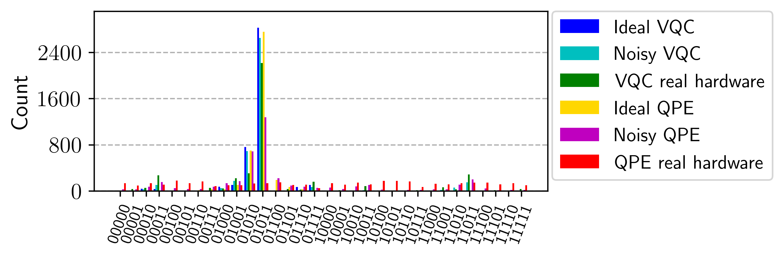
Results

Slide 19
Result Analysis
Ideal VQC output a very similar result to that of Ideal QPE
Noisy VQC performs better than Noisy QPE, compatible performance to that of Ideal VQC
VQC real hardware has performs better than QPE real hardware, even better performance than that of Noisy QPE

Slide 20
05
Discussion & Conclusion

Slide 21
As Part of the Quantum Complier
01
02
03
04
Inputted QPE circuit
Classical simulatable
Input corresponding VQC
Run VQC
User inputted quantum circuit
Run the VQC; yield the approximated wave function on the quantum hardware
If the circuit is simulatable, we can construct a corresponding VQC to approximate the result
The corresponding VQC usually have shallower circuit depth, which reduce the noise significantly

Slide 22
Helpful Use Case
Computational time
In this regime, quantum circuit executions may be faster on quantum computers, but is also possible to be simulated on the classical computers. However, the noise on quantum computer for this scale could also be significant. Thus, our LearnQPE could be a helpful approach to reduce the noise on the real quantum hardware in this case.
LearnQPE
Number of qubits
Easy for classical simulation
(20~30 qubits)
Classical simulatable boundary
(40 ~ 60 qubits)

Slide 23
Conclusion
QPE
Use VQC to simulate the QPE circuit.
Noise of quantum hardware is mitigated by the reduction of circuit depth.
This method can be generalized to other quantum algorithms that suffer from deep quantum circuit.
LearnQPE

Slide 24

Thanks!

