Slide 1
Solving Problems by Searching
By Abeeha Sattar

Slide 2
Problem-Solving Agent
When the correct action to take is not immediately obvious, an agent may need to plan ahead: to consider a sequence of actions that form a path to a goal state.
Such an agent is called a problem-solving agent, and the computational process it undertakes is called search.

Slide 3
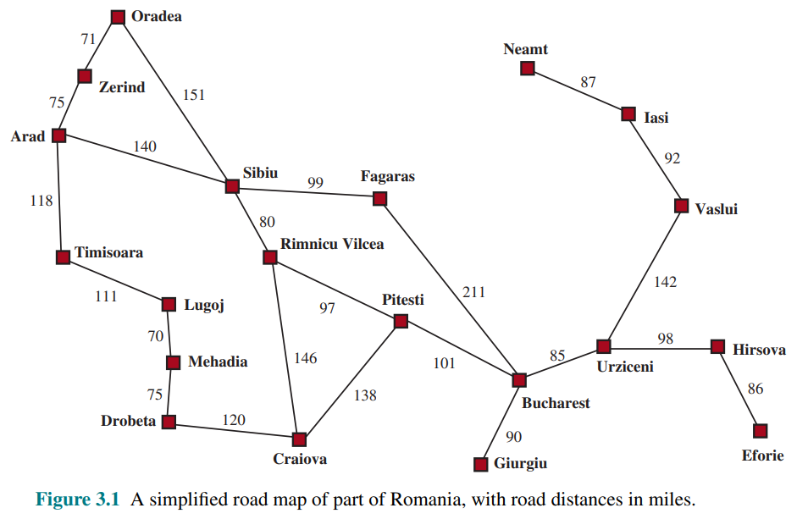
Romania Route-Finding Problem

Slide 4
Search Problem Definition
A set of possible states that the environment can be in. We call this the state space.
The initial state that the agent starts in.
A set of one or more goal states.
The actions available to the agent.
A transition model, which describes what each action does.
An action cost function that gives the numeric cost of applying action a in state s to reach state s’.

Slide 5
Solution for a Problem
A sequence of actions forms a path, and a solution is a path from the initial state to a goal Path state.
An optimal solution has the lowest path cost among all solutions.

Slide 6
Formulating Problems
When formulating a problem, we have to describe all the things (mentioned in prior slides) for our model.
Along with this, we also need to decide what level of abstraction we want for our problem.

Slide 7
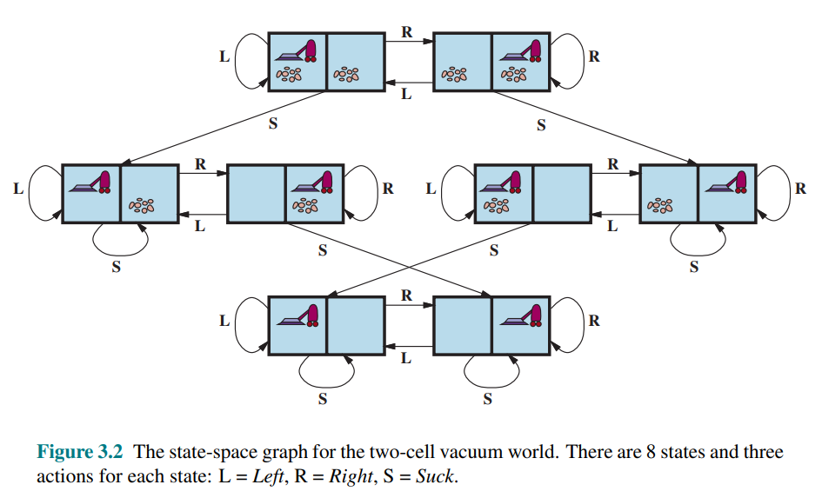
Some Standardized Problems
(Vacuum Cleaner World)
Let’s define:
States
Initial State
Actions
Transition Model
Goal States
Action Cost
Notes:
In general, a vacuum environment with n cells has n · 2^n states
Assume action cost is 1

Slide 8
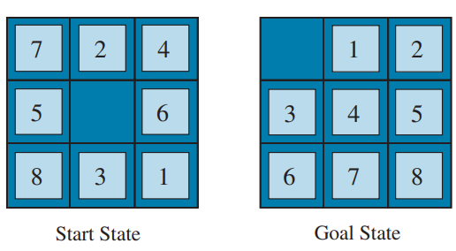
Some Standardized Problems
Sokoban – 8-Puzzle
Let’s define:
States
Initial State
Actions
Transition Model
Goal States
Action Cost
Notes:
For a world with n non-obstacle cells and b boxes, there are n×n!/(b!(n−b)!) states
for example, on an 8×8 grid with a dozen boxes, there are over 200 trillion states.

Slide 9
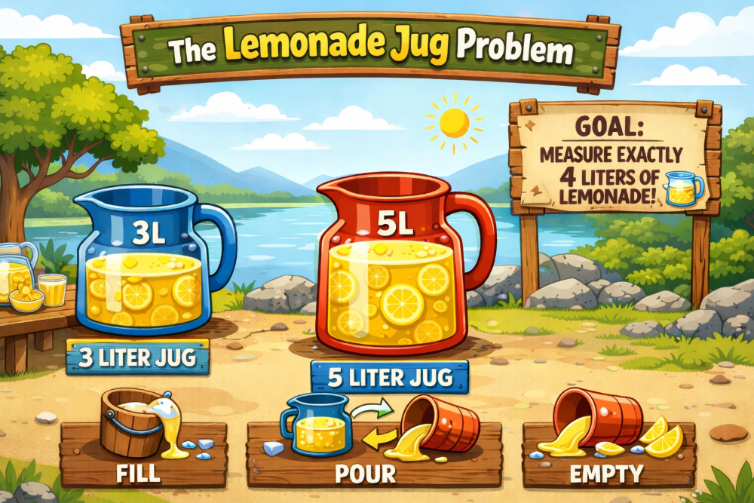
Water Lemonade-Jug Problem
(yes, I had ChatGPT make the image)
Measure exactly 4 liters of lemonade
using a 3-liter and a 5-liter jug.
What are the:
States
Initial State
Actions
Transition Model
Goal States
Action Cost

Slide 10
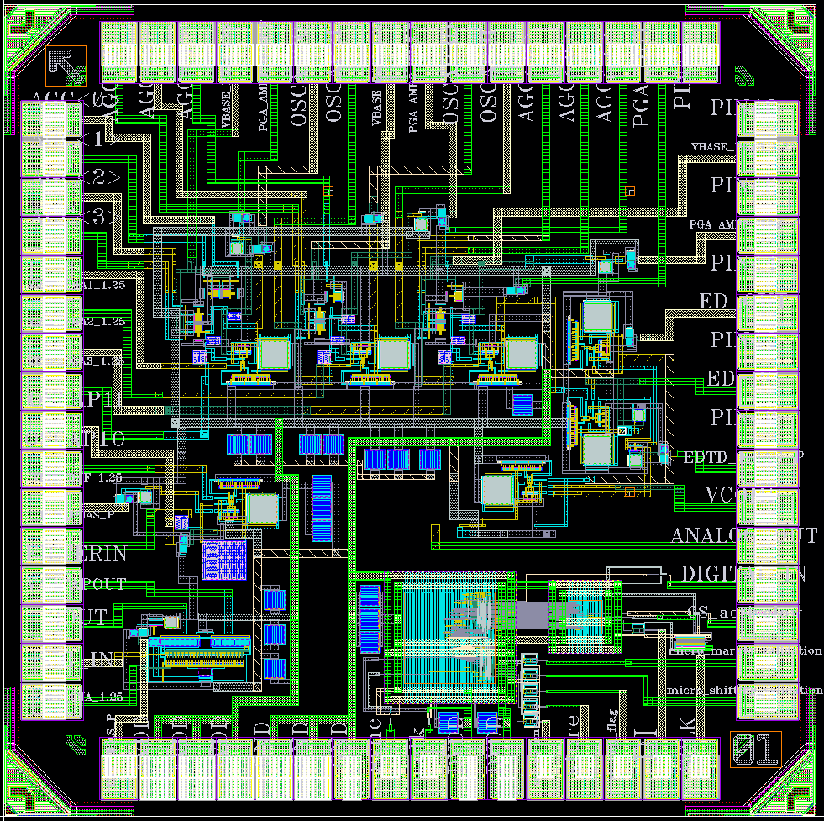
Real-World Problems
Route-Finding Problem
Touring Problems
  Previous Romania Example
  Travelling Salesman Problem
VLSI Layout Problems
Robot Navigation
Notes:
The traveling salesperson problem (TSP) is a touring problem in which every city on a map must be visited. The aim is to find a tour with cost < C (or in the optimization version, to find a tour with the lowest cost possible). An enormous amount of effort has been expended to improve the capabilities of TSP algorithms. The algorithms can also be extended to handle fleets of vehicles.
A VLSI layout problem requires positioning millions of components and connections on a chip to minimize area, minimize circuit delays, minimize stray capacitances, and maximize manufacturing yield
Robot navigation is a generalization of the route-finding problem described earlier. Rather than following distinct paths (such as the roads in Romania), a robot can roam around, in effect making its own paths

Slide 11
Search Algorithms
A search algorithm takes a search problem as input and returns a solution, or an indication of failure.

Slide 12
Types of Search Algorithms
Search Algorithms
Uninformed Search
Informed Search
number of steps, path cost unknown
agent knows when it reaches a goal
(Blind Search)
breadth-first
uniform-cost search
depth-first
depth-limited search
iterative deepening
bi-directional search
(Heuristic Search)
Greedy best-first
A*
agent has background information about the problem

Slide 13
Uninformed (Blind) Search
The Uninformed Search does not contain any domain knowledge such as closeness or location of goal.
It operates in a brute force way, as it only includes information about how to traverse the tree and how to identify leaf and goal nodes.
Uninformed Search applies a way in which the search tree is searched without any information, so it is called blind search.
It examines each node until it reaches the goal node.

Slide 14
Informed (Heuristic) Search
Searches involving or enabling discovery or problem-solving through methods such as experimentation, evaluation, and trial and error.

Slide 15
Evaluation of Search Strategies
Completeness: if there is a solution, will it be found
Time complexity: How long does it takes to find the solution
Space complexity: memory required for the search
Optimality: will the best solution be found
Time and space complexity are measured in terms of
b: maximum branching factor of the search tree
d: depth of the least-cost solution
m: maximum depth of the state space (may be ∞)

Slide 16
Search Trees
We us algorithms that superimpose a search tree over the state space graph, forming various paths from the initial state, trying to find a path that reaches a goal state.
Each node in the search tree corresponds to a state in the state space and the edges in the search tree correspond to actions. The root of the tree corresponds to the initial state of the problem.

Slide 17
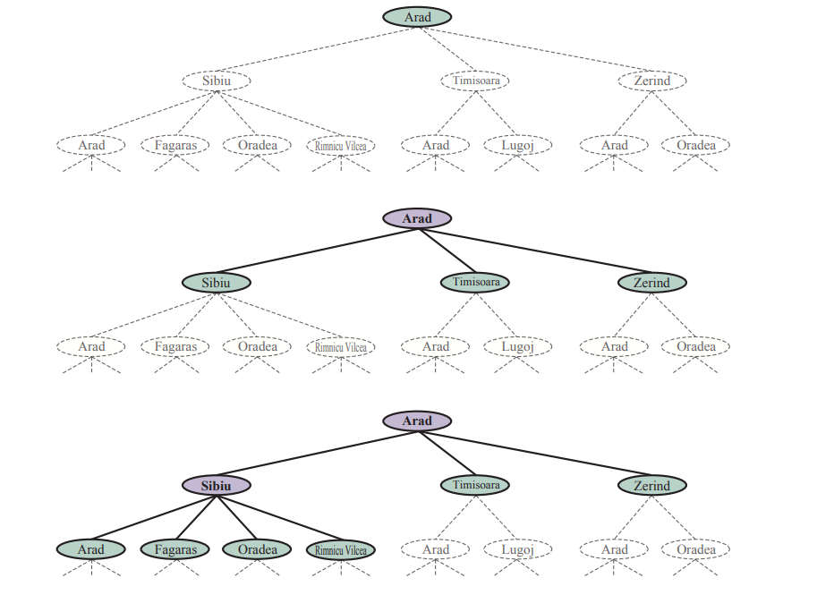
Search Tree – Romania Problem

Slide 18
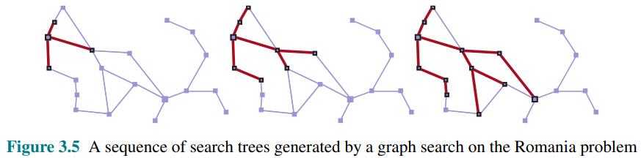
Search Tree – Romania Problem

Slide 19
Searching for Solutions (steps)
Traversal of the search space
  From the initial state to a goal state.
  Legal sequence of actions as defined by successor function.
General procedure
  Check for goal state
  Expand the current state
    Determine the set of reachable states
    Return “failure” if the set is empty
  Select one from the set of reachable states
  Move to the selected state
A search tree is generated
  Nodes are added as more states are visited

Slide 20
Search Tree
Generated as the search space is traversed
  The search space itself is not necessarily a tree, frequently it is a graph
  The tree specifies possible paths through the search space
Expansion of nodes
  As states are explored, the corresponding nodes are expanded by applying the successor function(or action), which generates a new set of (child) nodes
  The frontier (fringe/queue) is the set of nodes not yet visited. Newly generated nodes are added to the frontier.
Search strategy
  Determines the selection of the next node to be expanded
  Can be achieved by ordering the nodes in the frontier
    e.g. queue (FIFO), stack (LIFO), “best” node w.r.t. some measure (cost) (Priority Queue)

Slide 21
Let’s Apply the Terms on This One!

Slide 22
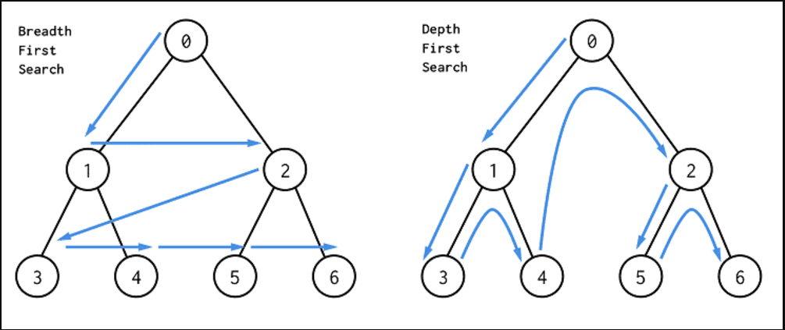
Breadth-First Search/Depth-First Search
Completeness, Time & Space Complexity, Optimality for BFS and DFS?
(See slide notes for some quick reference when studying)
Notes:
Algorithm Complete? Optimal? Time Complexity Space Complexity
BFS ✅ Yes (if b is finite) ✅ Yes (if all step costs are equal) O(b^{d+1}) O(b^{d+1})
DFS ❌ No (may loop infinitely) ❌ No O(b^{m}) O(b·m)
UCS ✅ Yes (if step cost ≥ ε) ✅ Yes O(b^{⌈C*/ε⌉}) O(b^{⌈C*/ε⌉})
b = branching factor
d = depth of the shallowest goal
m = maximum depth of the search tree
C* = cost of the optimal solution
ε = minimum step cost (> 0)

Slide 23
Uniform Cost Search
Remember Dijkstra’s Algorithm? It’s pretty similar to that, but with a minor difference.
The primary goal of the uniform-cost search is to find a path to the goal node which has the lowest cumulative cost.
Uniform-cost search expands nodes according to their path costs form the root node.
It can be used to solve any graph/tree where the optimal cost is in demand.
Uniform cost search is equivalent to BFS algorithm if the path cost of all edges are the same.

Slide 24
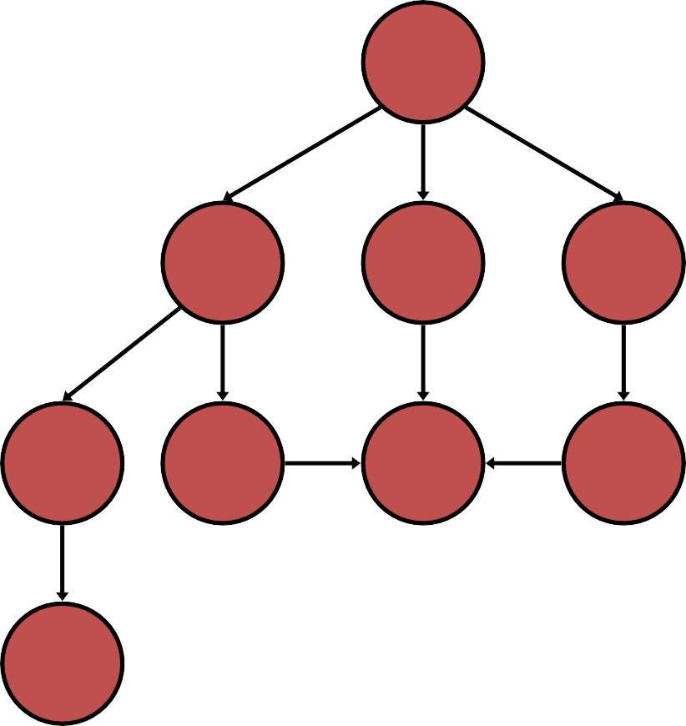
Uniform Cost Search
generalSearch(problem, priorityQueue)
# of nodes tested: 0, expanded: 0
S
start
Closed Node | Open Node
 | {S}
5
2
4
A
B
C
9
4
6
G
goal
2
6
1
D
E
F
7
H

Slide 25
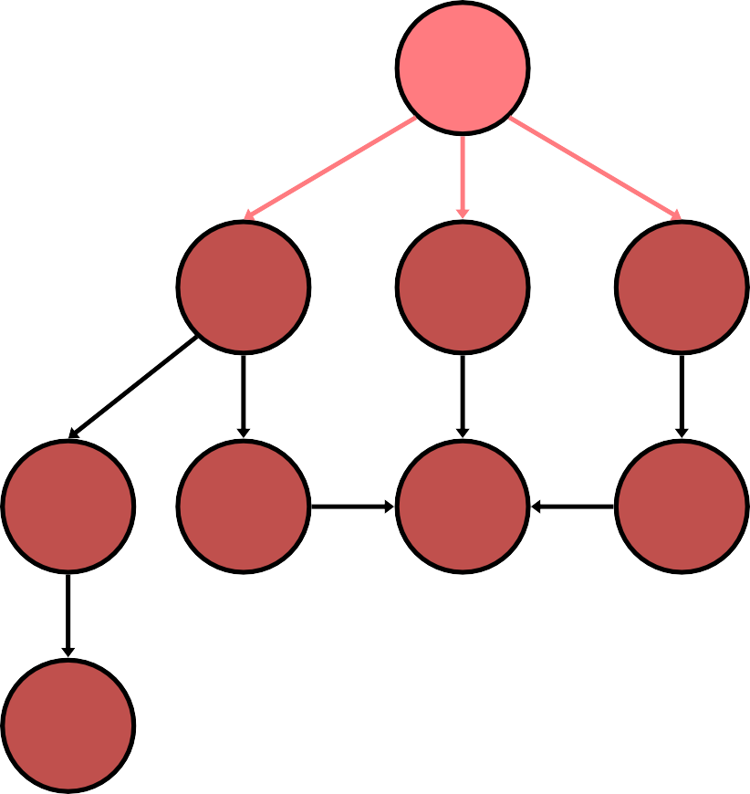
Uniform Cost Search
generalSearch(problem, priorityQueue)
# of nodes tested: 1, expanded: 1
S
start
Closed Node | Open Node
 | {S:0}
S not goal | {B:2,C:4,A:5}
5
2
4
A
B
C
9
4
6
G
goal
2
6
1
D
E
F
7
H

Slide 26
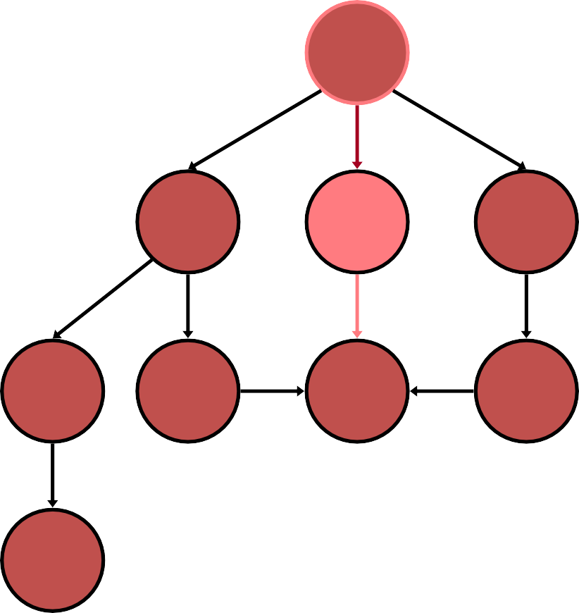
Uniform Cost Search
generalSearch(problem, priorityQueue)
# of nodes tested: 2, expanded: 2
S
start
Closed Node | Open Node
 | {S}
S | {B:2,C:4,A:5}
B not goal | {C:4,A:5,G:2+6}
5
2
4
A
B
C
9
4
6
G
goal
2
6
1
D
E
F
7
H

Slide 27
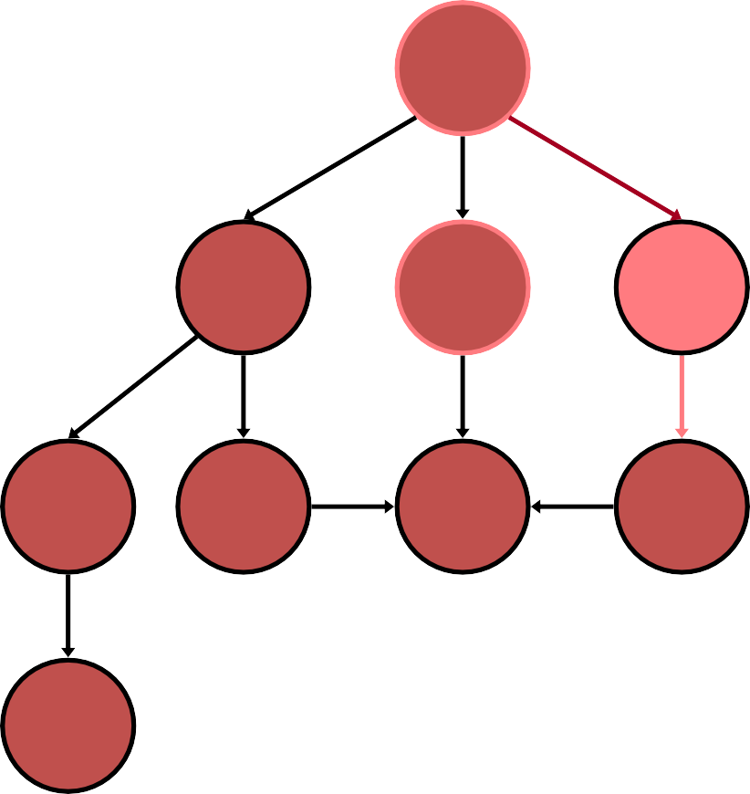
Uniform Cost Search
generalSearch(problem, priorityQueue)
# of nodes tested: 3, expanded: 3
S
start
Closed Node | Open Node
 | {S}
S | {B:2,C:4,A:5}
B | {C:4,A:5,G:8}
C not goal | {A:5,F:4+2,G:8}
5
2
4
A
B
C
9
4
6
G
goal
2
6
1
D
E
F
7
H

Slide 28
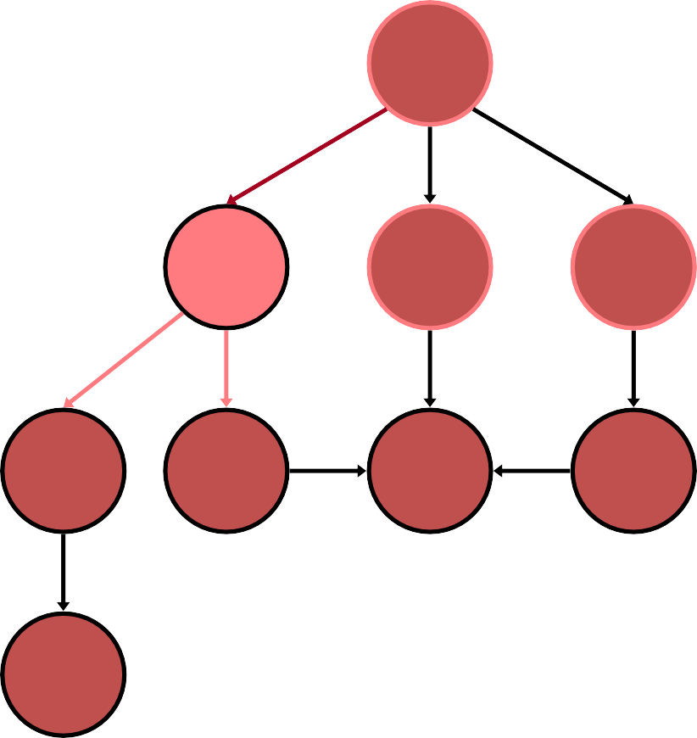
Uniform Cost Search
generalSearch(problem, priorityQueue)
# of nodes tested: 4, expanded: 4
S
start
Closed Node | Open Node
 | {S}
S | {B:2,C:4,A:5}
B | {C:4,A:5,G:8}
C | {A:5,F:6,G:8}
A not goal | {F:6,G:8,E:5+4, D:5+9}
5
2
4
A
B
C
9
4
6
G
goal
2
6
1
D
E
F
7
H

Slide 29
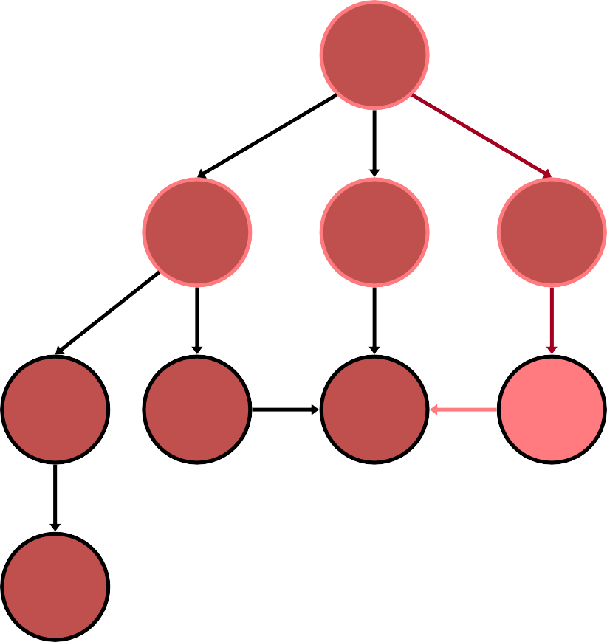
Uniform Cost Search
generalSearch(problem, priorityQueue)
# of nodes tested: 5, expanded: 5
S
start
Closed Node | Open Node
 | {S}
S | {B:2,C:4,A:5}
B | {C:4,A:5,G:8}
C | {A:5,F:6,G:8}
A | {F:6,G:8,E:9,D:14}
F not goal | {G:4+2+1,G:8,E:9,D:1 4}
5
2
4
A
B
C
9
4
6
G
goal
2
6
1
D
E
F
7
H

Slide 30
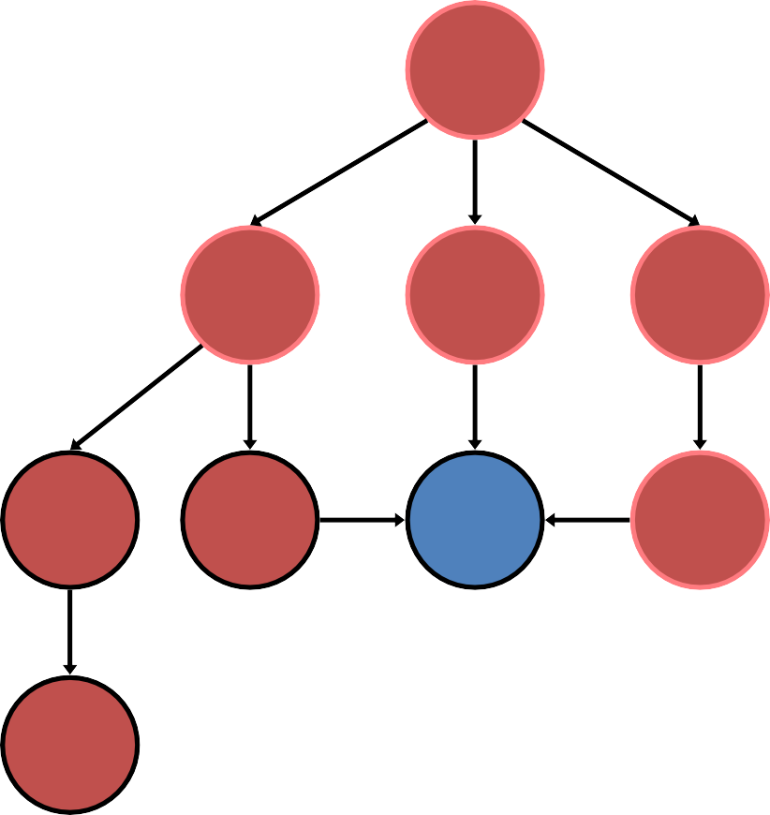
Uniform Cost Search
generalSearch(problem, priorityQueue)
# of nodes tested: 6, expanded: 5
S
start
Closed Node | Open Node
 | {S}
S | {B:2,C:4,A:5}
B | {C:4,A:5,G:8}
C | {A:5,F:6,G:8}
A | {F:6,G:8,E:9,D:14}
F | {G:7,G:8,E:9,D:14}
G goal | {G:8,E:9,D:14} no expand
5
2
4
A
B
C
9
4
6
G
goal
2
6
1
D
E
F
7
H

Slide 31
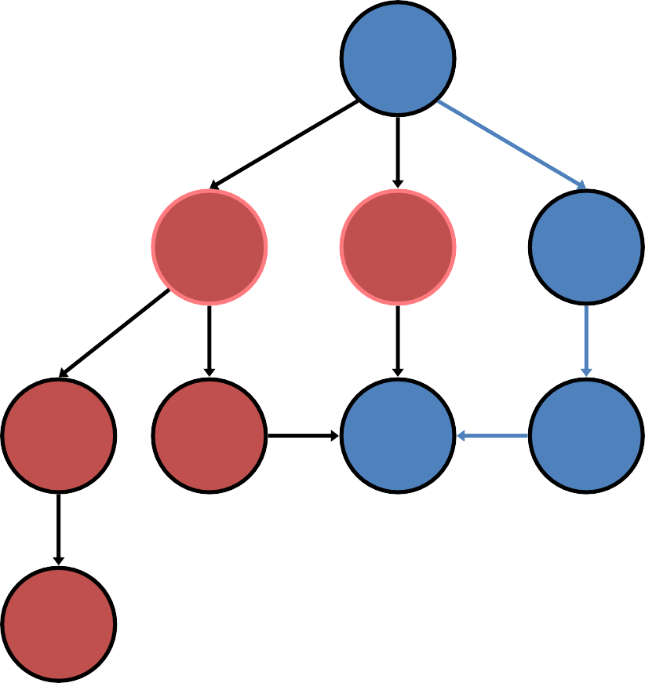
Uniform Cost Search
generalSearch(problem, priorityQueue)
# of nodes tested: 6, expanded: 5
S
start
Closed Node | Open Node
 | {S}
S | {B:2,C:4,A:5}
B | {C:4,A:5,G:8}
C | {A:5,F:6,G:8}
A | {F:6,G:8,E:9,D:14}
F | {G:7,G:8,E:9,D:14}
G | {G:8,E:9,D:14}
5
2
4
A
B
C
9
4
6
G
goal
2
6
1
D
E
F
7
path: S,C,F,G cost: 7
H

Slide 32
Properties of Uniform-cost Search (UCS)
Completeness : Yes, if branching factor (b) is finite and step cost (ε) is positive.
Time Complexity: O(b^{⌈C*/ε⌉}) where C* is the cost for optimal solution
Space Complexity: O(b^{⌈C*/ε⌉})
Optimality - Yes, it’s optimal

Slide 33
Depth-Limited Search
A depth-limited search algorithm is similar to depth-first search with a predetermined limit.
In this algorithm, the node at the depth limit will be treated as if it has no successor nodes.
Depth-limited search can be terminated with two conditions of failure:
  Standard failure value: It indicates that problem does not have any solution.
  Cutoff failure value: It defines no solution for the problem within a given depth limit.

Slide 34
Let’s Perform DLS with depth = 2
A
Frontier - ?
Reached - ?
Assume A is initial state, and G is goal state.
B
C
D
E
F
G
H

Slide 35
Properties for DLS
Completeness: No (if goal beyond l (l<d), or infinite branch length) (l is the depth limit)
Time Complexity: O(b^{l})
Space Complexity: O(bl)
Optimality: No (if l < d)

Slide 36
Iterative Deepening Search
The iterative deepening algorithm is a combination of DFS and BFS algorithms.
This search algorithm finds out the best depth limit and does it by gradually increasing the limit until a goal is found.
This algorithm performs depth-first search up to a certain "depth limit", and it keeps increasing the depth limit after each iteration until the goal node is found.

Slide 37
IDS - Example
A
Frontier - ?
Reached - ?
Assume A is initial state, and G is goal state.
B
C
D
E
F
G
H

Slide 38
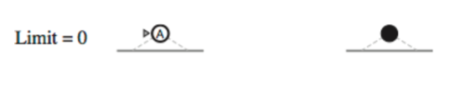
IDS – Limit 0

Slide 39
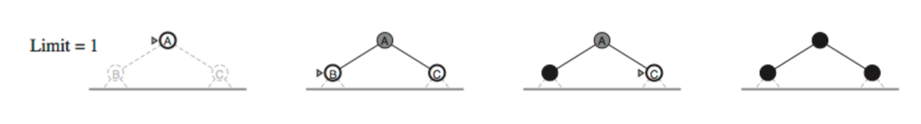
IDS – Limit 1

Slide 40
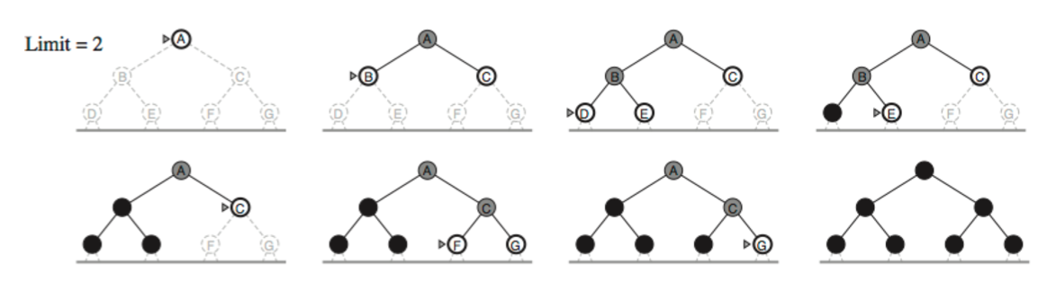
IDS – Limit 2

Slide 41
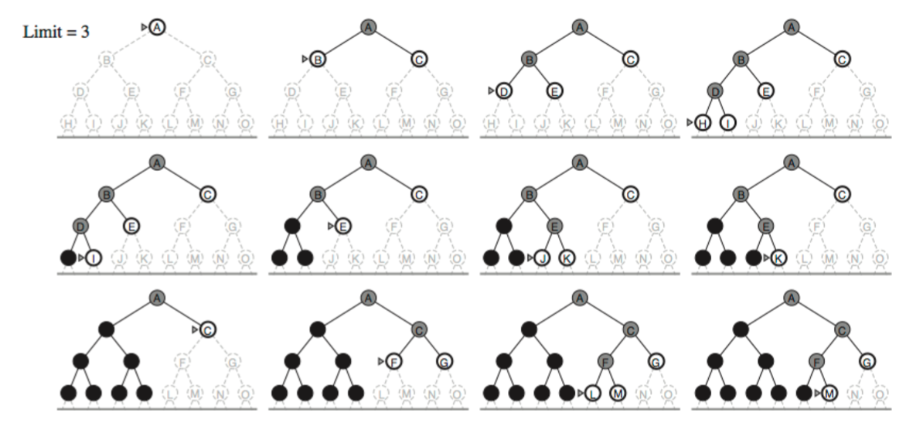
IDS – Limit 3

Slide 42
Properties of IDS
Complete: Yes (if the b is finite)
Time: (d+1)b⁰ + d b¹ + (d-1)b² + … + b^{d} = O(b^{d})
Space: O(bd)
Optimal: Yes, if step cost = 1

Slide 43
Bi-directional Search
Bidirectional search algorithm runs two simultaneous searches, one form initial state called as forward-search and other from goal node called as backward-search, to find the goal node.
Bidirectional search replaces one single search graph with two small subgraphs in which one starts the search from an initial vertex and other starts from goal vertex.
The search stops when these two graphs intersect each other.
Bidirectional search can use search techniques such as BFS, DFS, etc.

Slide 44
Bi-directional Search
Both search forward from initial state, and backwards from goal state.
Motivation: b^{d/2} + b^{d/2} is much less than b^{d}
Replace the goal test with a check to see whether the frontiers of the two searches intersect, if yes then solution is found.

Slide 45
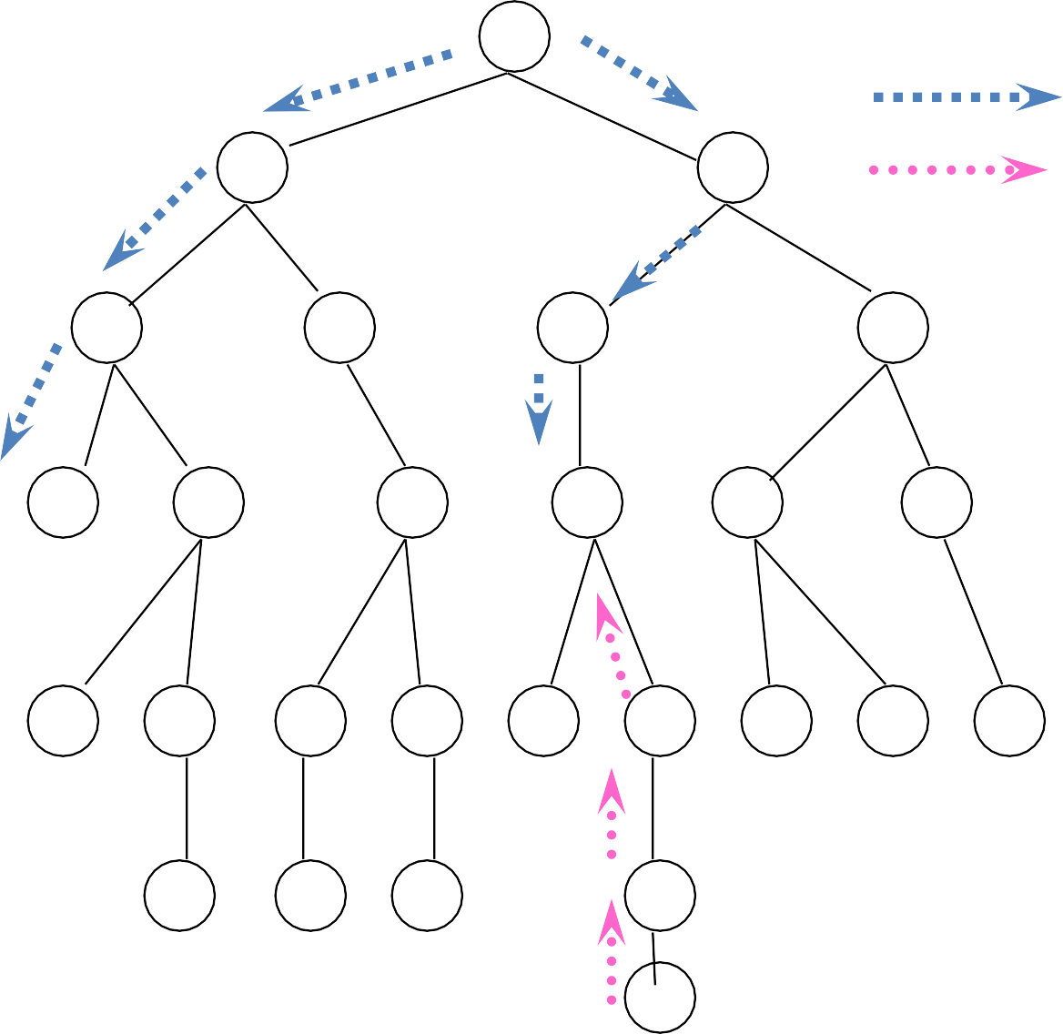
S
Forward Backwards
A
D
B
D
A
E
C 11
E
E
B
B
F
D F
14
B F
C E A C G
17 15 15 13
G 19
C G
19 17
F
G 25

Slide 46
Properties of Bi-directional Search
Completeness: Bidirectional Search is complete if we use BFS in both searches.
Time Complexity: Time complexity of bidirectional search using BFS is O(bd).
Space Complexity: Space complexity of bidirectional search is O(bd).
Optimal: Bidirectional search is Optimal.

Slide 47
Quick Summary
Breadth-First Search:
Some solutions are known to be shallow
Uniform-Cost Search:
Actions have varying costs
Least cost solution is the required
This is the only uninformed search that worries about costs.
Depth-First Search:
Many solutions exist
Know (or have a good estimate of) the depth of solution
Iterative-Deepening Search:
Space is limited and the shortest solution path is required

Slide 48
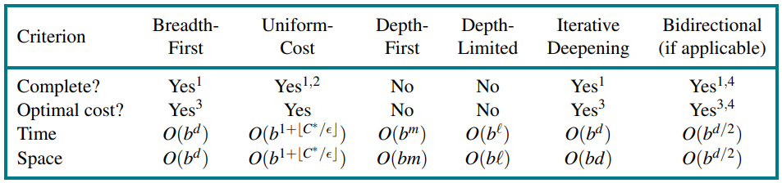
Quick Summary
1 complete if b is finite, and the state space either has a solution or is finite.
2 complete if all action costs are ≥ > 0;
3 cost-optimal if action costs are all identical;
4 if both directions are breadth-first or uniform-cost.

Slide 49
Best First Search
ACTIONS – available actions for a state
RESULT – where does the action lead to
“Frontier” – Un-expanded nodes
“Reached” – Nodes you have already reached

Slide 50
We’ll be using a Search Data Structure
Node (for the tree):
node.STATE: the state to which the node corresponds;
node.PARENT: the node in the tree that generated this node;
node.ACTION: the action that was applied to the parent’s state to generate this node;
node.PATH-COST: the total cost of the path from the initial state to this node. In mathematical formulas, we use g(node) as a synonym for PATH-COST.

Slide 51
Queue for the Frontier
IS-EMPTY(frontier) returns true only if there are no nodes in the frontier.
POP(frontier) removes the top node from the frontier and returns it.
TOP(frontier) returns (but does not remove) the top node of the frontier.
ADD(node, frontier) inserts node into its proper place in the queue.
Usually, we use one of the following queues:
LIFO (stack)
FIFO
Priority Queue

Slide 52
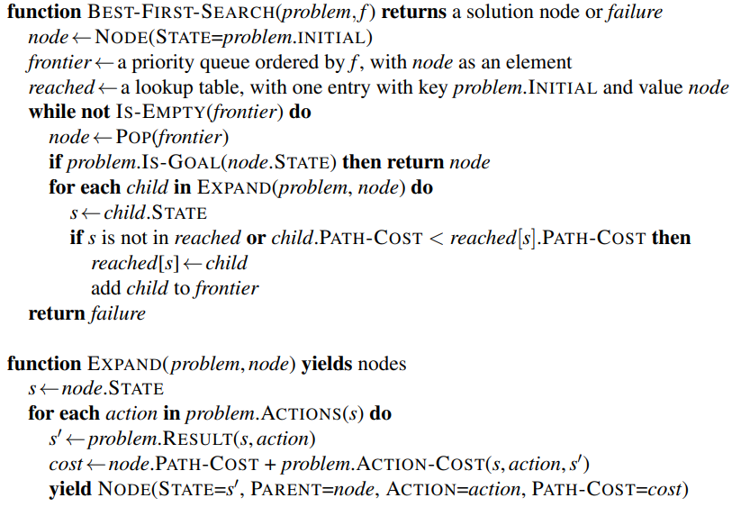
Algorithm for Best First Search

Slide 53
Fin.
>:3

