Slide 1
Solving Problems by Searching
By Abeeha Sattar

Slide 2
Informed Search Strategies
Heuristic Searches:
Greedy Best-First Search
A*

Slide 3
Heuristic Search
Heuristic search is a type of problem-solving algorithm that uses heuristic functions to guide the exploration of possible solutions.
A heuristic function is an approximation or estimation used as a way to find better, more efficient solutions than exhaustive searches through all possible combinations.
It significantly reduces computing power needed for complex problems by quickly focusing on promising areas within search spaces

Slide 4
Search Heuristics
A heuristic is:
A function that estimates how close a state is to a goal
Designed for a particular search problem
Examples: Manhattan distance, Euclidean distance for pathing, etc.

Slide 5
How can you navigate this?
0,7 |  |  |  |  |  |  |  |  |  |  | 7,11
0,0 |  |  |  |  |  |  |  |  |  |  | 0,11
Manhattan Distance
Euclidean Distance

Slide 6
Greedy Best First Search
In greedy search, we expand the node closest to the goal node. The “closeness” is estimated by a heuristic h(x) .
Heuristic: A heuristic h is defined as-
h(x) = Estimate of distance of node x from the goal node.
Lower the value of h(x), closer is the node from the goal.
Strategy: Expand the node closest to the goal state, i.e. expand the node with lower h value.

Slide 7
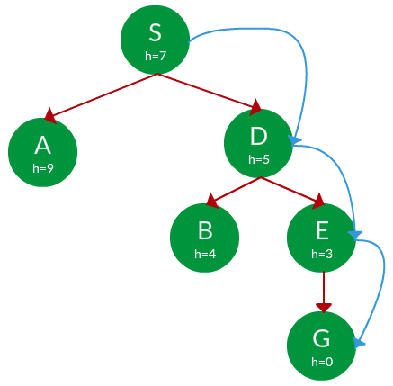
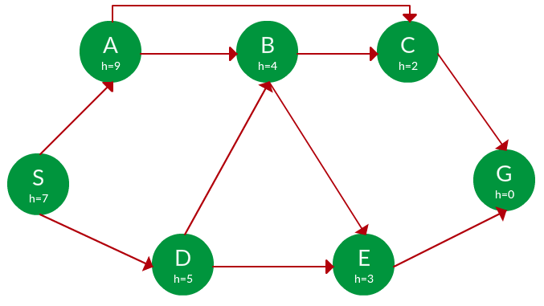
Example (S is start, G is goal)
Path:
S -> D -> E -> G

Slide 8
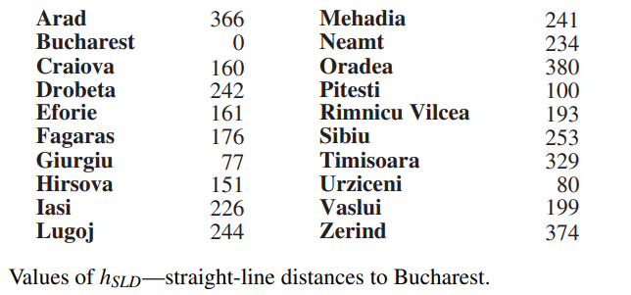
Traveling Problem with Greedy Best First

Slide 9

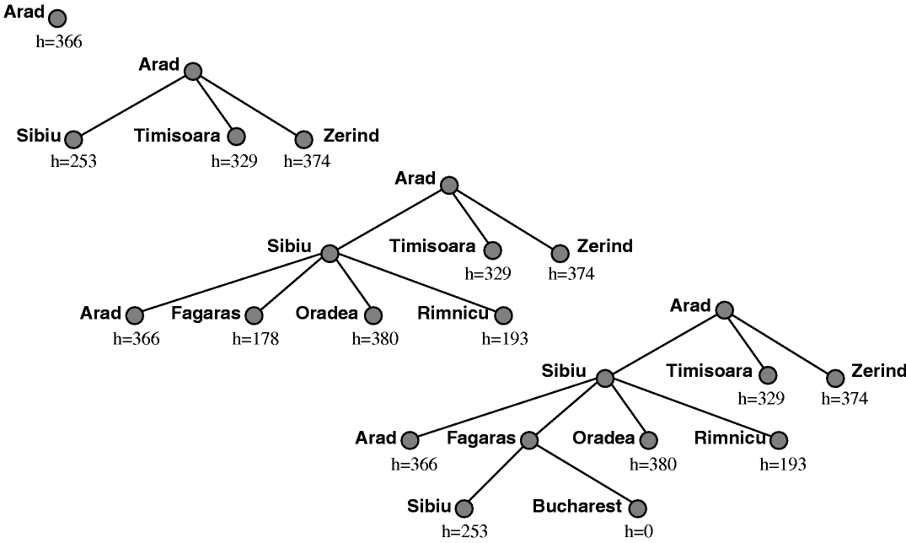
What could go wrong?

Slide 10
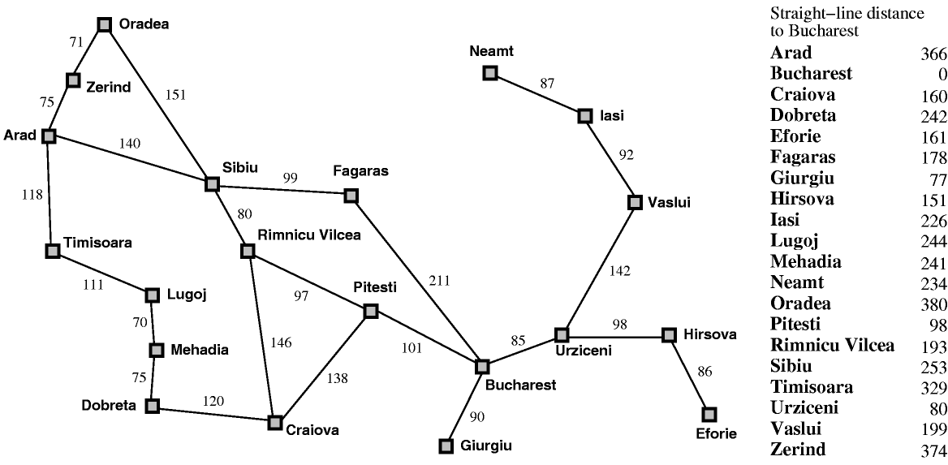
Greedy search leads to a minimal cost search because no node off the solution path is expanded. However, it does not find the optimal path: the path it found via Sibiu and Fagaras to Bucharest is 13 miles longer than the path through Pimnicu Vilcea and Pitesti.
Red Path (GBF)=431
Green Path (UCS)= 418

Slide 11
A* Search
A* Search, combines the strengths of uniform-cost search and greedy search. In this search, the heuristic is the summation of the cost in UCS, denoted by g(x), and the cost in greedy search, denoted by h(x). The summed cost is denoted by f(x).
  Heuristic: The following points should be noted w.r.t heuristics in A* search.
  A* Search orders by the sum: f(x) = g(x) + h(x)
Uniform-cost orders by path cost, or backward cost g(x)
Greedy orders by goal proximity, or forward cost h(x)

Slide 12
Apply A* Search to this

Slide 13
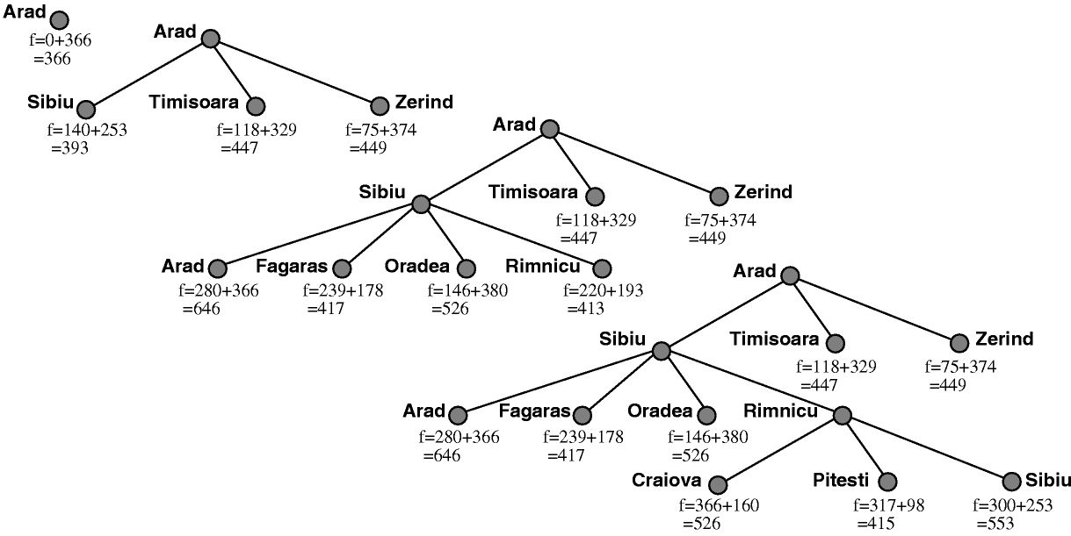
A* Search – Solution

Slide 14
Admissible Heuristics
→ (Self-Study: 3.5.2, 3.5.3, 3.5.4) ←
A heuristic h is admissible (optimistic) if:
0 ≤ h(n) ≤ h*(n)
where h*(n) is the true cost to a nearest goal.
Self Study: Read more on Admissible and Consistent Heuristics (bonus bits: read about the triangle equality part as well)
Self Study: Read about Inadmissible Heuristics and Weighted A*

Slide 15
Weighted A*
Works exactly like A*, but the formula is a little modified:
f(x) = g(x) + w.h(x), where w is a weight > 1
By increasing w, the algorithm places more emphasis on the heuristic estimate (h), which makes it search more directly toward the target, often resulting in faster execution times.

Slide 16
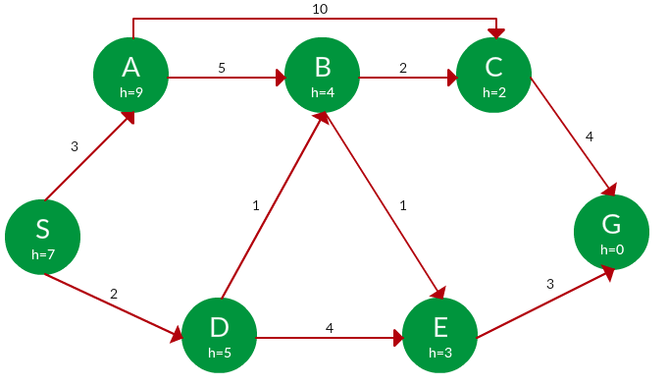
Problems for Practice (Solve using A*)

Slide 17
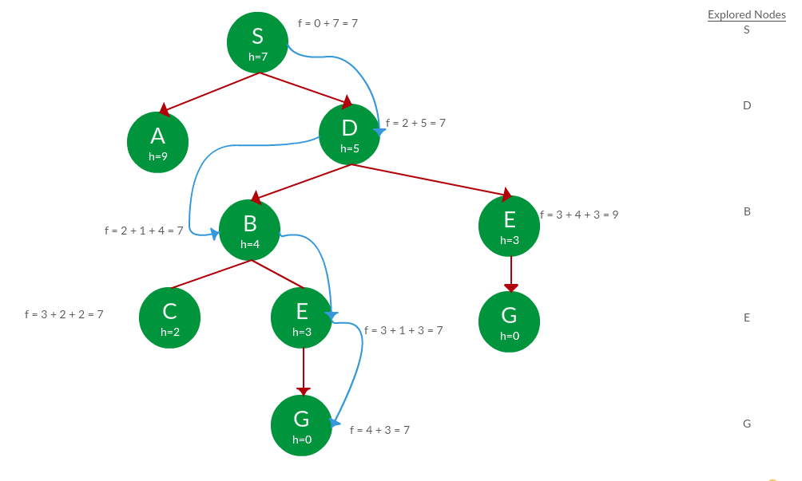
A* Search Solution.
2
Path: S -> D -> B -> C -> E -> G
Cost: 7

Slide 18
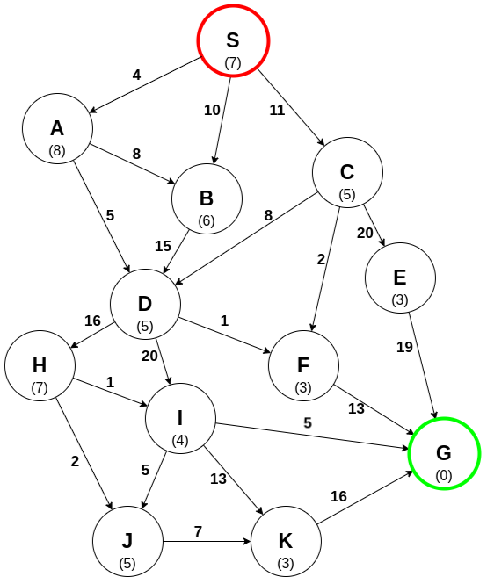
https://www.codecademy.com/resources/docs/ai/search-algorithms/a-star-search

Slide 19
Other Websites with examples
https://www.gatevidyalay.com/a-algorithm-a-algorithm-example-in-ai/
https://medium.com/nerd-for-tech/ai-search-algorithms-with-examples-54772c6d973a
https://www.101computing.net/a-star-search-algorithm/
https://www.cs.cmu.edu/~motionplanning/lecture/Asearch_v8.pdf

Slide 20
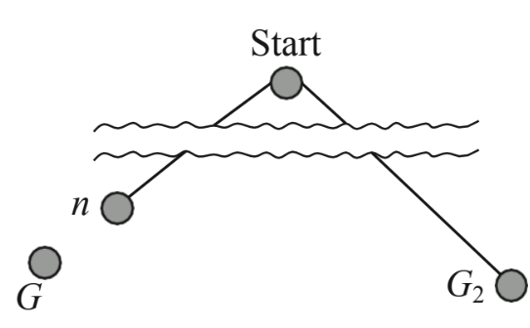
Optimality of Proof
Recall that f(n) = g(n) + h(n)
Now, suppose some suboptimal goal G2 has been generated and is in the frontier.
Let n be an unexpanded node in the frontier such that n is on a shortest path to an optimal goal G.
We want to prove:
  f(n) < f(G2) (then A* will prefer n over G2)

Slide 21
Optimality of Proof
f(G2) = g(G2) since h(G2) = 0
g(G2) > g(G) since G2 is suboptimal
f(G) = g(G) since h(G) = 0
Then f(G2) > f(G) from above
h(n) ≤ h*(n) since h is admissible
g(n) + h(n) ≤ g(n) + h*(n)
Then f(n) ≤ f(G)
Thus, A* will never select G2 for expansion

Slide 22
Optimality of Proof
In other words:
  f(G2) = g(G2) + h(G2) = g(G2) > C*, since G2
  is a goal on a non-optimal path (C* is the optimal cost)
  f(n) = g(n) + h(n) ≤ C*, since h is admissible
  f(n) ≤ C* < f(G2), so G2 will never be expanded
  A* will not expand goals on sub-optimal paths

Slide 23
Memory Bounded Search
Beam Search
Iterative-deepening A* Search (IDA*)
Recursive Best-First Search (RBFS)
Simplified Memory Bounded A* (SMA*)

Slide 24
Beam Search – Read More from the Book
Beam search limits the size of the frontier.
Keep only the k nodes with the best f-scores, discarding any other expanded nodes.
Makes the search incomplete and suboptimal, but we can choose k to make good use of available memory, and the algorithm executes fast because it expands fewer nodes
For many problems it can find good near-optimal solutions.

Slide 25
IDA* – Read More from the Book
IDA∗ gives us the benefits of A∗ without the requirement to keep all reached states in memory, at a cost of visiting some states multiple times.
In standard iterative deepening the cutoff is the depth, which is increased by one each iteration. In IDA∗ the cutoff is the f-cost (g + h);

Slide 26
RBFS
RBFS resembles a recursive depth-first search, but rather than continuing indefinitely down the current path, it uses the f-limit variable to keep track of the f-value of the best alternative path available from any ancestor of the current node.

Slide 27
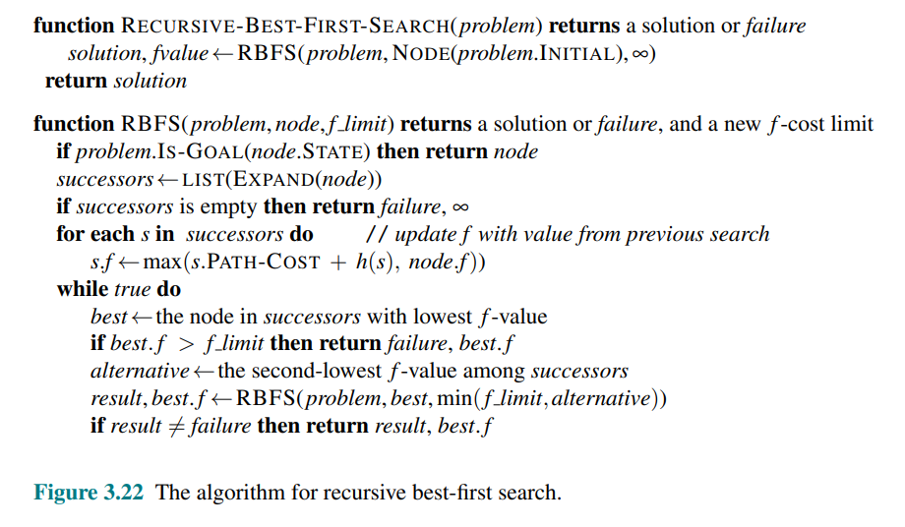
RBFS - Algorithm

Slide 28
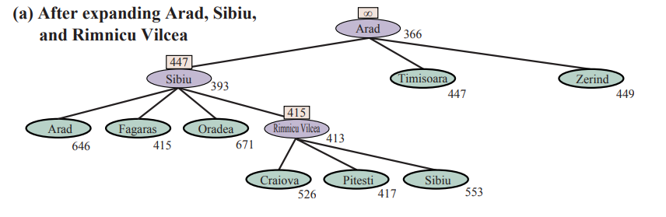
RBFS

Slide 29
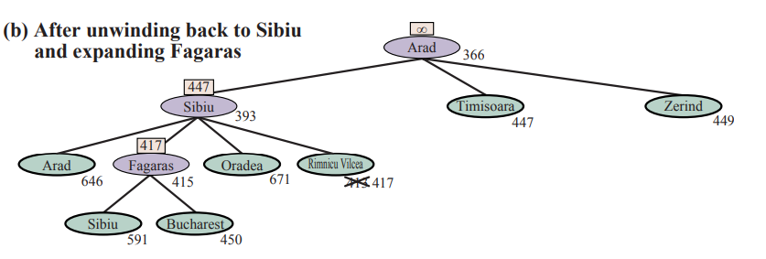
RBFS

Slide 30
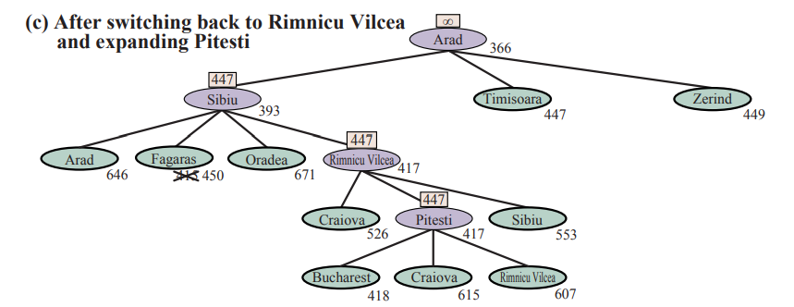
RBFS

Slide 31
Simple Memory Bounded A* (SMA*)
This is like A*, but when memory is full, we delete the worst node (largest f-value).
Like RBFS, we remember the best descendent in the branch we delete.
If there is a tie (equal f-values) we first delete the oldest nodes first.
SMA* finds the optimal reachable solution given the memory constraint.
But time can still be exponential.

Slide 32
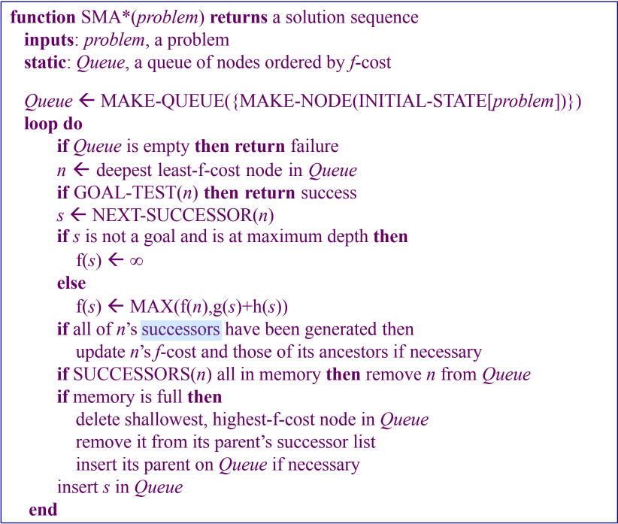
Algorithm for SMA*

Slide 33
Characteristics of SMA*
SMA* is a shortest path algorithm based on the A* algorithm.
The advantage of SMA* is that it uses a bounded memory, while the A* algorithm might need exponential memory.
All other characteristics of SMA* are inherited from A*.
How it works:
Like A*, it expands the best leaf until memory is full.
Drops the worst leaf node- the one with the highest f-value.
SMA* then backs up the value of the forgotten node to its parent.

Slide 34
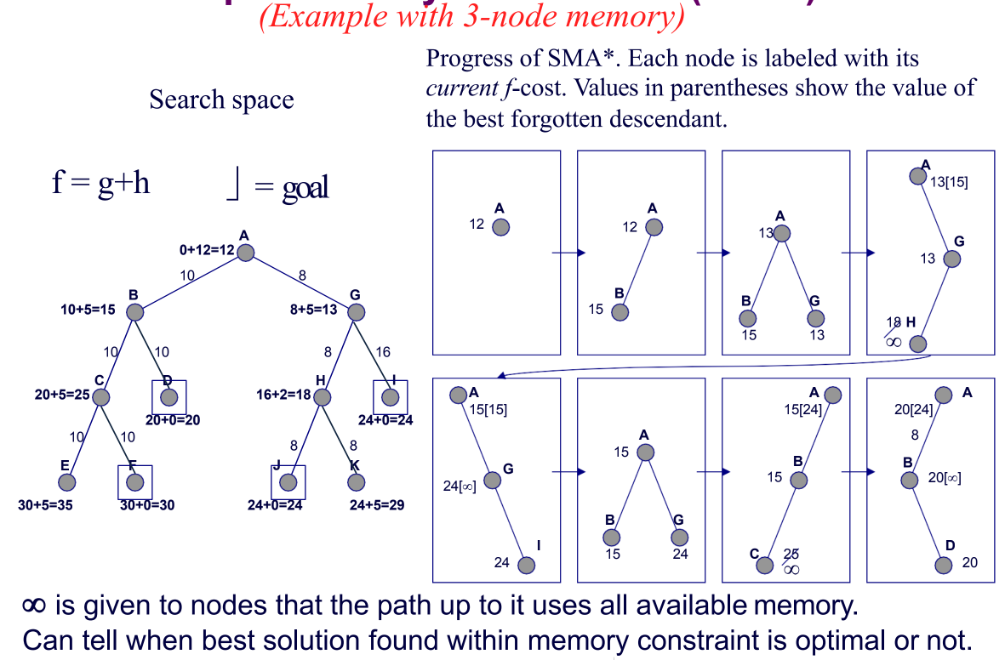
Example (courtesy of Ms. Anaum)

Slide 35
Flow of SMA* in the Previous Slide
Let MaxNodes = 3
Initially B and G are added to open list, then hit max.
B is larger f value, so discard but save f(B)=15 at parent A
Add H, but f(H)=18. This is not a goal and we can never go deeper, so set f(H)=infinity and save at G.
Generate next child I with f(I)=24, which is bigger than the other child of A(f(B) was 15). Now we have seen all children of G, so reset f(G) to 24.
Regenerate B and child C. This is not a goal so f(C) is reset to infinity.
Generate second child D with f(D)=20, backing up value to ancestors.
D is a goal node, so search terminates.

Slide 36
Properties of SMA*
It is complete if the allowed memory is high enough to store the shallowest solution.
It is optimal if the allowed memory is high enough to store the shallowest optimal solution, otherwise it will return the best solution that fits in the allowed memory.
It avoids repeated states as long as the memory bound allows it
It will use all memory available.
Enlarging the memory bound of the algorithm will only speed up the calculation.
When enough memory is available to contain the entire search tree, then calculation has an optimal speed

Slide 37
Fin.
>:3

