Slide 1
Solving Problems by Searching
By Abeeha Sattar

Slide 2
Informed Search Strategies
Heuristic Searches:
Greedy Best-First Search
A*

Slide 3
Heuristic Search
Heuristic search is a type of problem-solving algorithm that uses heuristic functions to guide the exploration of possible solutions.
A heuristic function is an approximation or estimation used as a way to find better, more efficient solutions than exhaustive searches through all possible combinations.
It significantly reduces computing power needed for complex problems by quickly focusing on promising areas within search spaces

Slide 4
Search Heuristics
A heuristic is:
A function that estimates how close a state is to a goal
Designed for a particular search problem
Examples: Manhattan distance, Euclidean distance for pathing, etc.

Slide 5
How can you navigate this?
0,7 |  |  |  |  |  |  |  |  |  |  | 7,11
0,0 |  |  |  |  |  |  |  |  |  |  | 0,11
Manhattan Distance
Euclidean Distance

Slide 6
Greedy Best First Search
In greedy search, we expand the node closest to the goal node. The “closeness” is estimated by a heuristic h(x) .
Heuristic: A heuristic h is defined as-
h(x) = Estimate of distance of node x from the goal node.
Lower the value of h(x), closer is the node from the goal.
Strategy: Expand the node closest to the goal state, i.e. expand the node with lower h value.

Slide 7
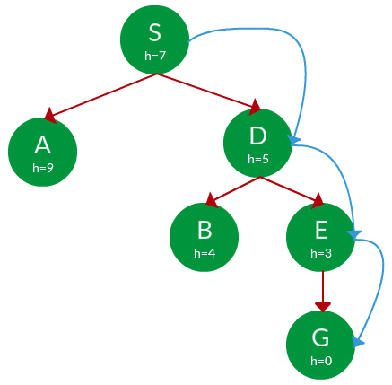
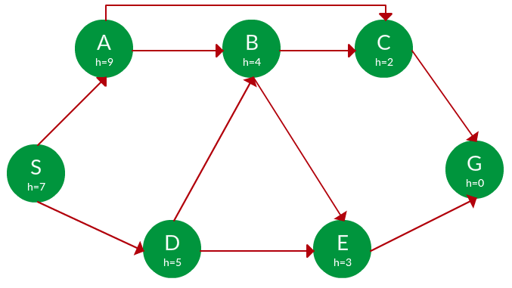
Example (S is start, G is goal)
Path:
S -> D -> E -> G

Slide 8
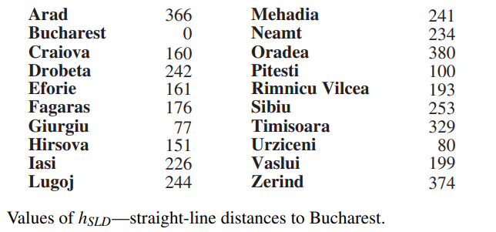
Traveling Problem with Greedy Best First

Slide 9

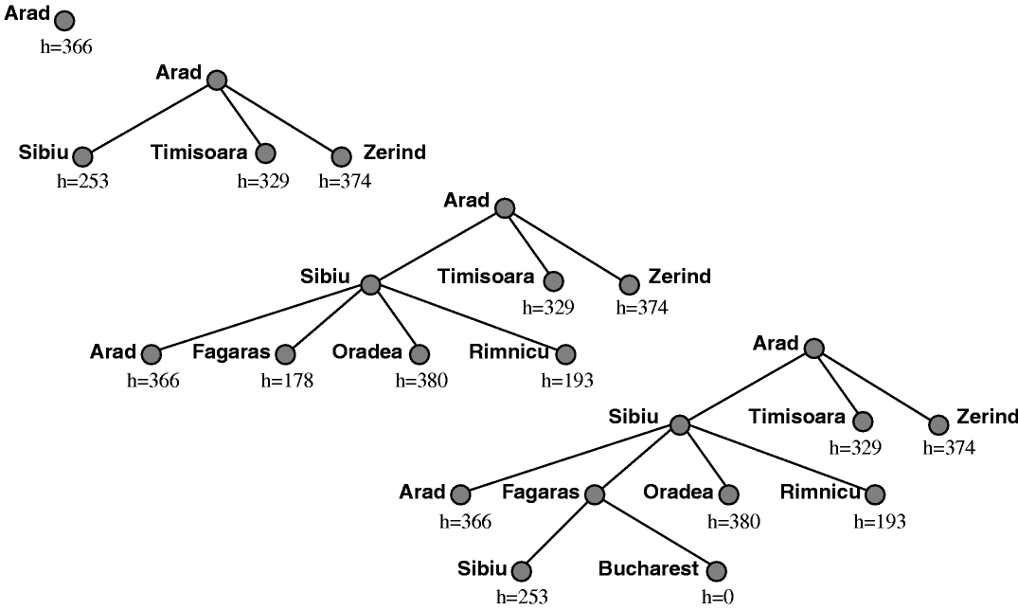
What could go wrong?

Slide 10
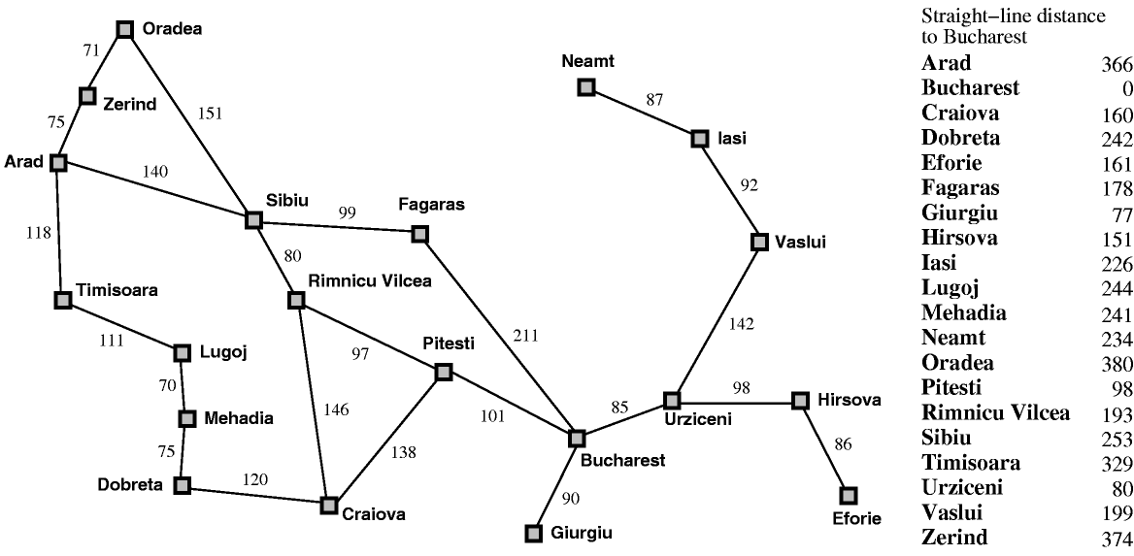
Greedy search leads to a minimal cost search because no node off the solution path is expanded. However, it does not find the optimal path: the path it found via Sibiu and Fagaras to Bucharest is 13 miles longer than the path through Pimnicu Vilcea and Pitesti.
Red Path (GBF)=431
Green Path (UCS)= 418

Slide 11
A* Search
A* Search, combines the strengths of uniform-cost search and greedy search. In this search, the heuristic is the summation of the cost in UCS, denoted by g(x), and the cost in greedy search, denoted by h(x). The summed cost is denoted by f(x).
  Heuristic: The following points should be noted w.r.t heuristics in A* search.
  A* Search orders by the sum: f(x) = g(x) + h(x)
Uniform-cost orders by path cost, or backward cost g(x)
Greedy orders by goal proximity, or forward cost h(x)

Slide 12
Apply A* Search to this

Slide 13
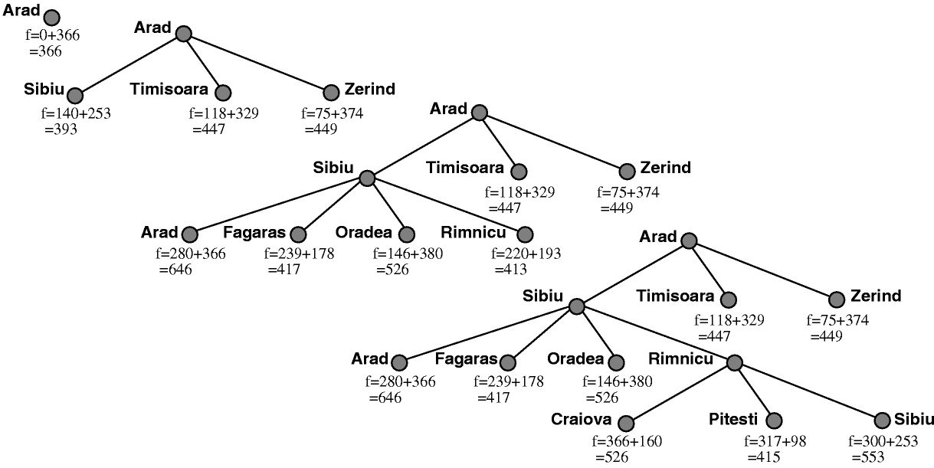
A* Search – Solution

Slide 14
Admissible Heuristics
A heuristic h is admissible (optimistic) if:
0 ≤ h(n) ≤ h*(n)
where h*(n) is the true cost to a nearest goal

Slide 15
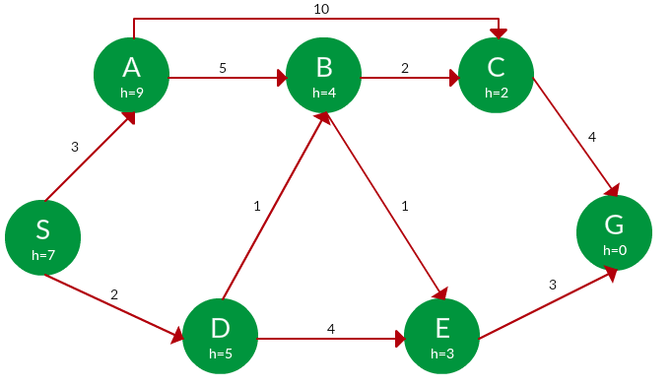
Problems for Practice (Solve using A*)

Slide 16
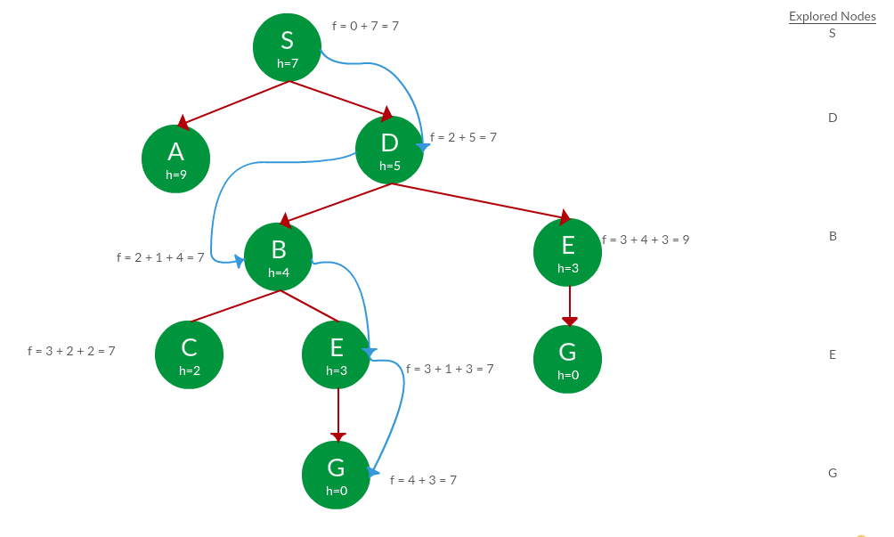
A* Search Solution. (there’s a typo on E)
Path: S -> D -> B -> C -> E -> G
Cost: 7

Slide 17
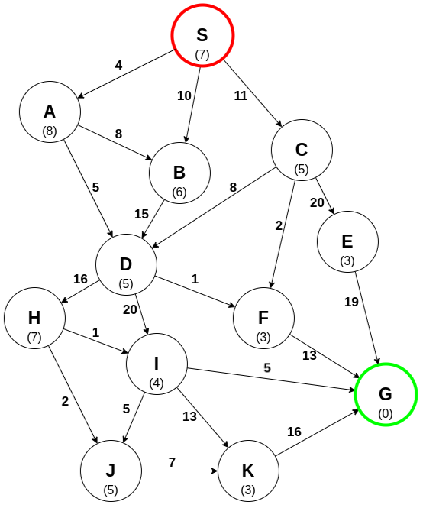
https://www.codecademy.com/resources/docs/ai/search-algorithms/a-star-search

Slide 18
Other Websites with examples
https://www.gatevidyalay.com/a-algorithm-a-algorithm-example-in-ai/
https://medium.com/nerd-for-tech/ai-search-algorithms-with-examples-54772c6d973a
https://www.101computing.net/a-star-search-algorithm/

Slide 19
Fin.
>:3

