Slide 1
Object-oriented Programming
Week 10 | Lecture 3

Slide 2
Stream
C++ Input/Output implement concept of stream . Stream is the sequences of bytes or flow of data , which acts as a source from which the input data can be obtained by a program or a destination to which the output data can be sent by the program.

Slide 4
Stream
A stream is an abstraction of a device where input/output operations are performed. You can represent a stream as either a destination or a source of characters of indefinite length.
When we open a stream, one end is always attached to the program that opens the stream and the other end is attached to a file, which is accessed by its name.

Slide 5
Stream
Input Stream :
It is flow of data bytes from a device (e.g Keyboard , disk drive) to main memory (when we read/take file’s data into a program variable)
Output Stream :
It is flow of data bytes from main memory (i.e program) to a device(when we store/write variable’s data into a file)

Slide 6
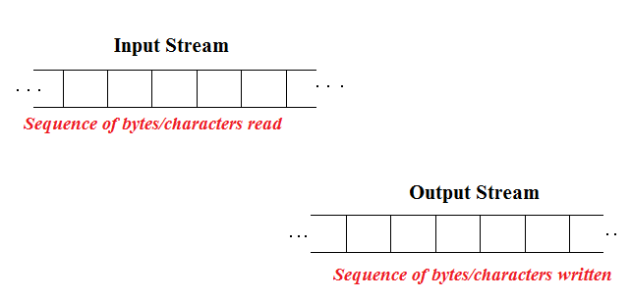
Stream

Slide 7
Stream
In input operations, Data bytes flow from an input source (such as keyboard, file, network or another program) into the program.
In output operations, data bytes flow from the program to an output sink (such as console, file, network or another program). Streams acts as an intermediaries between the programs and the actual IO devices

Slide 8
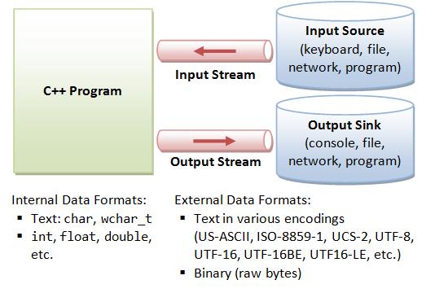

Slide 9
Files store data permanently in a storage device. With file handling, the output from a program can be stored in a file. Various operations can be performed on the data while in the file.
Using file handling we can store our data in Secondary memory (Hard disk).

Slide 10
Why use File Handling in C++:-
For permanet storage.
The transfer of input - data or output - data from one computer to another can be easily done by using files.

Slide 11
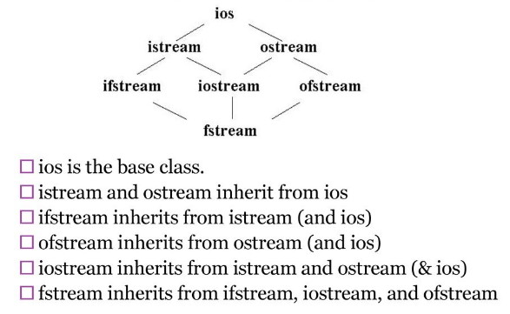
Classes for stream input and output

Slide 12
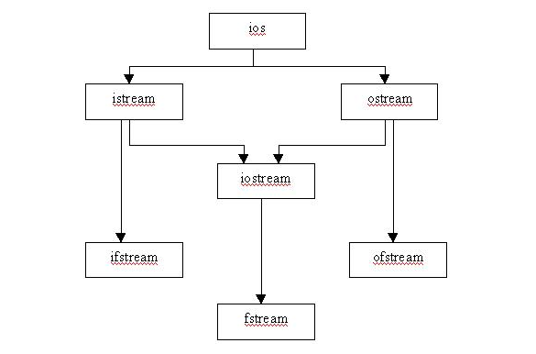
Stream Class Hierarchy

Slide 13
File I/O
To perform file I/O, you must include the header <fstream> in your program
It defines several classes, including ifstream, ofstream, and fstream
C++ views each file as a sequence of bytes

Slide 14
File Stream
There are three types of file streams: input, output, and input/output
ifstream in; // input stream object
ofstream out; // output stream object
fstream io; // input/output stream object

Slide 15
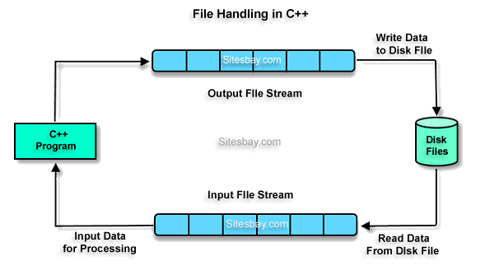

Slide 16
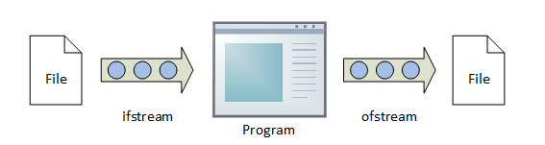

Slide 17
Ofstream predefined methods
This class is used to prepare an object which performs write operations on file.
its predefined methods are
open()
write()
put()
seekp()
tellp()
close()

Slide 18
ifstream predefined methods
it is used to prepare an object which performs read operations on file.
Its predefined methods are
open()
read()
get()
getline()
seekg()
tellg()
close()

Slide 19
fstream predefined methods
It performs both read and write operations of file

Slide 20
Reading from a file
//open a file for reading using constructor ifstream in(“myfile”);
//open a text file for reading ifstream in(“myfile.txt”);
if for some reason, file cannot be opened then ifstream object has the value false

Slide 21
Alternate Syntax
An alternate way to open a file for read/write is by using open() function
ofstream out; out.open("test", ios::out);

Slide 22
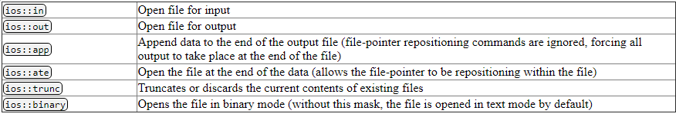
ios Modes

Slide 23
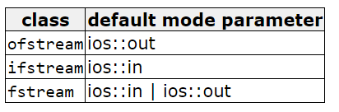

Slide 24
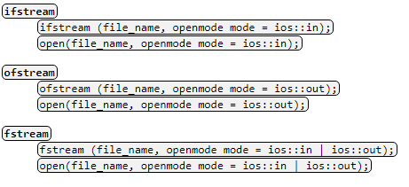
Prototypes for the stream constructors and open functions
Prototypes for the stream constructors and open functions. The function prototypes show the default open modes for the different kinds of file stream classes.

Slide 25
ORing
All these flags can be combined using the
bitwise operator OR (|).
ofstream myfile;
myfile.open ("example.bin", ios::out | ios::app );

Slide 26
Closing a file
To close a file, we can use the member function close( )
Example:
mystream.close();

Slide 27
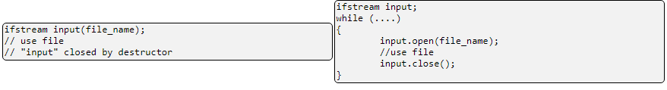
Opening And Closing Files

Slide 28
File open using constructor method
#include <iostream>
#include <fstream>
using namespace std;
int main(){
ofstream f("XYZ");
f << "hello";
f.close();
}

Slide 29
Multiple File open using open method with same filestream
#include <iostream>
#include <fstream>
using namespace std;
int main(){
ofstream f;
f.open("file1");
f << "hello";
f.close();//without close compiler implicitly close the file
// second file through the same file stream
f.open("file2") ;
f<<"i am a student";
f.close();
}

Slide 30
formatted and unformatted IO
C++ provides both the formatted and unformatted IO functions.
In formatted or high-level IO, bytes are grouped and converted to types such as int, double, string or user-defined types.
In unformatted or low-level IO, bytes are treated as raw bytes and unconverted.
Formatted IO operations are supported via overloading the stream insertion (<<) and stream extraction (>>) operators,

Slide 31
The << and >> operators are overloaded to handle fundamental types (such as int and double), and classes (such as string). You can also overload these operators for your own user-defined types.

Slide 32
Types of I/O
We can perform either formatted or unformatted I/O with file stream
Formatted output is carried out on streams via the stream insertion << and stream extraction >> operators
Character translations are performed between console window and files

Slide 33
Formatted I/O
Formatted I/O can be performed by using extraction >> and insertion << operators
All information is stored in the file in the same format as it would be displayed on the screen
When reading text files using the >> operator, certain character translations occur. For example, white-space characters are omitted

Slide 34
Formatted output converts the internal binary representation of the data to ASCII characters which are written to the output file. Formatted input reads characters from the input file and converts them to internal form.

Slide 35
Advantages and Disadvantages of Formatted I/O
Formatted input/output is very portable. It is a simple process to move formatted data files to various computers, even computers running different operating systems, as long as they all use the ASCII character set.
Formatted files are human readable and can be typed to the terminal screen or edited with a text editor.

Slide 36
To write to the file, use the insertion operator (<<)
#include <iostream> #include <fstream> using namespace std; int main() { // Create and open a text file ofstream MyFile("filename.txt"); // Write to the file using insertion operator MyFile << "Files can be tricky, but it is fun enough!"; // Close the file MyFile.close(); }

Slide 37
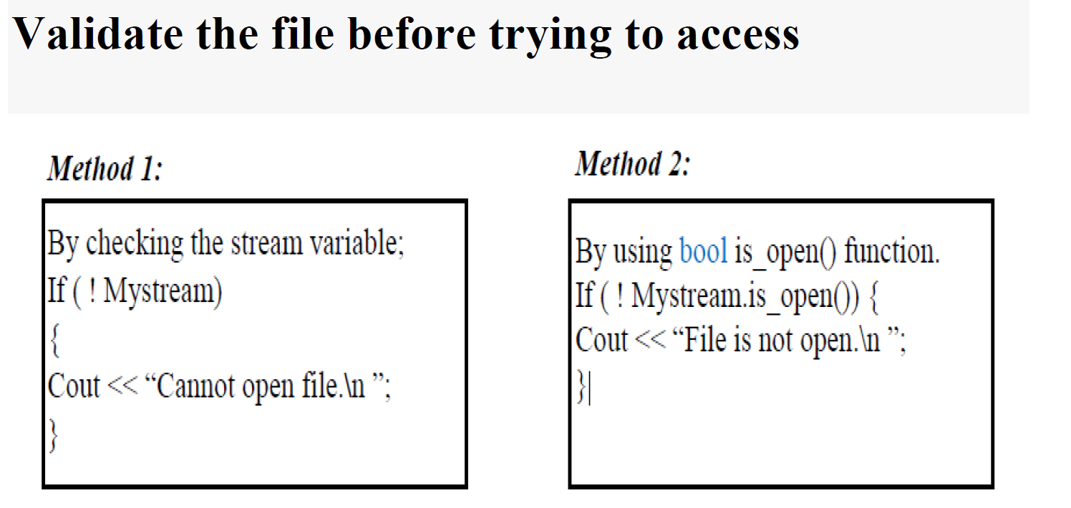

Slide 38
Example for reading file
#include <iostream>
#include <fstream>
using namespace std;
int main(){
ifstream in("File2");
if(!in){
cout << "Failed to open file." << endl;
return 1; }
char c[20];
in >> c ;
cout << c << endl;
in.close();
return 0;}

Slide 39
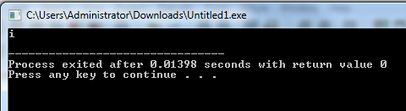
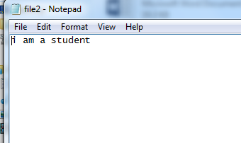

Slide 40
#include <iostream>
#include <fstream>
using namespace std;
int main(){
ifstream in("File2");
if(!in){
cout << "Failed to open file." << endl;
return 1; }
char c[20];
while(!in.eof()){
in >> c ;
cout << c ;}
in.close();
return 0;}

Slide 41
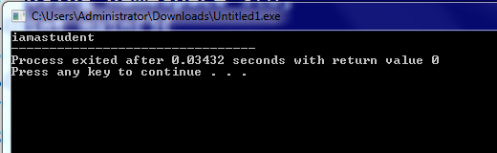

Slide 42
Writing to a file
// open a file for writing ofstream out(“myfile”);
// open a text file for writing ofstream out(“myfile.txt”);
If file does not already exist then it is created
If the file cannot be opened or created, then ofstream object has the value false

Slide 43
Example
#include <iostream>
#include <fstream>
using namespace std;
int main()
{
ofstream out("Test.txt");
if(!out){
cout << "File creation failed"; return 1;}
out << "Ali " << 100 << endl;
out << "Abid " << 200 << endl;
out.close();return 0;
}

Slide 44
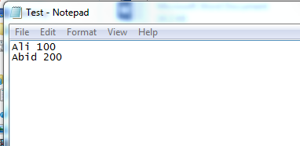

Slide 45
File Read through char array
#include <iostream>
#include <fstream>
using namespace std;
int main(){
char str[12];
ifstream f;
f.open("Test.txt");
while(f) //reading through file object
{
f.getline(str,10);
cout<<str<< endl; }
f.close();}

Slide 46
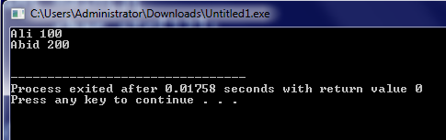

Slide 47
File Read through string object
#include <iostream>
#include <fstream>
using namespace std;
int main(){
string str;
ifstream f;
f.open("Test.txt");
while(f){
getline(f,str);
cout<<str<<endl; }
f.close();}

Slide 48
File Read through string object
#include <iostream>
#include <fstream>
using namespace std;
int main(){
string str;
ifstream f;
f.open("abc.txt");
while(getline(f,str)){
cout<<str<<endl;
}
f.close();
}

Slide 50
File read and write
#include <iostream>
#include <fstream>
using namespace std;
int main(){
fstream file;
file.open("smple.txt",ios::out);
if(!file){
cout<<"error";
return 0;
}
cout <<"File created" << endl;
file << "hi i am";
file.close();}

Slide 51
File read and write
file.open("smple.txt",ios::in);
if(!file){
cout<<"error";
return 0;
}
char ch[40];
cout <<"contents are: ";
while(!file.eof()) //reading through eof
{
//file>>ch; white spaces omitted
file.getline(ch,40);
cout<<ch ;
}
file.close();
return 0;
}

Slide 52
File read write w/o closing
#include <iostream>
#include <fstream>
using namespace std;
int main() {
fstream f;
f.open("oop", ios::in | ios::out | ios::ate);
if (!f) {
cout << "Failed to open file.";
return 1;
}
f << "hello oop class. ";
f.seekg(0);
string s;
while (getline(f, s)) {
cout << s << endl;
}
f.close();
return 0;
}

Slide 53
Unformatted I/O
When we need to store unformatted (raw) binary data (not text) in a file, we can make use of the following set of functions
When performing binary operations on a file, we open it using the ios::binary mode specifier
Although unformatted file functions can work on text files, some character translations may still occur

Slide 54
Unformatted I/O
Unformatted Input/Output is the most basic form of input/output. Unformatted input/output transfers the internal binary representation of the data directly between memory and the file

Slide 55
Unformatted I/O
The unformatted output functions (e.g., put(), write()) outputs the bytes as they are, without format conversion.
In unformatting input, such as get(), getline(), read(), it reads the characters as they are, without conversion.

Slide 56
Advantages and Disadvantages of Unformatted I/O
Unformatted input/output is the simplest and most efficient form of input/output. It is usually the most compact way to store data. Unformatted input/output is the least portable form of input/output. Unformatted data files can only be moved easily to and from computers that share the same internal data representation.
Unformatted input/output is not directly human readable, so you cannot type it out on a terminal screen or edit it with a text editor.

Slide 57
Get/Put Functions
The functions get() and put() reads and writes a single character to a file, respectively

Slide 58
get() Function
istream &get(char &ch);
The get( ) function reads a single character from the invoking stream and puts that value in ch. It returns a reference to the stream

Slide 59
Example
#include <iostream>
#include <fstream>
using namespace std;
int main(){
ifstream in("Test.txt");
if(!in) {
cout << "Failed to open file" << endl;
return 1; }
char c;
while(in) {
in.get(c);
cout << c; }
return 0;
}

Slide 60
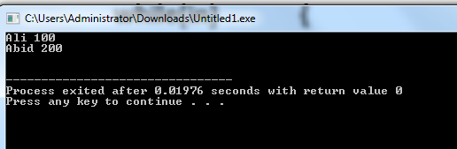

Slide 61
put() Function
ostream &put(char ch);
The put( ) function writes ch to the stream and returns a reference to the stream

Slide 62
Example
#include <iostream>
#include <fstream>
using namespace std;
int main(){
ofstream o("newfile.txt");
if(!o){
cout << "Failed to open file" << endl;
return 1; }
for(int i = 65; i < 90; i++){
o.put(i);}
o.close();
return 0;
}

Slide 63
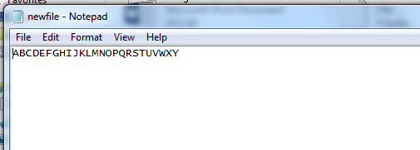

Slide 64
get() and put() are for single characters, not full objects
These functions are for low-level character input/output:
Function | Purpose
get() | Reads a single character
put() | Writes a single character

Slide 65
Read/Write Functions
The functions read() and write() are similar to get() and put() except that we can read and write entire blocks of bytes (e.g. character array) in a file
istream &read(char *buf, int num);
ostream &write(const char *buf, int num);

Slide 66
Example
// Writing block (array) of characters
char chW[20] = {'T', 'h', 'i', 's', 'i', 's', 'a', 't','e','s','t'};
o.write(chW, 20);
// Reading block (array) of characters
char chR[20];
i.read(chR, 20);
for(int i = 0; i < 20; i++)
{
cout << chR[i];
}

Slide 67
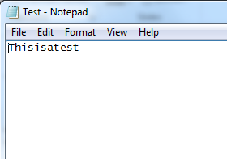
#include <iostream>
#include <fstream>
using namespace std;
int main(){
fstream in("Test.txt");
char chW[20] = {'T', 'h', 'i', 's', 'i', 's', 'a', 't','e','s','t'};
in.write(chW, 20);
return 0;
}

Slide 68
#include <iostream>
#include <fstream>
#include <string>
using namespace std;
int main() {
ofstream out("Test.txt", ios::binary);
string msg = "This is a test";
out.write(msg.c_str(), msg.size()); // write raw bytes of the string
out.close();
return 0;
}

Slide 69
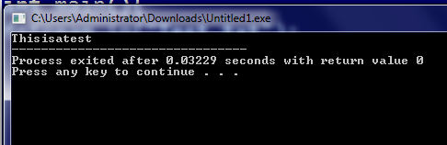
#include <iostream>
#include <fstream>
using namespace std;
int main(){
fstream in("Test.txt");
char chR[20];
in.read(chR, 20);
for(int i = 0; i < 20; i++){
cout << chR[i];}
return 0;
}

Slide 70
eof() Function
bool eof( );
You can detect when the end of the file is reached by using the member function eof( )
It returns true when the end of the file has been reached; otherwise it returns false

Slide 71
Example 1
int main()
{
ifstream i("myfile.txt");
if(!i)
{
cout << "Failed to open file" << endl;
return 1;
}
char c;
for(int x = 0; x < 50; x++)
{
i.get(c);
cout << c;
}
return 0;
}
myfile.txt contains text: “Hello”
Output:
Helloooooo

Slide 72
Example 2
int main()
{
ifstream in("myfile.txt");
if(!in)
{
cout << "Failed to open file" << endl;
return 1;
}
char c;
for(int x = 0; x < 10; x++)
{
if(in.eof())
break;
in.get(c);
cout << c; }
return 0;
}

Slide 73
flawed behavior
Unfortunately, the behavior of the eof( ) function is not as straightforward as we might expect. The function does not actually test the file to see if there is more data to read. Instead, the eof( ) function returns the current value of the eof-bit (one of the stream's state flags), which is set by the last read function to run. That means that the value that eof( ) returns depends on the outcome of a different, previously run, function. This unexpected behavior is usually only a problem when reading single characters from a file - functions reading more complex data generally set the eof-bit as a part of the read operation.

Slide 74
flawed behavior
#include <iostream>
#include <fstream>
using namespace std;
int main()
{
ifstream in("my_file");
char c;
while (!in.eof())
{
in >> c;
cout << c ;
}
return 0;
}

Slide 75
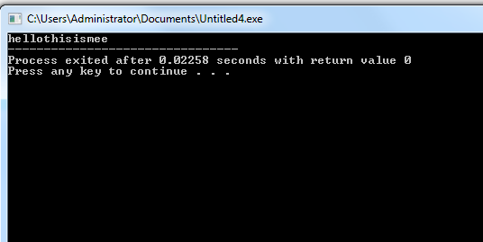
Duplication of last char

Slide 76
ignore() Function
istream &ignore(int num_of_char, char delimiter)
It reads and discards characters until either num characters have been ignored (1 by default) or the character specified by delim is encountered (EOF by default)

Slide 77
#include <iostream>
#include <fstream>
using namespace std;
int main(){
ifstream in("Test.txt");
if(!in) {
cout << "Failed to open file" << endl;
return 1; }
char c;
in.ignore();// 1 character by default
while(in) {
in.get(c);
cout << c; }
return 0;
}

Slide 78
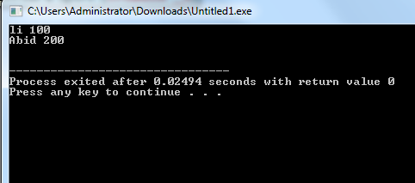

Slide 79
Example
int main()
{
ifstream in("myfile.txt");
if(!in)
{
cout << "Failed to open file" << endl;
return 1;
}
char c;
in.ignore(5, ' ');
while(in)
{
in.get(c);
cout << c;
}
return 0;
}
myfile.txt contains text: “Hello this is test”
Output:
this is testt

Slide 80
#include <iostream>
#include <fstream>
using namespace std;
int main(){
ifstream in("Test.txt");
if(!in) {
cout << "Failed to open file" << endl;
return 1; }
char c;
in.ignore(6 , ' ');
while(in) {
in.get(c);
cout << c; }
return 0;
}

Slide 81
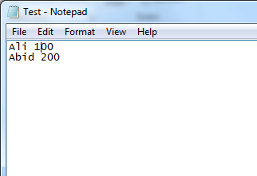
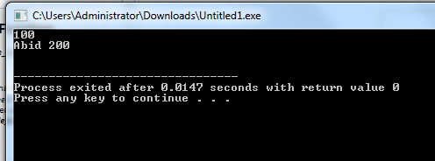

Slide 82
#include <iostream>
#include <fstream>
using namespace std;
int main(){
ifstream in("Test.txt");
if(!in) {
cout << "Failed to open file" << endl;
return 1; }
char c;
in.ignore(5 , 'i');
while(in) {
in.get(c);
cout << c; }
return 0;
}

Slide 83
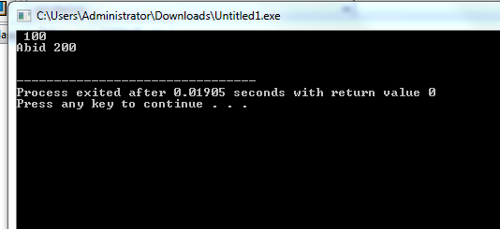

Slide 84
C++ Binary read() and write() Functions
Write an object of a class to this file, by using the write() function.
write( (char *) & ob, sizeof(ob));
Read the stored object from the file, by using the read() function.
read( (char *) & ob, sizeof(ob));

Slide 85
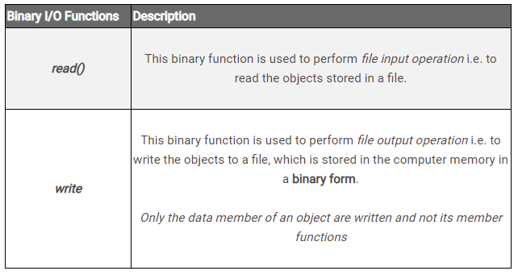
C++ Binary read() and write() Functions

Slide 86
























Slide 87






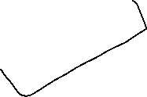














Slide 88




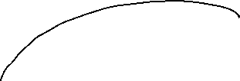


















Slide 89































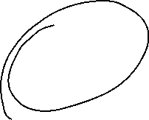







Slide 90
File pointers
Every file maintains two pointers called get_pointer (in input mode file) and put_pointer (in output mode file) which tells the current position in the file where reading or writing will takes place. These pointers help attain random access in file. That means moving directly to any location in the file instead of moving through it sequentially.
There may be situations where random access in the best choice. For example, if you have to modify a value in record no 21, then using random access techniques, you can place the file pointer at the beginning of record 21 and then straight-way process the record. If sequential access is used, then you'll have to unnecessarily go through first twenty records in order to reach at record 21.

Slide 91
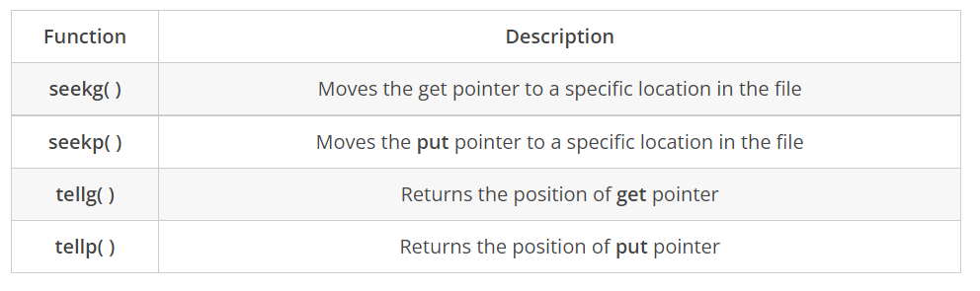

Slide 92
The seekg(), seekp(), tellg() and tellp() Functions
random access is achieved by manipulating seekg(), seekp(), tellg() and tellp() functions. The seekg() and tellg() functions allow you to set and examine the get_pointer, and the seekp() and tellp() functions perform these operations on the put_pointer.
The seekg() and tellg() functions are for input streams (ifstream) and seekp() and tellp() functions are for output streams (ofstream).

Slide 93
tellg() and tellp()
The functions tellg() and tellp() return the position, in terms of byte number, of put_pointer and get_pointer respectively, in an output file and input file.

Slide 94
Random Access
We can move the pointer (while reading or writing) to a specific position in a file
istream &seekg(int offset, origin);
ostream &seekp(int offset, origin);
Where origin can be any of the three following options

Slide 95
Origin Options
ios::beg // Beginning-of-file position
ios::cur // Current location position
ios::end // End-of-file position
If we don’t specify the second argument, then ios :: beg is the default reference position.

Slide 96
fin.seekg(30); // will move the get_pointer (in ifstream) to byte number 30 in the file(starts from beg)
fout.seekp(30);// will move the put_pointer (in ofstream) to byte number 30 in the file
It automatically points at the beginning of file, allowing us to read the file from the beginning.
fin.seekg(30, ios::beg); // go to byte no. 30 from beginning of file
fin.seekg(-2, ios::cur); // back up 2 bytes from the current position
fin.seekg(0, ios::end); // go to the end of the file
fin.seekg(-4, ios::end); // backup 4 bytes from the end of the file

Slide 97
seekg() Function
The seekg( ) function moves the associated file's current pointer offset the number of characters from the specified origin
The seekg() function is member of the ifstream class and is called through an ifstream object
The function only moves the pointer ahead, the reading operation should then be performed through some other function

Slide 98
Example
// Starting from the beginning, move position pointer five characters further
i.seekg(5, ios::beg);
char chR[20];
i.read(chR, 20);
for(int i = 0; i < 20; i++)
{
cout << chR[i];
}

Slide 99
seekp() Function
The seekp() function moves the associated file's current pointer offset the number of characters from the specified origin
The seekp() function is member of the ofstream class and is called through an ofstream object
The function only moves the pointer ahead, the writing operation should then be performed through some other function

Slide 100
Example 1
// Starting from the beginning, move position pointer two characters forward… then perform writing with put()
char ch = ‘K’;
i.seekp(2, ios::beg);
i.put(ch); // writes K at third position in the file

Slide 101
Example 2
// Starting from the end, move position pointer three characters backwards… then perform writing with put()
char ch = ‘J’;
i.seekp(-3, ios::end);
i.put(ch); // writes J at fourth from last position

Slide 102
#include<iostream>
#include<fstream>
using namespace std;
int main() {
fstream fp;
char buf[100];
int pos;
// open a file in write mode with 'ate' flag (ate to move the pointer)
fp.open("pointer.txt", ios :: out | ios :: ate);
cout << "\nWriting to a file ... " << endl;
fp << "This is a line" << endl; // write a line to a file
fp << "This is a another line" << endl; // write another file
pos = fp.tellp();
cout << "Current position of put pointer : " << pos << endl;

Slide 103
// move the pointer 10 bytes backward from current position
fp.seekp(-10, ios :: cur);
fp << endl << "Writing at a random location ";
// move the pointer 7 bytes forward from beginning of the file
fp.seekp(7, ios :: beg);
fp << " Hello World ";
fp.close(); // file write complete
cout << "Writing Complete ... " << endl;

Slide 104
// open a file in read mode with 'ate' flag
fp.open("pointer.txt", ios :: in | ios :: ate);
cout << "\nReading from the file ... " << endl;
fp.seekg(0); // move the get pointer to the beginning of the file
// read all contents till the end of file
while (!fp.eof()) {
fp.getline(buf, 100);
cout << buf << endl;
}
pos = fp.tellg();
cout << "\nCurrent Position of get pointer : " << pos << endl;
return 0;
}

Slide 105
