Slide 1

SMART INDIA HACKATHON 2026
TITLE PAGE
Problem Statement ID – SIH26060
Problem Statement Title- Digital Platform for efficient remote
management of Indian Antarctic Research Stations
Theme- Smart Automation
PS Category- Software
Team ID-
Team Name (Registered on portal)- ARCHLARPERS404

Slide 2
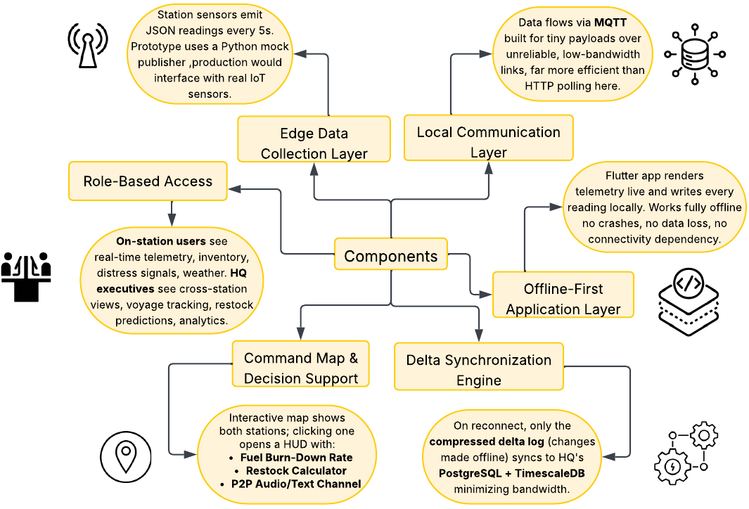

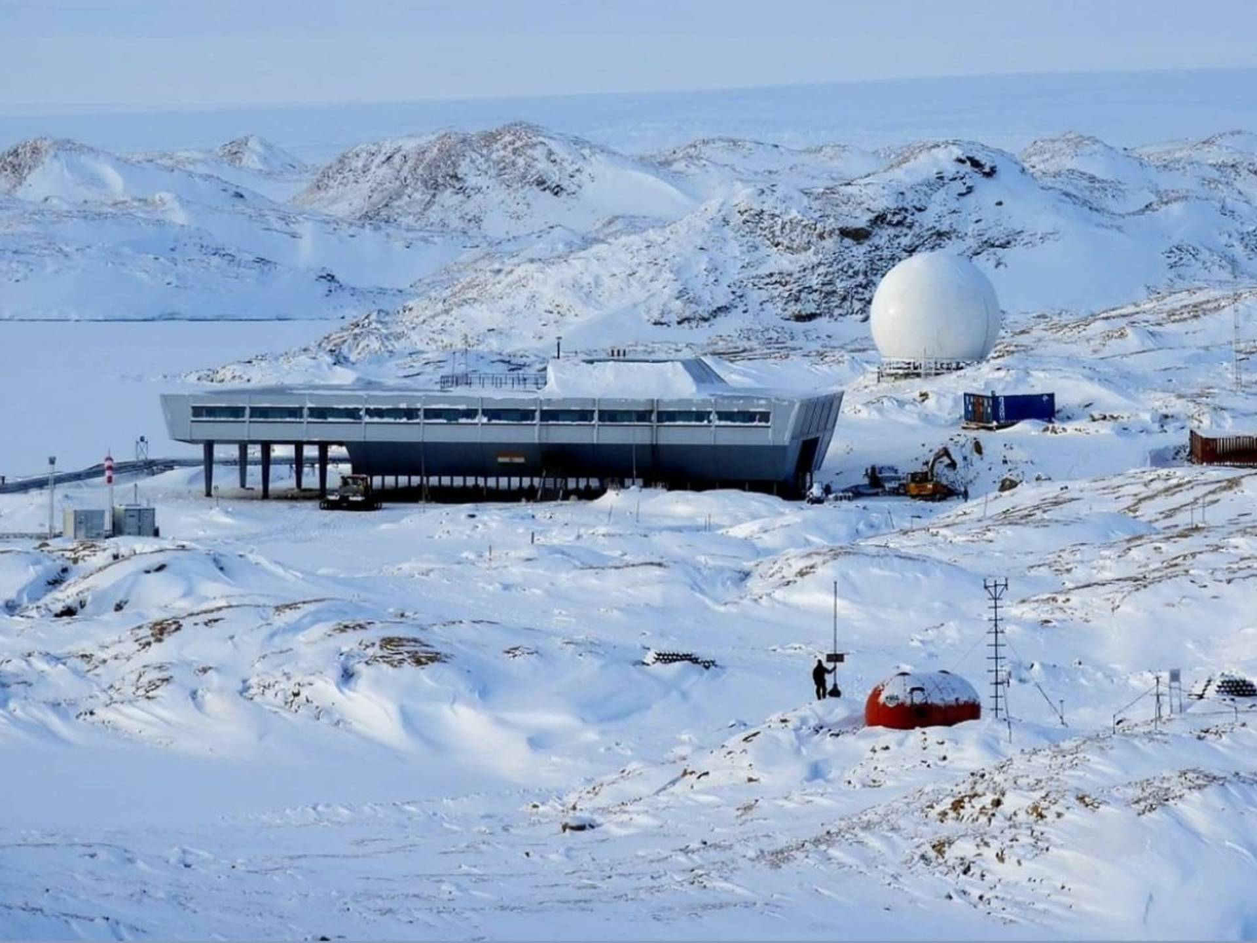
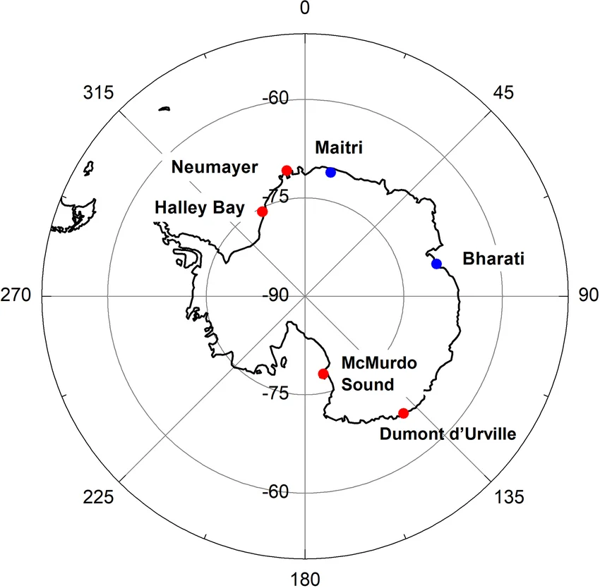
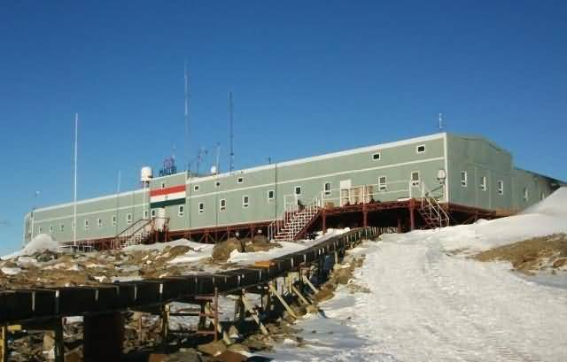
IDEA TITLE
ARCH
LARPERS
404
Proposed Solution (Describe your Idea/Solution/Prototype)
We propose an offline-first, satellite-resilient monitoring and command system for India's Antarctic research stations — Bharati and Maitri connected to a central control centre at NCPOR HQ, Goa.
Station Console
for Base Commanders/Researchers
single cross-platform application built in Flutter
Command Centre Console
for NCPOR Executives

Slide 3
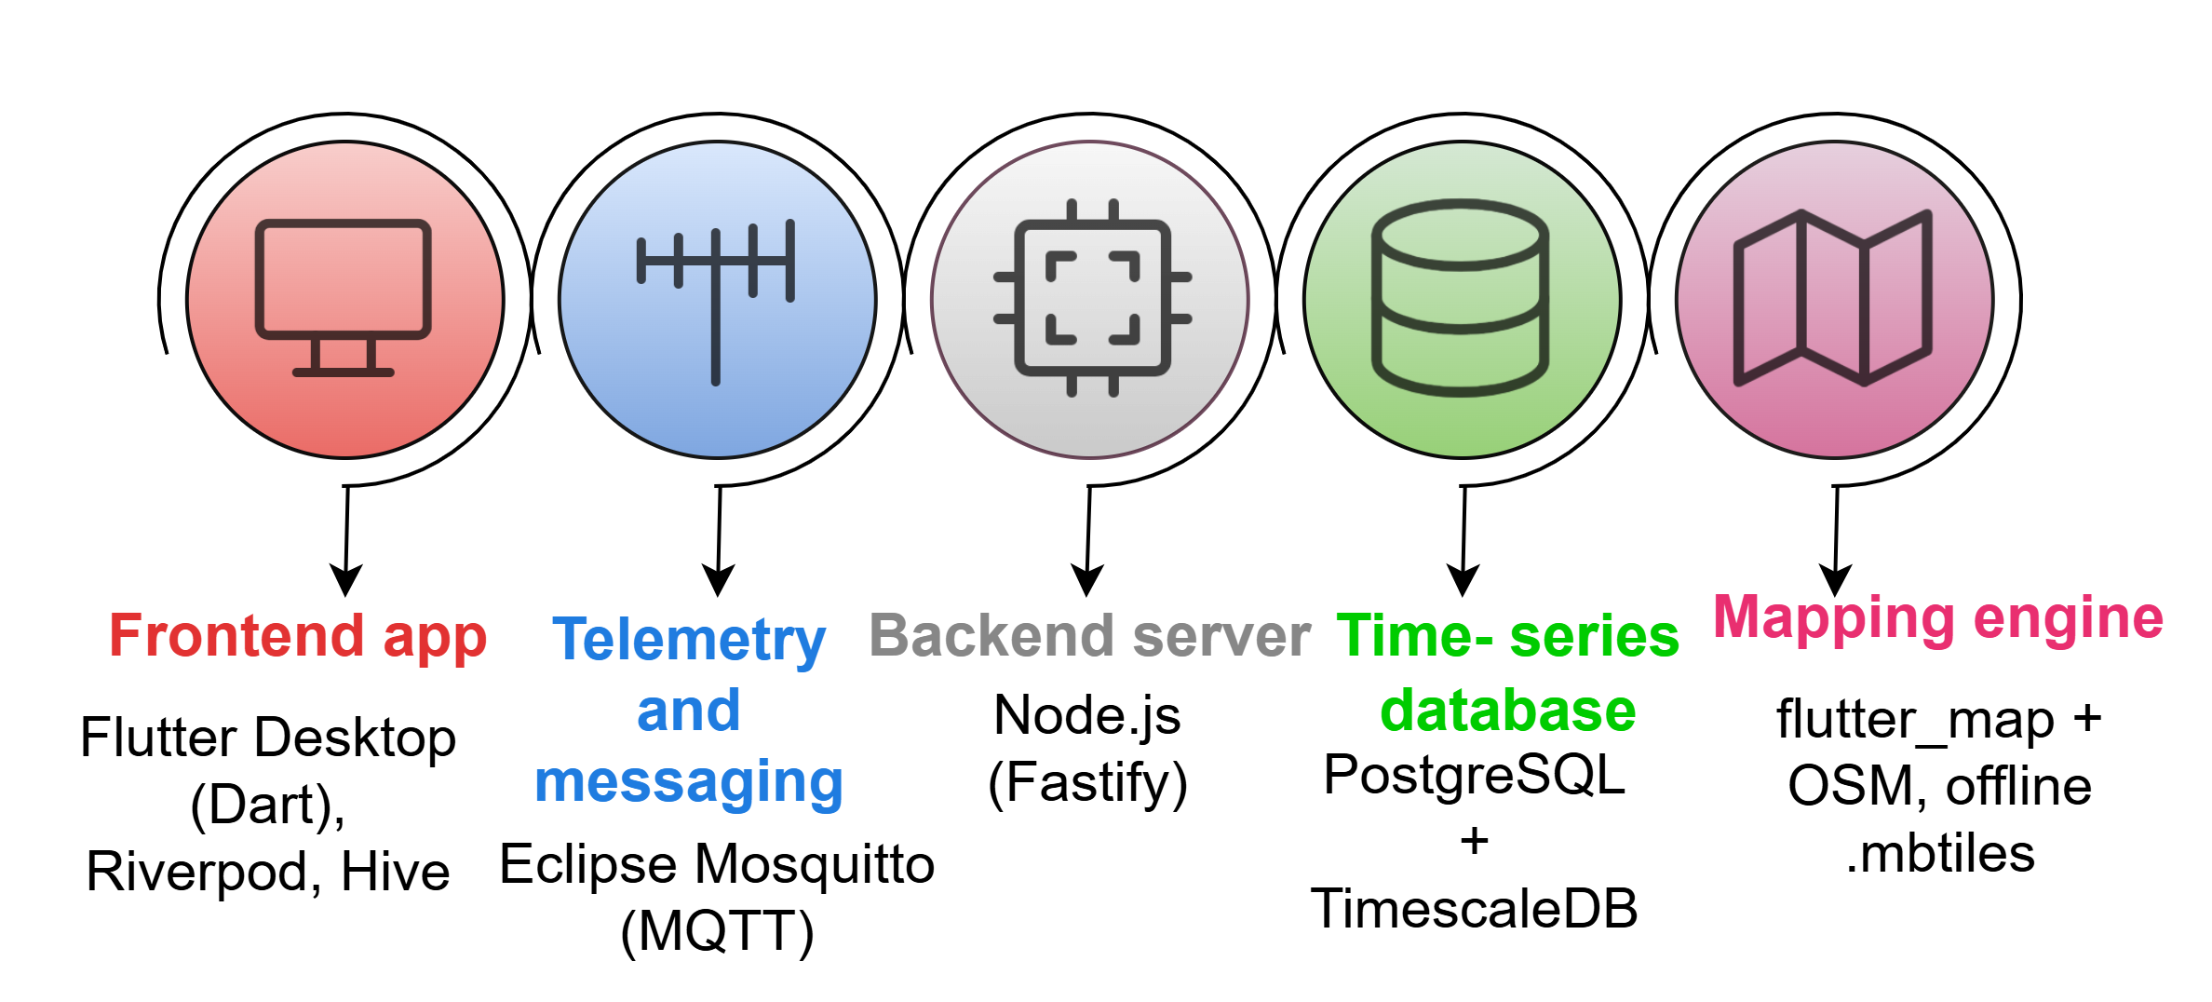
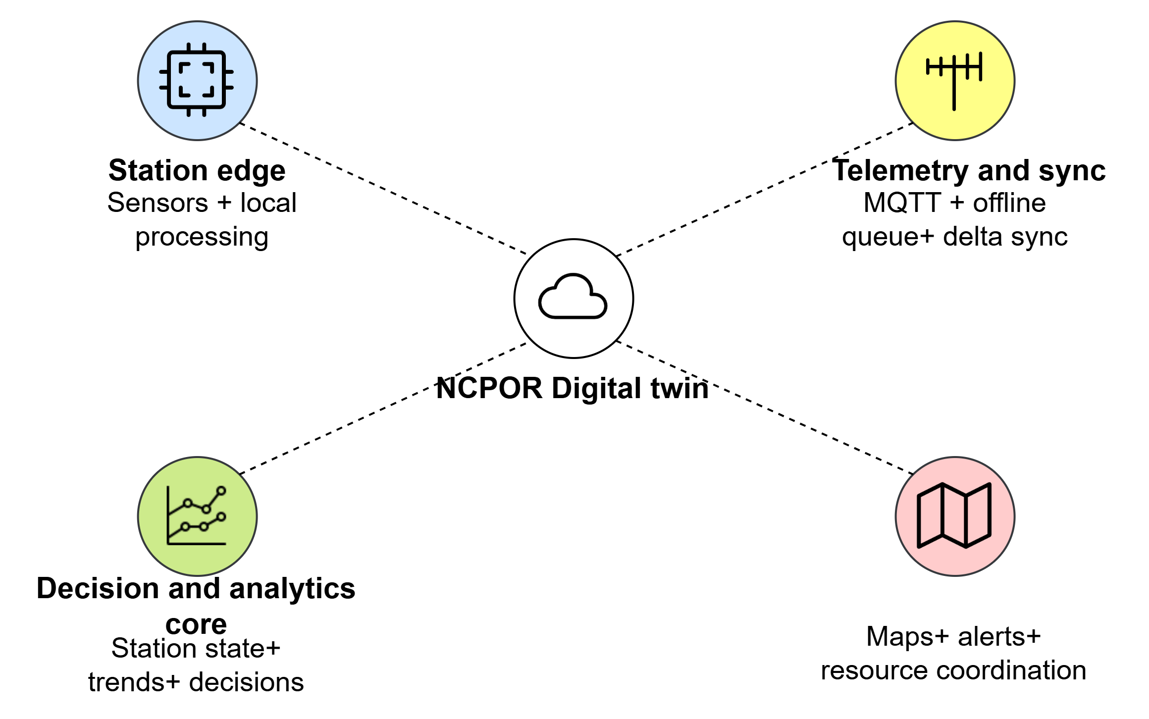
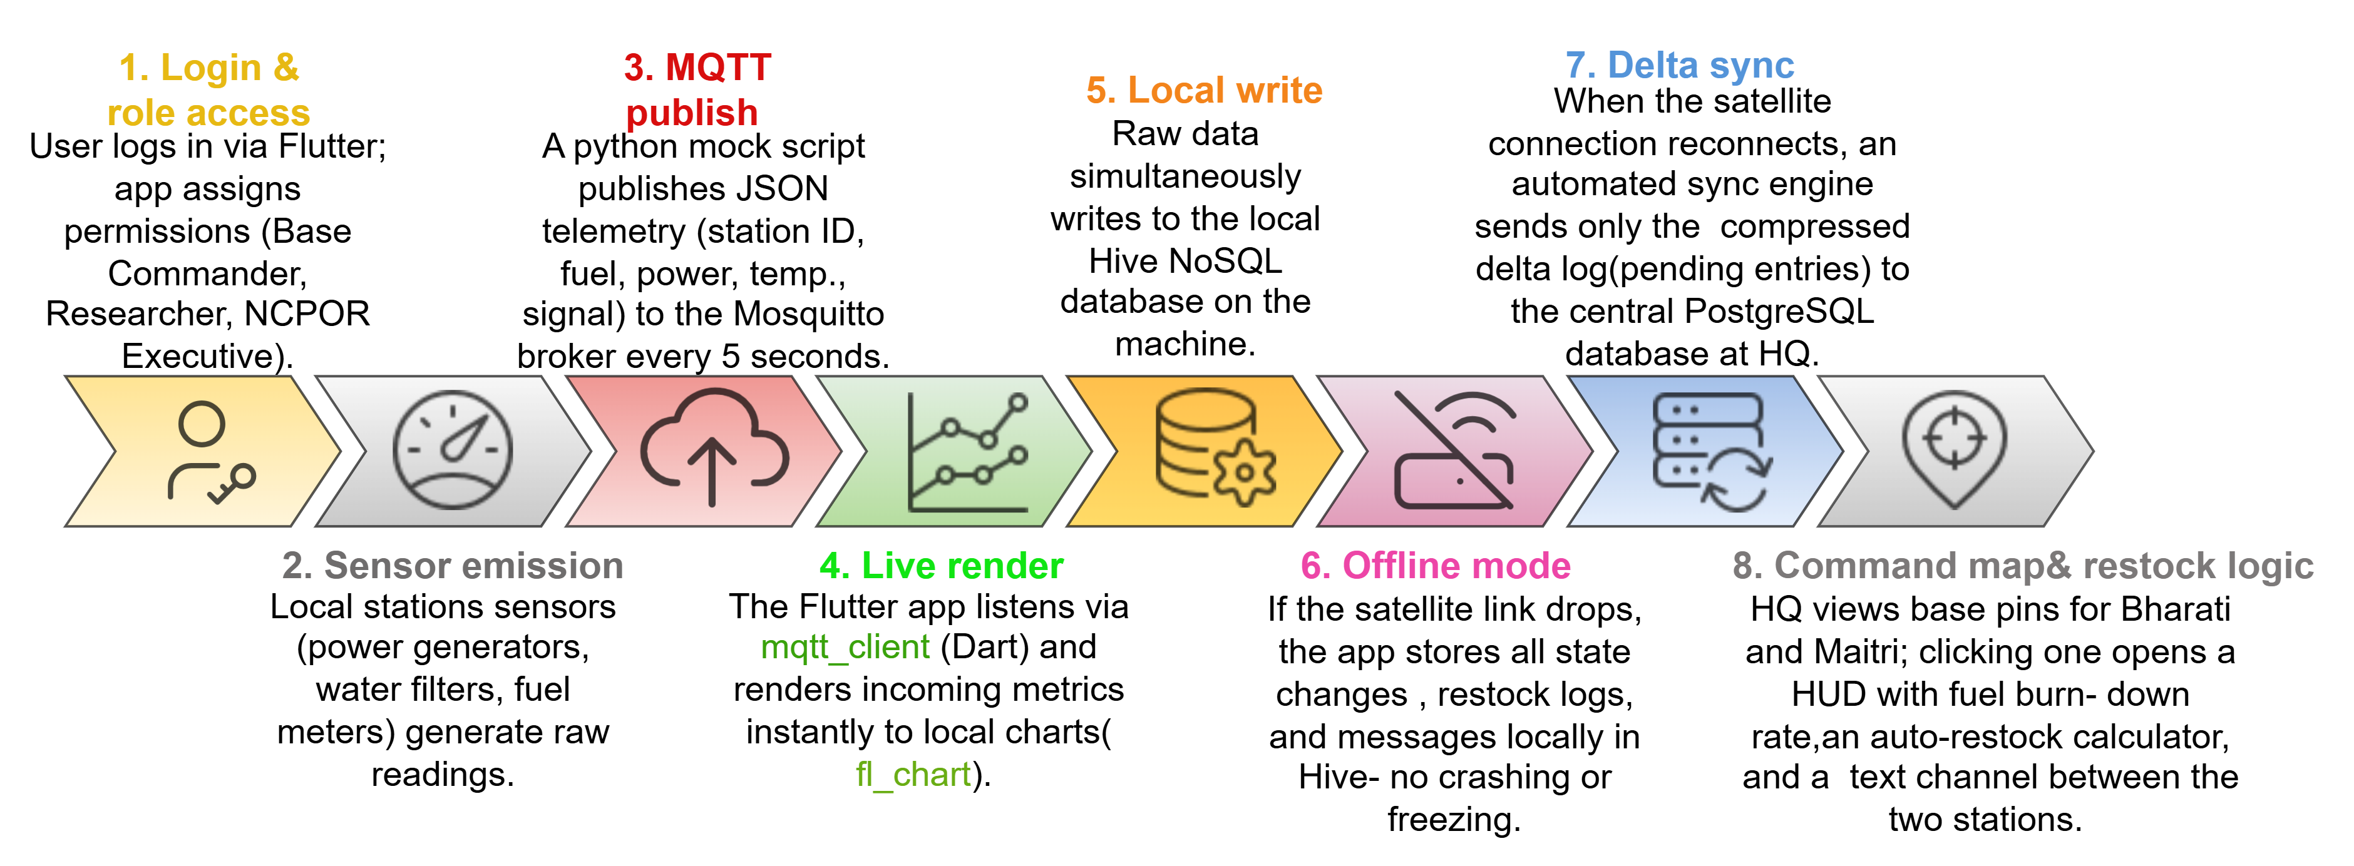
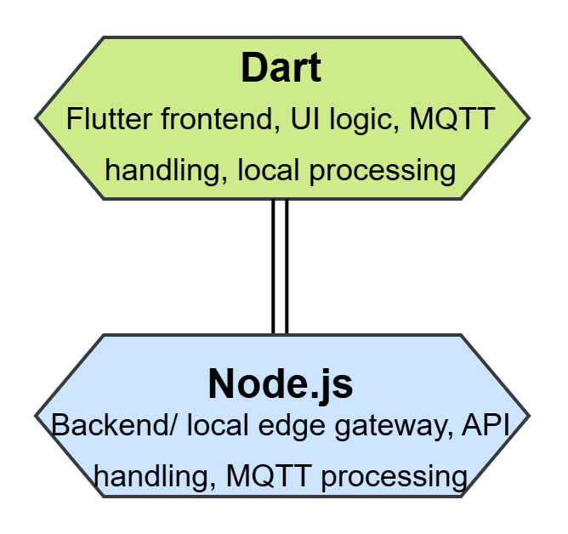
TECHNICAL APPROACH
ARCH
LARPERS
404
System Components
Technologies to be used
System Workflow
Programming
languages

Slide 4
FEASIBILITY AND VIABILITY
ARCH
LARPERS
404
FEASIBILITY
VIABILITY
TECHNICAL — HIGH
• Open-source stack
• Offline-first
• No new hardware
️
Decision Efficiency
Reliability
& Resilience
Continuous Monitoring
Transferability
Transforms live station data into actionable insights for faster intervention.
Ensures uninterrupted monitoring and reduced dependence on continuous human intervention.
Provides a unified, real-time view of infrastructure, energy, logistics and environmental health.
Can be adapted to other remote and low-connectivity environments.
OPERATIONAL — HIGH
• Existing infrastructure
• Intermittent-connectivity ready
• Remote monitoring
️
COST — LOW TCO
• Zero licensing
• Delta sync
• Low maintenance
CHALLENGE / RISK
MITIGATION / STRATEGY
️
CONNECTIVITY
-Intermittent satellite communication
→ Offline-first storage with automatic sync
EXTREME CONDITIONS
-Harsh cold affects sensor reliability
→ Redundant sensors with periodic recalibration
SCALABILITY — HIGH
• Modular sensors
• Multi-station ready
• Easily extensible
BANDWIDTH
-Limited bandwidth for data transfer
️
→ Delta synchronization reduces data transmission
POWER
-Limited energy for edge systems
→ Lightweight MQTT with edge processing

Slide 5








IMPACT AND BENEFITS
ARCH
LARPERS
404
SOCIAL & HUMAN SAFETY
NCPOR HQ GOA
•Consolidated cross-station real-time telemetry
dashboard.
•Tracking of voyages during emergency supplies.
•Enhanced Safety: Instant distress alerts & automated life-support monitoring.
• Institutional Memory
POLAR PROGRAMME
ECONOMIC EFFICIENCY
•Avoids costly emergency ship charters through predictive restocking.
•Zero License Costs: Built entirely on open-source stack .
•Zero loss of life-critical operational history data , renewable fuel consumption.
ANTARCTIC DIGITAL TWIN IMPACT & BENEFITS
STATION CREW
SCIENTIFIC FOCUS
•Automated logging frees ~80% researcher time from manual checks.
•Immediate station-level distress & life-support alert triggers.
•Strengthens India's strategic polar infrastructure capabilities.
•Researchers focus on core polar science, not manual maintenance.
SCALABILITY
GREEN INITIATIVES
• Extends Himansh research posts and remote defence outposts with zero connectivity
• Deployment in off-grid disaster camps & remote naval outposts.
• Precise burn-down analytics reduce unnecessary fuel usage & emissions.
•Reduced ship trips align with Antarctic environmental protection.
@SIH Idea submission- Template
5

Slide 6
RESEARCH AND REFERENCES
ARCH
LARPERS
404
Antarctica and digital twins: towards integrated outreach, open science and research station management
NATIONAL CENTRE FOR POLAR AND OCEAN RESEARCH
C. Caini, H. Cruickshank, S. Farrell and M. Marchese, "Delay- and Disruption-Tolerant Networking (DTN): An Alternative Solution for Future Satellite Networking Applications," in Proceedings of the IEEE, vol. 99, no. 11, pp. 1980-1997, Nov. 2011, doi: 10.1109/JPROC.2011.2158378.
Mallorquí A, Zaballos A. A Heterogeneous Layer-Based Trustworthiness Model for Long Backhaul NVIS Challenging Networks and an IoT Telemetry Service for Antarctica. Sensors (Basel). 2021 May 15;21(10):3446. doi: 10.3390/s21103446. PMID: 34063376; PMCID: PMC8157133
Fatma Hmissi, Sofiane Ouni. TD-MQTT: Transparent Distributed MQTT Brokers for Horizontal IoT Applications. arXiv 2406.02731.
Atmoko, Rachmad & Riantini, Rona & Hasin, M. (2017). IoT real time data acquisition using MQTT protocol. Journal of Physics: Conference Series. 853. 012003. 10.1088/1742-6596/853/1/012003.
Kleppmann, Martin & Wiggins, Adam & Hardenberg, Peter & McGranaghan, Mark. (2019). Local-first software: you own your data, in spite of the cloud. 154-178. 10.1145/3359591.3359737.

