Slide 1
Supply chain Analytics Assignment
Analysis of DataCo. Supply chain Dataset
Presented By:
Abeer Pareek

Slide 2
Presentation Flow
About Dataset
EDA
Expected Shipment Time Estimation
ABC Analysis
Suggested Action

Slide 3
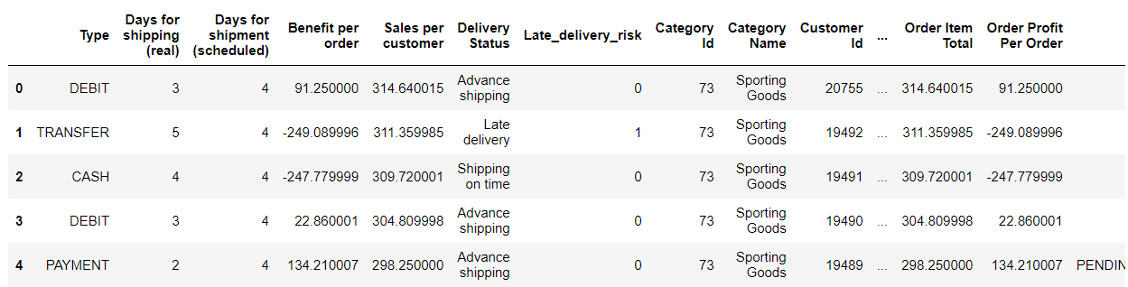
About Data
Dataco global's supply chains dataset includes products, financials (profit and loss, total sales, etc.), Shipments, and customers. The dataset contains 53 columns that detail 180,520 customers who purchased clothing, sports equipment, and electronic components. Some of the important columns are as follows:
Market
Order City
Order Customer Id
Order Item Discount
Order Item Quantity
Sales
Product Category Id
shipping date (DateOrders)
Order Item Product Price
Days for shipping (real)
Days for shipment (scheduled)
Benefit per order
Sales per customer
Late_delivery_risk
Category Id
Category Name
Customer Segment
Department Id

Slide 4
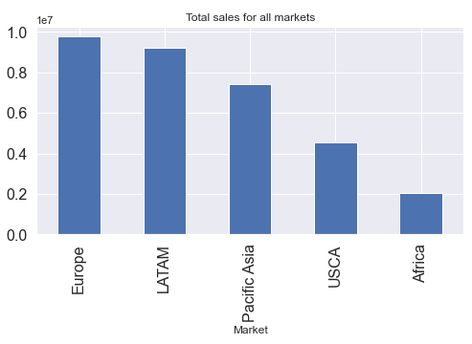
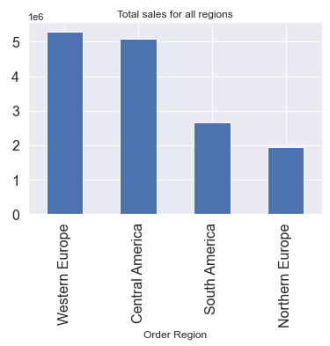
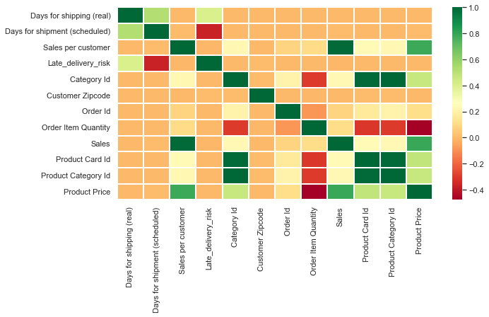
Exploratory Data Analysis
Total Market Sales
Total Regional Sales
Correlation Matrix
Sales and Per customer are highly correlated Product price
Costly products are purchased in less quantity by an individual as order quantity is negatively correlated to the Price of the product
Europe being the biggest market for the brand but it is not having any significant dominance displaying the global presence of the brand.
When observed at a level deeper Western Europe and Central America are neck to neck in quantity sales.

Slide 5
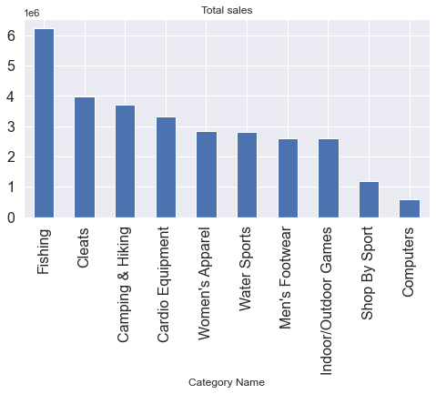
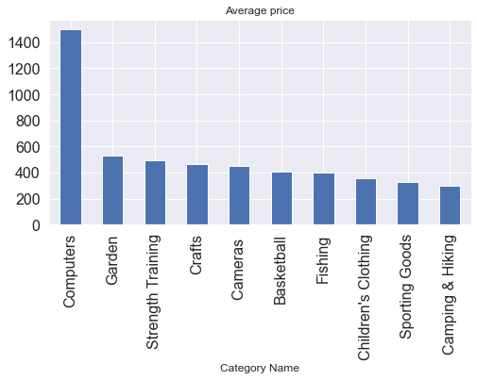
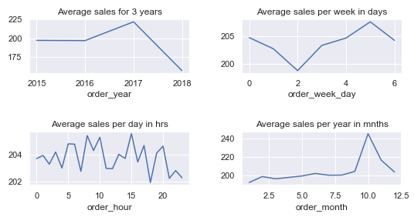
Top Selling Products
Total Regional Sales
Time- Sale Visual
From the plots it can be observed that:
Fishing products are sold and are having a product level dominance
Computers are the costliest Products available followed by Gardening category products. And the ration between the price of the two categories is approx 3:1
There have been a steady increase in sales from year 2015 to 2017 and since the data is not for complete year of 2018 it shows a sudden dip in the average sales for that year
On checking the order dates, it was found that on the Tuesdays the sales are the least while Saturdays attract most sales.
The month of October is the most engaging month in a year while the start of the years are low sales months.

Slide 6
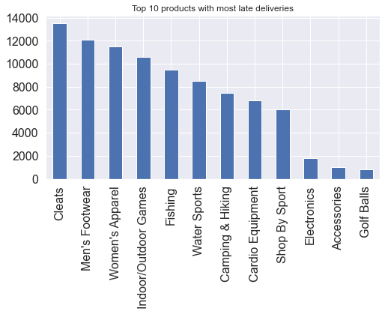
Expected Shipment time Estimation
This analysis is done to help the company understand which products are late for delivery and to help them understand how should they plan the time taken for shipment of any product.
It can be assumed that a longer expected shipment time will be fine with the customers but the product being delivered late can impact the brand image.
Firstly, it was found that there are 9 categories which are having most late deliveries from which cleats, footwears, apparels stands at the top.

Slide 7
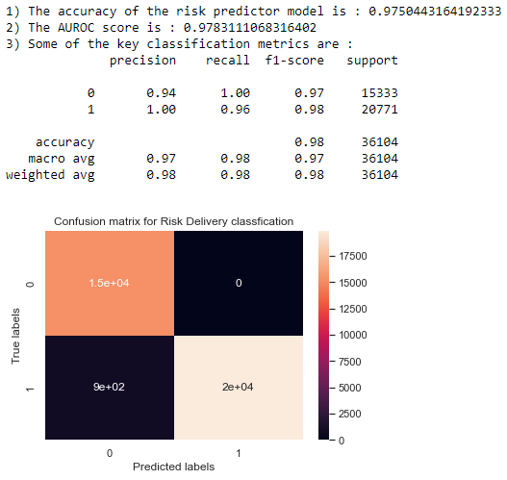
This problem can be because of two reasons
Product schedule planning is not done properly
There is problem in the product management system which leads to late delivery
For the later problem more data is required hence we will be looking at the first problem
We created a decision tree model to train on the data classifier to classify orders with high probability of late delivery (late delivery risk analyzer) hence using it to estimate the delivery time of the product so as it do not result in late delivery.
The model is trained and tested by splitting the dataset into ratio of 80:20 and the output of the model is presented in the image.
Decision Tree Model Output

Slide 8
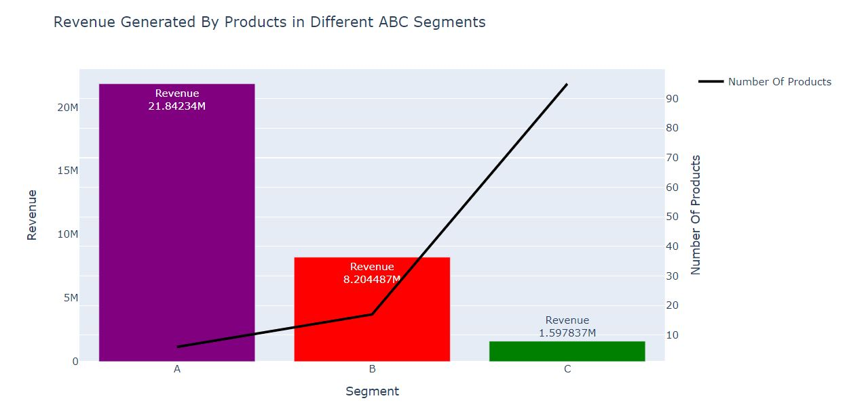
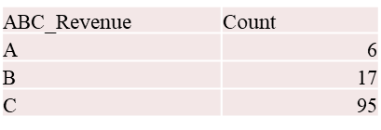
ABC Analysis
We can see that 6 products(class A) contribute to 75% of the total revenue. They are critical for the store, and we should provide a high service level for them. We should have safety stock for them and never be out of stock for these products.
B category products here contribute to around 20% of revenue. They are also important to the business. We should have them in stock, and have a procedure in place to order them.
Inventory of class c products should be minimum as they generate the least revenue. There are 95 products in class C and if we have inventory of such products more than is needed, a lot of stocking space will be utilized also a lot of capital will get blocked.

Slide 9
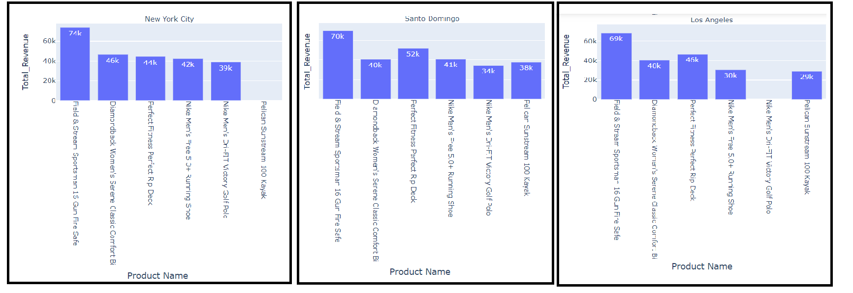
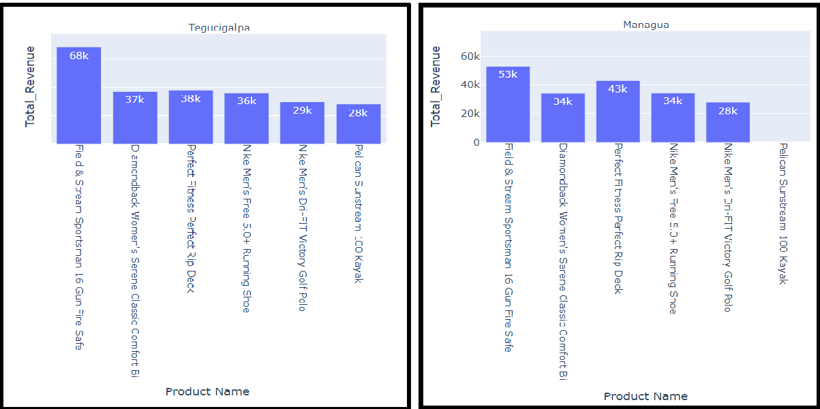
Segmentation of A category products in top 5 cities

Slide 10
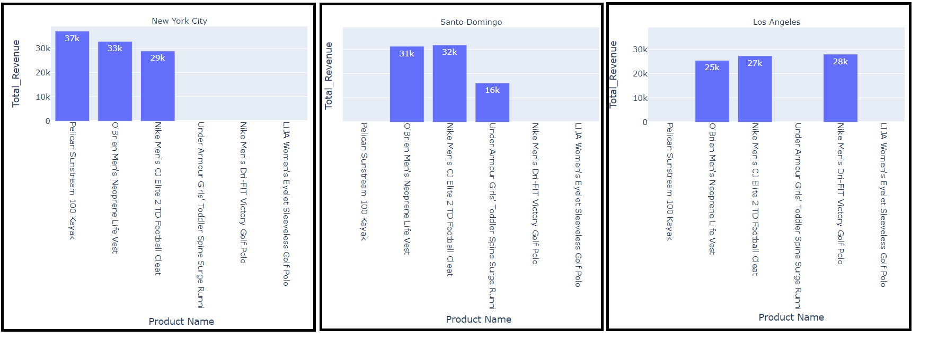
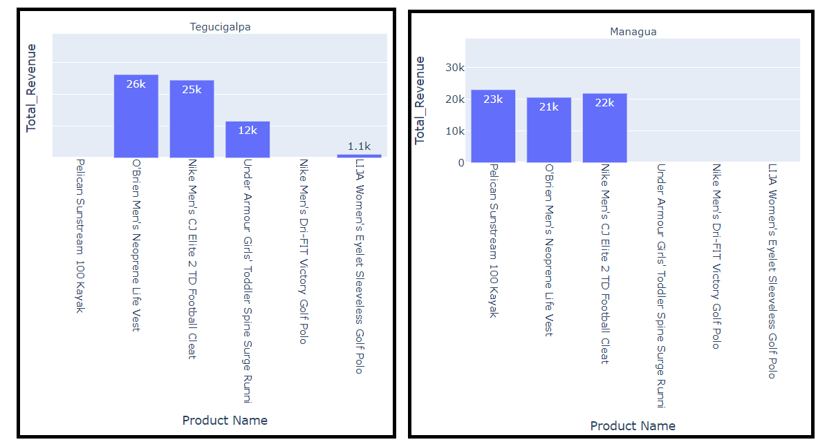
Segmentation of B category products in top 5 cities

Slide 11
Segmentation of A category products in top 5 cities
Segmentation of B category products in top 5 cities
We could see that the product “field & stream sportsman 16 gun fire safe” has the highest revenue in all top 5 cities.
“Pelican sunstream 100 kayak” has no sale in managua and new york city.
Revenue generated by different products are different in different cities and there is no fixed pattern
“O’brien men’s neoprene life vest” is the only product that is sold in all the top 5 cities and generate a descent amount of revenue from all the top 5 cities

Slide 12
Post analysis action Plan
To deal with the decreasing sales and the late delivery of the products Company should work on the following parameters:
Further Investigate on the Root cause of the problem of individual product delivery, and select the category of Cleats and men’s footwears for analysis for starters
Work with the new model and measure the progress if there is any improvement in the late delivery of the product.
On basis of ABC analysis introducing inventory management plan to focusing on products based on their priority which will help increase in service level.

Slide 13
Thank you

