Slide 1
Announcements
Grading: 60% homework (30 pts), 40% participation (20 pts)

Slide 2
Announcements
Grading: 60% homework (30 pts), 40% participation (20 pts)
HW: Up to 12 pts, 10 pts each max
Participation: 2.5 pts each class *due by next class* (A2.b thread today)

Slide 3
Announcements
Grading: 60% homework (30 pts), 40% participation (20 pts)
HW: Up to 12 pts, 10 pts each max
Participation: 2.5 pts each class *due by next class* (A2.b thread today)
Let Paul Cognata know by tomorrow: Letter, Pass/Fail, or Audit

Slide 4
Announcements
Grading: 60% homework (30 pts), 40% participation (20 pts)
HW: Up to 12 pts, 10 pts each max
Participation: 2.5 pts each class *due by next class* (A2.b thread today)
Let Paul Cognata know by tomorrow: Letter, Pass/Fail, or Audit
HW2 due Tue @ 8 AM PST, will receive graded HW1 around then
Don’t worry about ‘missing’ (explanation RE Canvas + Jupyterhub)

Slide 5
Announcements
Grading: 60% homework (30 pts), 40% participation (20 pts)
HW: Up to 12 pts, 10 pts each max
Participation: 2.5 pts each class *due by next class* (A2.b thread today)
Let Paul Cognata know by tomorrow: Letter, Pass/Fail, or Audit
HW2 due Tue @ 8 AM PST, will receive graded HW1 around then
Don’t worry about ‘missing’ (explanation RE Canvas + Jupyterhub)
HW3 available, HW4 will be available Tuesday (and so on)
*Note, may better to look ahead rather than get a head start

Slide 6
Resources
Bash (why we have the participation thread)
Scripting cheatsheet
Changing directory
Running scripts (different ways)
Awk
awk examples
pattern examples
Nano vs emacs vs vim
Zoom study group (self-organized) for any time Meeting ID: 944 7012 5565 Passcode: AbcbStudy

Slide 7
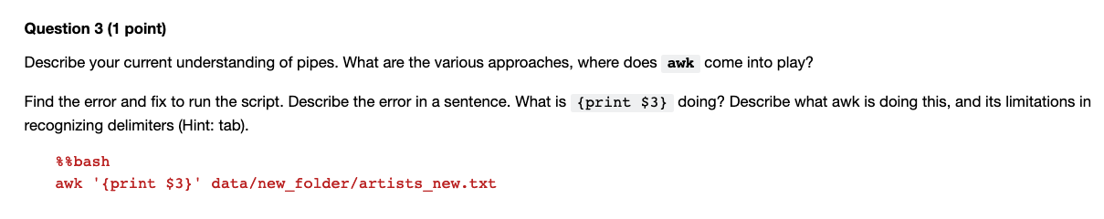
HW2 - An intro to debugging

Slide 8
A2.ba
Loops
Sabah Ul-Hasan Credit: Karthik Gangavarapu

Slide 9
What’s a Loop?
Runs the code you wrote again and again until you let it know to stop
Loops can assist navigating a larger task where there’s either/or, true/false etc
Loop can do commands repeatedly instead of writing out again

Slide 10
What’s a Loop?
In short, and way to iterate a task (condense code, save time)

Slide 11
What’s a Loop?
In short, and way to iterate a task (condense code, save time)
Bash categories
for - most common, list of items
while - repeated commands until a condition occurs
until - corresponds to condition that is true / false
select - numbered, selected options
https://www.tutorialspoint.com/unix/for-loop.htm
https://tldp.org/HOWTO/Bash-Prog-Intro-HOWTO-7.html

Slide 12
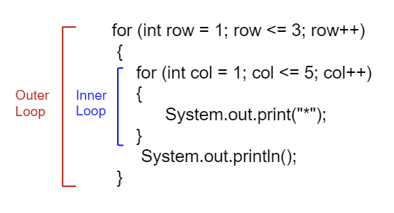
Example (Nested)
https://bash.cyberciti.biz/guide/Nested_for_loop_statement

Slide 13
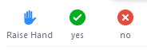
Let’s try it!
[ ] Complete A2.ba tasks in breakout groups of 3
*these are arranged by learning stage

Slide 14
A2.bb
Scripting
Sabah Ul-Hasan

Slide 15
Congratulations! You’re ready to code 😎

Slide 16


Congratulations! You’re ready to code 😎
+
https://cultofthepartyparrot.com/

Slide 17

Congratulations! You’re ready to code 😎
=

Slide 18
Writing a Script

Slide 19
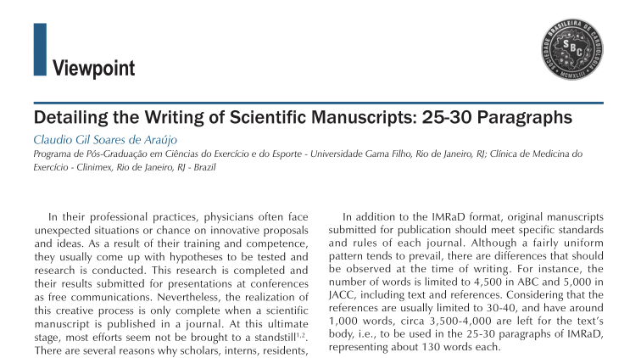
Writing a Script
Manu-script

Slide 20
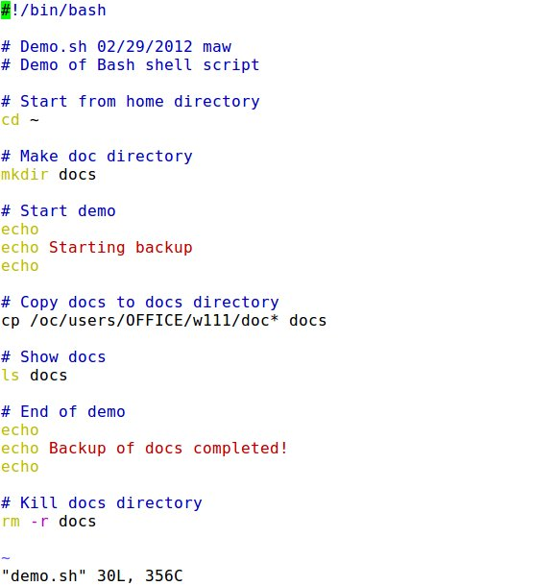
Writing a Script
Manu-script Bash script
http://cis2.oc.ctc.edu/oc_apps/Westlund/xbook/xbook.php?unit=10&proc=book

Slide 21
Tying it altogether
Basic commands
Redirections, pipes, glob, awk
Loops
vi editor, nano, chmod...
https://bertvv.github.io/cheat-sheets/Bash.html

Slide 22
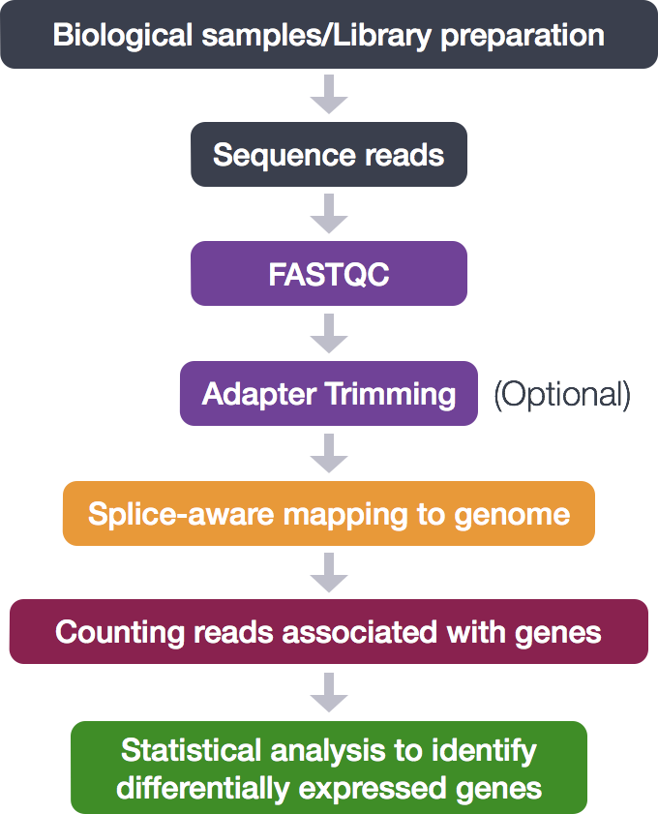
Tying it altogether
{
Basic commands
Redirections, pipes, glob, awk
Loops
vi editor, nano, chmod...
https://bertvv.github.io/cheat-sheets/Bash.html

Slide 23
Running the job (script)?

Slide 24
Running the job (script)? HPC aka jupyterhub
High Performance Computer https://www.scripps.edu/science-and-medicine/cores-and-services/high-performance-computing/index.html

Slide 25
Running the job (script)? HPC aka jupyterhub
High Performance Computer https://www.scripps.edu/science-and-medicine/cores-and-services/high-performance-computing/index.html
More on this later in the course (~week 9)

Slide 26
Let’s try it!
[ ] Complete A2.bb tasks on your own
[ ] If you get done early, start the rest of over-the-weekend HW2

Slide 27
Zoom Poll
What’s been the most difficult day, thus far?
Day 1 (A1.a)
Day 2 (A1.b)
Day 3 (A2.a)
Day 4 (A2.b, today)
Notes:
Want to know if you encounter unwelcoming behavior outside or inside classroom

Slide 28
Zoom Poll
What’s been your favorite suite of topics, thus far?
Day 1 (A1.a)
Day 2 (A1.b)
Day 3 (A2.a)
Day 4 (A2.b, today)
Notes:
Want to know if you encounter unwelcoming behavior outside or inside classroom

