Slide 1
Blood Glucose Forecasting
Progress Update — Bachelor Project
University of Duisburg-Essen
Khalil & Abeer | 2026-07-11
Blood Glucose Forecasting | University of Duisburg-Essen
1

Slide 2
Overview
What we did since the last meeting
Corrected the LSTM Autoencoder architecture (Srivastava et al. 2015)
Built a shared GitHub repository with unified src/ structure
Replaced fixed 80/20 split with Walk-Forward Validation
Added Grid Search with literature-justified parameter ranges
Ran full benchmark: 5 models × 12 patients × 3 horizons (added Transformer)
Fixed a Random Forest bug (nested parallelism crashing on Windows)
Re-ran feature ablation excluding patients 563/575 (professor's request)
Extended Grid Search to Autoencoder, TCN, and Transformer
Added Clarke Error Grid analysis for every feature combination
New: Glucdict dataset pipeline (13 patients) — cross-dataset validation
Blood Glucose Forecasting | University of Duisburg-Essen
2

Slide 3
Shared Repository Structure
Folder | Contents
src/preprocessing/ | Dataset-specific loaders (OhioT1DM XML, BIG IDEAs parquet)
src/models/ | RF, LSTM, Autoencoder, TCN — identical interface
src/training/ | Pipeline, Walk-Forward splits, Grid Search
src/evaluation/ | Metrics, Clarke Error Grid plots
experiments/ | One notebook per dataset
Blood Glucose Forecasting | University of Duisburg-Essen
3

Slide 4
Decision 1: Walk-Forward Validation
BEFORE
AFTER
Fixed 80/20 chronological split. One validation estimate — potentially biased by the specific 20% period chosen.
Walk-Forward Validation (TimeSeriesSplit, n_splits=3). Each fold trains on the past, validates on the immediately following period.
→
Justification: Cerqueira et al. (2020), Bergmeir & Benítez (2012) — walk-forward CV avoids future leakage and respects autocorrelation in CGM data.
Blood Glucose Forecasting | University of Duisburg-Essen
4

Slide 5
Decision 2: Corrected Autoencoder Architecture
BEFORE (wrong)
Encoder LSTM → bottleneck → linear layer prediction
AFTER (correct — Srivastava et al. 2015)
Encoder LSTM → bottleneck (64 → 32) → Decoder LSTM • Decoder initialised from latent vector • Autoregressive: each predicted step fed back as next input • Output layer: Decoder hidden state → one glucose value per step
Key difference: the decoder is a full LSTM — not a linear layer.
Blood Glucose Forecasting | University of Duisburg-Essen
5

Slide 6
Decision 3: Grid Search with Literature Justification
Random Forest
LSTM
Parameter | Values | Source
n_estimators | [50, 100, 200] | Probst et al. (2019)
max_depth | [10, 15, 20] | Biau & Scornet (2016)
min_samples_leaf | [1, 2, 4] | Probst et al. (2019)
Parameter | Values | Source
hidden_size | [32, 64, 128] | Kalita & Mirza (2025)
lr | [0.001, 0.0005] | Kingma & Ba (2015)
Best found: RF: n_estimators=200, max_depth=10, min_samples_leaf=4 LSTM: hidden_size=128, lr=0.0005
Blood Glucose Forecasting | University of Duisburg-Essen
6

Slide 7
Decision 3b: Grid Search Extended to All 5 Models
Autoencoder, TCN, Transformer — previously untuned / hardcoded
Same validation-set search strategy as LSTM: architecture width × learning rate, on patient 559
Model | Parameter | Values | Source
Autoencoder | latent_size | [16, 32, 64] | Srivastava et al. (2015) — bottleneck sizing
 | lr | [0.001, 0.0005] | Kingma & Ba (2015)
TCN | num_filters | [32, 64, 128] | Bai et al. (2018) — TCN capacity
 | lr | [0.001, 0.0005] | Kingma & Ba (2015)
Transformer | d_model | [32, 64, 128] | Vaswani et al. (2017), nhead=4 fixed
 | lr | [0.001, 0.0005] | Kingma & Ba (2015)
Best found: Autoencoder: latent_size=16, lr=0.0005 TCN: num_filters=32, lr=0.0005 Transformer: d_model=128, nhead=4, lr=0.0005
Blood Glucose Forecasting | University of Duisburg-Essen
7

Slide 8
Main Results
OhioT1DM | Clinical features (glucose, bolus, carbs) | 12 patients | all 5 models tuned
RMSE [mg/dL] mean ± std across 12 patients
Horizon | RF | LSTM | Autoencoder | TCN | Transformer
5 min | 5.87 ± 1.97 | 5.76 ± 1.42 | 6.37 ± 1.67 | 8.24 ± 2.46 | 8.51 ± 3.43
15 min | 14.06 ± 4.14 | 12.62 ± 2.45 | 12.91 ± 2.47 | 14.67 ± 2.22 | 14.12 ± 3.28
30 min | 23.35 ± 6.00 | 21.21 ± 3.48 | 21.41 ± 3.49 | 24.29 ± 3.73 | 22.91 ± 4.54
Model hierarchy at 30 min: LSTM ≈ Autoencoder > Transformer > RF > TCN
All 5 models now use tuned hyperparameters (previously only RF/LSTM were grid-searched).
Blood Glucose Forecasting | University of Duisburg-Essen
8

Slide 9
Feature Ablation — Clean Cohort
2018 Cohort, excl. patients 563/575 (professor's request) | 30-min horizon | RF and LSTM
30-min RMSE [mg/dL] — mean ± std across 4 patients (★ = best)
Feature Set | RF RMSE | LSTM RMSE
glucose_only | 21.36 ± 2.29 | 20.54 ± 2.80
clinical ★ | 21.33 ± 2.27 | 20.22 ± 2.76
glucose_steps | 24.03 ± 4.78 | 21.37 ± 4.65
clinical_steps | 24.03 ± 4.78 | 21.24 ± 4.38
clinical_hr | 24.83 ± 2.48 | 23.61 ± 2.68
glucose_hr | 24.84 ± 2.51 | 24.91 ± 3.69
full | 32.61 ± 12.90 | 35.37 ± 18.81
wearable | 32.74 ± 13.08 | 33.75 ± 16.61
Clean re-run Excluding 563/575 removes the sparse-wristband distortion from the earlier run. glucose_only ≈ clinical — bolus/carbs add essentially nothing. full / wearable are consistently worst AND highest-variance — extra sensors hurt, not help, at the 30-min horizon. Also fixed: RF nested-parallelism bug that was silently dropping patients from some runs.
Blood Glucose Forecasting | University of Duisburg-Essen
9

Slide 10
Cross-Dataset Check: Glucdict
13 patients | Dexcom G6 + TicWatch HR + accelerometer + meal events | 30-min horizon
30-min RMSE [mg/dL] — mean ± std (N = patients with valid data for that feature set)
Feature Set | N | RF RMSE | LSTM RMSE
glucose_only ★ | 13 | 15.23 ± 2.26 | 13.98 ± 1.81
glucose_activity | 13 | 15.19 ± 2.21 | 13.97 ± 1.75
glucose_hr | 10 | 17.89 ± 9.90 | 17.17 ± 8.77
full_wearable | 10 | 17.28 ± 8.87 | 17.61 ± 9.43
Same pattern as OhioT1DM: glucose_only ≈ glucose_activity — meal/drink events add nothing. glucose_hr / full_wearable are worse AND lose 3 patients (User3/13/15 — no heart-rate coverage in their test-period tail, likely watch battery dropout, not a bug). Confirms the OhioT1DM finding on an independent dataset: extra wearable sensors don't improve 30-min forecasts.
RF/LSTM hyperparameters reused from the OhioT1DM grid search — no Glucdict-specific tuning yet.
Blood Glucose Forecasting | University of Duisburg-Essen
10

Slide 11
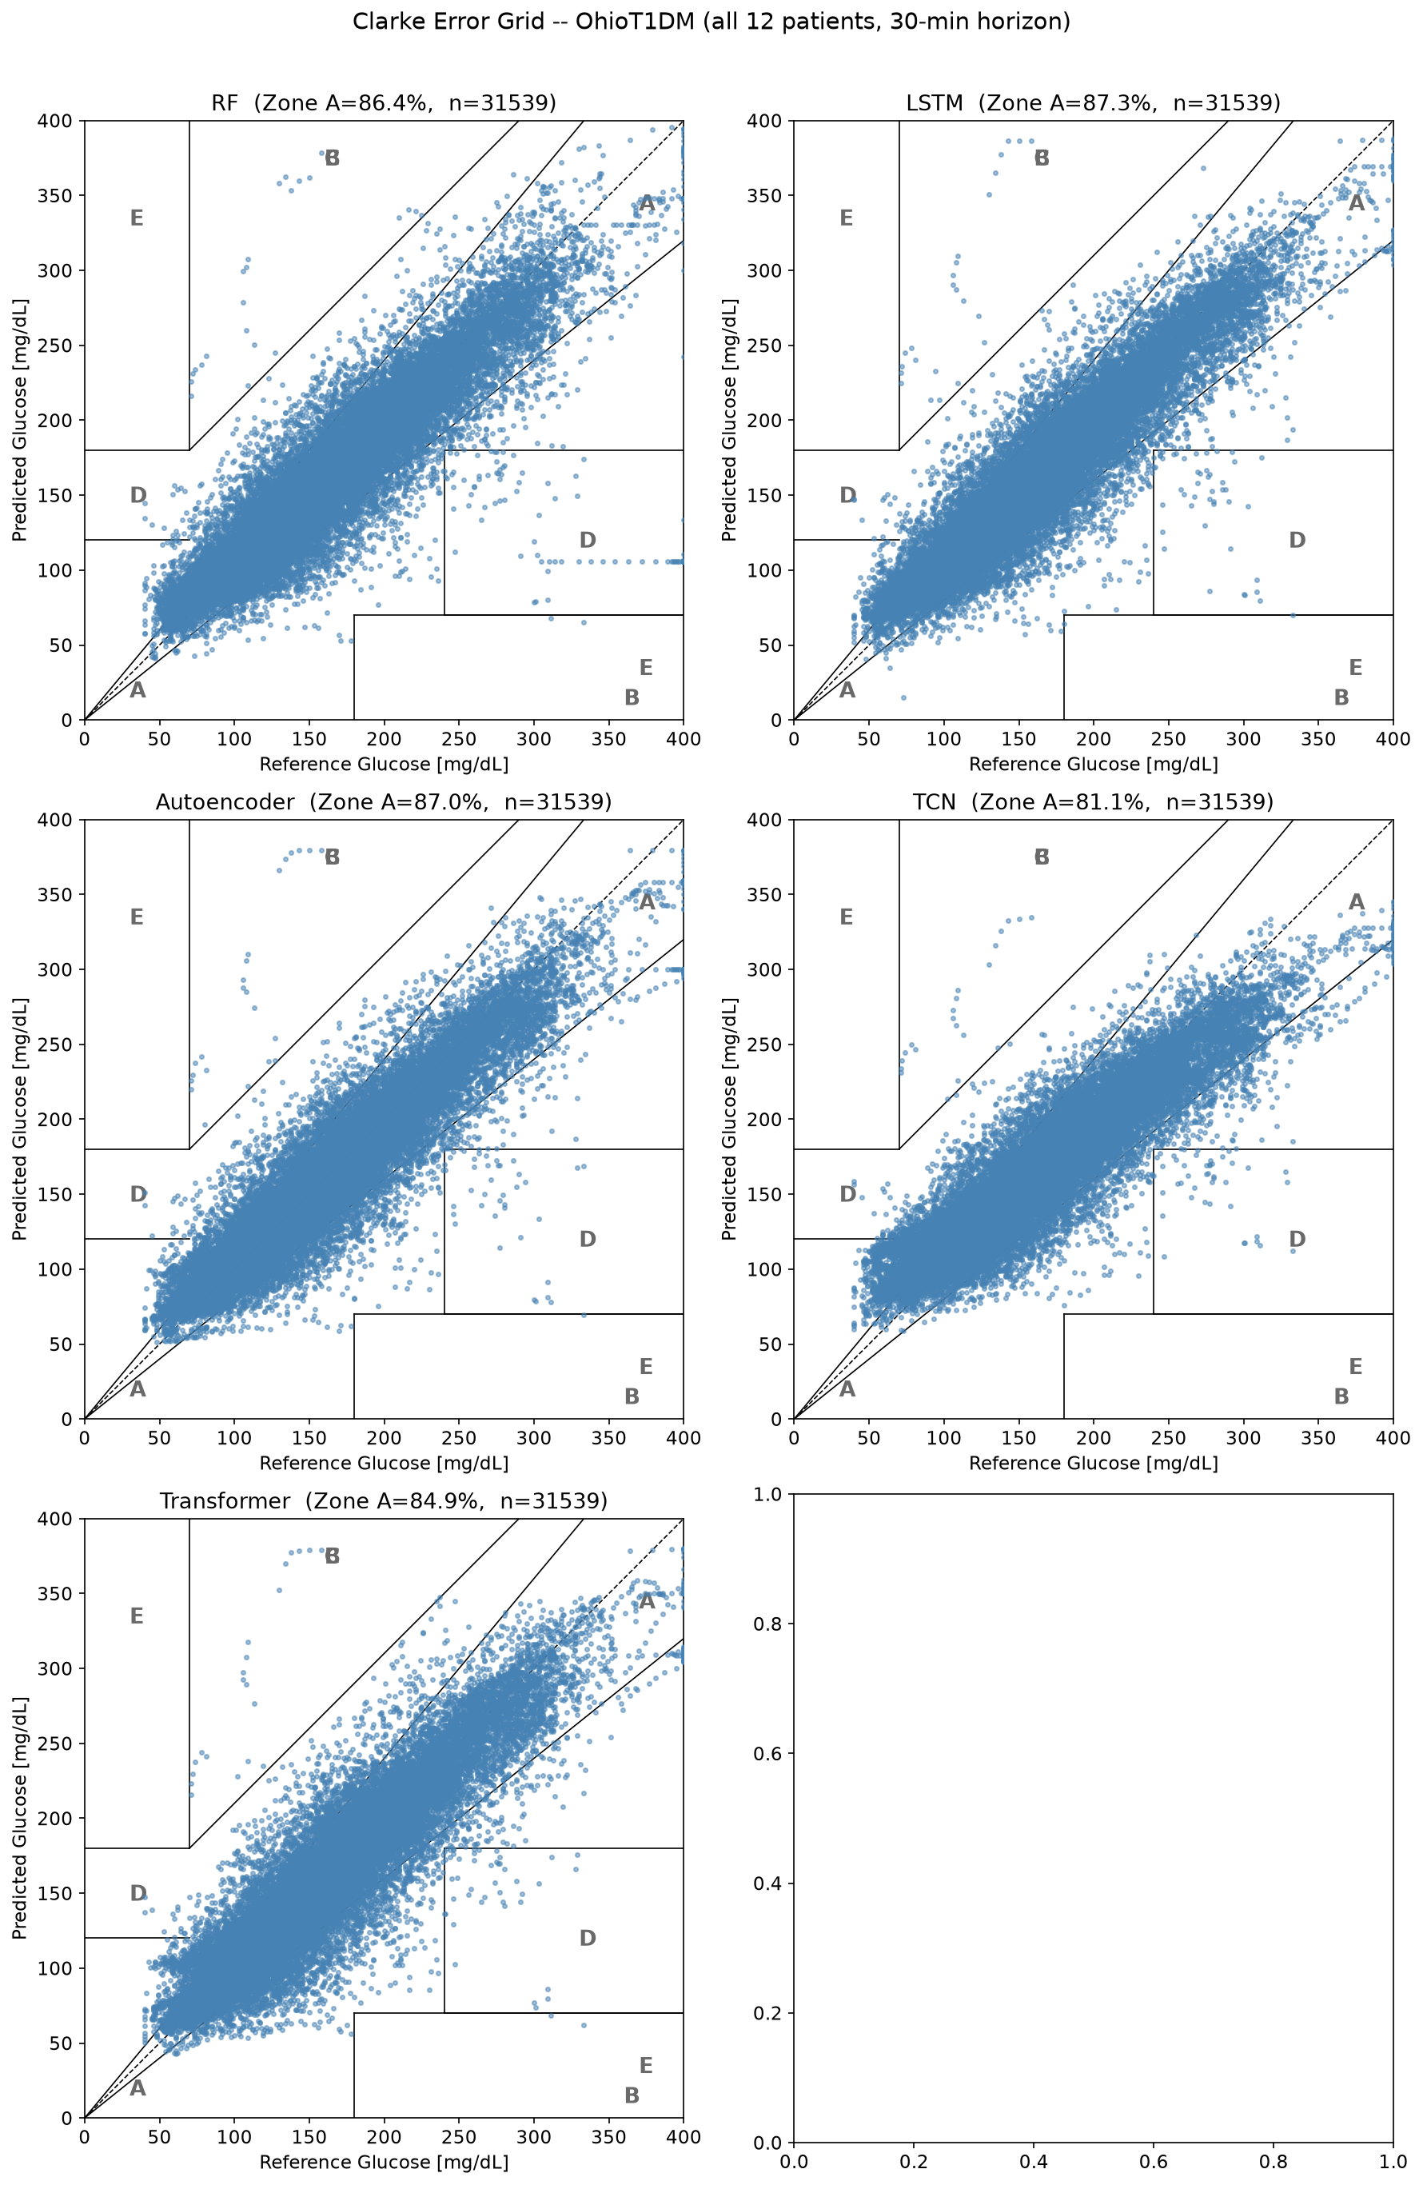
Clarke Error Grid
30-min horizon | all 12 patients pooled | all 5 models
Model | Zone A (mean ± std) | Zone B
LSTM | 87.3% ± 5.0% | 12.4%
Autoencoder | 87.0% ± 5.7% | 12.7%
Transformer | 85.0% ± 7.0% | 14.7%
RF | 86.4% ± 5.1% | 13.1%
TCN | 81.0% ± 8.5% | 18.7%
Target: > 95% Zone A Gap explained by 3-feature input only. TCN variance (8.5%) — inconsistent across patients.
Blood Glucose Forecasting | University of Duisburg-Essen
11

Slide 12
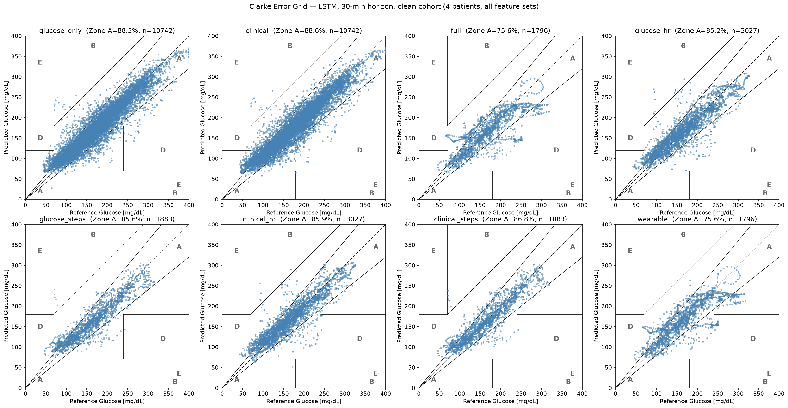
Clarke Error Grid — Every Feature Combination
LSTM, 30-min horizon, predictions pooled across patients
OhioT1DM clean cohort (4 patients, 8 feature sets):
Zone A drops from 88.6% (clinical) to 75.6% (full/wearable) — with 1.5% landing in dangerous Zone D once heartrate/steps are added.
Blood Glucose Forecasting | University of Duisburg-Essen
12

Slide 13
Literature Comparison
30-min horizon
Model | RMSE [mg/dL] | Dataset | Features
MHA-NBEATS (Kalita & Mirza 2025) | 16.57 | OhioT1DM | 5–6
Rodríguez-Rodríguez et al. | 18.60 | OhioT1DM | 5–6
Xiong et al. | 19.33 | OhioT1DM | 5–6
Our LSTM | 21.21 | OhioT1DM | 3
Our Autoencoder | 21.41 | OhioT1DM | 3
Our Transformer | 22.91 | OhioT1DM | 3
Our RF | 23.35 | OhioT1DM | 3
Grid Search reduced the gap by ~3 mg/dL vs. our previous run. Gap to Xiong et al.: only 1.9 mg/dL — with 3 features vs. 5–6.
Blood Glucose Forecasting | University of Duisburg-Essen
13

Slide 14
Key Findings
1
Grid Search matters: +2–3 mg/dL improvement over default parameters
2
LSTM best at 30 min (21.21 mg/dL), Autoencoder essentially tied — only 1.7 mg/dL behind Xiong et al.
3
Tuned Transformer (22.91) now beats RF and TCN — was worse than both when untuned
4
TCN still underperforms: OhioT1DM is too small / window too short for TCN's advantage to show
5
More features hurt, not help: on BOTH OhioT1DM and Glucdict, glucose_only/clinical beat every feature set that adds heartrate/steps — confirmed via RMSE and Clarke Zone A/D
6
Clarke Zone A ~87% (best models): below 95% target — explainable by 3-feature input only
Blood Glucose Forecasting | University of Duisburg-Essen
14

Slide 15
Next Steps
Glucdict-specific Grid Search (currently reusing OhioT1DM hyperparameters)
Investigate the User7 heart-rate outlier in Glucdict (RF RMSE 45 vs. cohort mean ~15)
Explore longer window sizes (24, 36, 72 steps)
Investigate Leave-One-Patient-Out (LOPO) cross-validation
Look for additional experiment setups from literature not yet covered
Merge Abeer's BIG IDEAs results into the shared benchmark
Blood Glucose Forecasting | University of Duisburg-Essen
15

