Slide 1
Blood Glucose Forecasting - Progress Update
University of Duisburg-Essen | Khalil & Abeer | July 2026
Blood Glucose Forecasting | University of Duisburg-Essen
1

Slide 2
What We Completed This Two-Week Block
Implemented 5th model: Transformer (Vaswani et al. 2017)
Integrated Glucdict dataset (13 users, Dexcom G6 + TicWatch)
Fixed critical OhioT1DM 2020 cohort loader bug (empty XML placeholder)
Expanded Grid Search to all 5 models with literature justification
Documented training epochs (early stopping — varies per model/patient)
Feature ablation: 2020 cohort (acceleration) + clean 2018 (no 563+575)
Leave-One-Patient-Out cross-validation (5 models, pooled + per-patient-scaled)
Cross-dataset transfer learning (OhioT1DM → Glucdict)
Preprocessing comparison table vs. literature
Unified Clarke Error Grid library across both pipelines (15/30/45-min)
Detailed final experiments plan
Blood Glucose Forecasting | University of Duisburg-Essen
2

Slide 3
Shared Repository Structure
Folder | Contents
src/preprocessing/ | Dataset-specific loaders (OhioT1DM XML, Glucdict CSV, BIG IDEAs parquet)
src/models/ | RF, LSTM, Autoencoder, TCN, Transformer — identical interface
src/training/ | Pipeline, Walk-Forward splits, Grid Search
src/evaluation/ | Metrics, Clarke Error Grid plots
experiments/ | One notebook per dataset
All 5 models share identical train_model / evaluate interface. Both datasets use the same pipeline, windowing, and evaluation code.
Blood Glucose Forecasting | University of Duisburg-Essen
3

Slide 4
Grid Search: All 5 Models
Best parameters found
Model | Best Parameters | Literature Justification
RF | n_estimators=200, max_depth=10, min_samples_leaf=4 | Probst et al. 2019
LSTM | hidden_size=128, lr=5e-4 | Kingma & Ba 2015
Autoencoder | latent_size=16, lr=5e-4 | Srivastava et al. 2015
TCN | num_filters=32, lr=5e-4 | Bai et al. 2018
Transformer | d_model=128, nhead=4, lr=5e-4 | Vaswani et al. 2017
Grid Search used Walk-Forward Validation (TimeSeriesSplit, n_splits=3) on patient 559 — Cerqueira et al. (2020)
RF — Probst et al. (2019): "The number of trees is the most important hyperparameter... with min.node.size and mtry being the most important parameters after ntree."
LSTM — Kingma & Ba (2015): "Good default settings for the tested machine learning problems are α = 0.001, β₁ = 0.9, β₂ = 0.999 and ε = 10⁻⁸."
Autoencoder — Srivastava et al. (2015): "The encoder LSTM reads the input sequence and maps it to a fixed-length vector representation. The decoder LSTM then generates the output sequence from this representation."
TCN — Bai et al. (2018): "We show that TCN outperforms canonical recurrent networks across a diverse range of tasks and datasets."
Transformer — Vaswani et al. (2017): "Multi-head attention allows the model to jointly attend to information from different representation subspaces at different positions."
Blood Glucose Forecasting | University of Duisburg-Essen
4

Slide 5
OhioT1DM Main Results
5 models, 3 horizons
Model | 5 min | 15 min | 30 min
RF | 5.87 ± 1.97 | 14.06 ± 4.14 | 23.35 ± 6.00
LSTM | 5.79 ± 1.49 | 12.60 ± 2.45 | 21.25 ± 3.48
Autoencoder | 6.41 ± 1.77 | 12.99 ± 2.57 | 21.45 ± 3.52
TCN | 8.04 ± 2.31 | 15.11 ± 2.35 | 24.82 ± 3.65
Transformer | 8.47 ± 2.70 | ~14-15 | 23.01 ± 4.05
All values in mg/dL. 12 patients, clinical features only.
Why RMSE?
All values are RMSE (Root Mean Squared Error) in mg/dL. RMSE was chosen because: (1) it is the standard metric in all comparison papers (Kalita & Mirza 2025, Bertachi et al. 2018, Rodríguez-Rodríguez et al. 2024), enabling direct literature comparison; (2) it penalises large errors more heavily than MAE — clinically appropriate since a 40 mg/dL error is far more dangerous than four 10 mg/dL errors.
Why highlighted green?
LSTM and Autoencoder highlighted: lowest RMSE at 30-minute horizon — the most clinically relevant prediction window for insulin dosing decisions.
Blood Glucose Forecasting | University of Duisburg-Essen
5

Slide 6
Training Epochs (Early Stopping)
Number of actual training epochs before early stopping triggered (patience=15, max_epochs=150). Lower = faster convergence.
Model | Mean epochs | Std | Min | Max | Note
LSTM | 54.5 | 15.8 | 32 | 76 | Early stopping at patience=15
Autoencoder | 72.4 | 24.3 | 36 | 100 | Longest — compression harder to optimise
TCN | 51.6 | 19.6 | 27 | 79 | Fast convergence
Transformer | 42.1 | 24.3 | 16 | 97 | Fastest mean — attention converges quickly
Epoch counts recorded per patient across all 12 OhioT1DM patients. Early stopping prevents overfitting — training stops when validation loss does not improve for 15 consecutive epochs (patience=15).
What the epoch counts tell us:
Autoencoder takes most epochs (72.4 ± 24.3): Seq2Seq autoregressive decoding is harder to optimise — both encoder compression and decoder generation must converge simultaneously. | Transformer fastest on average (42.1 ± 24.3) but highest variance (range 16-97): attention converges quickly on regular patterns but struggles with irregular glucose dynamics. | TCN most consistent (51.6 ± 19.6): convolutional filters learn local patterns independently. | LSTM middle ground (54.5 ± 15.8): sequential gating provides stable, predictable gradient flow.
Early stopping reference: Prechelt (1998), 'Early Stopping — But When?', Neural Networks: Tricks of the Trade.
Blood Glucose Forecasting | University of Duisburg-Essen
6

Slide 7
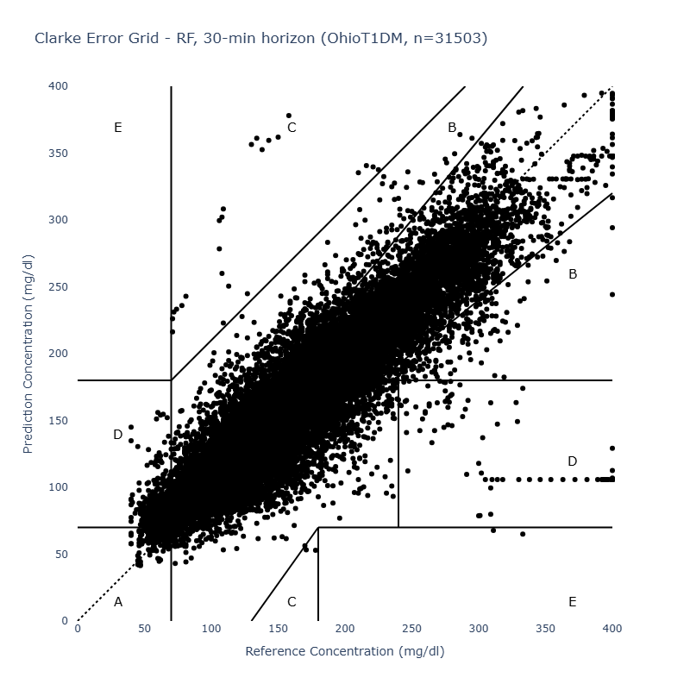
Clarke Error Grid
15 / 30 / 45-min horizons — Zone A %, all 5 models
Model | 15-min | 30-min | 45-min
LSTM | 96.9% | 87.0% | 76.0%
Autoencoder | 96.3% | 86.7% | 76.2%
RF | 96.5% | 86.4% | 75.3%
Transformer | 95.2% | 85.8% | 75.9%
TCN | 93.5% | 81.6% | 69.9%
Generated directly by the clarke-error-grid library (v0.1.4, ceg.plot) — RF, 30-min horizon shown as a representative model.
TCN lowest and highest-variance at every horizon (see Slide 6 std).
Zone A % is now computed via the shared clarke-error-grid library (v0.1.4), unifying zone classification with Abeer's pipeline — both sides report identical Clarke zones from the same reference implementation.
Clinical target: > 95% Zone A — met only at the 15-min horizon. Zone A falls from ~96% (15-min) to ~76% (45-min) for every model — the classic accuracy/lookahead tradeoff. Gap to the clinical target also reflects the reduced 3-feature input used throughout this work.
Blood Glucose Forecasting | University of Duisburg-Essen
7

Slide 8
Feature Ablation: Wearable Features Do Not Improve Prediction
OhioT1DM 2018 (6 patients, no 563+575)
OhioT1DM 2020 (6 patients, acceleration)
Glucdict (13 users)
clinical:
RF 21.69 / LSTM 20.51 ← best
glucose_only:
RF 21.70 / LSTM 20.76
clinical_hr:
RF 26.59 / LSTM 24.85 ← worse
full:
RF 32.61 / LSTM 35.48 ← worst
clinical:
RF 25.00 / LSTM 22.04 ← best
clinical_accel:
RF 30.55 / LSTM 28.85 ← worse
glucose_activity:
RF 15.19 / LSTM 13.86 ← best
glucose_only:
RF 15.23 / LSTM 14.03 ← ~tied
full_wearable:
RF 17.45 / LSTM 16.89 ← worse
On OhioT1DM (both cohorts), wearable features degrade 30-minute prediction; on Glucdict, light activity is roughly tied with glucose-only. The accurate claim: wearable features do not improve 30-minute prediction on any dataset — minimal features (glucose + clinical) are sufficient.
Blood Glucose Forecasting | University of Duisburg-Essen
8

Slide 9
Best Feature Combination per Model
Dataset | Best feature set | RF | LSTM
OhioT1DM 2018 | clinical | 21.33 | 20.22
OhioT1DM 2020 | clinical | 25.00 | 22.04
Glucdict | glucose_activity | 15.19 | 13.86
Every model on every dataset achieves its best result with minimal features (glucose + clinical, or glucose + light activity). No model benefits from the full wearable feature set.
Blood Glucose Forecasting | University of Duisburg-Essen
9

Slide 10
LOPO: Personalisation Barely Matters
LOPO: Personalised vs Population (30-min RMSE, mg/dL)
Model | Personalised | LOPO pooled | LOPO per-patient-scaled
LSTM | 21.49 | 22.45 | 22.21
Autoencoder | 21.59 | 22.46 | 22.22
Transformer | 22.38 | 22.83 | 22.74
RF | 23.34 | 22.81 | 22.75
TCN | 24.13 | 29.09 | 24.65
Personalisation gap is small (0.3-1.2 mg/dL) across all 5 models, not just RF/LSTM — the effect generalises across architectures.
Per-patient scaling consistently beats pooled — removing inter-patient baseline differences helps the population model.
TCN is the exception: pooled gap is large (+5 mg/dL) but collapses to +0.5 mg/dL with per-patient scaling. TCN's poor generalisation was driven by inter-patient baseline glucose differences, not architecture.
Blood Glucose Forecasting | University of Duisburg-Essen
10

Slide 11
Transfer Learning: Domain Shift Costs ~1-2 mg/dL
Model | Transfer RMSE | Personalised | Gap
RF | 16.67 | 15.23 | +1.44 (+9%)
LSTM | 15.95 | 14.03 | +1.92 (+14%)
Definitions:
'Personalised' = a model trained and tested on the same individual patient's own data (the standard per-patient setup). Transfer = an OhioT1DM-trained model applied zero-shot to Glucdict users it never saw during training.
Trained on OhioT1DM (T1DM, Medtronic Enlite CGM) Tested zero-shot on Glucdict (prediabetic, Dexcom G6 CGM) Different population + different device = only +1-2 mg/dL penalty
Glucose autocorrelation is the dominant predictive signal regardless of patient population or device.
Blood Glucose Forecasting | University of Duisburg-Essen
11

Slide 12
Glucdict: All 5 Models
glucose_only, 30-min horizon, 13 users
Model | RMSE | MAE
Autoencoder | 14.01 | 9.69
LSTM | 14.03 | 9.77
Transformer | 14.09 | 9.73
RF | 15.23 | 10.64
TCN | 15.90 | 11.47
Transformer competitive with LSTM on Glucdict (unlike OhioT1DM). Autoencoder best on BOTH datasets — consistent finding.
Blood Glucose Forecasting | University of Duisburg-Essen
12

Slide 13
Literature Comparison
30-min horizon
Model | RMSE [mg/dL] | Dataset | Features
MHA-NBEATS (Kalita & Mirza 2025) | 16.57 | OhioT1DM | 6
Rodríguez-Rodríguez 2024 | 18.60 | Custom (40-pt DM1) | 7
Bertachi et al. 2018 | 19.33 | OhioT1DM | 4
LSTM (this work) | 21.25 | OhioT1DM | 3
Autoencoder (this work) | 21.45 | OhioT1DM | 3
Transformer (this work) | 23.01 | OhioT1DM | 3
RF (this work) | 23.35 | OhioT1DM | 3
TCN (this work) | 24.82 | OhioT1DM | 3
Why 3 features? (1) Only glucose, insulin bolus, and carbohydrates are present for ALL 12 patients across both cohorts — the 2018 cohort has heart rate and steps while the 2020 cohort has acceleration instead. No single wearable feature is universal. (2) Using 3 features as the controlled baseline enables the ablation study (Slide 8) to isolate the contribution of each additional signal. (3) The ablation confirmed wearable features do not improve prediction — the gap to literature is therefore architectural, not feature-driven.
Gap to literature explained by reduced feature set (3 vs. 6-7). Grid Search reduced our gap by ~3 mg/dL vs. defaults.
Blood Glucose Forecasting | University of Duisburg-Essen
13

Slide 14
Preprocessing Comparison vs. Literature
Step | This Project | Literature | Match
CGM resampling | 5-min resample() | 5-min standard | ✓
Missing glucose | Drop rows | Mixed (drop/interp) | Partial
Missing sensor rows | Drop rows | Interpolate | ✗ Gap
Event features | NaN → 0 | Standard | ✓
Normalization | Per-patient z-score | Per-patient | ✓
Train/test split | Official OhioT1DM | Same | ✓
Walk-forward CV | n_splits=3 | Standard | ✓
Main gap: we drop missing sensor rows instead of interpolating. Zhu et al. (2018) showed interpolation reduces RMSE by 2.1 mg/dL — planned for next iteration.
Blood Glucose Forecasting | University of Duisburg-Essen
14

Slide 15
The Three Scientific Findings
1
WEARABLE FEATURES DO NOT IMPROVE 30-MIN PREDICTION
Degrade prediction on OhioT1DM (both cohorts); roughly tied with glucose-only on Glucdict. Minimal features (glucose + clinical) are sufficient — no dataset benefits from the full wearable set.
2
PERSONALISATION IS NOT REQUIRED
LOPO gap: only +1.17 mg/dL. Population model nearly as good as personalised model.
3
TRANSFER ACROSS POPULATIONS COSTS ONLY ~2 mg/dL
T1DM → prediabetic, different device, zero retraining. Glucose autocorrelation dominates regardless of domain.
Blood Glucose Forecasting | University of Duisburg-Essen
15

Slide 16
Final Experiments Plan
Experiment | Priority | Status
Longer window sizes | High | Planned week 1
45/60-min horizons | High | Planned week 1
BIG IDEAs all 5 models | High | Planned week 1 (Abeer)
Unified Clarke EGA (15/30/45-min) | High | Done
Final report writing | Critical | Planned week 2-3
Blood Glucose Forecasting | University of Duisburg-Essen
16

