Slide 1


Kernel structure & Task management
© P.J.Fondse April 2010

Slide 2
Outline
    Introduction to µC/OS-II
    Basic concepts
    Kernel structure
    Task management
    Sample application program
    Running the program

Slide 3
Introduction to µC/OS-II
  µC/OS-II is a portable, ROMable, scalable, deterministic,
  pre-emptive, real-time multitasking kernel
  Simple to use and simple to implement, but very effective
  compared to the price/performance ratio.
Can manage up to 64 tasks
Supports all types of processors from 8-bit to 64-bit, ported to
more than 100 microprocessors and microcontrollers
Extensible with many additional modules (TCP/IP stack, USB host and client, FAT file system etc.)

Slide 4








Additional modules
Real-Time Operating System (RTOS)
TCP-IP protocol stack
Host USB stack
Device USB stack
CAN protocol stack
Runtime data monitor
µC/Shell and µC/LCD driver
Microsoft compatible FAT File System

Slide 5
Basic concepts
Processor independent code:
Common code which is available in the form of source code. This code is independent of the hardware or processor.
Processor specific code:
According to the specification of the processor. Partially C code, partially assembly.

Slide 6
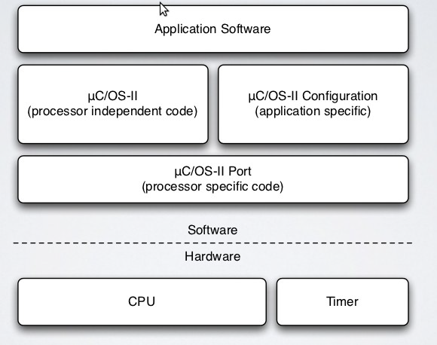
µC/OS-II software architecture

Slide 7
Processor independent code
ucos_ii.h Master header file for µC/OS-II
ucos_ii.c Master program file for µC/OS-II
os_core.c Core functions
os_flag.c Eventflag management
os_mbox.c Mailbox management
os_mem.c Memory management
os_mutex.c Mutex management
os_q.c Queue management
os_sem.c Semaphore management
os_task.c Task management
os_time.c Time management
os_tmr.c Timer management
os_cfg_r.h Configuration file for µC/OS-II (template file)
os_dbg_r.c Debugger constants (template file)

Slide 8
Processor dependent code
app_cfg.h General application specific header file
os_cfg.h µC/OS-II configuration header, application dependent
os_cpu.h 680x0 specific header file
os_cpu_c.c 680x0 specific C code
os_fcpu_c.c 680x0 specific C code with 68881 FPU support
os_cpu_a.asm 680x0 specific assembly code
os_fcpu_a.asm 680x0 specific assembly code w. 68881 FPU support
os_boot.asm IDE68K specific assembly code (vectors, basic IO)

Slide 9
Software license
The μC/OS-II operating system software is neither freeware nor Open Source software. A licensed copy of version 2.91 of the operating system should be obtained directly from Micriµm
LICENSING TERMS:
µC/OS-II is provided in source form for FREE evaluation, for educational use or for peaceful research. If you plan on using µC/OS-II in a commercial product you need to contact Micriµm to properly license its use in your product. We provide ALL the source code for your convenience and to help you experience µC/OS-II. The fact that the source is provided does NOT mean that you can use it without paying a licensing fee.

Slide 10
µC/OS-II API
The Application Program Interface of µC/OS-II consists of a set of C-functions. These functions are used to write the application programs (tasks) with µC/OS-II
API functions are used to handle
    Tasks
    Time management
    Mailboxes
    Semaphores and Mutexes
    Memory Management
    Timers
    etc.

Slide 11
µC/OS-II Initialization
Call OSInit() before you call any of its other services.
OSInit() creates the idle task (OSTaskIdle()) which is always
ready to run.
The priority of OSTaskIdle() is always set to OS_LOWEST_PRIO
If OS_TASK_STAT_EN and OS_TASK_CREATE_EXT_EN in file os_cfg.h are both set to ‘1’, OSInit() also creates the statistics task, OSTaskStat() and makes it ready to run.
The priority of OSTaskStat() is always OS_LOWEST_PRIO – 1.

Slide 12
OSInit()
void OSInit(void)
{
OSInitHookBegin();
OS_InitMisc();
OS_InitRdyList();
OS_InitTCBList();
OS_InitEventList();
OS_InitTaskIdle();
#if (OS_FLAG_EN > 0u) && (OS_MAX_FLAGS > 0u)
OS_FlagInit();
#endif
#if (OS_MEM_EN > 0u) && (OS_MAX_MEM_PART > 0u)
OS_MemInit();
#endif

Slide 13
OSInit() (continued)
#if (OS_Q_EN > 0u) && (OS_MAX_QS > 0u)
OS_QInit();
#endif
#if OS_TASK_STAT_EN > 0u
OS_InitTaskStat();
#endif
#if OS_TMR_EN > 0u
OSTmr_Init();
#endif
#if OS_DEBUG_EN > 0u
OSDebugInit();
#endif
OSInitHookEnd();
}

Slide 14
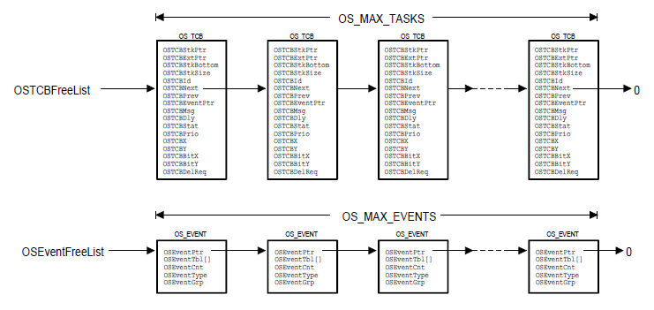
Free pools

Slide 15
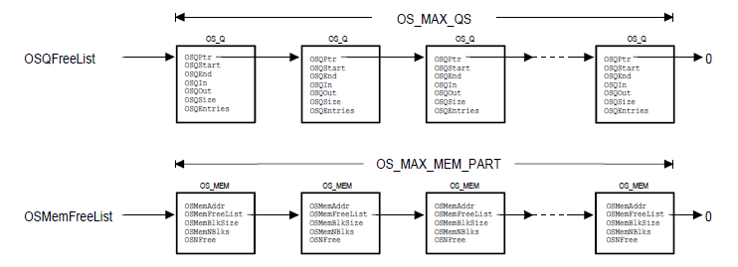
Free pools (continued)

Slide 16
OSStart()
void OSStart(void)
{
INT8U x, y;
if (OSRunning == FALSE) {
y = OSUnMapTbl[OSRdyGrp];
x = OSUnMapTbl[OSRdyTbl[y]];
OSPrioHighRdy = (y << 3) + x;
OSPrioCur = OSPrioHighRdy;
OSTCBHighRdy = OCTCBPrioTbl[OSPrioHighRdy];
OSTCBCur = OSTCBHighRdy;
OSStartHighRdy();
}
}

Slide 17
The main() function
void main(void)
{
OSInit(); /* Initialize uC/OS-II */
/* Install uC/OS-II's context switch vector */
/* Create your startup task (e.g. TaskStart()) */
OSStart(); /* Start multitasking */
}
void TaskStart(void *pdata)
{
/* Install and initalize uC/OS-II's ticker */
OSStatInit(); /* Initialize statistics task */
/* Create your application task(s) */
for (;;) }
/* Code for TaskStart() goes here! */
}
}

Slide 18
Critical Sections
Two macro’s are used together to wrap around the critical section
OS_ENTER_CRITICAL() : Disable interrupts
OS_EXIT_CRITICAL() : Enable Interrupts
Defined in OS_CPU.H
Three implementations:
OS_CRITICAL_METHOD = 1, 2, 3

Slide 19
Critical sections (continued)
OS_CRITICAL_METHOD = 1
The status register (or PSW) is not saved at the calls to OS_ENTER_CRITICAL(). The status of interrupts may change on calling µC/OS-II functions
OS_CRITICAL_METHOD = 2
The status register is saved on the stack at OS_ENTER_CRITICAL() and restored at OS_EXIT_CRITICAL(). The compiler must use
in-line assembly instructions.
OS_CRITICAL_METHOD = 3
The status register is saved in a local variable, declared in the task function, at OS_ENTER_CRITICAL(). This variable is used to restore the status register at OS_EXIT_CRITICAL().

Slide 20
Tasks
µC/OS-II can manage up to 64 tasks. Each task has a unique priority. Two tasks with the lowest priority are reserved for the system.
This means, in theory, we can create up to 62 tasks
OS_LOWEST_PRIO (= 63), the priority of the idle task, is the lowest priority task in the system.
Idle task means that if there is no task in the ready queue, the CPU will execute the idle task.

Slide 21
Task Management
Creating a task
Stack checking
Changing the task priority
Getting Information about a task
Suspending a task
Resuming a task
Request to delete a task
Deleting a task

Slide 22
Task creation
There are two functions to create a task:
  OSTaskCreate()
  OSTaskCreateExt()
OSTaskCreate( ) requires 4 arguments:
  ‘task’ is pointer to the task function
  ‘pdata’ is a pointer to an argument that is passed to
  the task function when it starts executing
  ‘ptos’ is a pointer to the top of the stack
  ‘prio’ is the task priority

Slide 23
OSTaskCreateExt()
OSTaskCreateExt() offers more functionality but at the expense of additional overhead. This function requires 9 arguments. The first four arguments are same as with OSTaskCreate()
Extra arguments:
‘id’ a unique identifier for the task being created. This argument has been added for future expansion and is not used by µC/OS-II, usually set to task priority.
‘pbos’ is a pointer to the task's bottom of stack, used to
perform stack checking
‘stk_size’ is the size of the stack in number of elements. This
argument is also used for stack checking

Slide 24
OSTaskCreateExt() (continued)
‘pext’ is a pointer to a user supplied data area that can be used to extend the size of the task control block
‘opt’ specifies options to OSTaskCreateExt(). This argument specifies whether stack checking is allowed, whether the stack will be cleared, and whether floating point operations are performed by the task.
The file os_cfg.h contains a list of available options
      OS_TASK_OPT_STK_CHK
      OS_TASK_OPT_STK_CLR
      OS_TASK_OPT_SAVE_FP

Slide 25
Task initialization
OSTaskCreate() calls OSTaskStkInit () to initialize the stack for the task. OSTaskInit() is defined in the file os_cpu.c
μC/OS-II supports processors that have stacks that grow from either high memory to low memory or from low memory to high memory (defined by OS_STK_GROWTH in the file os_cpu.h)
OSTCBInit() initializes the TCB for this task. Defined in os_core.c
OSTaskCreateHook() is a user specified function that extends the functionality of OSTaskCreate() but can increase interrupt latency
Finally, OSTaskCreate() calls OSSched() to determine whether the new task has a higher priority than its creator.
If the task was created before multitasking has started (i.e. OSStart() was not called yet), then the scheduler is not called.

Slide 26
Task function
A task is typically an infinite loop function
void YourTask(void *pdata)
{
for (;;) {
/* USER CODE */
Call one of uC/OS-II's services:
OSMboxPend();
OSQPend();
OSSemPend();
OSTaskDel(OP_PRIO_SELF);
OSTaskSuspend(OS_PRIO_SELF);
OSTimeDly();
OSTimeDlyHMSM();
/* USER CODE */
}
}

Slide 27
Task deletion
A task can delete itself upon completion.
void YourTask(void *pdata)
{
/* USER CODE */
OSTaskDel(OS_PRIO_SELF);
}

Slide 28
Task Stack
Each task must have its own stack. A stack must be declared as being of type OS_STK and must consist of contiguous memory locations.
We pass the top of stack pointer in the task create function
Memory can be allocated statically or dynamically
Static allocation
OS_STK MyTaskStack[STACKSIZE];
Dynamic allocation
OS_STK *pstk;
pstk = (OS_STK *) malloc(STACKSIZE);
if (pstk != (OS_STK *) 0) {
/* Create the task */
}

Slide 29
Task Stack (continued)
If in file os_cpu.h the constant OS_STK_GROWH is set to 1 you must pass the highest memory location of the stack to the task-create function because the stack grows from high to low memory
If the constant OS_STK_GROWTH is set to 0, you must pass the lowest memory location of the stack to the task-create function because the stack grows from low to high memory
OS_STK TaskStack[STACKSIZE];
OSTaskCreate(task, pdata, &TaskStack[STACKSIZE - 1], prio);
OS_STK TaskStack[STACKSIZE];
OSTaskCreate(task, pdata, &TaskStack[0], prio);

Slide 30
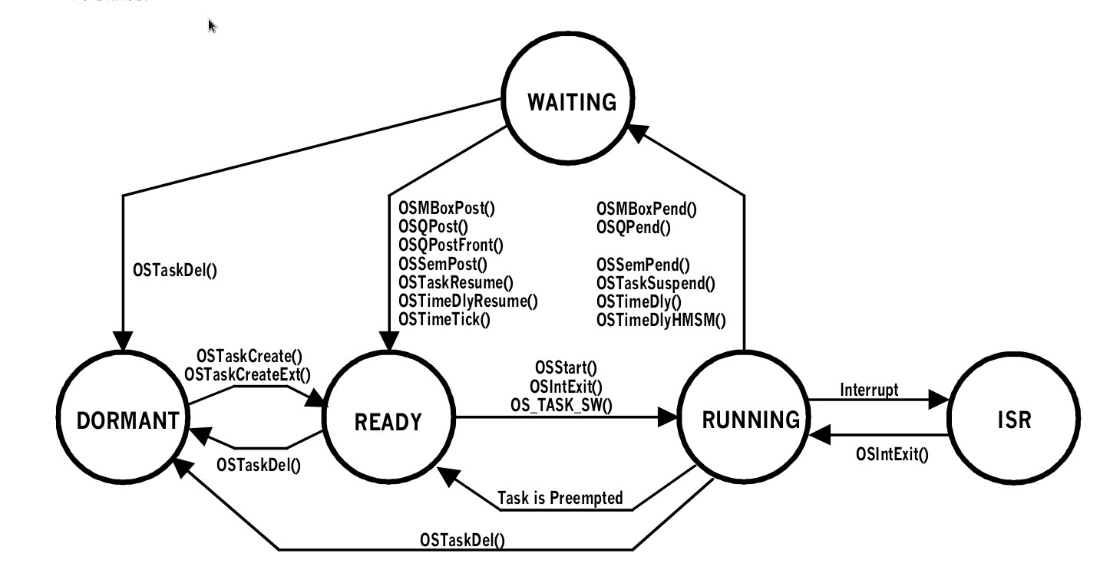
Task states

Slide 31
Task Control Block
A task control block is a data structure called OS_TCB, that is used by μC/OS-II to store the state of a task when it is preempted.
When the task regains control of the CPU, data in the task control block allows the task to resume execution exactly where it left off.
All OS_TCB’s reside in RAM.
The OS_TCB is initialized when a task is created.

Slide 32
OS_TCB structure
typedef struct os_tcb {
OS_STK *OSTCBStkPtr;
#if OS_TASK_CREATE_EX_EN
void *OSTCBExtPtr;
OS_STK *OSTCBStkBottom;
INT32U OSTCBStkSize;
INT16U OSTCBOpt;
INT16U OSTCBId;
#endif
struct os_tcb *OSTCBNext;
struct os_tcb *OSTCBPrev;
#if (OS_Q_EN && (OS_MAX_QS >= 2)) || OS_MBOX_EN || OS_SEM_EN
OS_EVENT *OSTCBEventPtr;
#endif

Slide 33
OS_TCB structure (continued)
#if (OS_Q_EN && (OS_MAX_QS >= 2)) || OS_MBOX_EN
OS_EVENT *OSTCBMsg;
#endif
INT16U OSTCBDly;
INT8U OSTCBStat;
INT8U OSTCBPrio;
INT8U OSTCBX;
INT8U OSTCBY;
INT8U OSTCBBitX;
INT8U OSTCBBitY;
#if OS_TASK_DEL_EN
BOOLEAN OSTCBDelReq;
#endif
} OS_TCB;

Slide 34
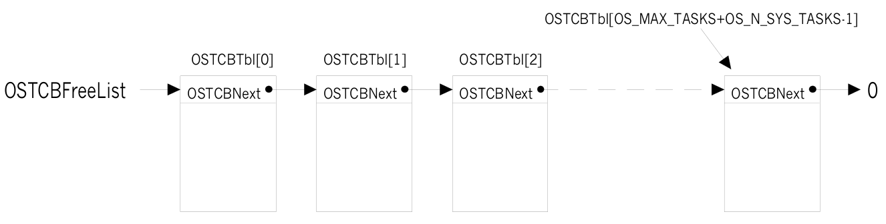
Free Task Control Blocks
Global constants and variables:
  OS_MAX_TASKS
  OS_N_SYS_TASKS
  OSTCBTbl[]
  OSTCBFreeList

Slide 35
Task priorities
Each task is assigned a unique priority level between 0 (highest) and OS_LOWEST_PRIO inclusively.
Task priority OS_LOWEST_PRIO is always assigned to the idle task when μC/OS-II is initialized.
A task that is ready to run is represented by a ‘1’ in the Ready List bitmap at a location according to its priority.
The task with the highest priority is found by searching the Ready List from position 0 upwards to position OS_LOWEST_PRIO (= 63)

Slide 36
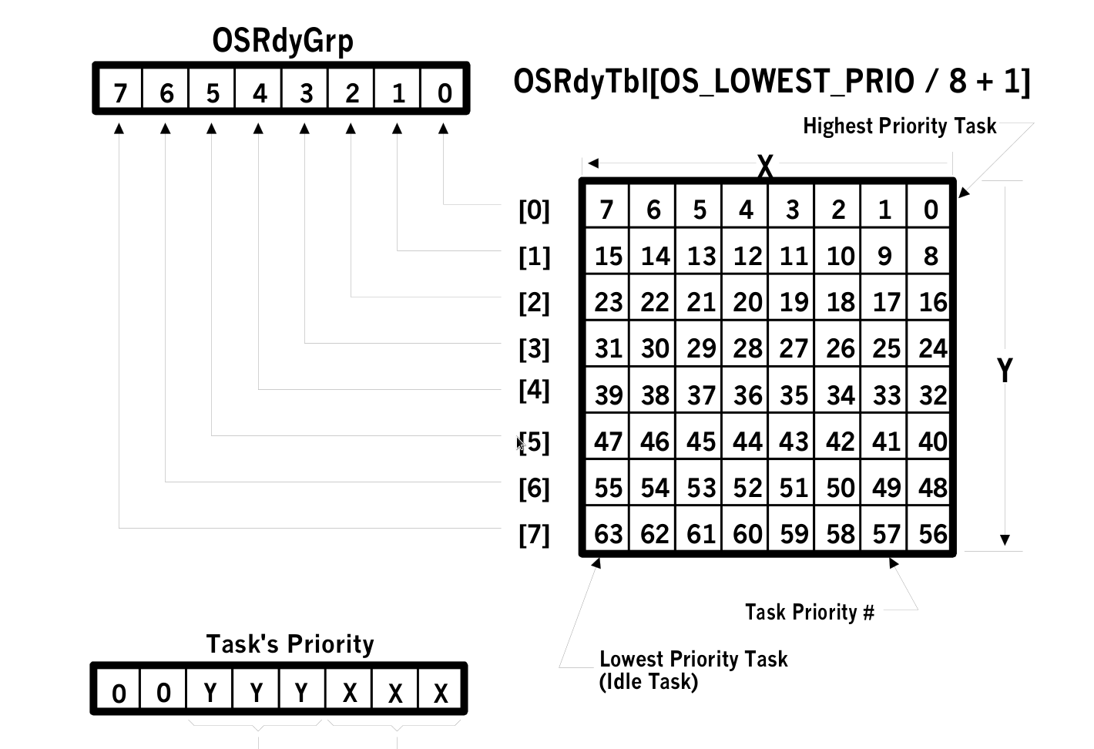
The Ready List

Slide 37
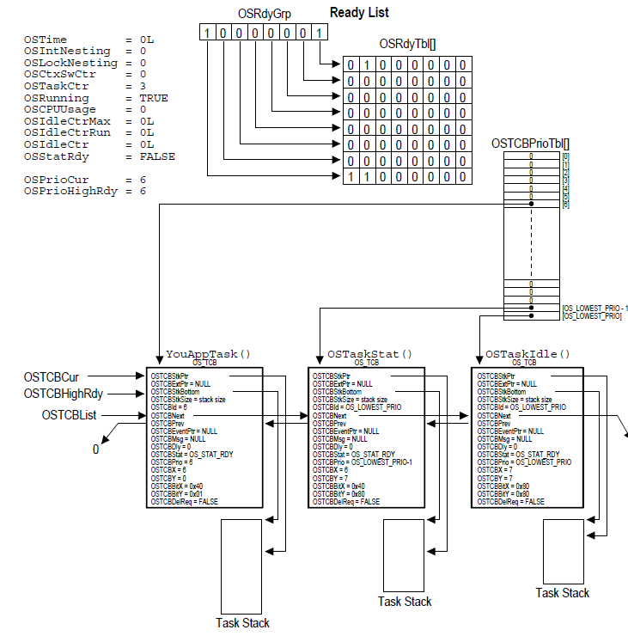
Ready List with 3 tasks

Slide 38
Task insertion and deletion
To insert a task in the ready list:
OSRdyGrp |= ptcb->OSTCBBitY;
OSRdyTbl[ptcb->OSTCBY] |= ptcb->OSTCBBitX;
To delete a task from ready list
if ((OSRdyTbl[ptcb->OSTCBY] &= ~ptcb->OSTCBBitX) == 0)
OSRdyGrp &= ~ptcb->OSTCBBitY;
ptcb is a pointer to the task’s TCB structure

Slide 39
OSTCBBitX and OSTCBBitY
OSTCBBitX and OSTCBBitY are pre-computed fields in the TCB structure, initialized when the task is created and the task’s TCB is initialized
ptcb->OSTCBX = prio & 0x07;
ptcb->OSTCBY = prio >> 3;
ptcb->OSTCBBitX = 1 << ptcb->OSTCBX;
ptcb->OSTCBBitY = 1 << ptcb->OSTCBY;
ptcb is a pointer to the task’s TCB structure, prio is the task’s priority

Slide 40
Finding the highest priority task
To find the highest priority task ready to run
y = OSUnMapTbl[OSRdyGrp];
x = OSUnMapTbl[OSRdyTbl[y]];
OSPrioHighRdy = (y << 3) + x;
The highest priority task which is ready to run is found with three statements. The time to find the highest priority task does not depend on the priority of the task or on the number of tasks in the ready list.

Slide 41
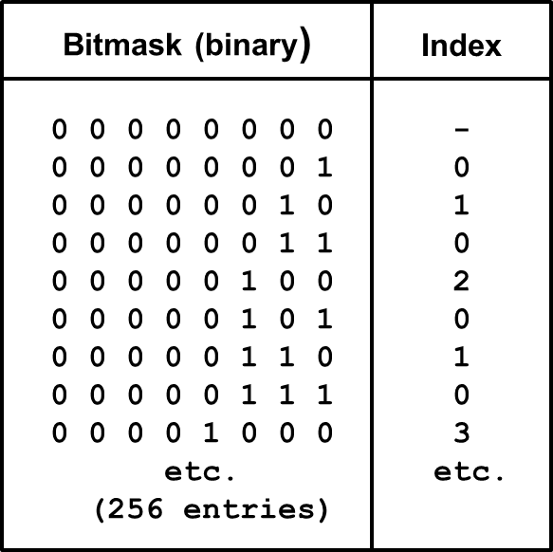
OSUnMapTbl[]
OSUnMapTbl[] (in the file os_core.c) is a table in ROM, used to equate an 8-bit bitmask to an index from 0 to 7 as shown in the table below.
Index is position of least-significant ‘1’ in the bitmask

Slide 42
Task Scheduling
µC/OS-II always executes the highest priority task that is ready to run.
Which task has highest priority is determined by the scheduler.
Task level scheduling is performed by OSSched()
ISR level scheduling is performed by OSIntExit()
µC/OS-II task scheduling time is constant irrespective of the number of tasks created by the application.

Slide 43
OS_Sched()
void OS_Sched(void)
{
INT8U y;
OS_ENTER_CRITICAL();
if ((OSLockNesting | OSIntNesting) == 0) {
y = OSUnMapTbl[OSRdyGrp];
X = OSUnMapTbl[OSRdyTbl[y]];
OSPrioHighRdy = (y << 3) + x;
if (OSPrioHighRdy != OSPrioCur) {
OSTCBHighRdy = OSTCBPrioTbl[OSPrioHighRdy];
OSCtxSwCtr++;
OS_TASK_SW();
}
}
OS_EXIT_CRITICAL();
}

Slide 44
Context Switch
OSTCBHighRdy points to the OS_TCB of the highest priority task by indexing into OSTCBPrioTbl[].
OSCtxSwCtr keeps track of number of context switches.
OS_TASK_SW() is the actual context switch function (a macro in the file os_cpu.h).
All of the code in OSSched() is considered a critical section.

Slide 45
Locking & Unlocking the
Scheduler
The function OSSchedLock()is used to prevent task
rescheduling until its counterpart, OSSchedUnlock(),
is called.
The task that calls OSSchedLock() keeps control of
the CPU even though other higher priority tasks are
ready to run.
Interrupts, however, are still recognized and serviced
(assuming interrupts are enabled).
The variable OSLockNesting keeps track of the
number of times OSSchedLock() has been called to
allow for nesting.

Slide 46
OS_SchedLock()
void OS_SchedLock(void)
{
if (OSRunning == TRUE) {
OS_ENTER_CRITICAL();
OSLockNesting++;
OS_EXIT_CRITICAL();
}
}

Slide 47
OS_SchedUnlock()
void OS_SchedUnLock(void)
{
if (OSRunning == TRUE) {
OS_ENTER_CRITICAL();
if (OSLockNesting > 0) {
OSLockNesting--;
if ((OSLockNesting | OSIntNesting) == 0) {
OS_EXIT_CRITICAL();
OSSched();
} else {
OS_EXIT_CRITICAL();
}
} else {
OS_EXIT_CRITICAL();
}
}
}

Slide 48
What is the Idle Task?
If there is no task, then the CPU will execute the idle task.
The idle task cannot be deleted because it should always be present in case there is no other task to run.
The idle task function OSTaskIdle() has the lowest priority, OS_LOWEST_PRIO.
OSTaskIdle() does nothing but increments a 32-bit
counter called OSIdleCtr.
OSIdleCtr is used by the statistics task to determine
how much CPU time (in percentage) is actually being
used by the application task software

Slide 49
Idle Task
void OS_TaskIdle(void *pdata)
{
pdata = pdata;
for (;;) {
OS_ENTER_CRITICAL();
OSIdleCtr++;
OS_EXIT_CRITICAL();
}
}

Slide 50
Stack Checking
The OSTaskStkChk() function tells how much free stack space is available for your application.
To enable the µC/OS-II stack checking feature you must set OS_TASK_CREATE_EXT to ‘1’ in file os_cfg.h
Create the task using OSTaskCreateExt() and give the task more space than you think it really needs.
Set ‘opt’ argument in OSTaskCreateExt() to OS_TASK_OPT_STK_CHK
Call OSTaskStkChk() from a task by specifying the priority of the task you want to check. You can inquire about any task stack, not just the running task.

Slide 51
Stack Checking (continued)
Assume OS_STK_GROWTH is set to 1 (Stack grows to lower memory addresses).
To perform stack checking, μC/OS-II requires that the stack is filled with zeros when the task is created
μC/OS-II needs to know the address of the Bottom-Of-Stack (BOS) and the size of the stack that is assigned to the task. These two values are stored in the task’s OS_TCB when the task is created.
μC/OS-II determines the free stack space by counting the zero-elements from the Bottom-Of-Stack to the first no-zero element.

Slide 52
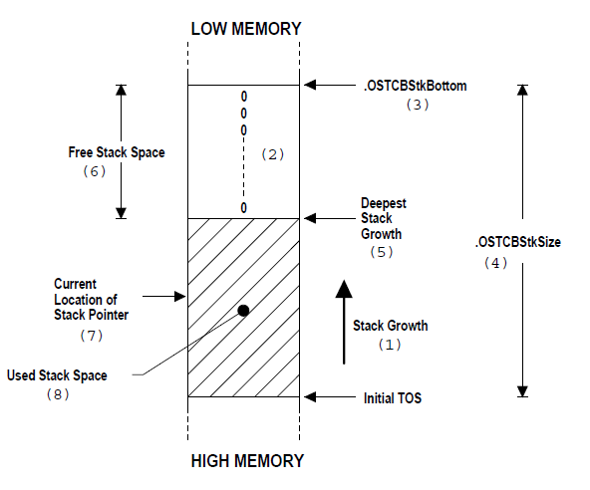
Stack Checking (continued)

Slide 53
Suspending a Task
Sometimes we need to explicitly suspend the execution of a task.
Suspension is done by calling OSTaskSuspend()
The suspended task can only be resumed by calling OSTaskResume()
Task suspension is cumulative.
A task can suspend itself or another task.

Slide 54
Resuming a Task
Sometimes we need to resume a task that we have suspended some time before.
A suspended task can only be resumed by calling OSTaskResume()
A task is resumed only if the number of calls to OSTaskResume() matches the calls to OSTaskSuspend()
A task cannot resume itself, only another task can do this.

Slide 55
Changing the task priority
Call the OSTaskChangePrio() function if you want to change priority of task at runtime.

Slide 56
Getting Information about a task
A task can retrieve information about itself or another application tasks by calling OSTaskQuery()
The function OSTaskQuery() gets a copy of specified task's OS_TCB.
To call OSTaskQuery(), your application must first allocate storage for OS_TCB.
After calling OSTaskQuery() this OS_TCB contains a snapshot of the OS_TCB for the desired task.

Slide 57
Requesting to delete a task
When a task deletes another task, there is a risk that there is no systematically de-allocation of the resources created by the other task.
This would lead to memory leaks which are not acceptable.
In this case it is required that a task tells the other task to delete itself when it is done with it's resources.
We can do this by using OSTaskDelReq() function.
Both the requesting task and task to be deleted must call
OSTaskDelReq()

Slide 58
Deleting a Task
The OSTaskDel() function deletes a task, but that does not mean that we are deleting the code of the task from memory.
The task is returned to the dormant state. The task is simply no longer scheduled by µC/OS-II.
The OSTaskDel() function ensures that a task cannot not be deleted within an ISR.
Make sure you should never delete the idle task.
A task can delete itself by specifying OS_PRIO_SELF as the argument.

Slide 59
Task Statistics
µC/OS-II contains a task, OS_TaskStat(),that provides run- time statistics and is created by µC/OS-II if the configuration constant OS_TASK_STAT_EN in the file os_cfg.h is set to 1.
When enabled, OS_TaskStat() runs once every second and reads the value of OSIdleCtr accumulated while running the idle task in the preceding second.
From this, and OS_IdleCtrMax, the value accumulated when only the idle process was running, OS_TaskStat() computes the percentage of CPU time used while running the application tasks.
This value is placed in an 8 bit signed integer variable OSCPUUsage. The resolution of OSCPUUsage is 1%.

Slide 60
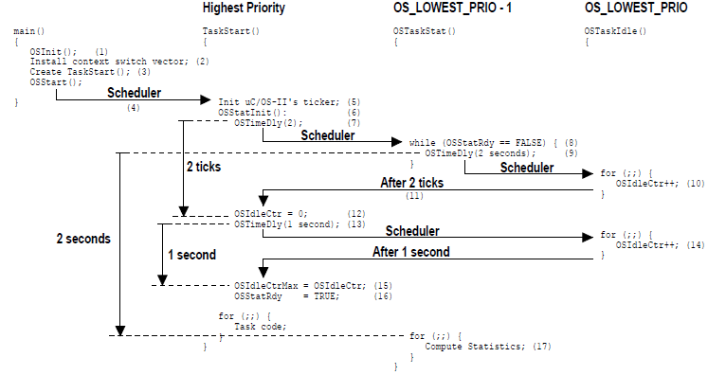
Computing CPU usage

Slide 61

Statistics Task initialisation
void OSStatInit(void)
{
OSTimeDly(2);
OS_ENTER_CRITICAL();
OSIdleCtr = 0;
OS_EXIT_CRITICAL();
OSTimeDly(OS_TICKS_PER_SEC);
OS_ENTER_CRITICAL();
OSIdleCtrMax = OSIdleCtr;
OSStatRdy = TRUE;
OS_EXIT_CRITICAL();
}

Slide 62
OSTaskStat()
void OSTaskStat(void *pdata)
{
INT32U run;
INT8S usage;
pdata = pdata
while (OSStatRdy == FALSE) {
OSTimeDly(2 * OS_TICKS_PER_SEC);
}
for (;;) {
OS_ENTER_CRITICAL();
OSIdleCtrRun = OSIdlCtr;
run = OSIdleCtr;
OSIdleCtr = 0;
OS_EXIT_CRITICAL();

Slide 63
OSTASKSTAT() (continued)
if (OSIdleCtrMax > 0) {
usage = 100 - run / (OSIdleCtrMax / 100);
if (usage > 100) {
OSCPUUsage = 100;
} else if (usage < 0) {
OSCPUUsage = 0;
} else {
OSCPUUsage = usage;
}
} else {
OSCPUUsage = 0;
}
OSTaskStatHook();
OSTimeDly(OS_TICKS_PER_SEC);
}
}

Slide 64
Interrupts with µC/OS-II
μC/OS-II requires that an Interrupt Service Routine (ISR) be written in assembly language.
μC/OS-II needs to know that you are servicing an ISR and thus you need to either call OSIntEnter() or increment the global variable OSIntNesting.
μC/OS-II allows you to nest interrupts because it keeps track of nesting in OSIntNesting.
The ISR terminates by calling OSIntExit() which decrements the interrupt nesting counter.
YourISR:
Save all CPU registers;
Call OSIntEnter() or increment OSIntNesting directly;
Execute user code to service ISR;
Call OSIntExit() or decrement OSIntNesting directly;
Restore all CPU registers;
Execute <Return from Interrupt> instruction;

Slide 65
OSIntEnter()
The function OSIntEnter() notifies µC/OS-II about the beginning of an interrupt service routine.
The function OSIntExit() notifies µC/OS-II about the ending of an interrupt service routine.
void OSIntEnter(void)
{
OS_ENTER_CRITICAL();
OSIntNesting++;
OS_EXIT_CRITICAL();
}

Slide 66
OSIntExit()
void OSIntExit(void)
{
INT8U x, y;
OS_ENTER_CRITICAL();
if ((--OSIntNesting | OSLockNesting) == 0) {
y = OSUnMapTbl[OSRdyGrp];
x = OSUnMapTbl[OSRdyTbl[y]]);
OSPrioHighRdy = (INT8U)((y << 3) + x);
if (OSPrioHighRdy != OSPrioCur) {
OSTCBHighRdy = OSTCBPrioTbl[OSPrioHighRdy];
OSCtxSwCtr++;
OSIntCtxSw();
}
}
OS_EXIT_CRITICAL();
}

Slide 67
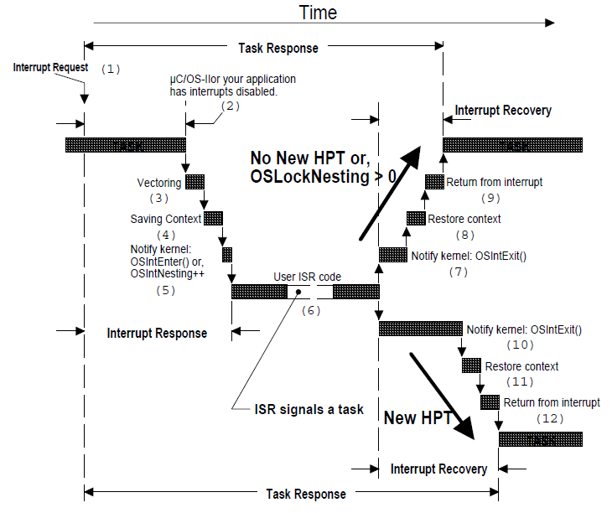
Servicing an Interrupt

Slide 68
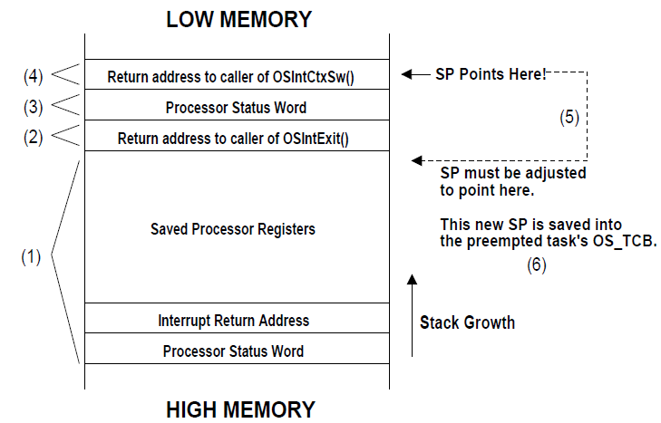
Stack cleanup by OSIntCtxSw()

Slide 69
Get µC/OS-II version
INT16U OSVersion(void)
{
return OS_VERSION;
}
The version number returned by OSVersion() contains a major and a minor version number.
For instance, when OSVersion() returns 291, the real version number of µC/OS-II is 2.91

Slide 70
Semaphores
A semaphore consists of an integer counter and a wait list
OSSemPend():
  counter--;
  If the value of the semaphore < 0, then the task is
  blocked and moved to the wait list.
  A time-out value can be specified.
OSSemPost():
  counter++;
  If the value of the semaphore >= 0, then a task in
  the wait list is removed from the wait list.
  Reschedule if necessary.

Slide 71
Mailbox
A mailbox is for data exchange between tasks and consists of a data pointer and a wait list.
OSMboxPost():
  If there is already a message in the mailbox, then
  an error is returned (message not overwritten).
  The message (a pointer) is posted in the mailbox.
  If tasks are waiting for a message from the mailbox,
  then the task with the highest priority is removed
  from the wait-list and scheduled to run.
OSMboxPend():
  If the mailbox is empty, the task is blocked and
  moved to the wait-list.
  The message in the mailbox is retrieved.
  A time-out value can be specified.

Slide 72
Message Queue
A message queue can hold many data elements (on a FIFO basis) and consists of an array of elements and a wait list.
OSQPost():
  The highest-priority pending task (if there is one in the
  wait-list) is scheduled to run and receives the message.
  If there is no task in the wait-list, the message is
  appended to the queue.
OSQPend():
  If there is a message in the queue, the message is
  retrieved from the queue.
  If there no message, the task is moved to the wait-list
  and becomes blocked.

Slide 73
Hooks
A hook function will be called by µC/OS-II when the corresponding event occurs.
For example, OSTaskSwHook () is called every time a context switch occurs.
The constant OS_CPU_HOOK_EN must be set to 1 in file os_cfg.h to enable hooks.
The hook functions are defined in the file os_cpu_c.h

Slide 74
Hook functions
void OSInitHookBegin(void);
void OSInitHookEnd(void);
void OSTaskCreateHook(OS_TCB *ptcb);
void OSTaskDelHook(OS_TCB *ptcb);
void OSTaskIdleHook(void);
void OSTaskReturnHook(OS_TCB *ptcb);
void OSTaskStatHook(void);
void OSTaskSwHook(void);
void OSTCBInitHook(OS_TCB *ptcb);
void OSTimeTickHook(void);

Slide 75
Example Program
#include <ucos_ii.h>
#include <stdio.h>
#define STACKSIZE 256
/* Stacks */
OS_STK Task1Stk[STACKSIZE];
OS_STK Task2Stk[STACKSIZE];
/* Prototypes */
void Task1(void *);
void Task2(void *);
void main(void)
{
OSInit();
OSTaskCreate(Task1, OS_NULL, &Task1Stk[STACKSIZE], 10);
OSTaskCreate(Task2, OS_NULL, &Task2Stk[STACKSIZE], 11);
OSStart();
}

Slide 76
Example Program (continued)
void Task1(void *pdata)
{
for (;;) {
printf(" This is Task #1\n");
OSTimeDlyHMSM(0, 0, 1, 0);
}
}
void Task2(void *pdata)
{
for (;;) {
printf(" This is Task #2\n");
OSTimeDlyHMSM(0, 0, 3, 0);
}
}

Slide 77
How does this program work?
1. Declare stacks and define prototypes for the task
functions Task1() and Task2()
2. In main(), call OSInit() to initialize µC/OS-II.
3. Create two tasks, Task1 with priority 10 and Task2
with priority 11.
4. Call OSStart() to start multitasking.
The functions for task #1 and task #2 are almost identical, both print “This is task #1”, resp. “This is task #2” and wait for 1 resp. 3 seconds to continue.

Slide 78
Running the program
We can run (simulate) this program with IDE68K.
In IDE68K set the Default directory to C:\IDE68K\OS Examples
and the Include directory to C:Ide68k\Include;C:\Ide68k\uCOSII.
Open existing project Example1(.prj).
Compile the project and run it on either the Command Line Simulator or the Visual Simulator.
See also the pdf-document Programming with uCOS-II and Ide68k.
This and other documents are accessible through the Help menu of IDE68K and can be downloaded from the IDE68K homepage, http://home.kpn.nl/pj.fondse/ide68k

