Slide 1
SMPS

Slide 2
INTRODUCTION
Summary
Problem Statement
This project is to design and simulate SMPS with proper protection system for the purpose of multiple load application Like for CCTV, spotlight and for car battery charger.
In designing a circuit, we must consider designing an efficient, stable power supply with a protection system for the reliability. of the power delivered to the load. Otherwise, it will reduce the efficiency and stability of the power delivered to the load.
Objective
1- Using SMPS with understanding of its operation
2- Applying protection to the SMPS

Slide 3
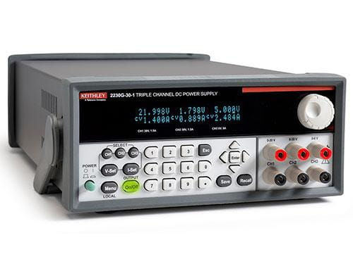
INTRODUCTION
What is a Power Supply?
DC power Supply
AC power supplies
Programmable
Uninterruptible power supply
High-voltage power supply

Slide 4
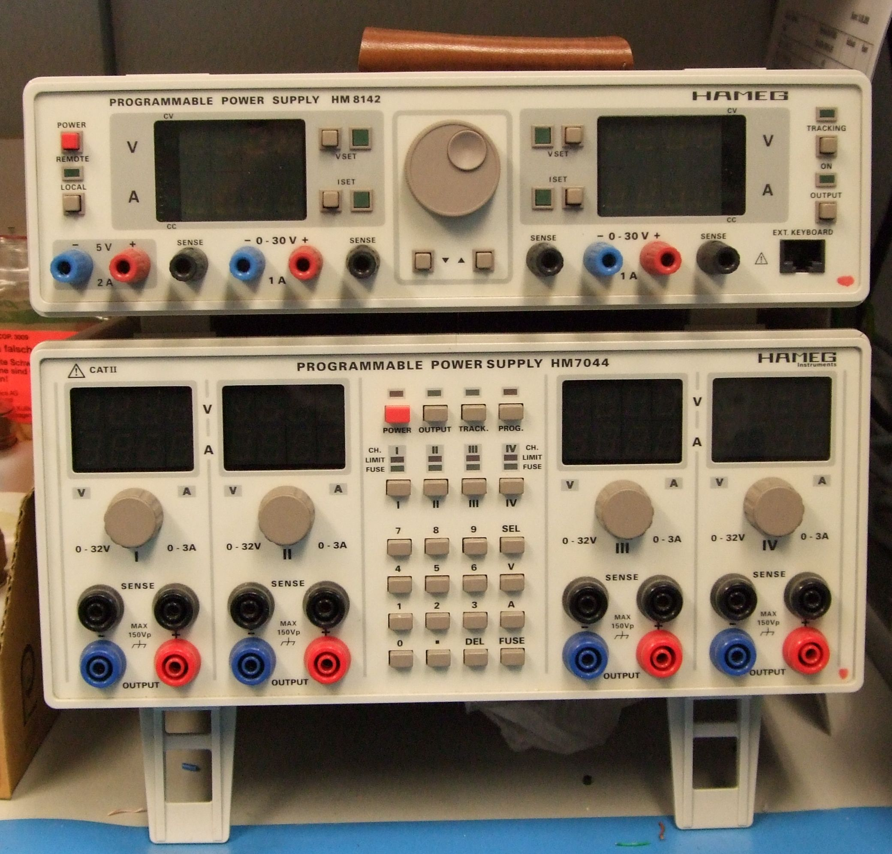
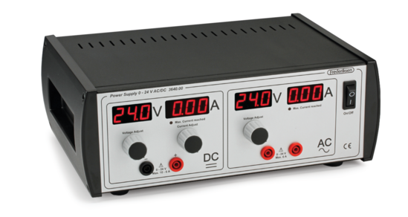
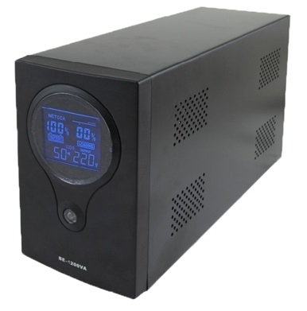
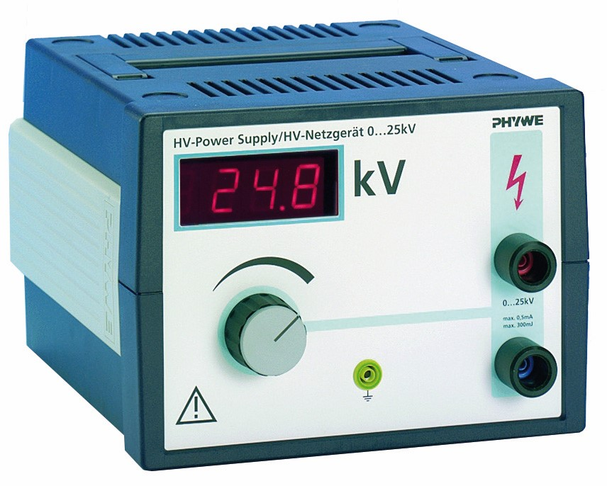
INTRODUCTION
AC Power Supply
Programmable
Uninterruptible power supply
High-voltage power supply

Slide 5
Types of DC power supply
DC Power Supply
Linear Power Source
SMPS

Slide 6
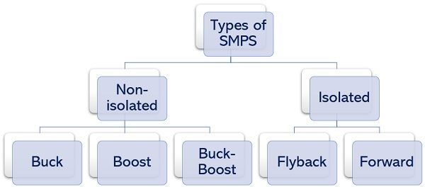
SMPS
SMPS
In a switched-mode power supply (SMPS), the AC input is directly rectified and then filtered to obtain a DC voltage. The resulting DC voltage is then switched on and off at a high frequency by electronic switching circuitry, thus producing an AC current that will pass through a high frequency transformer or inductor.
Types of SMPS

Slide 7
SMPS
Application
• It is used in machine tool industries.
• The SMPS is used in security system.
• It is used in railway system.
• It is also used in mobile.
• It is used in battery charger.
• The SMPS is used in vehicles.
• It is also used in lighting.
• It is used in servers, power stations,
and personal computers.
Advantage
Disadvantage
• Smaller in size and light-weighted.
• Better power efficiency of around 60 to 70 percent.
• Strong anti-interference.
• Wide range of output.
• Produces less heat.
• The SMPS design & working is more complex.
• Has higher output ripple and its regulation is not satisfactory.
• Mostly limited to the step-down regulator.
• Has high-frequency electrical noise.
• Leads to harmonic distortion.

Slide 8
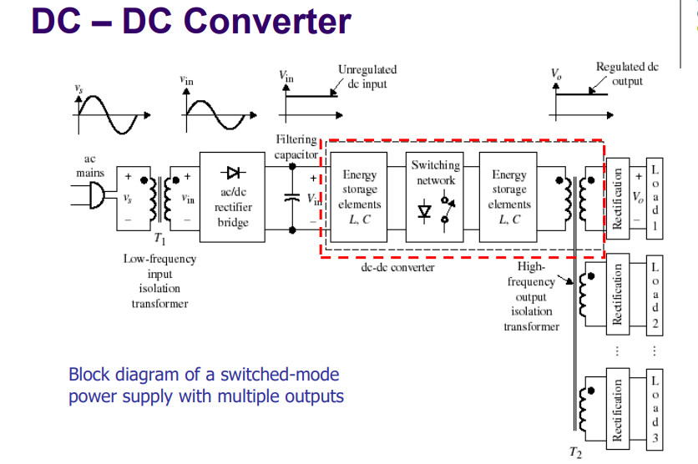
DC – DC Converter

Slide 9
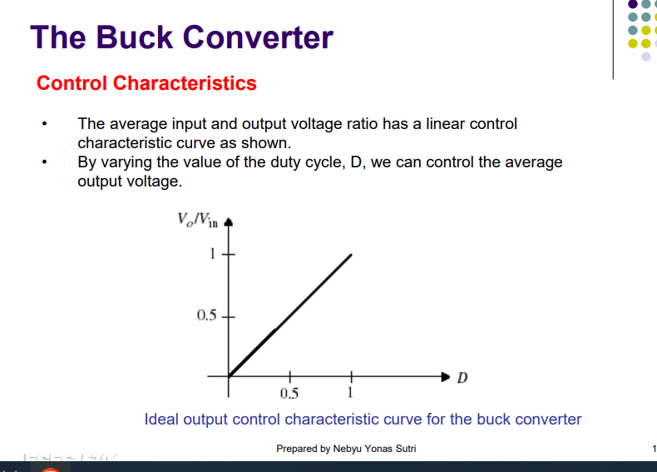
Buck Converter

Slide 10
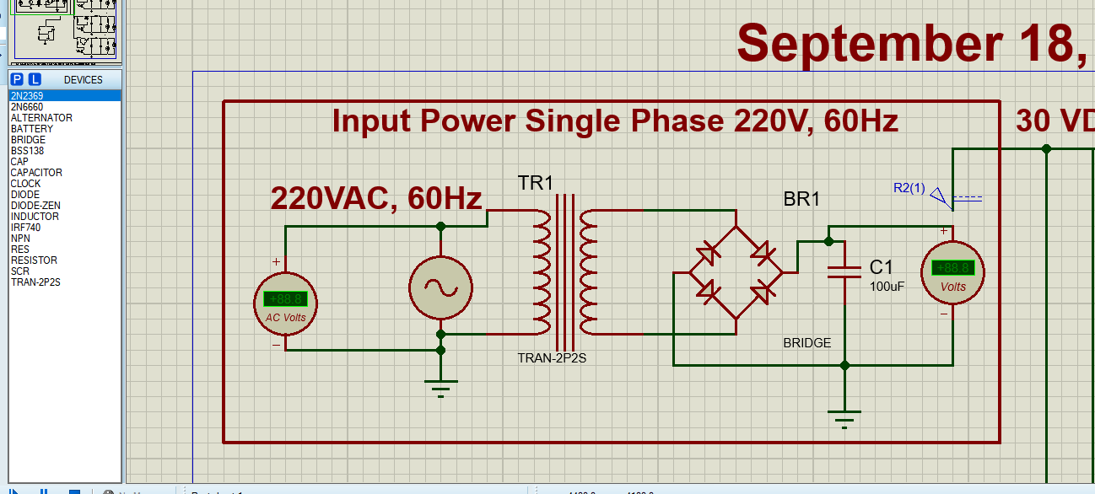
Design of the Circuit
Rectifier Circuit

Slide 11
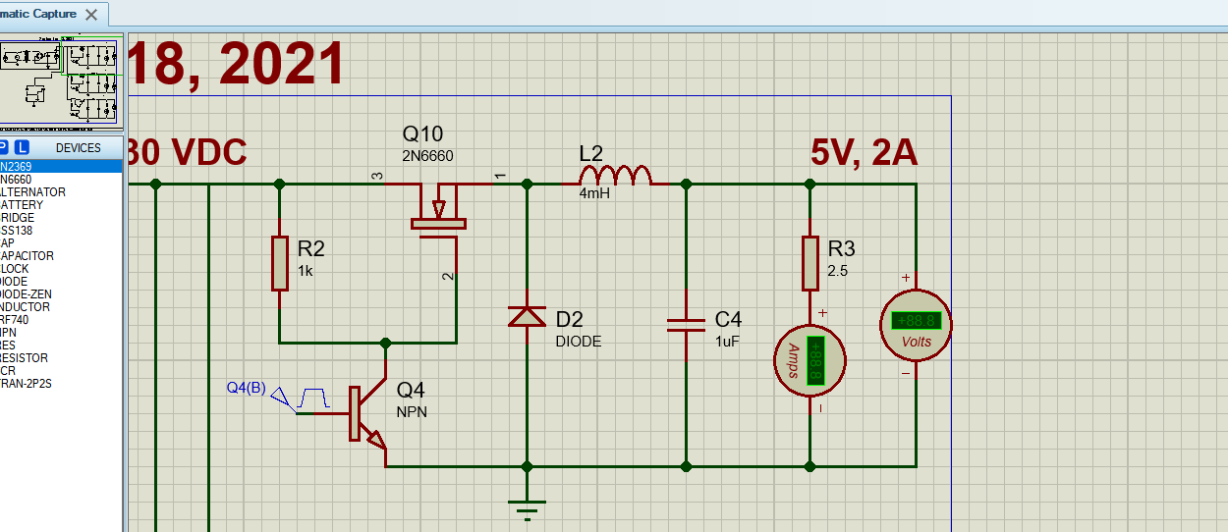
Operation of the Circuit
Buck Circuit

Slide 12
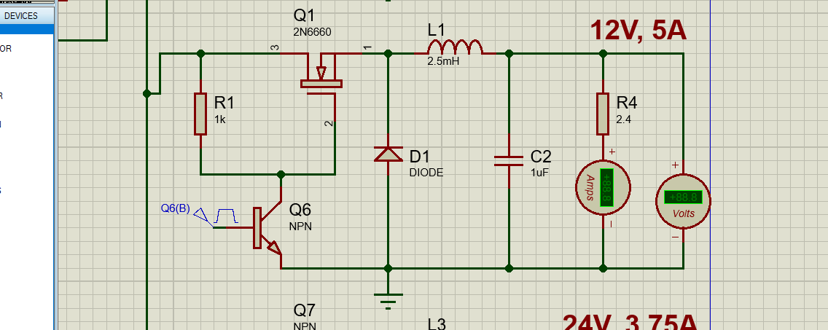
Operation of the Circuit
Buck Circuit

Slide 13
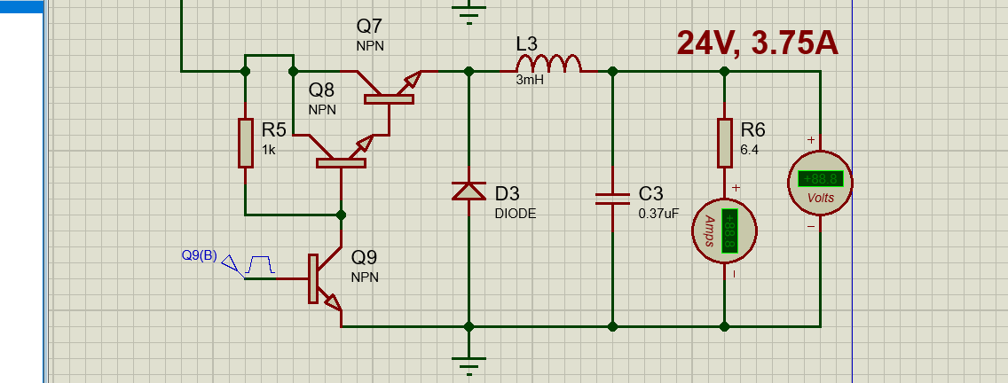
Operation of the Circuit
Buck Circuit

Slide 14
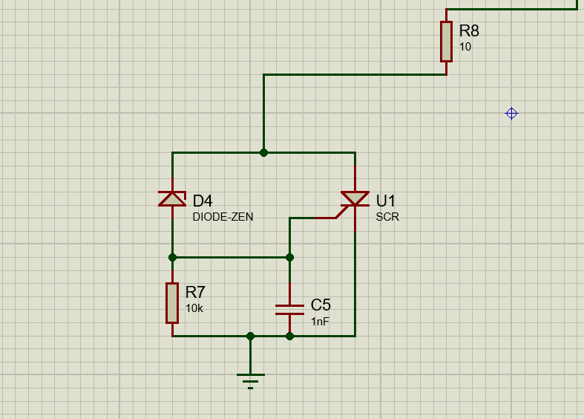
Protection Circuit

Slide 15
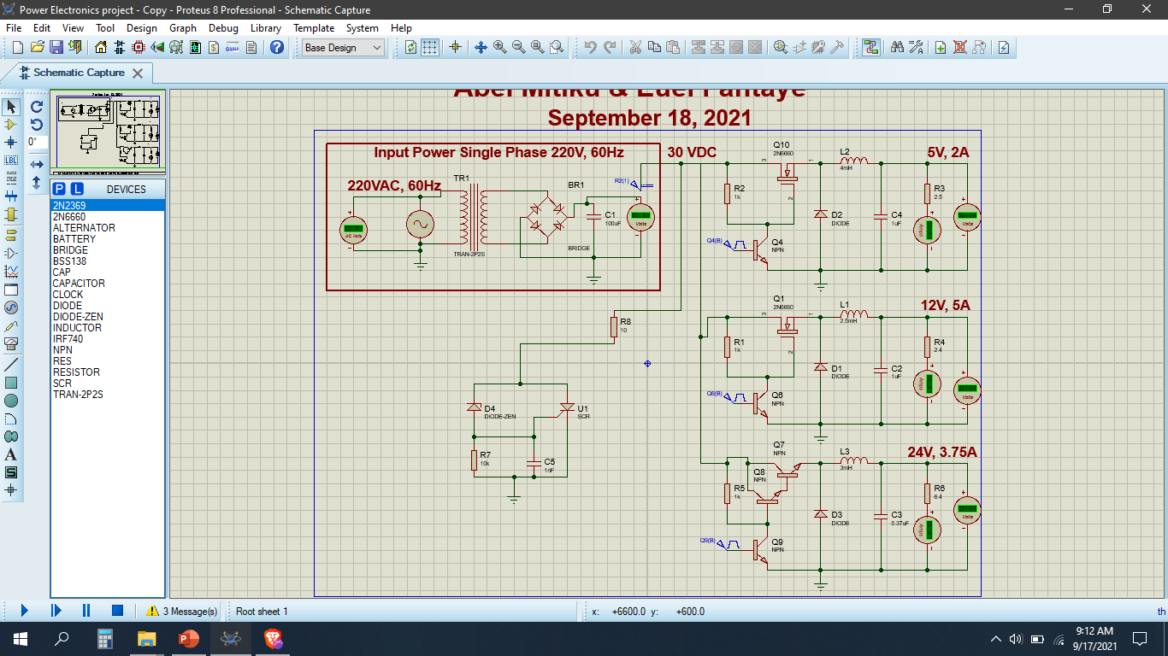
Simulation

Slide 16
THANK YOU

