Slide 1
Task Management System
Team Purple
Abel Scholl, Christelle Bernardin, and Sydney George

Slide 2
Outline
Project Objective
Team Description
Graphical User Experience Design
Graphical User Interface Design
Data Storage
Demonstration
References
Notes:
Abel

Slide 3
Project Objective
Create an interactive system for task storage
Require a login
Special administrative permissions:
Add, edit, delete user login info
Organizes personal tasks
Add, edit, remove, and search capabilities
Store task information in a csv file
Notes:
Abel

Slide 4
Team Description
Abel Scholl
Freshman from Wilkes-Barre PA
Major: Computer Science
Prior programming experience: Yes
Interests: art, animation, video games, crocheting, sewing, and general creation of things
Christelle Bernardin
Freshman from Middletown, New York
Major: Computer Science
Prior programming experience: No
Interests: Music, video games, poetry, thriller movies
Sydney George
Freshman from Rochester, NY
Major: Data Science and Applied Math
Prior programming experience: No
Interests: reading, art, plants, tennis
Notes:
All

Slide 5
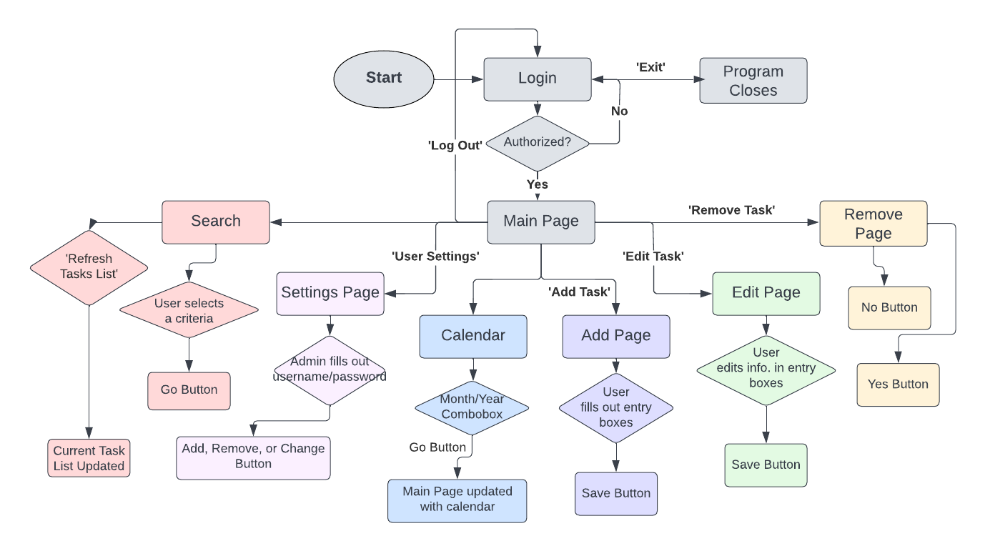
Graphical User Experience Design
Notes:
Abel

Slide 6
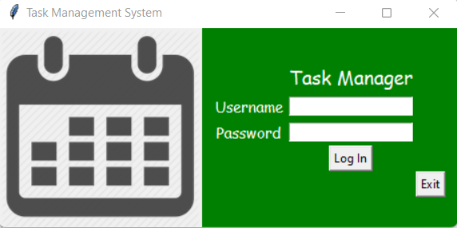
Graphical User Interface Design
Login Page
Username and password must be at least 8 characters long
One administrator login
Displays a message if access granted or access denied
Grants access to main window
Notes:
Christelle

Slide 7
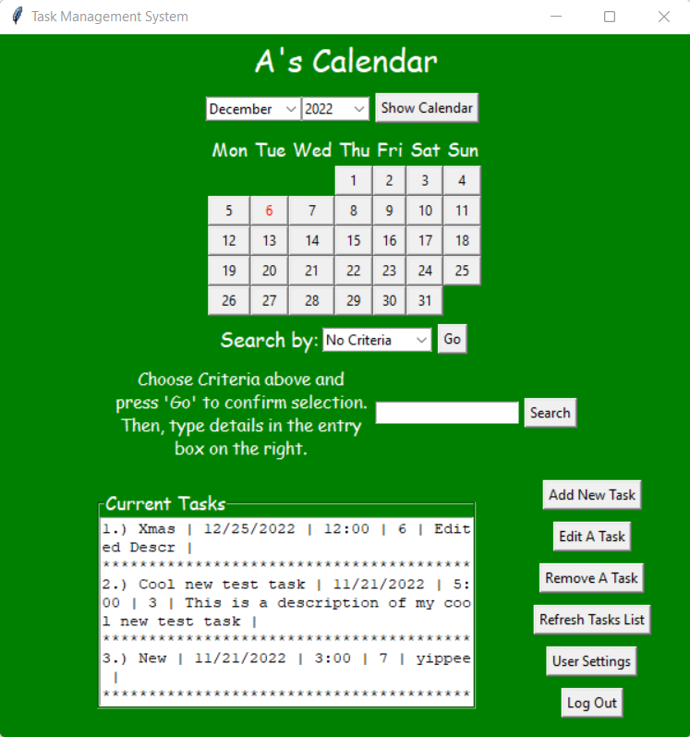
Graphical User Interface Design
Main Page
Interactive calendar controlled by combo boxes
Interactive search function controlled by combo box and buttons
Search by title, time, date, description, duration
Text box that displays all tasks for the logged in user
Buttons that link to other interactive pages:
Add, Edit, Remove a task
Button that refreshes task list
Administrator settings button (only shown if admin is logged in)
Log out button (links back to login page)
Notes:
Sydney

Slide 8
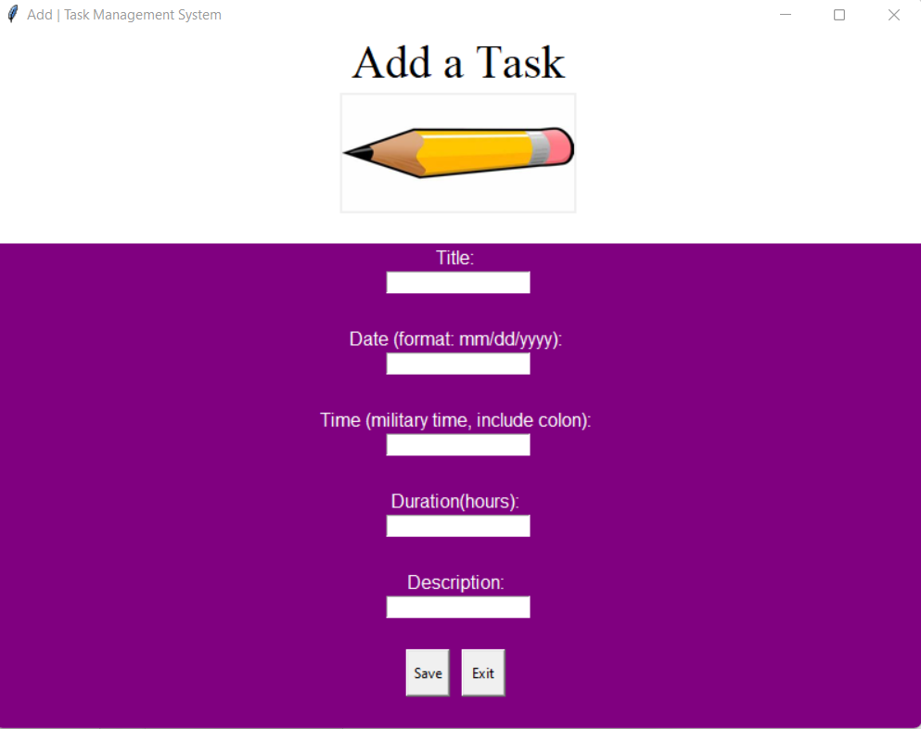
Graphical User Interface Design
Add Page
Requires task fields of title, data, time, duration, and description
Checks for valid formatting
Displays a task successfully saved message (or error message boxes)
Exit button returns to main page
Notes:
Christelle

Slide 9
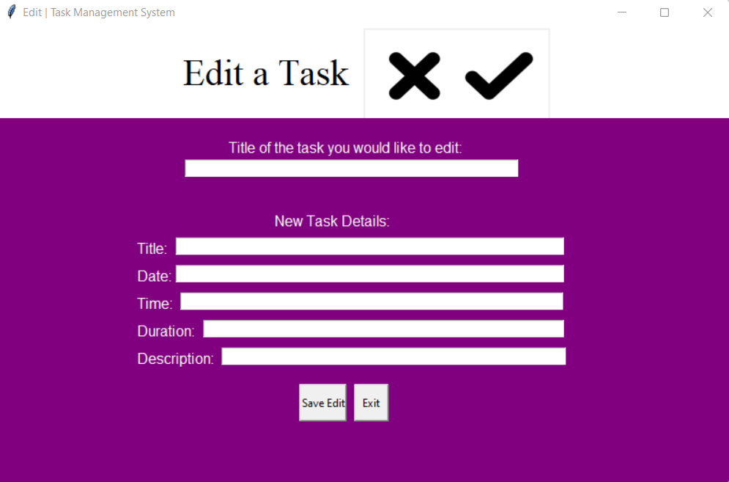
Graphical User Interface Design
Edit Page
Requires fields of old title, new title, data, time, duration, and description
Displays a task successfully edited message
Cannot edit a nonexistent task
Exit button returns to main page
Notes:
Sydney

Slide 10
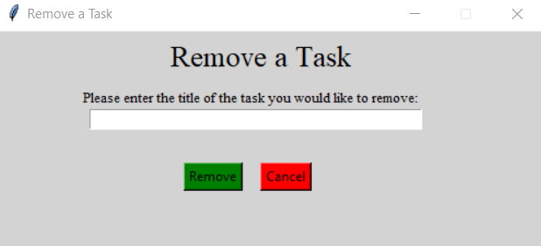
Graphical User Interface Design
Remove Page
Cannot remove a task that doesn’t exist
Notifies user with an action successful message
Cancel will return user to the main page
Notes:
Christelle

Slide 11
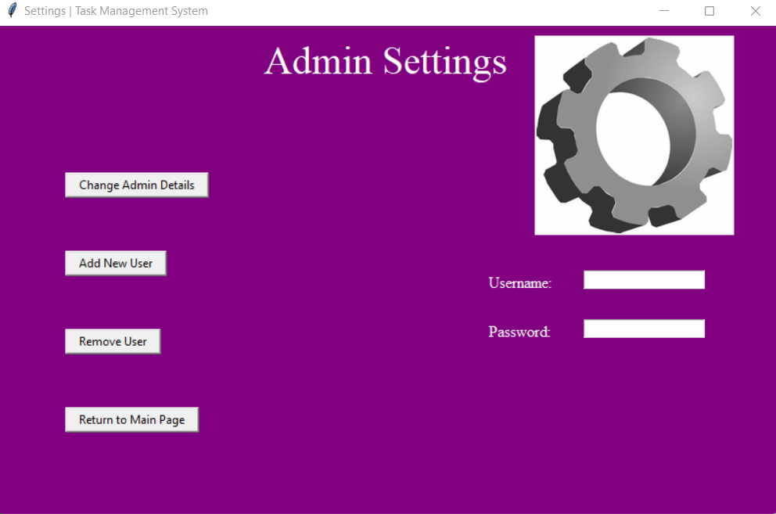
Graphical User Interface Design
Settings Page
Admin user only
Username/passwords must be at least 8 characters
Message boxes prompted by buttons guide the user on how to use application
User not found and successfully change message pop ups
Notes:
Sydney

Slide 12

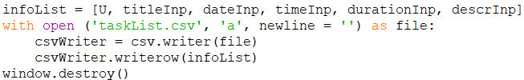
Data Storage
Two CSV files
userLoginInfo
TaskList
One Txt file
CurrentUser
Notes:
Sydney

Slide 13
Demonstration
Notes:
Sydney

Slide 14
References
https://coderslegacy.com/python/python-gui/python-tkinter-combobox/
https://docs.python.org/3/library/datetime.html#
https://www.lucidchart.com
https://www.plus2net.com/python/tkinter-rowconfigure.php
https://stephenallwright.com/python-month-number/
GUI Programming in Python
https://docs.python.org/3/library/calendar.html#module-calendar
https://www.plus2net.com/python/tkinter-rowconfigure.php
https://pythonguides.com/python-tkinter-listbox/
https://realpython.com/python-gui-tkinter/
https://www.plus2net.com/python/tkinter-rowconfigure.php
https://www.tutorialspoint.com/python/tk_relief.htm
Python GUI examples (Tkinter Tutorial) - Like
Geekshttps://pythonguides.com/python-tkinter-radiobutton/
Why is Button parameter "command" executed when declared? - Stack Overflow
https://coderslegacy.com/python/python-gui/python-tkinter-combobox/
https://stephenallwright.com/python-month-number/
https://docs.python.org/3/library/datetime.html#
https://likegeeks.com/python-gui-examples-tkinter-tutorial/#Add_radio_buttons_widgets
https://coderslegacy.com/python/tkinter-close-window/
https://www.geeksforgeeks.org/python-tkinter-text-widget/
Is there a way to clear all widgets from a tkinter window in one go without referencing them all directly? - Stack Overflow
https://pynative.com/python-get-the-day-of-week/
https://www.geeksforgeeks.org/how-to-install-pil-on-windows/amp/

