Slide 1
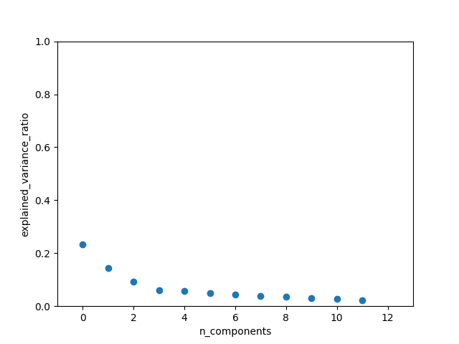
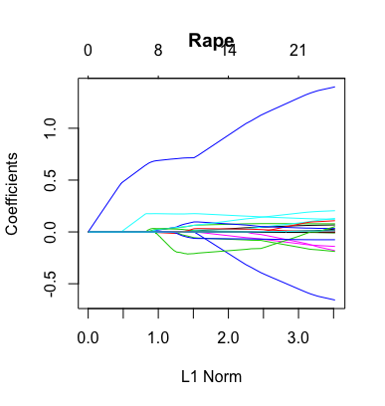
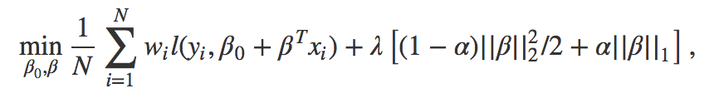
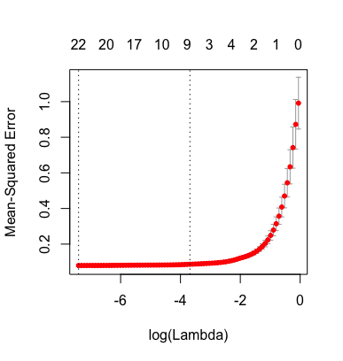
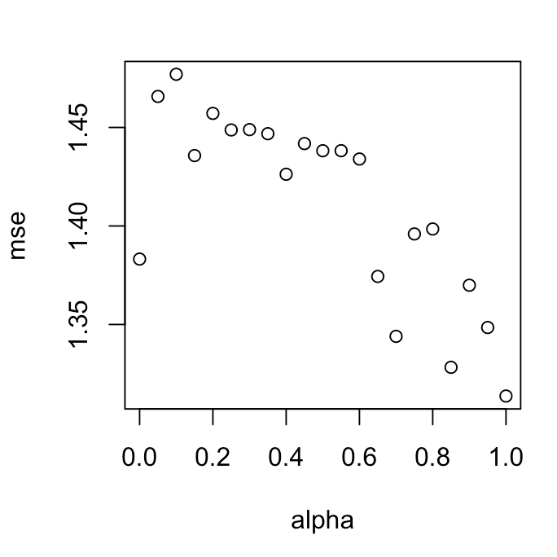
MATH 6380J Mini-Project 1: Linear Regression Models on Medical and Crime Data
Chenyang Dong¹, Tsz Cheung LO² and Jiacheng Xia² {cdongac, tcloaa, jxiaab}@ust.hk
¹: Department of Mathematics, HKUST ²: Department of Computer Science and Engineering, HKUST
1. Introduction
3. Crime Dataset
5. Analysis
We have gone through quite a few estimation as well as feature selection methods, for the first monthly project, we decide to test their usage via two distinct, popular datasets: Medical and Crime data. We found that with respect to different datasets, these methods can have different performance, and we briefly analyzed the reasons behind.
This dataset contains 7 crime types related to 23-dimensional inputs with n>1000. We found that with this dataset, PCA fails short, and using Lasso can make better prediction better than MLE and James-Stein estimator.
With two different kinds of data, features with strong and weak correlation with output coexists, Lasso(and elastic-net) is very effective in feature selection in both cases, therefore increasing prediction accuracy.
However other methods discussed in class including PCA, MLE and JS doesn’t always have satisfying performance.
PCA didn‘t give clear explain due to small p, and in the crime case where p << n, MLE and JS according to their definition doesn’t make much difference, exactly meeting our observation.
2. IC50 Dataset (In-class Kaggle Competition)
Methodology
One-stage Elastic net regularization
Why?
Since this is a "large p, small n" case, the elastic net method overcomes the limitations of direct-using LASSO, performing both variable selection and highly-reliable prediction.
How?
6. Conclusion
Using Lasso/Elastic-net, we find that in crime case, although not exactly the same, all crime types are strongly related to population size, police force and age group rates in the total population.
We didn’t have time to compare Lasso with other methods in high dimensional data but Lasso/Elastic-net itself is providing satisfying Kaggle scores.
In both high dimensional case and examples like crime data where n,p are both very small, Lasso/Elastic-net outplays most other methods with its capability of doing variable feature selections.
Top 12 PCA components for explained variance ratio
Lasso to analyze rape
4. Prediction on Crime Dataset
Conclusions/Future Work
For this dataset, using one-step Elastic net regularization tends to give the model same as LASSO. (So shall penalize more on L1-Norm)
From Kaggle score results, for such a small dataset, 50:50 splitting is much better than 80:20 one.
In the future, instead of one-step variable selection, we may try some recursive methods.
Using 10-fold cross validation, we can find that Lasso can achieve small Mean-Squared Error when selecting proper lambda. But our experiment showed that other methods got error at scale of 10⁻¹ , which is significantly larger than Lasso.
7. References
Hansen, Bruce E. "The risk of James–Stein and Lasso shrinkage." Econometric Reviews 35.8-10 (2016): 1456-1470.
8. Contribution
IC50 Dataset
LO Tsz Cheung
Crime Dataset
DONG Chenyang, XIA Jiacheng
Mean Square Error vs. alpha

